Slide 1
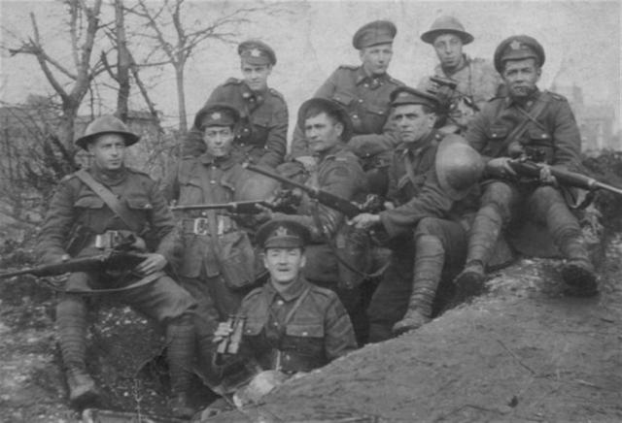
Canada and the First World War

Slide 2
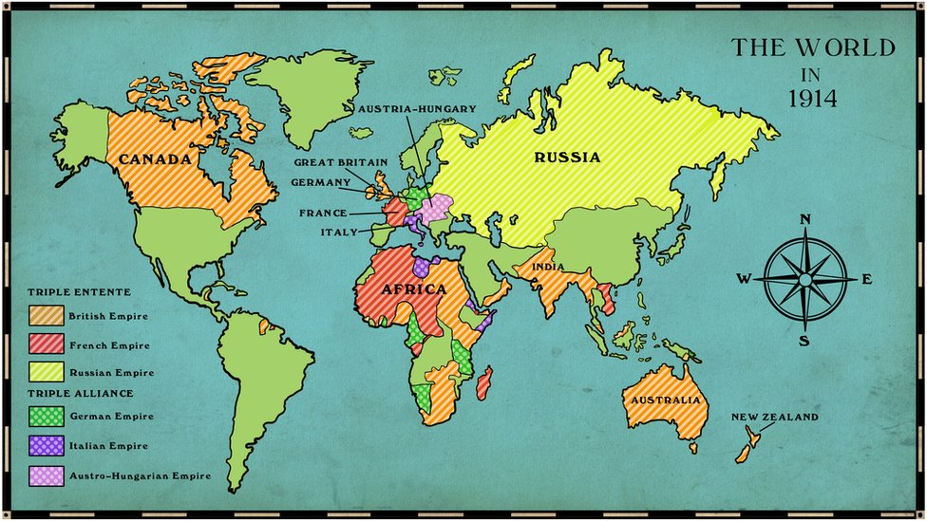
Causes of the War: Imperialism
Since the 15th century, several European nations had been aggressively expanding their territory, establishing colonies all over the world.
Massive industrialism in the 19th century fuelled the Great Powers’ desire to expand their domains, giving them access to more raw materials and creating new markets for their manufactured goods.
Germany’s aggressive pursuit of gaining more territory brought it into conflict with other imperial powers, in particular Britain and France.

Slide 3
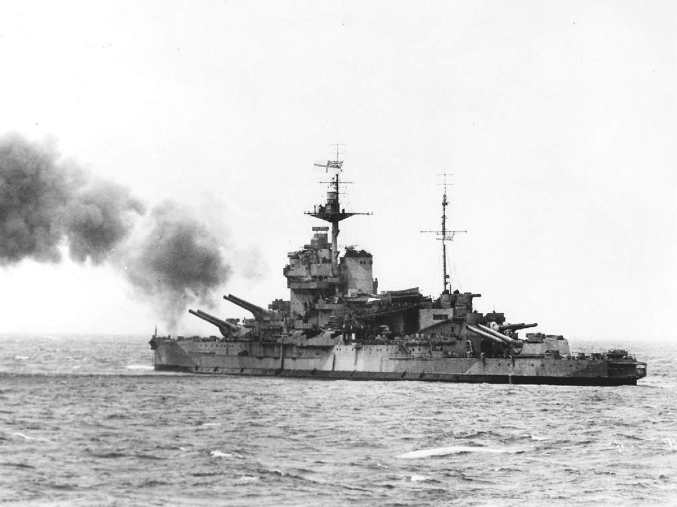
Causes of the War: Militarism
As the Great Powers expanded their empires, they developed their military resources to protect their interests and intimidate each other. The size of their armies and navies became essential to national prestige.
Britain had established the largest navy in the world to protect its vast empire. Germany’s desire to be a major power in Europe drove it to build up its military resources to match Britain’s naval strength. In response, Britain increased the size of its navy. This buildup of military resources forced France to arm itself. This arms race increased international tensions.

Slide 4
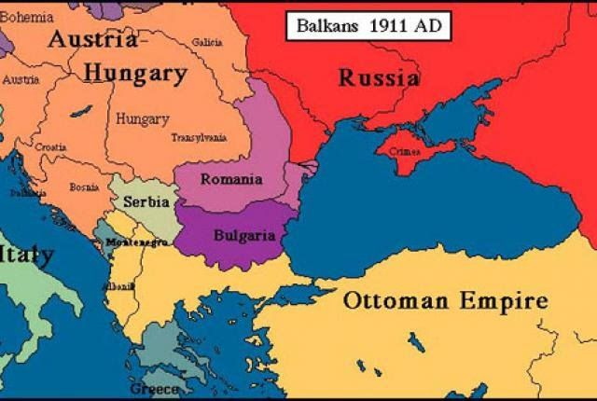
Causes of the War: The Balkans
Russia, Austria-Hungary, and the Ottomans wanted to control the Balkans. Russia wanted to unite the Slavic peoples of the Balkans. Russia hoped to gain access to the region’s ports to increase its import and export of goods.
Austria-Hungary controlled nations populated with Slavic peoples and located in the Balkans, including Slovenia and Croatia. It did not want these people to unite because it could cause Austria-Hungary to lose its territory.
Ottomans lost their hold on the Balkans and feared losing more territory.

Slide 5
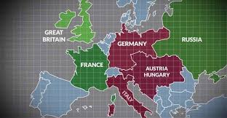
Causes of the War: Alliances
By the early 1900s, all the Great Powers in Europe were in alliances with other countries. Alliances made it easier for a country to be drawn into war. Since countries pledged to protect one another, if any one of them was involved in a conflict, its allies would automatically have to fight as well.
The Triple Alliance consisted of Germany, Austria-Hungary, and Italy. But, Italy didn’t join its allies in battle. Instead, it joined the Triple Entente in 1915.
The Triple Entente consisted of France, Britain. And Russia.

Slide 6
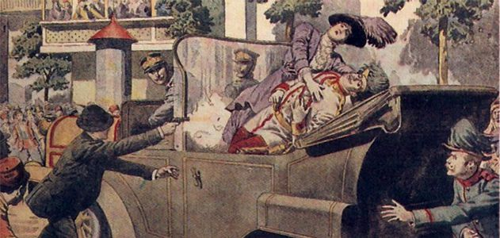
Assassination of Franz Ferdinand
In 1914, to demonstrate its imperial rule, the Austro-Hungarian Empire sent its crown prince, Archduke Franz Ferdinand, to Bosnia’s capital of Sarajevo.
The Black Hand, a terrorist group of Bosnian Serbs that was determined to free Bosnia from Austria-Hungary, saw Ferdinand’s visit as an opportunity to strike back at Austria-Hungary, whom they viewed as an invader.
As Archduke Franz Ferdinand’s procession made its way through the city, a Black Hand member, Gavrilo Princip, shot and killed him and his wife.

Slide 7
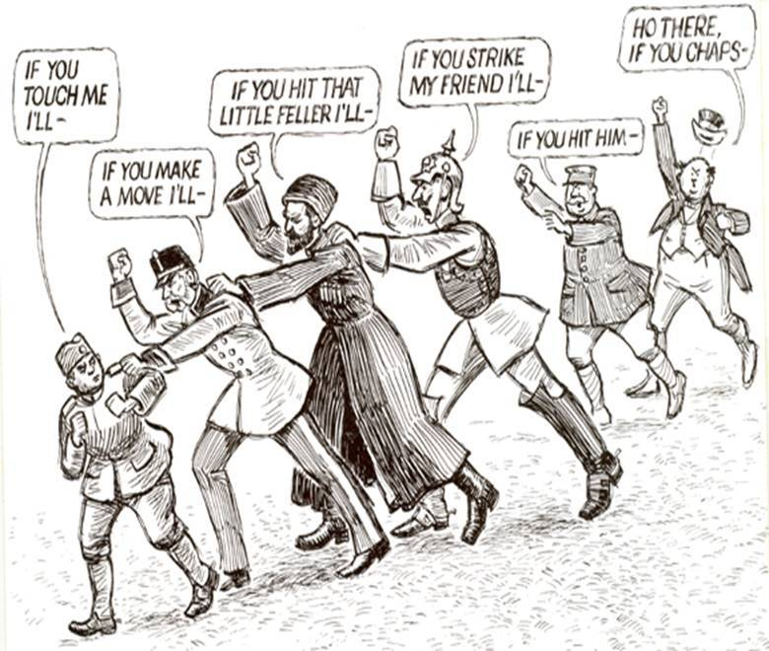
A Chain Reaction
Austria-Hungary blamed Serbia for the assassination. As part of the agreement of the Triple Alliance, Kaiser Wilhelm of Germany promised to support Austria-Hungary if they went to war. The empire declared war.
Russia mobilized its troops to defend Serbia. Germany responded with its own mobilization. This prompted Britain to put its navy on alert and France to mobilize its army. When Germany violated the neutrality of Belgium in order to attack France, Britain declared war on Germany to protect its ally. Canada, as part of the British Empire, automatically went to war too.

Slide 8
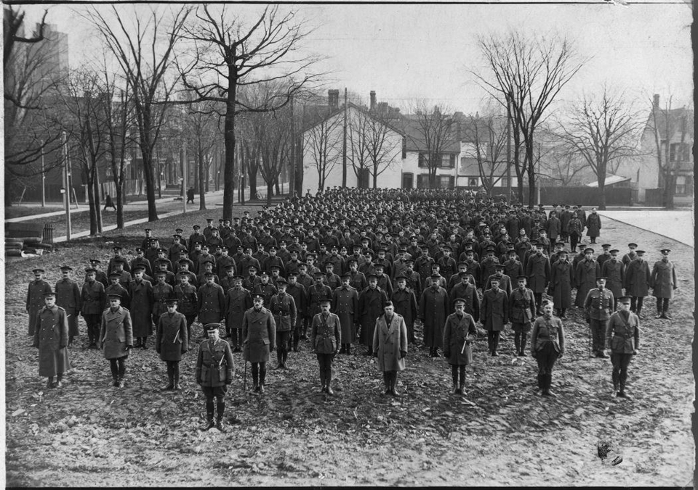
Mobilizing the Forces
Canadian Prime Minister Borden initially offered Britain 25,000 troops, but more than 30,000 volunteers from across Canada signed up within a month.
A lot of people volunteered because in 1914, most English-speaking Canadians were of British origin, and they supported the war out of a strong patriotic feeling for Britain. A lot of people believed that the war would be over by Christmas. Others signed up because they were unemployed and the war meant a chance to escape financial hardships at home. However, women, and Aboriginal peoples were not allowed to participate in battle.

Slide 9
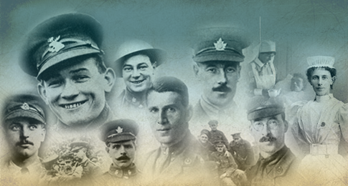
A National Identity Emerges
After basic training that lasted only four months, 32,000 enthusiastic, but ill prepared, Canadian and Newfoundland troops set sail for England. Young men from all over the country came together to train, first at Camp Valcartier in Quebec, then at bases in England. As they gathered and worked together, they began to develop a national sense of Canadian identity.
The army formed by these volunteers was known as the Canadian Expeditionary Force. For much of the war, they fought as a separate unit, which contributed to a growing sense of national identity and autonomy.

Slide 10
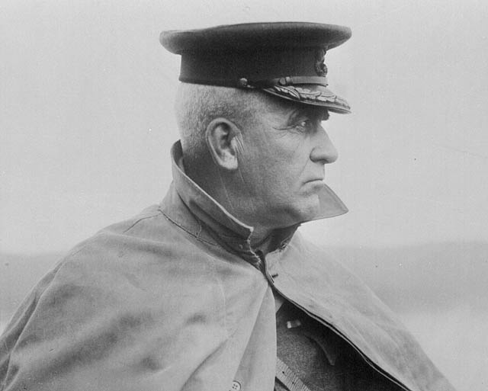
Canada’s Minister of Militia
Sam Hughes, Canada’s Minister of Militia, was also in charge of Canada’s armament industry. He created the Shell Committee to oversee the manufacture of artillery shells. Canada provided a large portion of Britain’s shells. Hughes, however, was a poor administrator.
Some of the shells were of such poor quality that they exploded before being fired, killing the gun crews. Troops came to hate the Canadian-made Ross rifle because it jammed, so they picked up British-made Lee-Enfield rifles from dead soldiers. Hughes was dismissed from his post in 1916.

Slide 11
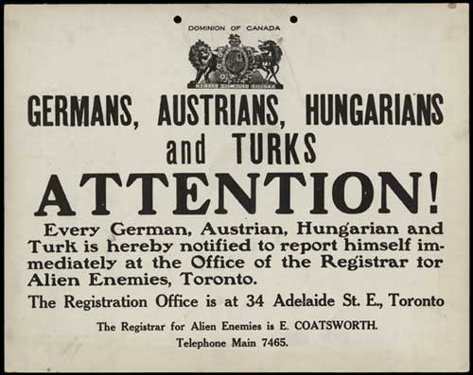
The War Measures Act
Prime Minister Borden introduced the War Measures Act in 1914. The act gave the government the authority to do everything necessary “for the security, defence, peace, order, and welfare of Canada.”
Anyone suspected of being an “enemy alien” or a threat to the government could be imprisoned or deported. Recent immigrants from Germany and the Austro-Hungarian Empire were treated particularly harshly. About 100,000 of them had to carry identity cards and report regularly to registration officers. More than 8500 people were detained in internment camps.

Slide 12
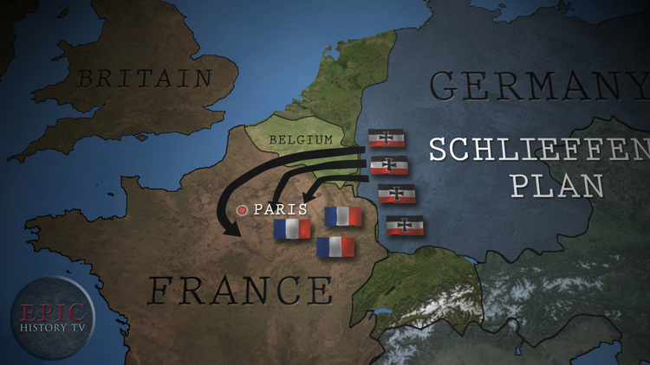
The War on Land
Germany’s Schlieffen Plan was a bold strategy for a two-front war. Germany believed it could fend off Russia in the east while it defeated France in the west with a lightning-speed massive attack.
The timetable left little room for error. German armies needed to drive through Belgium and swing south to capture Paris within a few weeks. Once this was accomplished, Germany could turn its attention to Russia. Germany assumed it would take Russia time to mobilize its huge army. It also assumed that Britain would remain neutral.

Slide 13
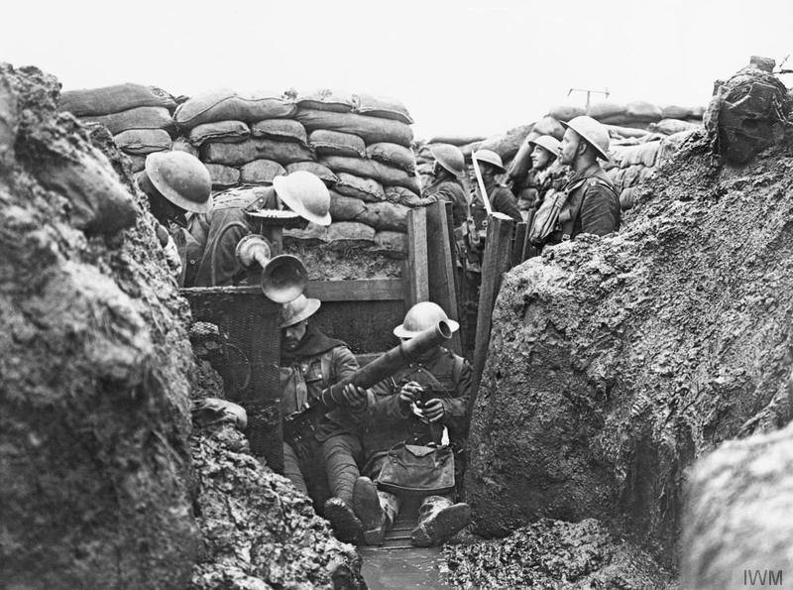
The Reality of the Schlieffen Plan
The Triple Entente was able to rally and stop Germany’s advance at the Battle of the Marne in September 1914, making a quick German victory impossible. Instead, the German army dug a defensive line of trenches along the river Somme and into Belgium. To counter this, British and French troops dug their own system of trenches to face them.
Armies protected by trenches that ran through northern France and Belgium on the Western Front were in a stalemate. With millions of soldiers on each side, neither Britain and France nor the Germans could advance.

Slide 14
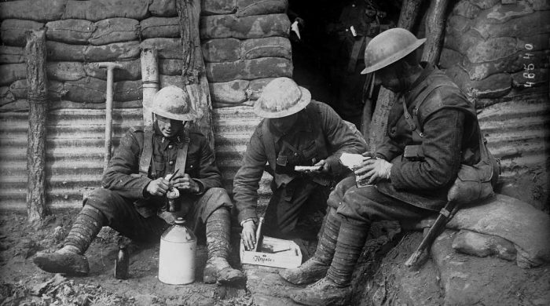
Life in the Trenches
Trenches were cold and damp in the winter and often flooded in the heavy rains of northern France and Belgium. Muddy trenches became stinking cesspools, overrun by rats.
Men spent weeks in the trenches without washing, which allowed disease to spread. Soldiers’ clothes were infested with lice, and many men developed trench foot, a painful condition that caused their feet to swell and turn black. Many of the wounded were left to die in no man’s land because rescue attempts were dangerous. Men were in constant fear of snipers and shells.

Slide 15
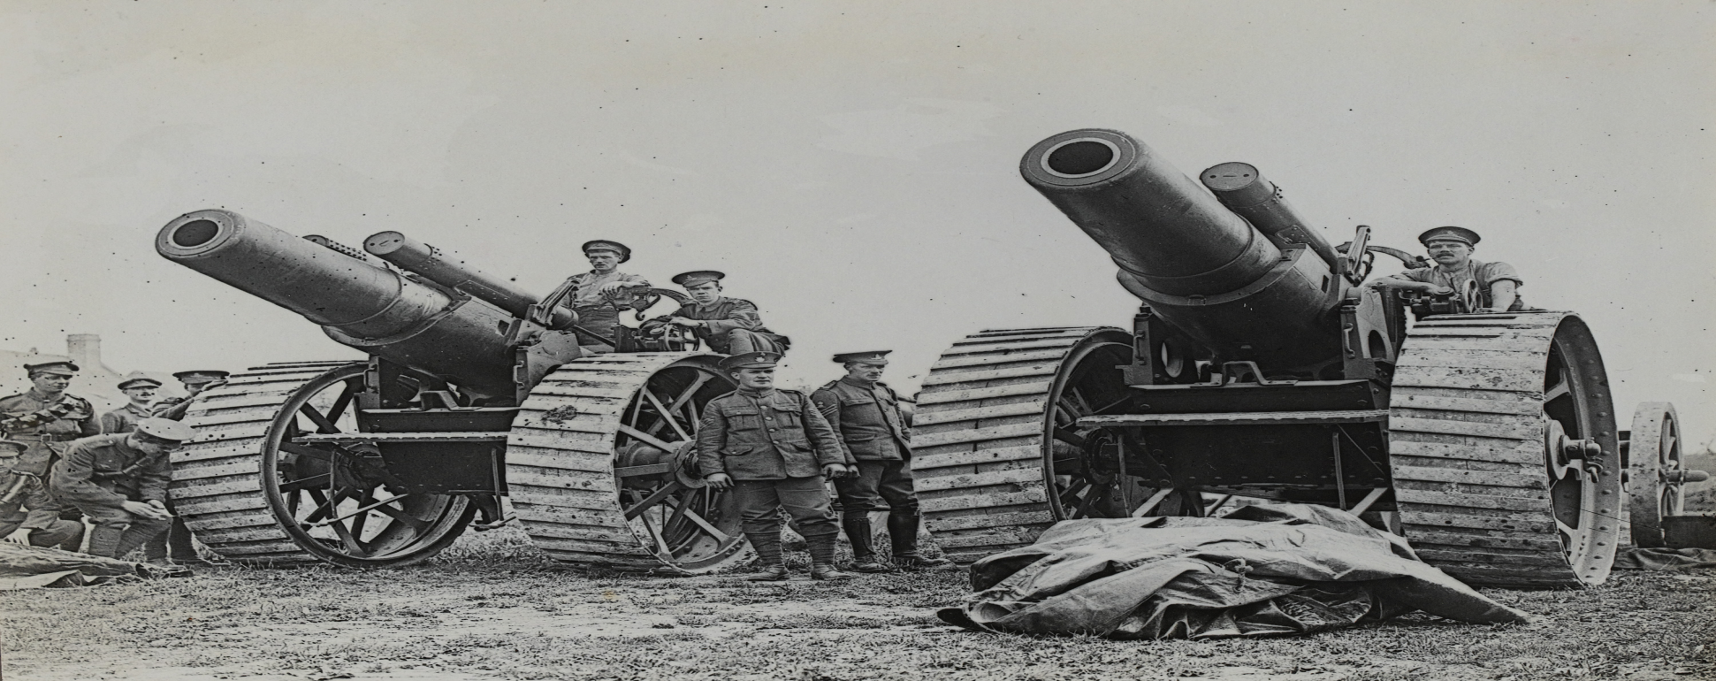
New Technology and the War
New weapons were so powerful and deadly that it was suicidal to charge across open ground. Machine guns fired at an unprecedented speed; massive artillery attacks killed thousands. Airplanes flew over the battlefields to pinpoint the enemy’s location and movements and were later equipped with machine guns and bombs.
Later in the war, armoured tanks were used to protect soldiers as they advanced across the battlefield. Tanks could break through the protective wall of barbed wire in front of trenches.

Slide 16
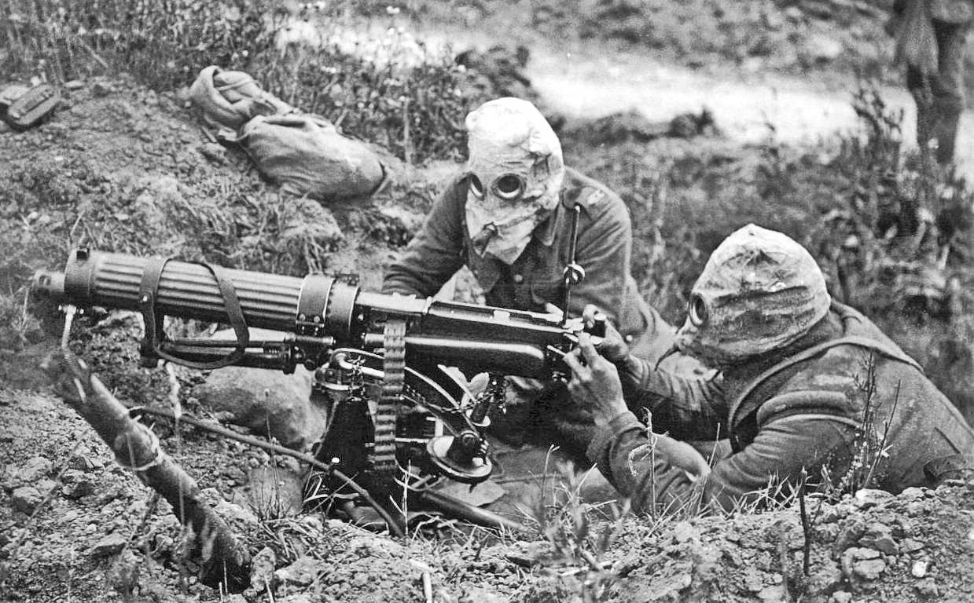
The Second Battle of Ypres
On April 22, 1915, French and Canadian troops were blinded, burned, or killed when the Germans used chlorine gas, a tactic that had been outlawed by international agreement since 1907. As the clouds of gas drifted low across the battlefield, soldiers tried to escape from the deadly fumes. Many suffocated or choked to death.
More than 6000 Canadians were killed, wounded, or captured holding their ground until reinforcements arrived. Lieutenant Colonel John McCrae, a doctor serving with the Canada Corps, wrote the poem “In Flanders Fields”.

Slide 17
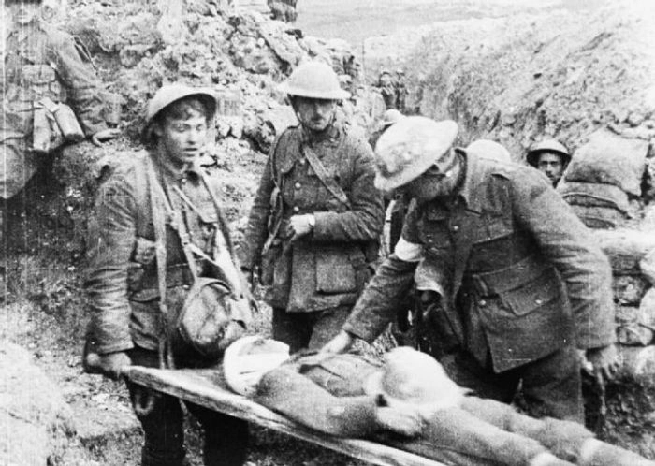
The Battle of the Somme
In July 1916, the Allies launched a massive attack against a line of German trenches near the Somme River in France. The battle lasted five months and the allies captured only 13 kilometers of land.
Both sides suffered heavy losses. There were more than 1.25 million casualties, with almost 24,000 Canadians among them. The Royal Newfoundland Regiment alone lost approximately 90 percent of its men, and every officer was either wounded or killed. Most soldiers were badly shaken by the slaughter.

Slide 18
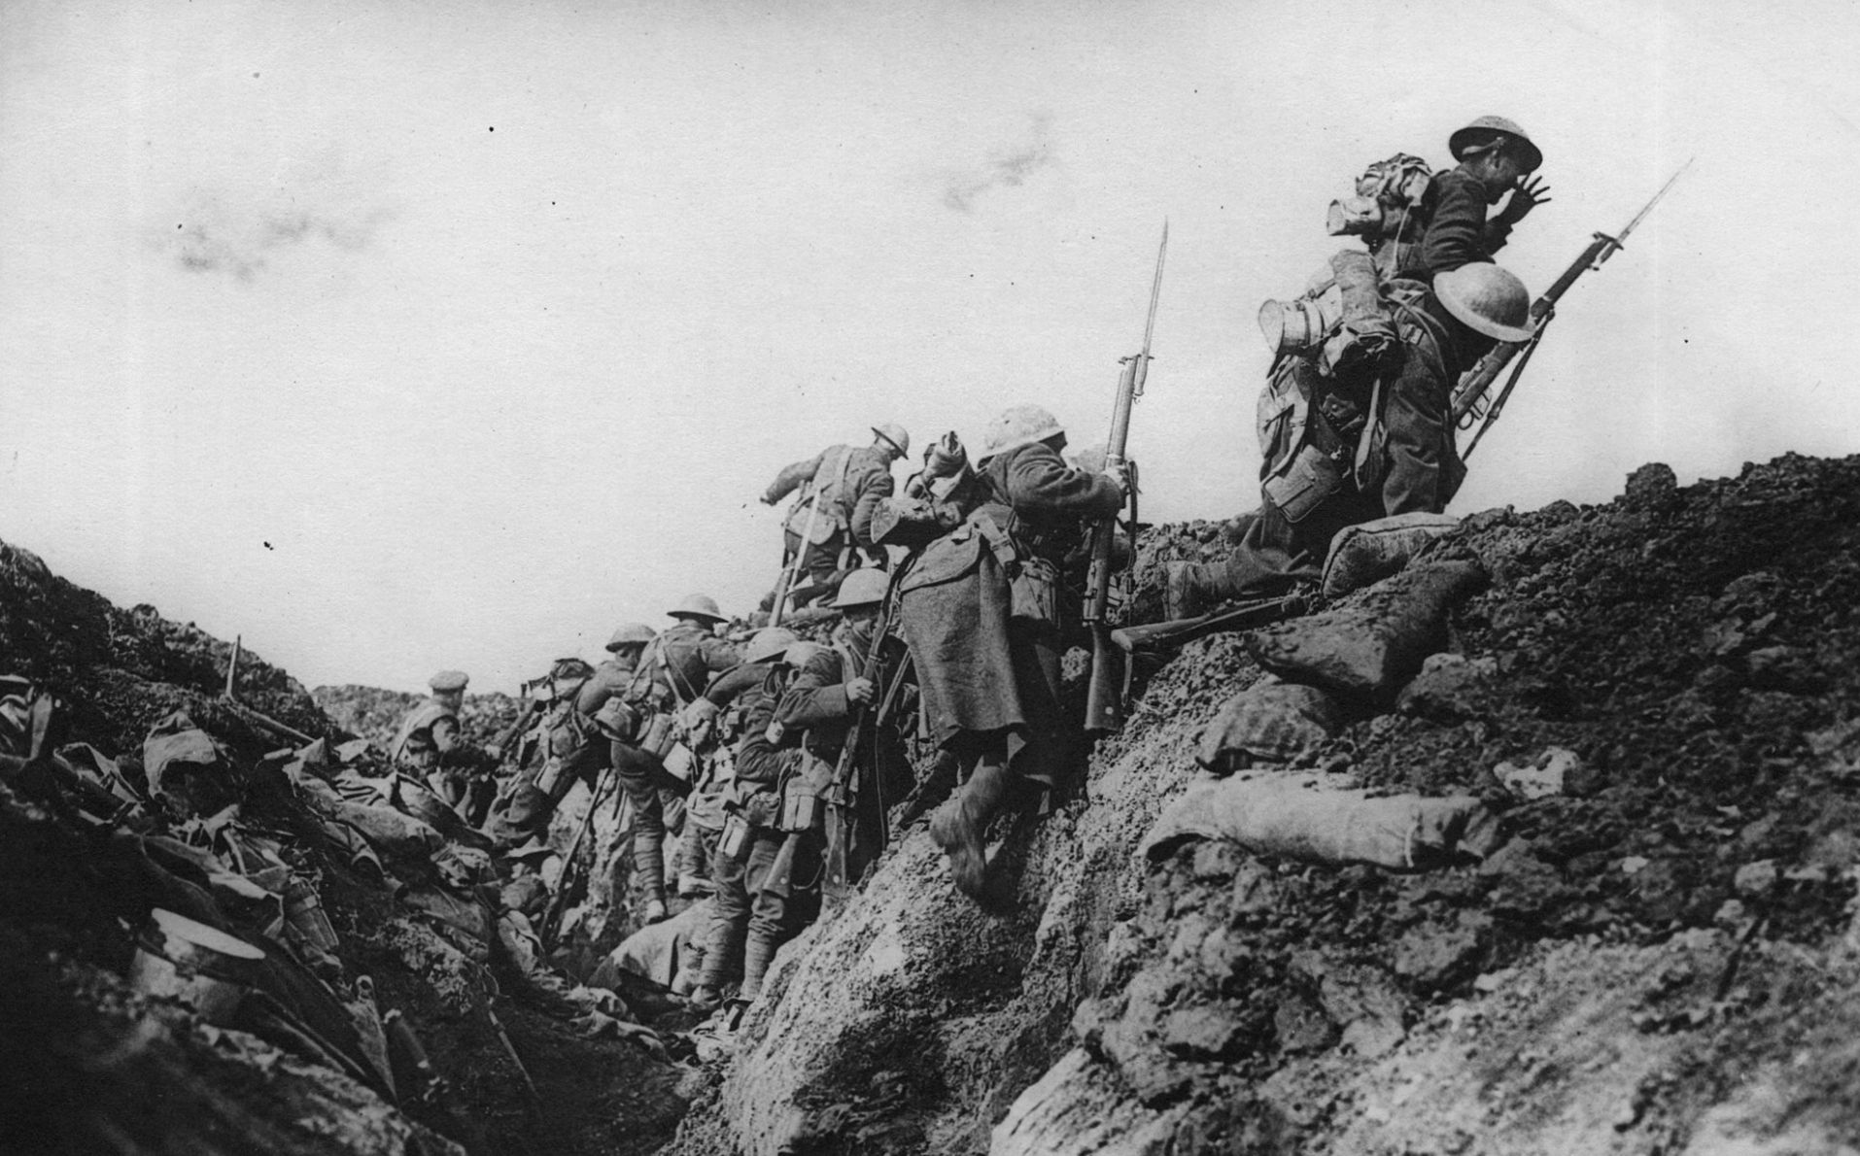
The Battle of Vimy Ridge
In 1914, the Germans took control of Vimy Ridge, a key position near the Somme. This vantage point gave a clear view of the surrounding countryside, supply routes, and enemy positions. For more than two years, both French and British forces tried to capture the ridge but were unsuccessful.
In 1916, Canadian troops were chosen to lead a new assault on Vimy Ridge. It was a stunning victory. Although the cost was high – more than 3500men were killed and another 7000 wounded. This was the first time that Canadian divisions attacked together. This success created a sense of national pride.

Slide 19
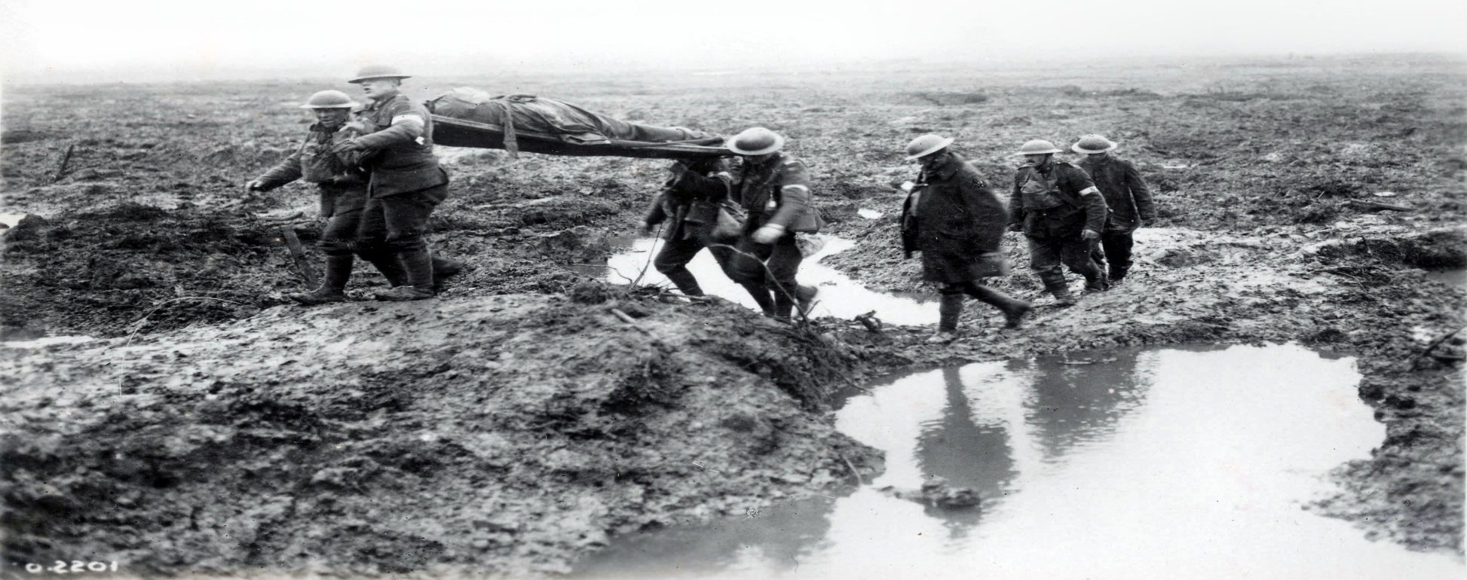
Passchendaele
In October 1917, the Canadian Corps were asked to break through German lines and retake the town of Passchendaele in Belgium. Massive shell craters, which the heavy autumn rains turned into a muddy bog, could be more than 30 meters wide. Some soldiers and horses drowned in mud-filled craters.
The Canadians captured Passchendaele, but the victory resulted in more than 200,000 casualties on each side, including more than 15,000 Canadians. The Allies had gained only seven or eight kilometers, and the Germans soon recaptured the town.

Slide 20
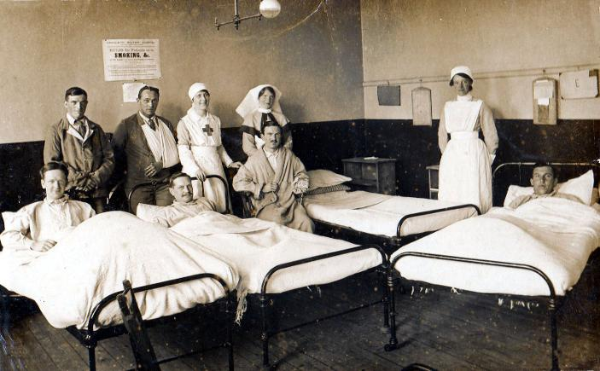
Women on the Western Front
More than 2800 women served during the First World War. They were part of the Royal Canadian Army Medical Corps and worked on hospital ships, in overseas hospitals, and in field ambulance units on the battlefields.
Many were killed or injured by artillery fire, bombs, and poison gas.

Slide 21
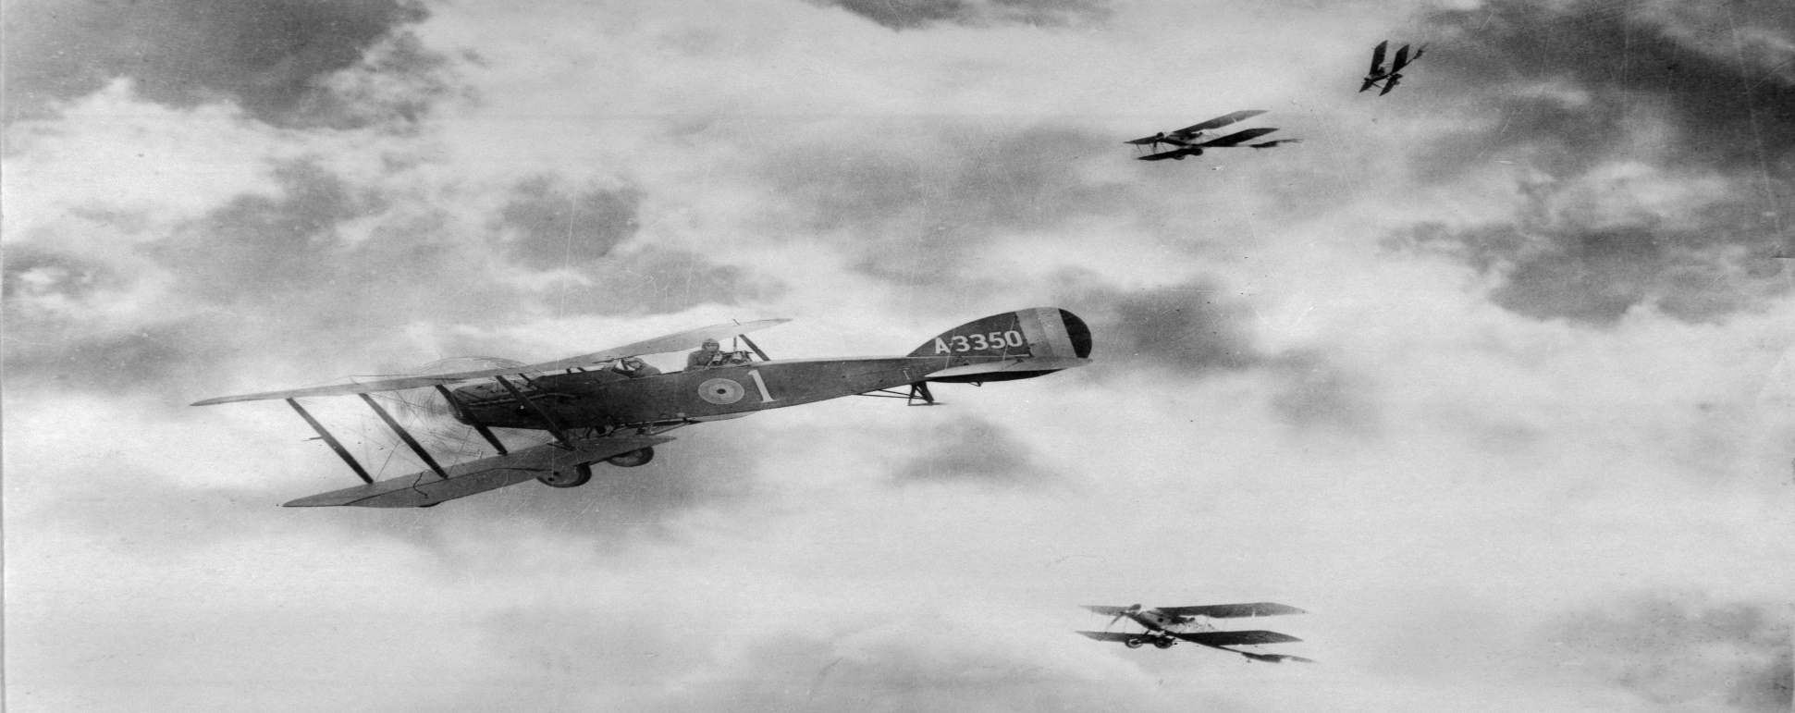
The War in the Air
During the First World War, airplanes were still a new invention and being a pilot was dangerous. Many pilots were killed in training and due to mechanical failure. The average life expectancy of a pilot in 1917 could be measured in weeks. Parachutes were not introduced until late in the war.
At the beginning of the war, pilots flew alone in biplanes doing aerial reconnaissance, photographing and reporting on enemy troop movements. Later on, pilots on both sides were armed, dropping bombs on the enemy below and firing guns at enemy planes in the air.

Slide 22
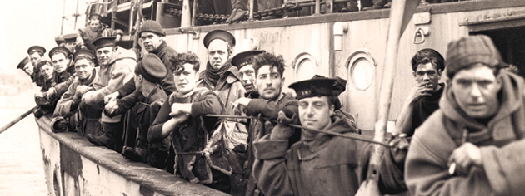
The War at Sea
During the First World War, Britain relied heavily on its own navy to protect the freighters that brought supplies and troops to the Western Front. While Canada’s navy was small and unable to contribute much to the war effort, Canada’s civilian ships and sailors that transported food, weapons, and munitions to Britain played a significant role in the war.
Although not officially members of the armed forces, many of these sailors lost their lives when their ships were attacked while crossing the Atlantic.

Slide 23
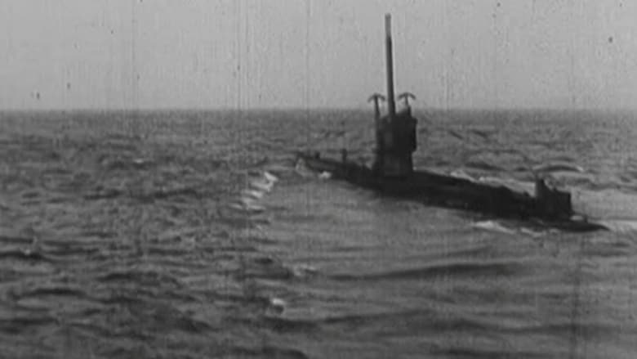
Submarine Warfare
Although Germany could not match Britain’s navy in size and strength, its U-boats were dangerous because they could travel under water without being detected. Equipped with torpedoes, U-boats destroyed many Allied warships and merchant ships.
In 1915, a German U-boat sank the Lusitania, a British passenger liner, killing close to 1200 passengers. In February 1917, Germany announced that U-boats would sink any ship within the war zone around Britain. This threat prompted the United States to enter the war on April 2, 1917 with the Allies

Slide 24
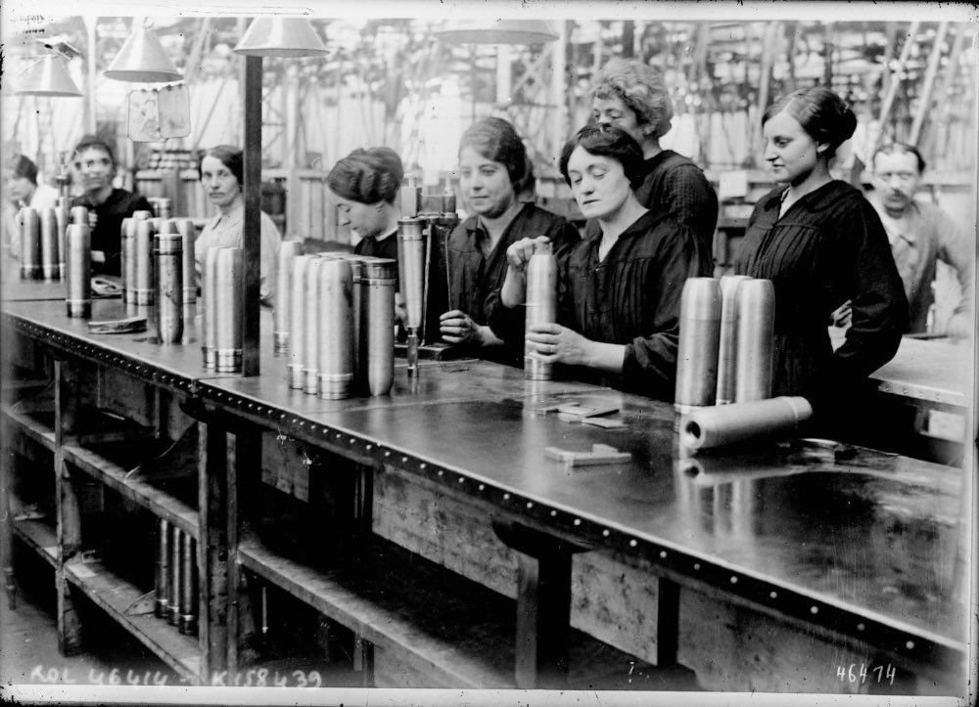
The Home Front
Canada and many of its citizens were committed to supporting the war effort. Prime Minister Borden created the highly efficient Imperial Munitions Board, and munitions factories started building ships and airplanes as well as shells. The production and export of Canadian goods reached record highs.
Resources such as lumber, nickel, copper, and lead were in high demand. Canadian farmers produced as much wheat and beef as they could to feed the troops overseas. This demand for Canadian goods helped its economy boom during the war.

Slide 25
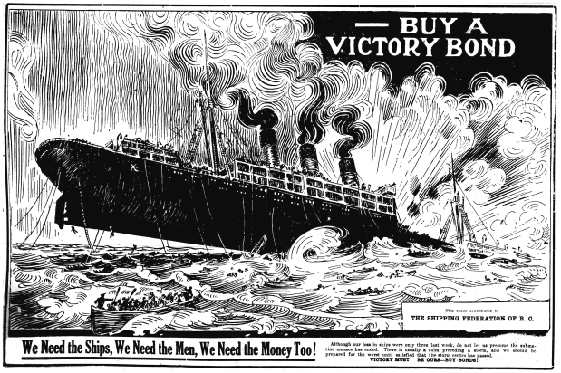
Supporting the War Effort
By 1918, the war effort was costing Canada about $2.5 million daily. The government launched several initiatives to cover these costs.
Canadians were urged to buy Victory Bonds to support the war effort. These could be cashed in for a profit when the war was over. Honour rationing was introduced to help combat food and fuel shortages on the home front. The government introduced income tax. Richer individuals and families had to pay a tax of between 1 and 15 percent of their income. A corporate tax was also introduced, charging businesses four percent of their revenues.

Slide 26
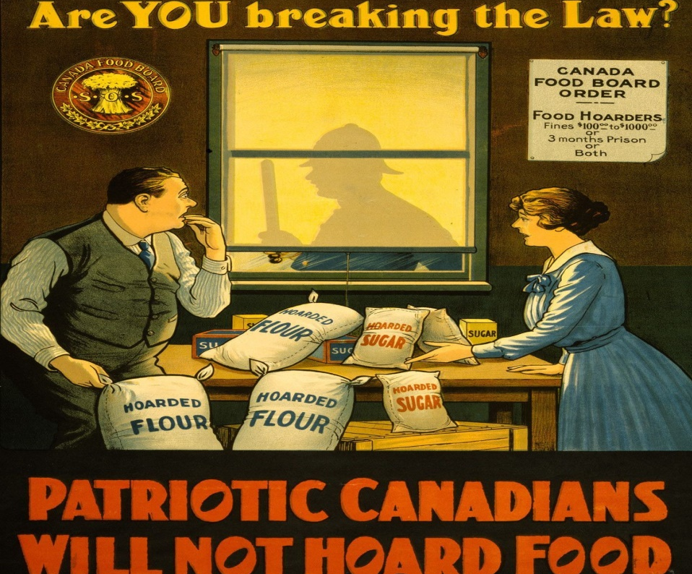
Getting the Message Out
Canadians were bombarded with propaganda. It was everywhere: films, magazine articles, radio programs, political speeches, and posters. Appealing to their sense of patriotism, propaganda encouraged people to join the army, buy Victory Bonds, use less fuel, eat less meat, and support the government.
When Germany invaded Belgium in 1914, refugees who escaped to England told horrible stories about the invasion. Writers used these stories to portray German troops as barbarians intent on destroying the civilized world. This propaganda intended to recruit soldiers, also fuelled prejudice.

Slide 27
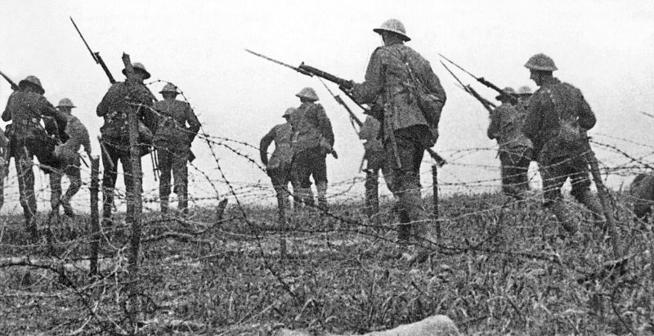
The Hundred Days Campaign
On March 3, 1918, Russia and the Central Powers signed the Treaty of Brest-Litovsk. This truce on the Eastern Front freed German troops to fight on the Western Front.
In March 1918, the German army struck at weak points in the Allies’ lines and drove deep into France. But, with the arrival of the Americans, the Allies rallied and were able to stop the German advance. In August 1918, the Allies launched a series of attacks that came to be known as the Hundred Days Campaign. Canadians won key battles at Arras, Cambrai, and Valenciennes.

Slide 28
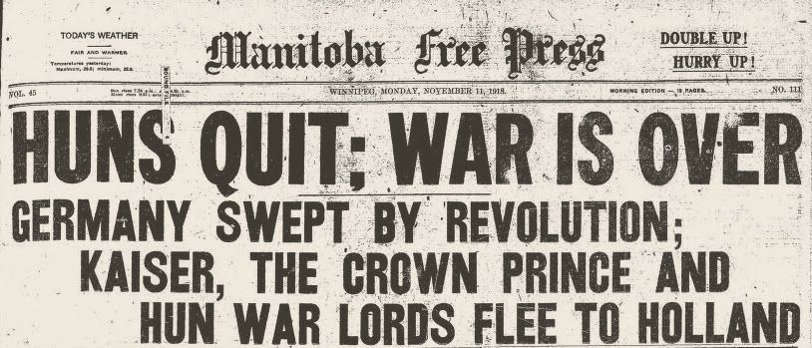
The Central Powers Collapse
The final offensive in France and the battles of the Hundred Days Campaign exhausted the Germans and the rest of the Central Powers. They had no reserves and could not continue without fresh troops, food, and supplies.
In November 1918, the German Kaiser abdicated and fled to Holland and Austria-Hungary agreed to a ceasefire. An armistice, or truce to end the war, on the Western Front was finally signed in a railway car in France at 5:00 a.m. on November 11, 1918. The war was to stop at 11:00 a.m. This corresponds to the date and time of our modern-day Remembrance Day ceremonies.

Slide 29
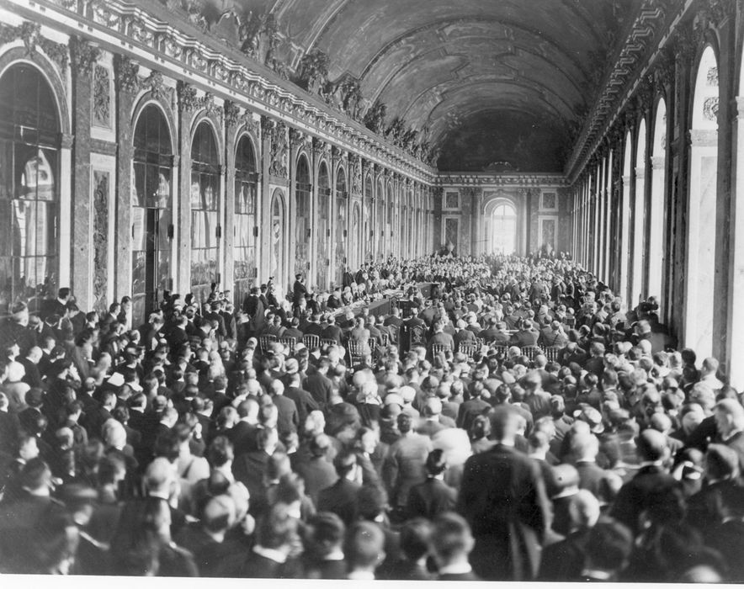
Participating in Peace
After signing the armistice, the leaders of the Allies and the other countries that won the war met in Paris in 1919 to discuss the terms of a peace agreement. The Paris Peace Conference resulted in a number of treaties that defined new borders and compensation for losses suffered during the war.
The Paris Peace Conference marked an important moment in Canada’s emerging autonomy from Britain. Because Canada had contributed so much to the war and its soldiers had fought under Canadian leaders on the battlefields, Prime Minister Borden was granted a seat at the conference.

Slide 30
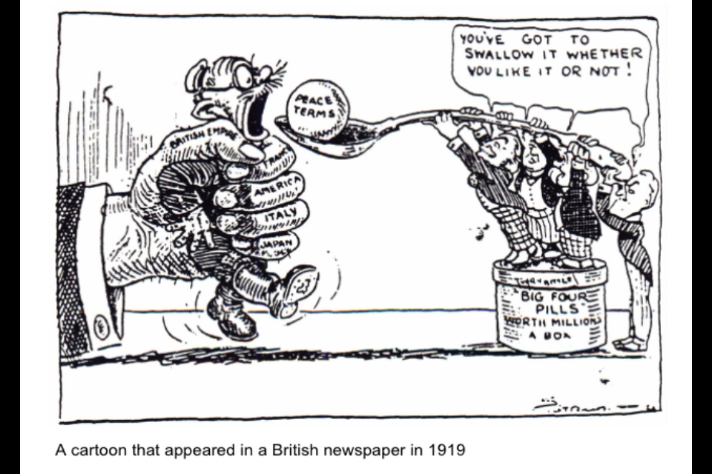
The Treaty of Versailles
The Treaty of Versailles outlined peace terms between Germany and the allies. Germany had to agree to a War Guilt Clause, meaning that it had to accept sole responsibility for causing the war.
Germany’s territory was reduced and it had to give up control of its colonies. Germany had to pay war reparations totalling approximately $30 billion. The German army was restricted to 100,000 men. It also had to surrender its navy. It was also not allowed to have an air force. These harsh terms, many historians believe, brought the certainty of renewed war.

