Slide 1
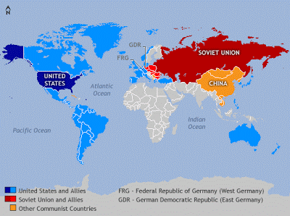
Canada and the Cold War

Slide 2
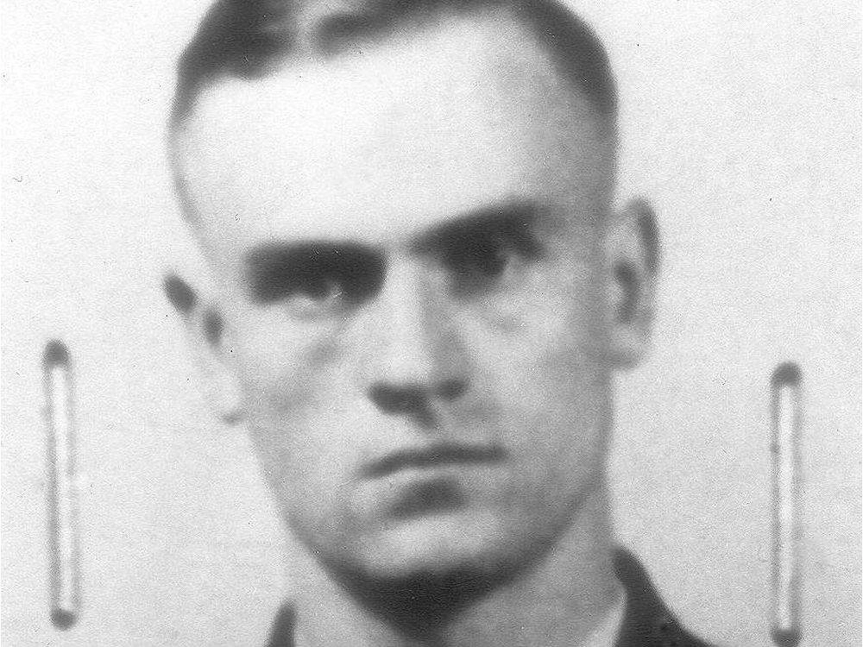
Igor Gouzenko
In 1945, a Russian citizen, Igor Gouzenko, was working as a clerk at the Soviet embassy in Ottawa. In September of that year, Gouzenko went to the Ottawa Journal with documents proving that a Soviet spy ring was operating within the Canadian government.
Canadian officials informed the British and American governments of the spy ring. In February, 1946, the RCMP made several arrests. The spy ring was likely trying to discover information about the atomic bomb, but it appeared that the Soviets had learned very little. The Gouzenko affair brought Canadians into the new reality of the post-war world – the period of intense hostility and suspicion known as the Cold War.

Slide 3
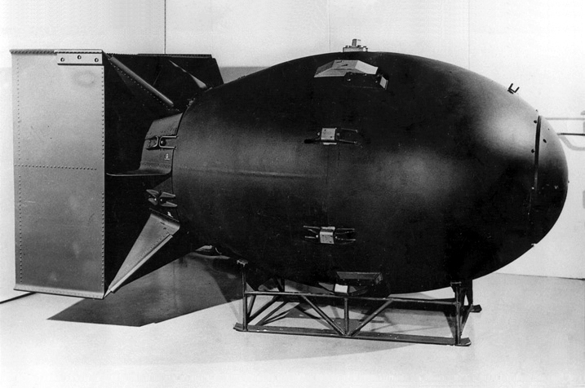
The Cold War
The Soviet Union was communist, which meant that the government controlled all industry and commerce. The United States and most Western countries were capitalist, which meant their economies were based on private enterprise, with individuals investing in business for profit.
Western countries feared that communists planned to overthrow Western societies in a world revolution. The Soviet Union feared that Western countries might try to invade Soviet territory. The two superpowers – the United States and the Soviet Union – did not fight a traditional war. No shots were fired. Instead, both sides built up huge stockpiles of military weapons, including the atomic bomb and also spied on one another.

Slide 4
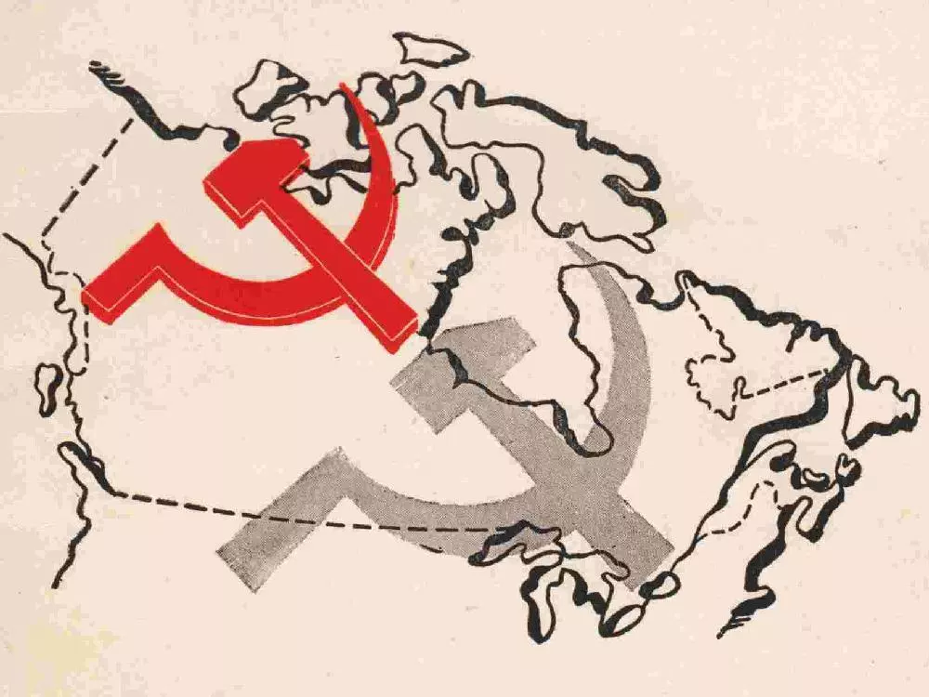
The Cold War at Home
The Canadian public was shocked to hear the news about the Igor Gouzenko story and the Soviet spy ring that had been operating in Canada. Many Canadians worried that a war between the Soviets and the Americans would result in nuclear bombs and missiles striking Canada.
The Canadian federal government developed civil defence plans, and cities prepared to protect their populations. Some cities had nuclear shelters in deep basements or subway tunnels. If an attack were to occur, sirens would sound a warning and people would try to find shelter. Schools performed drills to teach students to “duck and cover” or to lie in ditches.

Slide 5
NATO and the Warsaw Pact
In 1949, Canada joined with the United States, Britain, and other Western European countries to form a military alliance called the North Atlantic Treaty Organization (NATO). An attack on one NATO member was to be treated as an attack on all. When NATO accepted West Germany as a member in 1955, the Soviet Union created its own military alliance between it and Eastern European countries called the Warsaw Pact.
These military alliances divided the northern hemisphere into two hostile camps. Armies constantly practiced for war and added to their arsenals of weapons. Spies and counterspies probed for weaknesses in their enemy’s security – searching for secrets and carrying out assassinations.

Slide 6
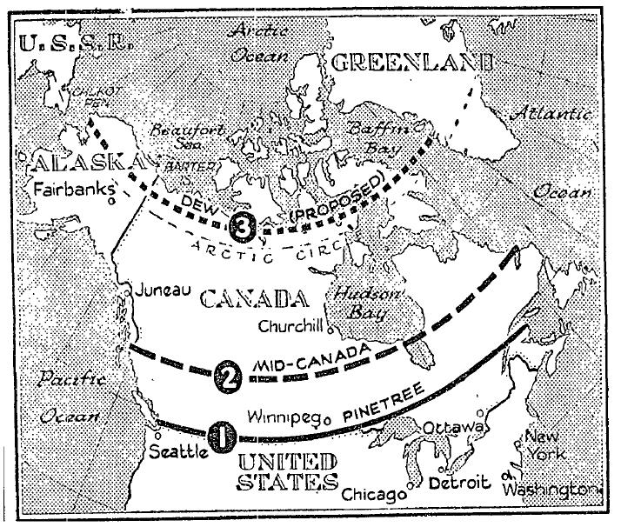
NORAD & North America Defence
In 1958, Prime Minister Diefenbaker signed an agreement with the United States committing Canada to the North American Aerospace Defense Command (NORAD). This meant that Canada and the U.S. had become part of a joint coordinated continental air defence against the threat of attack from the Soviet Union.
To protect against direct Soviet attack from the air, the United States built three lines of radar stations across Canada between 1950 and 1957 – the Pinetree Line, the Mid-Canada Line, and the Distant Early Warning Line. These stations were designed to detect a surprise Soviet attack over the North Pole, giving the United States time to launch a counterattack.

Slide 7
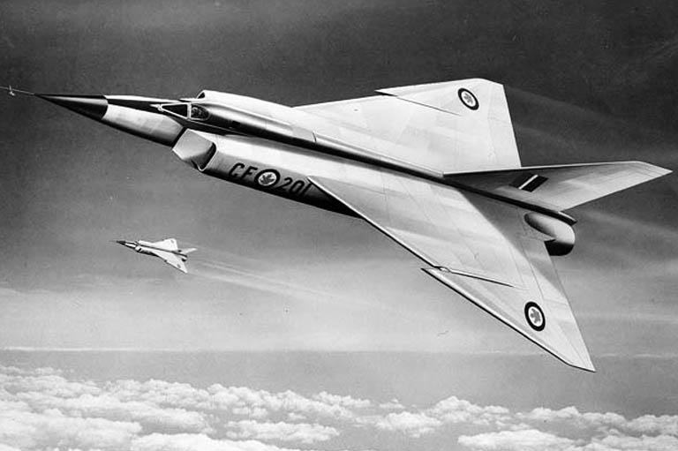
The Avro Arrow
By 1958, the A.V. Roe (AVRO) Company had developed the Arrow (CF 105), capable of flying at twice the speed of sound. The Arrow was to have exceptionally powerful and state-of-the-art engines and be faster than almost any other interceptor of the day. The purpose of this jet was to shoot down Soviet nuclear-armed bombers.
The Avro project was cancelled in 1959 by the Diefenbaker government. The government ordered that all the existing planes be destroyed.
Most of Avro’s designers, scientists and engineers moved to the United States. Many Canadians felt that an opportunity to establish a world-class space and aeronautics industry in Canada had been lost.

Slide 8
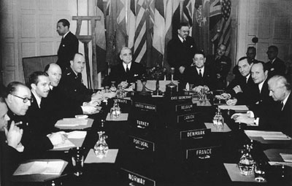
Canada and the United Nations
In October 1945, delegates from 51 countries signed a charter that established the United Nations (UN). It was designed to bring peace and security to the world. The founders of the UN also pledged to abolish disease and famine and to protect human rights.
Canada has been a strong supporter of the United Nations since its creation and has aided refugees from war or natural disasters and worked on development projects – such as building schools, dams, and roads – in various countries. Canadian peacekeepers have been involved in almost every UN operation since the start of these missions in 1956.

Slide 9
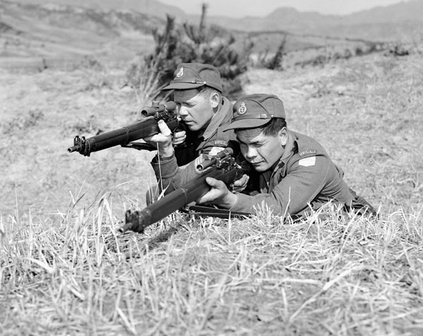
The Korean Conflict
The Second World War had left the Asian country of Korea divided. The Soviet Union and communist China supported North Korea, a communist state. The United States supported South Korea which had a fragile democracy. In 1950, war broke out when North Korea invaded South Korea.
The United Nations called on its members to assist South Korea. Prime Minister Louis St. Laurent sent more than 25,000 soldiers to fight in Korea. More than 1500 Canadian soldiers were seriously wounded and another 516 died. Although a ceasefire was reached in 1953, the war had increased tensions between the West and the communist countries.

Slide 10
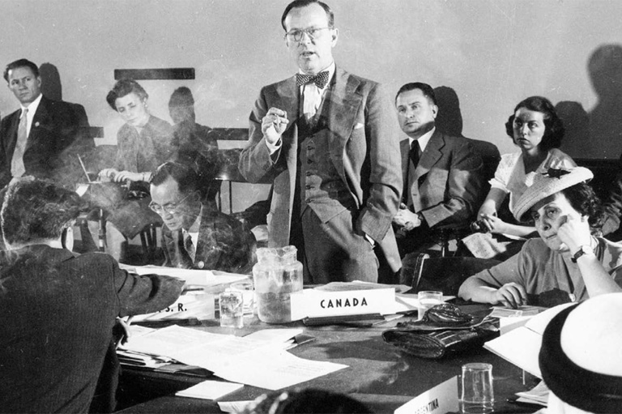
The Suez Crisis
The Suez Canal links the Mediterranean and Red Seas and provides the shortest sea route from Europe to the Indian Ocean. It was opened in 1869 and was privately owned by British and French investors. In 1956, Egypt’s president, Gamal Abdel Nasser, took over the canal and threatened to ban ships travelling to and from Israel.
Israel, Britain, and France landed troops in the canal zone in an effort to regain control of the canal. The Soviet Union offered Egypt financial and military aid. Lester Pearson went to the United Nations and proposed that a multinational peacekeeping force be sent to the war zone. The United Nations agreed, and the peacekeepers succeeded in ended hostilities.

Slide 11
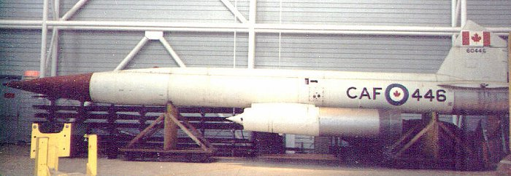
The Nuclear Issue in Canada
When the Avro Arrow was scrapped, Canada accepted U.S. Bomarc missiles that were capable of carrying nuclear warheads. Canadian citizens and the ruling Conservative Party were divided on the issue of whether or not nuclear weapons should be allowed on Canadian land.
The Minister of External Affairs felt Canada should be a non-nuclear nation. He argued that it was hypocritical to urge the United Nations to work for disarmament while accepting nuclear weapons. The Defence Minister, in contrast, insisted that nuclear weapons were vital in protecting Canada against communist aggression. Meanwhile, the anti-nuclear movement was growing among Canadian citizens.

Slide 12
The Cuban Missile Crisis
In 1959, Cuban rebels led by Fidel Castro overthrew Cuba’s pro-U.S. dictator, Fulgencio Batista. In 1961, a group of Cuban exiles, supported by the U.S., landed in Cuba and tried unsuccessfully to overthrow Castro. The invasion attempt prompted Cuba to turn to the Soviets for support.
In October 1962, U.S. surveillance showed that the Soviets were installing offensive nuclear missile bases in Cuba. Missiles launched from these sites were a threat to U.S. security. President Kennedy announced a naval and air blockade of Cuba. U.S. forces and NORAD were readied for war. But, the Canadian government refused to place Canada’s NORAD forces on alert or allow U.S. atomically-armed planes to land at Canadian bases.

Slide 13
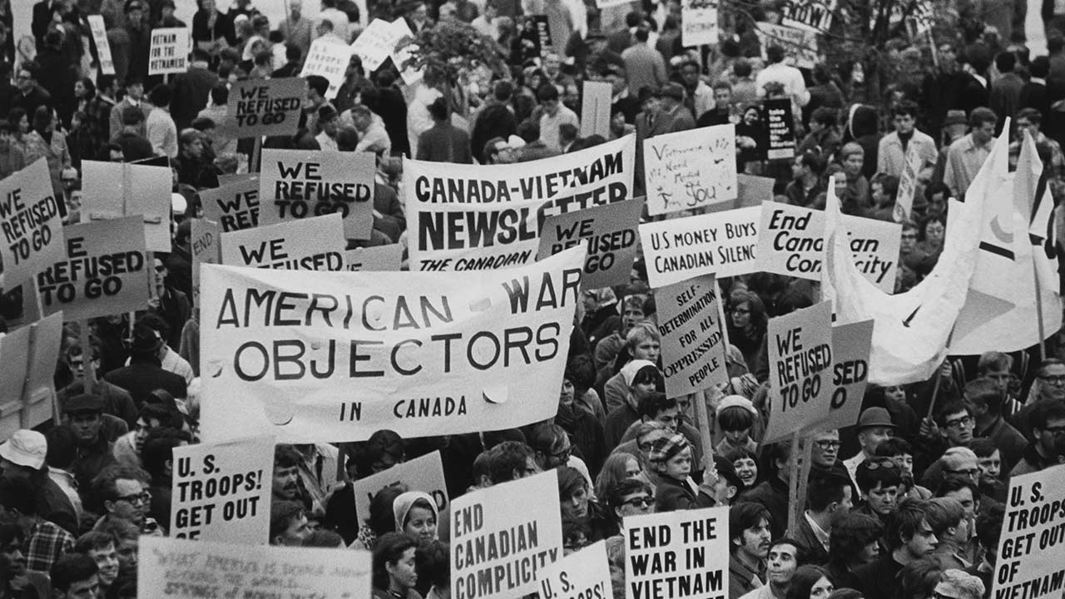
The Vietnam War
North Vietnam had a communist government. The government in South Vietnam, more a dictatorship than a democracy, was supported by the United States. The Americans felt that if the south fell to communism, then it would not be long before other Asian states fell, a sort of domino effect. It sent troops to help the South Vietnamese. At the same time, the Soviets and communist China supplied weapons and aid to North Vietnam.
Canada did not send troops to fight in the Vietnam War, but it accepted thousands of American draft resisters and deserters who were opposed to the war. Anti-draft groups were established in many Canadian cities to help them get settled and support their protests against the war.

Slide 14
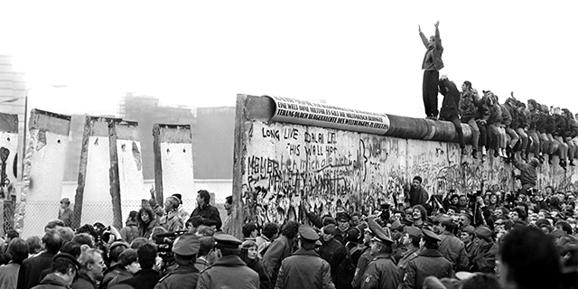
The End of the Cold War
By the mid-1980s, Soviet leader Mikhail Gorbachev realized that the Soviet Union could no longer afford its costly arms race with the United States. He proposed massive cuts in the arsenal of both superpowers.
Gorbachev then began a series of sweeping economic, social, and political reforms that would help the communist countries run more efficiently and create better conditions for their citizens. He also loosened censorship and allowed greater freedom of speech. These policies encouraged the people of East Germany, Poland, Czechoslovakia, Hungary, and Romania to demand similar reforms in their countries. By 1991, the Soviet Union had collapsed.

