Slide 1
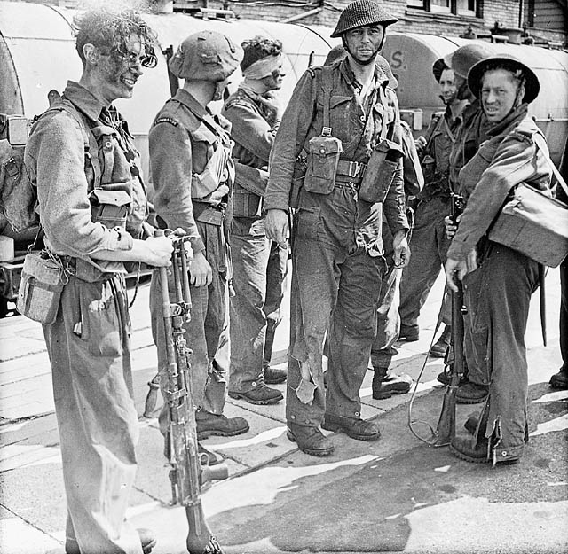
Canada and the Second World War

Slide 2
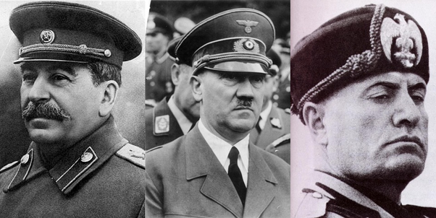
The Rise of Totalitarianism
Political philosophies that put the state about all else, including the rights of the individual, are totalitarian. In a totalitarian state, the government has total control over all aspects of politics and society.
Violence and intimidation are used to gain power, and then a police force maintains the government's control. Usually, the ruling party bans other political parties and does not tolerate any opposing ideologies. Propaganda and censorship reinforce the party message and control society. The government controls the economy and one leader has absolute power.

Slide 3
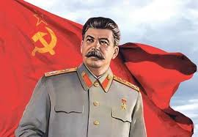
Stalin's Soviet Union
By 1917, the Communists had taken control of Russia. In 1924, Joseph Stalin became the leader of the Communist Party in what was the Soviet Union.
The first step of Stalin’s plan was to collectivize agriculture, which meant seizing all privately owned land. Next he created industrial projects, including building coal and steel mills, roads, and railways. Stalin focused on building industry and the military, practically ignoring the needs of the people. The government controlled all media and imposed strict censorship and travel restrictions on everyone. Secret police arrested anyone considered a threat.

Slide 4
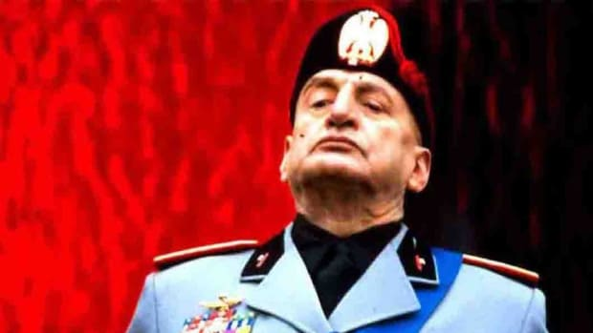
Mussolini's Italy
Benito Mussolini established the Fascist Party, which emphasized nationalism and challenged Italy’s democratic government. Mussolini created the Blackshirts, gangs of fascists who intimidated their opponents by attacking communists and socialists in the streets.
In 1922, Mussolini led the March on Rome: he gathered 26 000 Blackshirts outside the city and demanded that the government be turned over to him. Once in power, Mussolini brought all communications, industry, agriculture, and labour under fascist control and turned Italy into a totalitarian state.

Slide 5
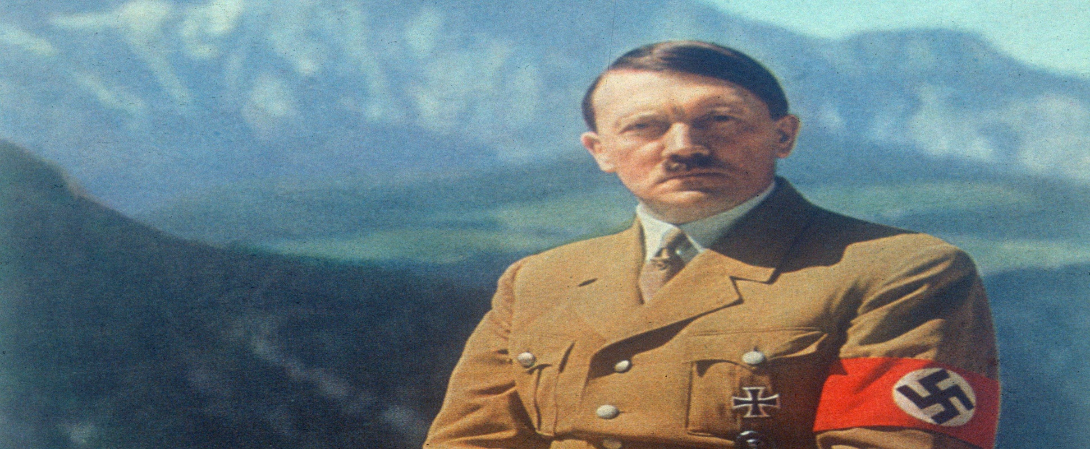
Hitler's Germany
In 1920, Adolf Hitler joined the National Socialist German Workers’ Party, also known as the Nazis, and by 1921 he was the leader of the party. Hitler persuaded Germans that he could save the country from the Depression and make it a great nation again. In 1933 he became chancellor of Germany.
Hitler ruled his country through intimidation and fear. He banned all other political parties and used the Gestapo, a secret police, to enforce his rule. Hitler’s government defied the terms of the Treaty of Versailles by stopping all reparation payments and rebuilding Germany’s military.

Slide 6
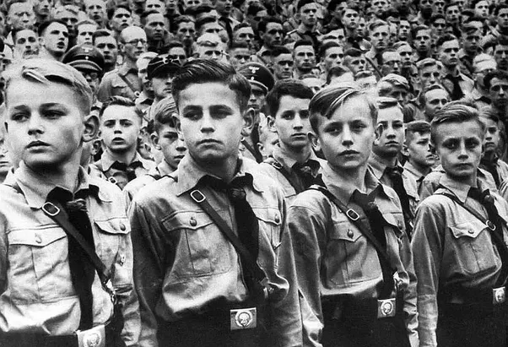
The “Master Race”
The Nazis believed that the German people were a “master race” of Aryans, a “pure” race of northern Europeans. Non-Aryans, including Jewish people, Roma (“Gypsies”), and Slavs, were considered inferior. People with mental or physical disabilities were despised because they destroyed the image of the master race. Communists and homosexuals were also deemed undesirables.
Hitler passed the Nuremberg Laws which forced Jewish people to wear the Star of David at all times, banned marriages between Jews and Aryans, and made it illegal for Jewish people to be lawyers or doctors.

Slide 7
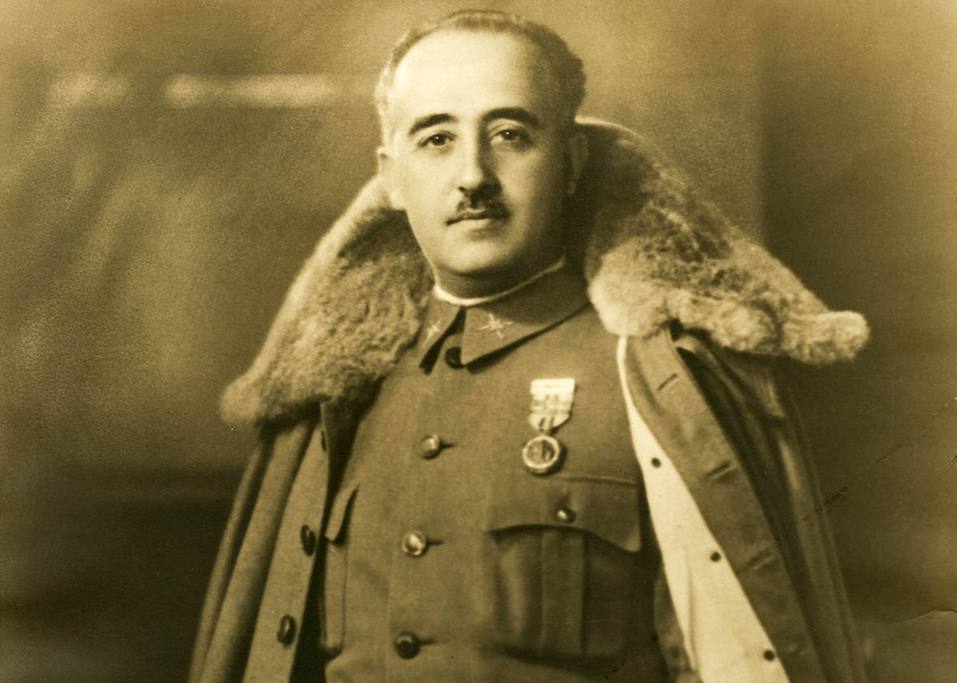
Fascism in Spain
During the Depression, Spain’s democratic government was unable to prevent widespread poverty, and people became more and more dissatisfied. Led by General Francisco Franco, fascist rebels—called Nationalists—tried to overthrow the elected socialist government in 1936.
Franco—with military support from Hitler and Mussolini—won the civil war and became the ruler of Spain in 1939. Once in control, Franco proved to be a brutal totalitarian dictator who ruled by intimidation and violence. Thousands of people were imprisoned in concentration camps or executed.

Slide 8
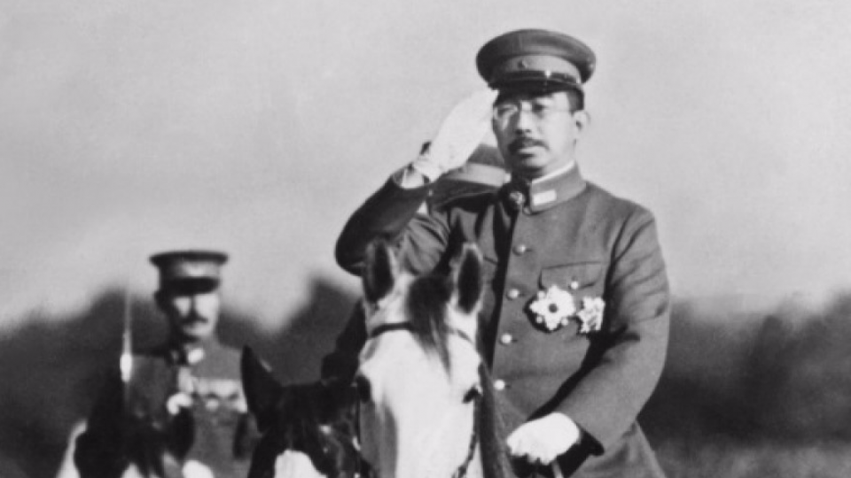
Totalitarianism in Japan
Japan had a government loyal to a single leader, the emperor. The country’s parliament had little power because government ministers answered only to the emperor. Much of the power rested with the military and the Zaibatsu, large family-run corporations. These groups took advantage of the political and economic problems of the Depression to gain control of the country.
Japan had a police force which arrested, tortured, or killed anyone suspected of being an enemy of the state. Militarists took control of Japan in the 1930s and began strengthening the empire by conquering other countries.

Slide 9
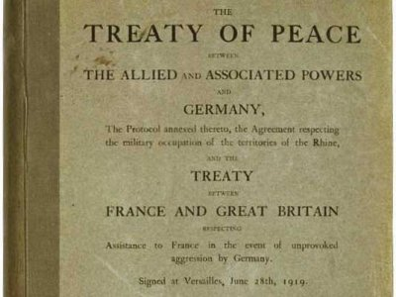
Causes of the Second World War
The totalitarian leaders had nationalistic ambitions to expand their territory and resources.
Germany and Italy felt that they had been cheated by treaties at the end of the First World War and wanted to right these wrongs. Japan wanted access to more resources to help support its industries. In other countries, leaders were conscious of the sacrifices their citizens had made during the last war and wanted to avoid another conflict at all costs. All these factors contributed to the Second World War.

Slide 10
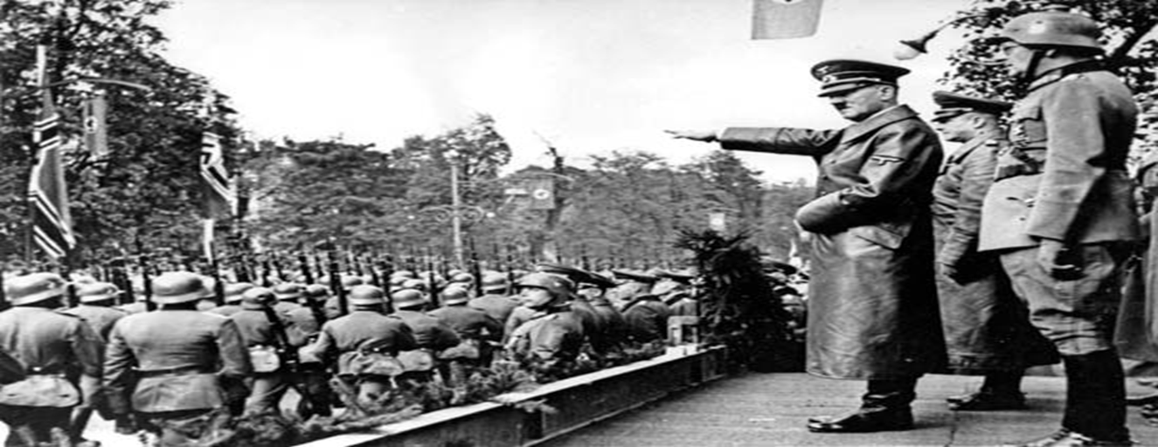
Hitler’s Imperialistic Ambitions
In 1936, Hitler ordered his troops into the Rhineland, an area along Germany’s western border that had been demilitarized and put under French protection by the Treaty of Versailles. Although this was a violation of the treaty, Britain and France chose not to act at the time.
Two years later, Germany annexed, or took over, Austria. Again, this was another breach of the treaty, but Britain and France chose not to act. They were willing to make concessions to maintain peace. However, their weakness made Hitler bolder.

Slide 11
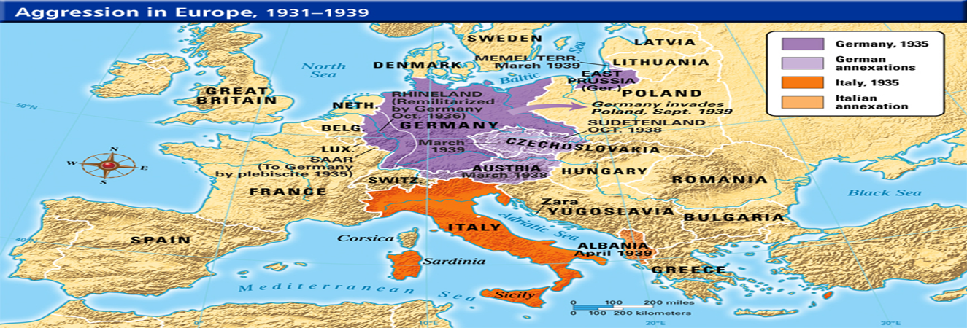
Appeasing Hitler
Next, Hitler set his sights on the Sudetenland, a territory populated by ethnic Germans given to Czechoslovakia at the Paris Peace Conference. When Hitler threatened to invade this territory, British and French leaders met with him in Munich to try to negotiate. In exchange for the Sudetenland, Hitler promised not to invade the rest of Czechoslovakia.
British Prime Minister Neville Chamberlain announced that the Munich Agreement and their policy of appeasement would secure “peace for our time.” In March 1939, Hitler broke his promise and invaded Czechoslovakia.

Slide 12
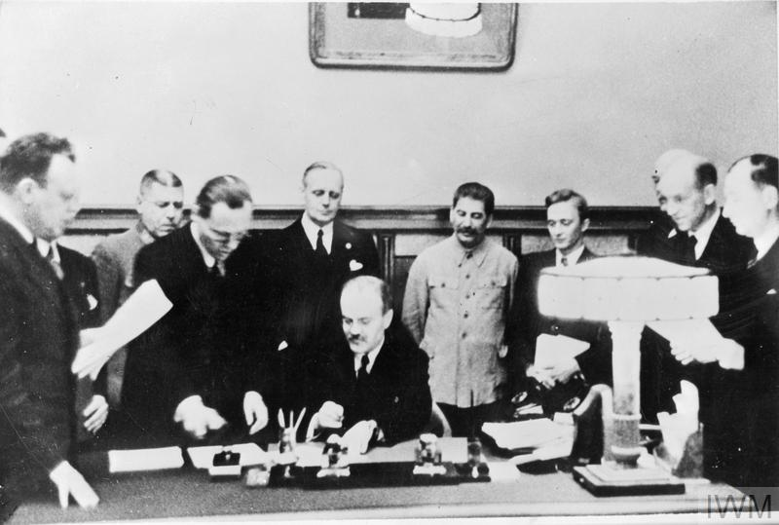
Nazi-Soviet Non-Aggression Pact
In August 1939, Hitler signed a non-aggression pact with Joseph Stalin, leader of the Soviet Union, even though the Nazis hated communists and vice versa. Both countries pledged not to fight each other if one of them went to war, and they agreed to divide Poland between them.
On September 1, 1939, German troops invaded Poland, and bitter fighting followed. This time, Britain and France responded immediately. They ordered Germany out of Poland by September 3, 1939. When Germany ignored this deadline, Britain and France declared war.

Slide 13
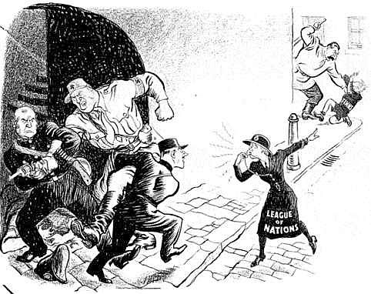
Failure of the League of Nations
While the policy of appeasement failed to prevent German aggression, the
League of Nations was not effective in preventing nationalistic aggression in
other parts of the world. The League was supposed to help maintain world
peace, but it was too weak and didn’t have a military to enforce its decisions.
In 1931, when Japan invaded Manchuria, Japan merely withdrew from the League after it condemned Japan’s actions and continued with its aggression. In 1935, when Italy attacked Abyssinia, the League voted to impose trade sanctions against Italy. But oil, a crucial import for Italy, was not included.

Slide 14
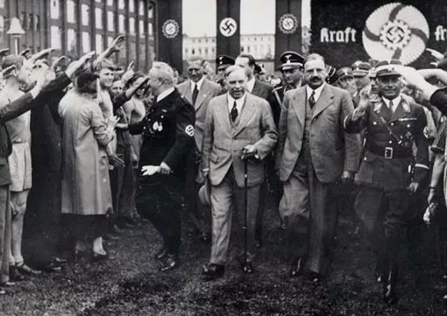
Canada’s Policy of Isolationism
Throughout the events of the 1930s, Canada practised isolationism, keeping out of affairs outside its borders. Prime Minister William Lyon Mackenzie King did not want Canada to become involved in another world conflict.
The First World War had deeply divided Canada on the issue of conscription, and Canadians had made many sacrifices in that overseas conflict. King knew that if he imposed conscription in this war, he and the Liberal Party would lose support in Québec. The economy was improving after the Depression and King did not want Canada plunged back into debt.

Slide 15
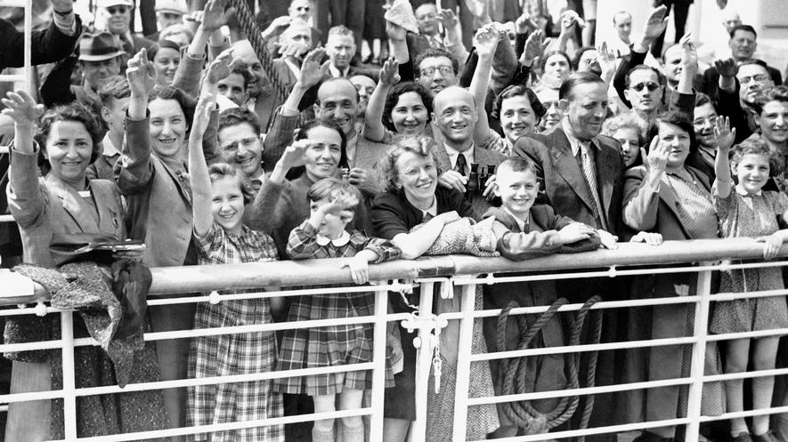
The S.S. St. Louis
Jewish refugees were seen as a burden on the state. Due to rising unemployment in the 1930s, Canada was reluctant to accept immigrants other than those from Britain or the U.S. who could support themselves.
In May 1939, the S.S. St. Louis left Hamburg, Germany with 907 Jewish passengers desperately trying to escape persecution. It was denied entry in Cuba, South America, and the United States. The Canadian government also refused to let the St. Louis dock. The ship was forced to return to Europe. Tragically, many of the people aboard later died during the Holocaust.

Slide 16
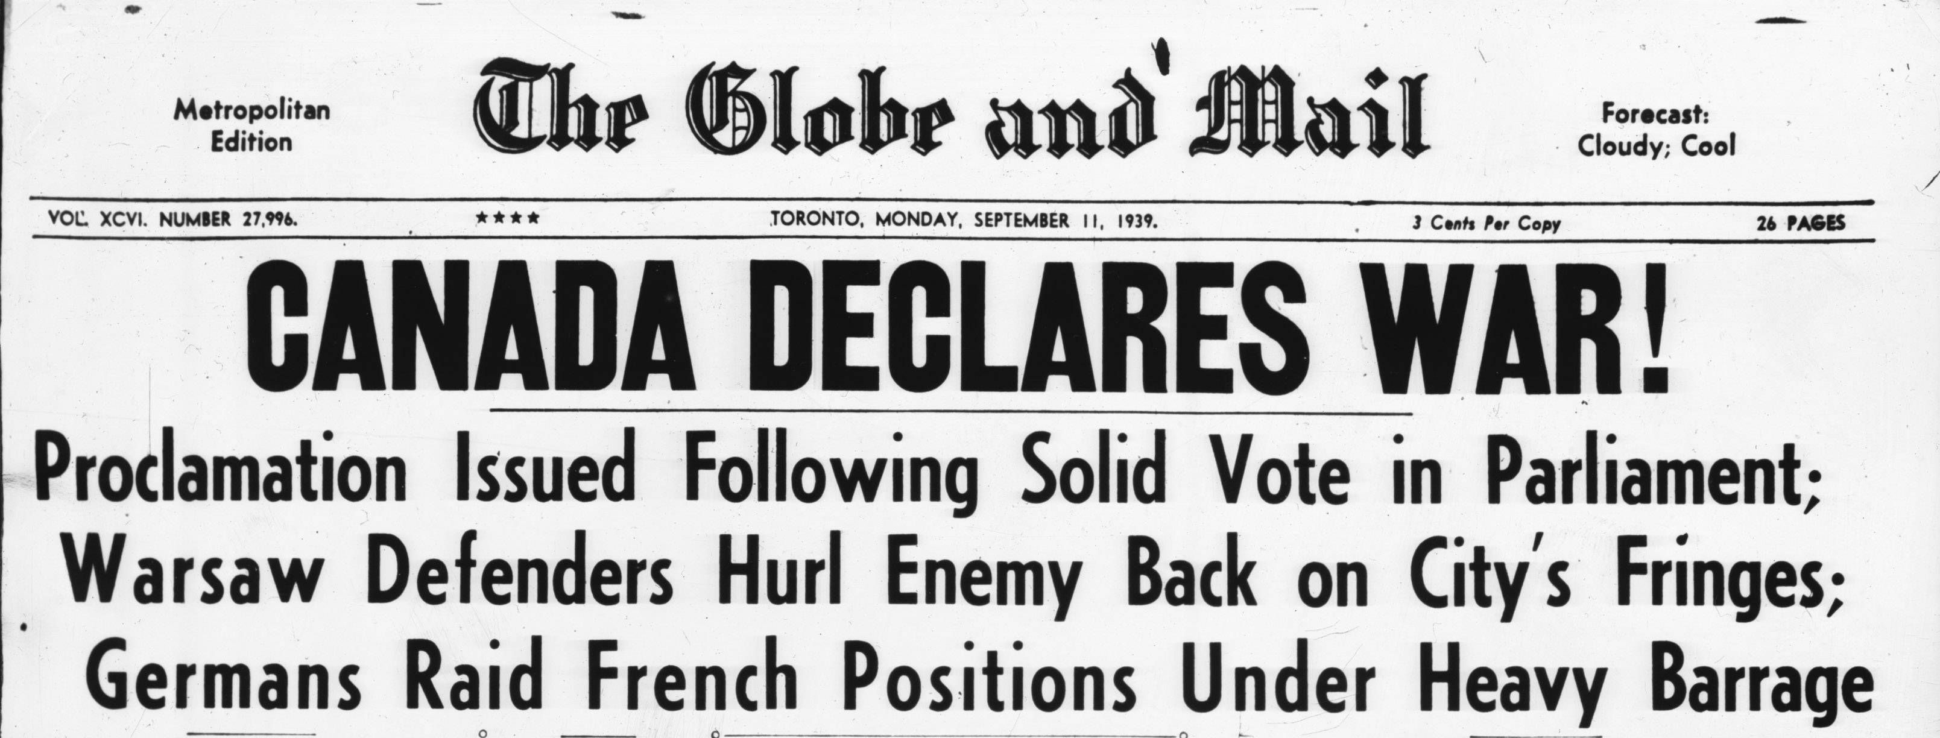
Canada Declares War
On September 1, 1939, Germany invaded Poland. Two days later, Britain and France declared war on Germany. In the First World War, when Britain declared war on Germany, Canada was automatically at war. But, in 1939, Canada was an autonomous country with no such obligation.
King’s position in favour of joining the war was supported by the opposition Conservative Party. Only J.S. Woodsworth, leader of the Co-operative Commonwealth Federation, argued against going to war. Parliament voted in favour of war. Canada declared war on Germany on September 10, 1939.

Slide 17
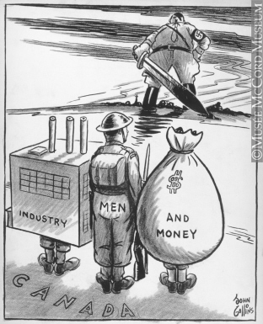
Mobilizing Canada’s Resources
Canada was not prepared for war. Its armed forces were small and unfit for combat. The army had only 4300 troops, a few light tanks, and no modern artillery. The air force and the navy were small with outdated equipment.
But Canada had no trouble finding volunteers. In September 1939, more than 58 000 people volunteered for service. Many people still felt strong ties to Britain and volunteered from a sense of duty. Others were driven by a sense of new-found national pride. After years of economic hardship, some Canadians were attracted by the lure of a steady income.

Slide 18
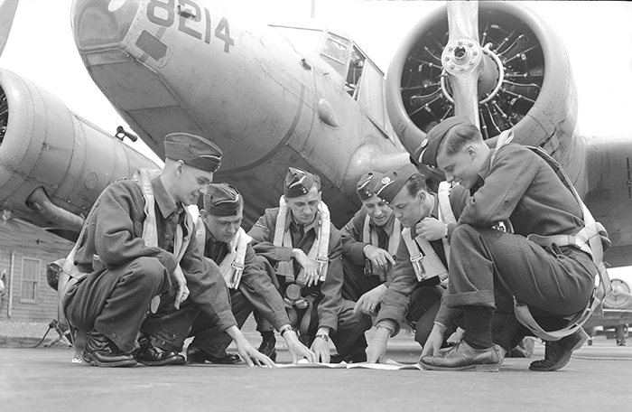
British Commonwealth Air Training Plan
In December 1939, Canada agreed to host and run the British Commonwealth Air Training Plan. Pilots and other flight personnel from all over the Commonwealth came to Canada to train with British instructors. Airfields were built on the Prairies and in other locations near small towns.
The program was a major Canadian contribution to the war effort. The BCATP trained more than 130 000 pilots, navigators, flight engineers, and ground crew. The total cost was more than $2.2 billion, of which Canada paid more than 70 percent.

Slide 19
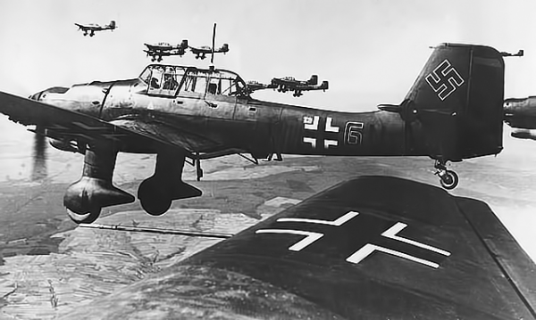
Axis Advances
With the declaration of war in September 1939, the Allies (Britain, France,
and Commonwealth countries including Canada, Australia, and New
Zealand) raced to get their forces organized. The alliance of Germany, Italy
(1939), and Japan (1940) became known as the Axis.
Using the blitzkrieg war tactic of surprise attacks by tanks and fighter planes, Germany quickly conquered Denmark and Norway. Germany then attacked the Netherlands, Luxembourg, and Belgium. Within weeks, all three countries were overrun. On June 22, 1940, France also surrendered to the Germans.

Slide 20
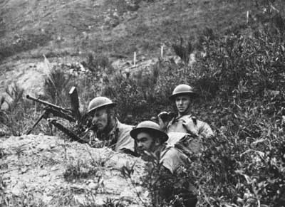
Battle of Hong Kong
Only hours after bombing Pearl Harbor, Japan attacked Hong Kong, a British colony. Weeks earlier, Canada had sent two battalions, from Winnipeg and Québec, to reinforce the British and Commonwealth forces in Hong Kong.
The Canadians were inexperienced and the 20 000 Allied soldiers were no match for the skilled Japanese soldiers. After 18 days of bitter fighting, Hong Kong fell to the Japanese on December 25, 1941. Every Canadian was either killed or taken prisoner. Nearly 1700 Canadian were taken as prisoners of war. They faced brutal conditions and were later used as slave labour.

Slide 21
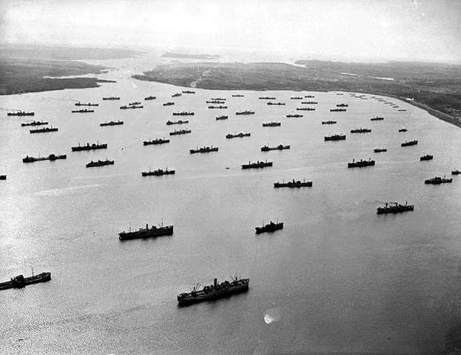
Battle of the Atlantic
Britain was almost completely dependent on food and military supplies from Canada and the United States. But the Allied supply ships bound for England were being attacked by “wolf packs” of German U-boats patrolling the Atlantic. Germany was trying to starve Britain by cutting off shipping routes.
To protect supply ships from German torpedoes, the Allies sailed in convoys so warships could help to protect vessels carrying vital supplies. The Royal Canadian Navy provided about half the escorts across the Atlantic. By May 1943, the Allies believed they had won the Battle of the Atlantic.

Slide 22
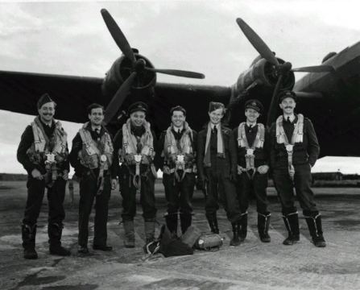
Bomber Command
The Royal Canadian Air Force participated in one of the most controversial missions of the war: night bombings over Germany. As part of Britain’s Bomber Command, Canada’s Bomber Group pounded German cities.
These cities were targeted for a number of reasons: to retaliate for the German air raids on English cities, to diminish German morale, and to destabilize German industrial centres. Tens of thousands of civilians were killed by these air raids. Nearly 10 000 Canadian Bomber Group members lost their lives during the war.

Slide 23
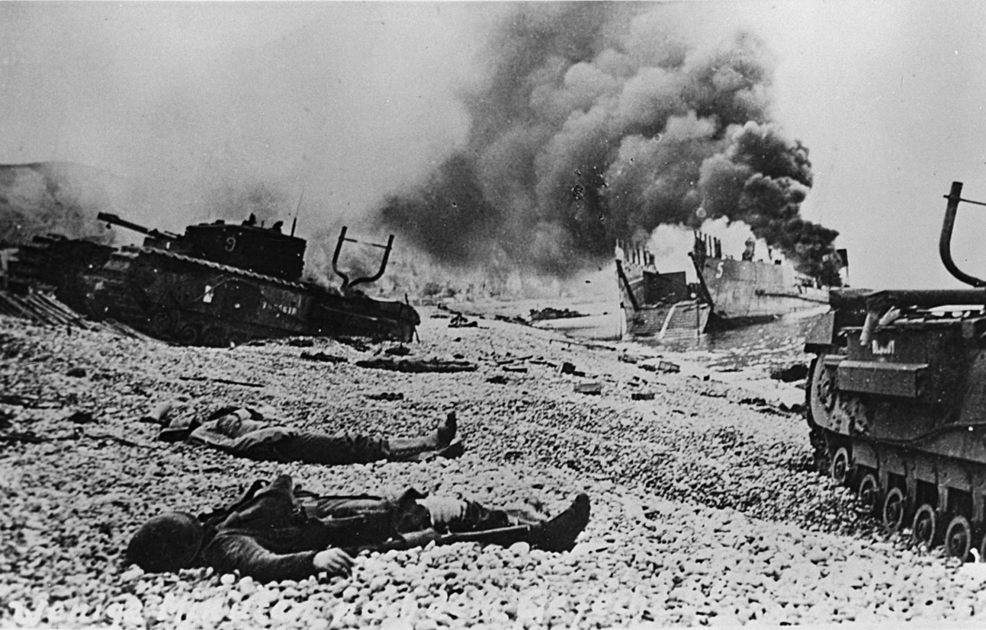
The Dieppe Raid
On the morning of August 19, 1942, one of the ships carrying Canadian soldiers to the French port of Dieppe met a small German convoy. The two sides engaged in a brief sea battle, and the noise alerted German troops on shore. To make matters worse, the ships were delayed and the troops landed in daylight. They were easily machine-gunned by waiting German soldiers.
The Dieppe Raid was a terrible failure. Casualties were high. Of the nearly 5000 Canadian soldiers involved in the nine-hour battle, 907 were killed. Almost 600 were wounded and another 1946 were taken prisoner.

Slide 24
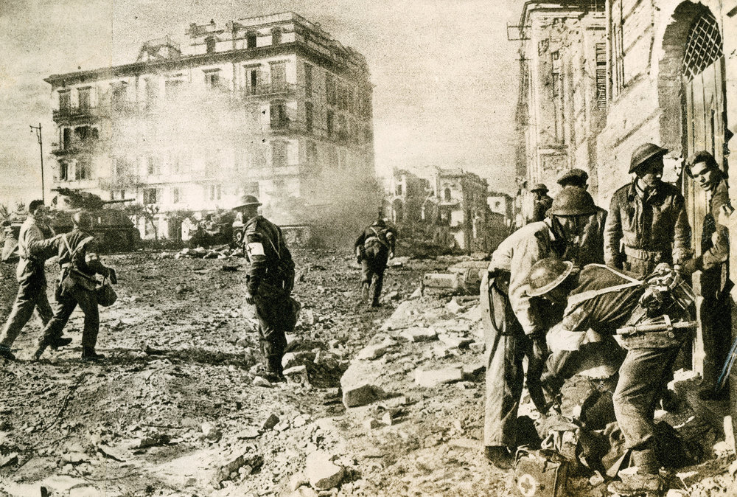
Battle of Ortona
Canadians were given the task of capturing the medieval town of Ortona on the Adriatic Sea. Once they reached Ortona, advances were slow and battles were often fought house by house on the town’s steep, rubble-filled streets.
Canadians captured the town on December 28, 1943, but lost 1372 soldiers before the Germans withdrew. After capturing Ortona, Canadian troops advanced through Italy until they were sent to join the campaign in France.

Slide 25
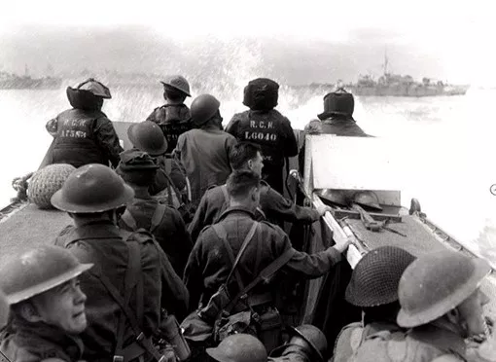
D-Day: The Normandy Invasion
On D-Day, June 6, 1944, the Allies (including British, Canadian, and American forces) launched a full-scale invasion of Europe called “Operation Overlord.”14 000 Canadian soldiers arrived at Juno Beach as part of the first wave of the attack. They had to make their way past the German defences, including concrete barriers, barbed wire, and land mines, to take the beach.
By the end of the day, the Canadians had fought their way inland by about nine kilometres. Although they were successful, casualties from the day were high—359 Canadians died and 715 were wounded.

Slide 26
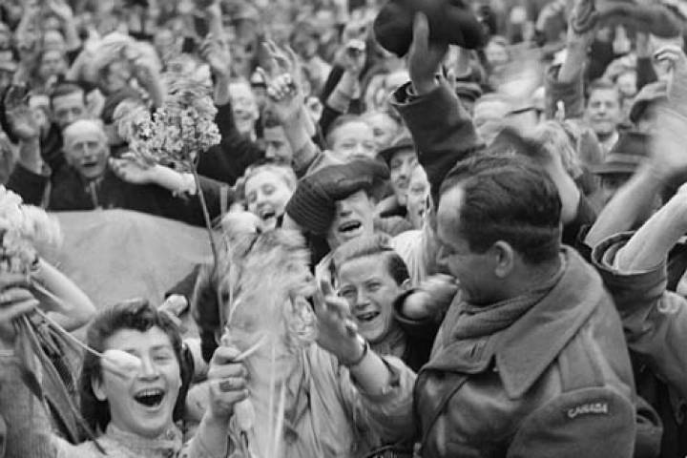
Liberating the Netherlands
Canadians were given the task of liberating the Netherlands. This was a difficult job. An earlier Allied attempt to free Holland had failed and German troops had practically destroyed the port cities of Amsterdam and Rotterdam and flooded much of the countryside. By the end of 1944, food and fuel supplies to the Dutch had been cut off and many were starving.
After reaching the Rhine, it took another month of fighting to drive the Germans out of the Netherlands. As they liberated towns and cities throughout the Netherlands, Canadians were hailed as heroes in parades.

Slide 27
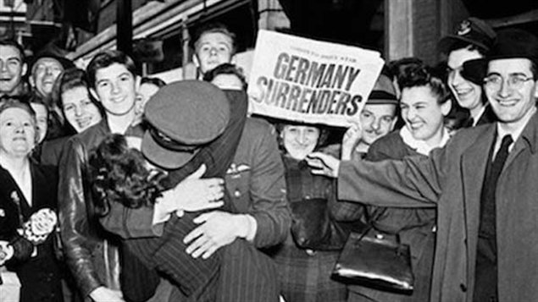
Victory in Europe
While the Allies invaded Germany from the north and west, the Soviet Union attacked from the east. Facing certain defeat, Germany surrendered to the Allies on May 7, 1945.
Hitler committed suicide in a bunker in Berlin before he could be captured. The war in Europe was over and the Allies declared May 8 as Victory in Europe (VE) Day.

Slide 28
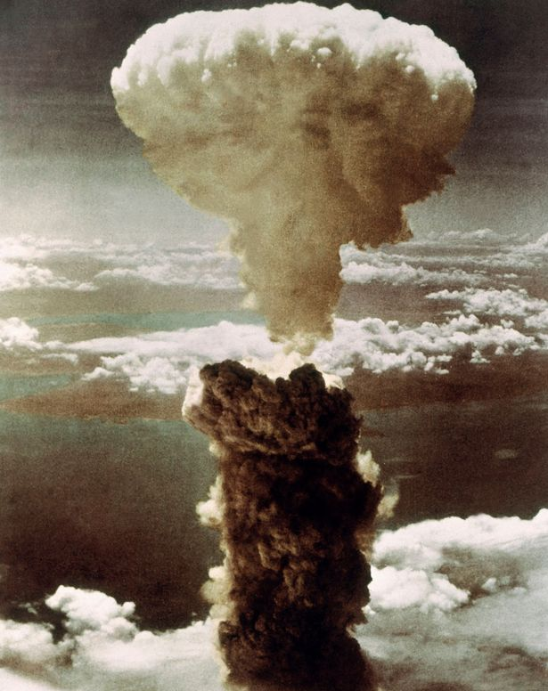
The Atomic Bomb
After the Allied victory in Europe, the war in the Pacific intensified. The Japanese declared they would “fight to the last person” and not surrender.
American and British scientists had been working on the Manhattan Project, a top-secret plan to create an atomic bomb. On August 6, 1945, an American bomber plane dropped an atomic bomb over the Japanese city of Hiroshima. Three days later, another atomic bomb was dropped on the city of Nagasaki. 100,000 people were killed, 100,000 were wounded, and more suffered long-term effects such as cancer. Japan surrendered on August 14, 1945.

Slide 29
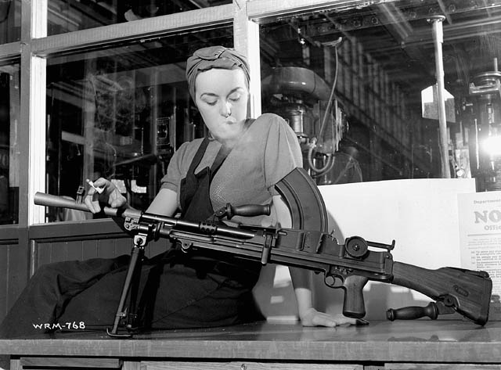
Women and the War Effort
As in the First World War, women joined war industries in roles that were unusual for them at the time. They worked as welders, drillers, and punchpress or machine operators. “Rosie the Riveter” became a popular nickname for these working women.
Women were in high demand as factory workers and many moved from rural areas to industrial centres. With government funding, some companies built dormitories close to their factories to house workers.

Slide 30
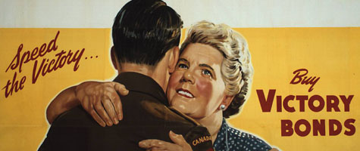
Canada’s Wartime Economy
Prime Minister Mackenzie King wanted to avoid soaring inflation and hoped to prevent the massive debt that had burdened Canada after the First World War so the government took the following steps:
Canadians were encouraged to buy victory bonds. The government used the money to help finance the war. Income taxes were increased. In 1941, the Wartime Prices and Trade Board froze all wages and prices to try to prevent inflation. In 1942, King introduced food rationing, limiting the amounts of certain goods that Canadians were allowed per week.

Slide 31
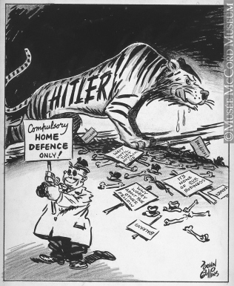
The Conscription Crisis
Prime Minister Mackenzie King had promised there would be no conscription when Canada declared war in 1939. But the speed with which the Germans occupied Europe in 1940 stunned Canadians and made it clear that thousands of soldiers would be needed to fight against the Nazis.
Canadians, including the opposition Conservative Party, demanded that their government do more for the war effort. In response to these demands, King’s government quickly brought in the National Resources Mobilization Act. This Act allowed for conscription, although only for home defence.

Slide 32
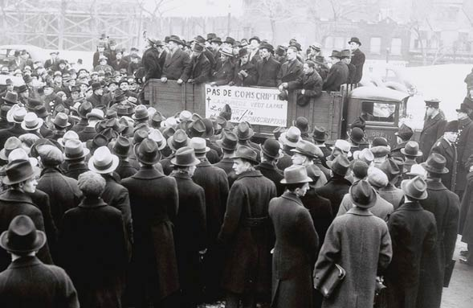
“Yes” to Conscription
Mackenzie King knew that there would be strong resistance to conscription in Québec. As in the First World War, many Québécois did not feel connected to a war in Europe that did not directly affect Canada.
King decided to hold a plebiscite to get Canadians’ views on conscription. On April 27, 1942, voters were asked whether they would release the government from its promise not to send conscripts overseas. In all provinces but Québec, the majority voted “yes.” Once again, the issue of conscription divided the nation. Many Quebecois felt King betrayed them.

