Slide 1
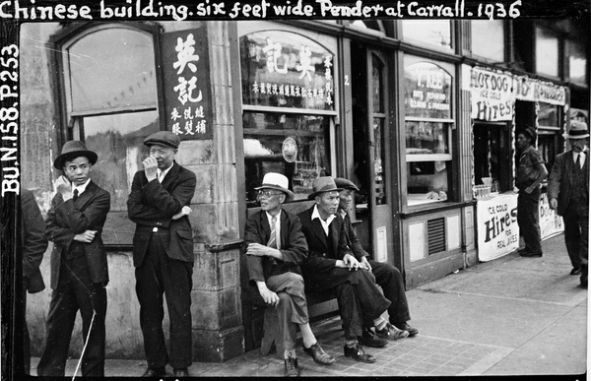
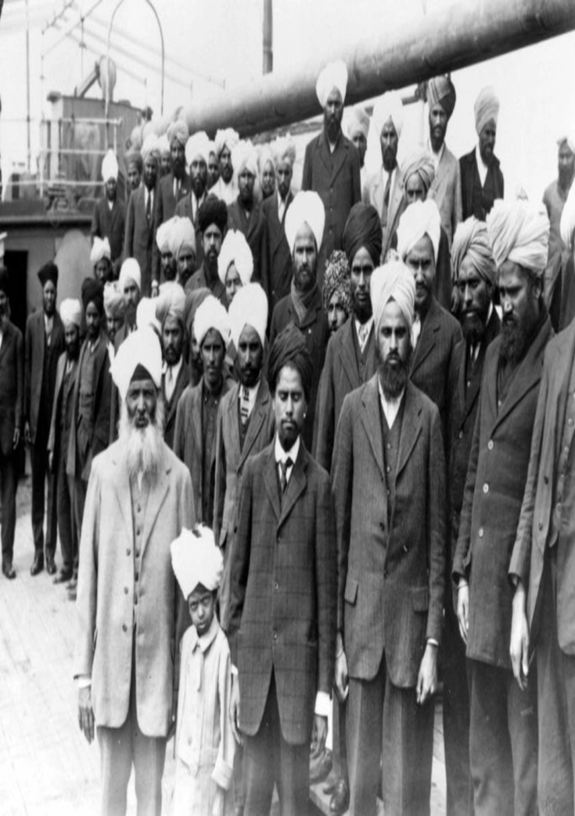
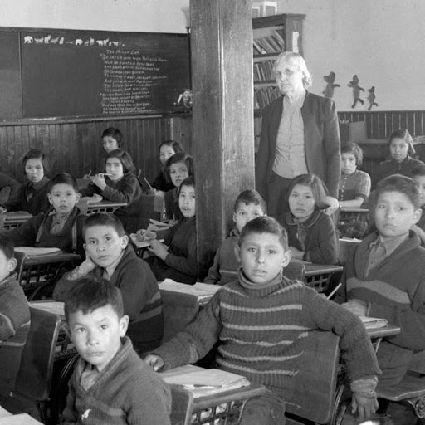
Discrimination in Canada: The Head Tax, Komagata Maru, and Residential Schools

Slide 2
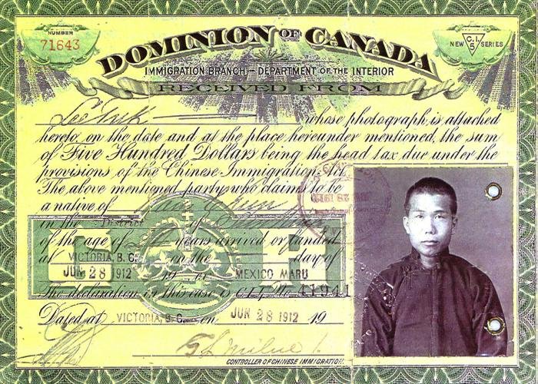
The Head Tax

Slide 3
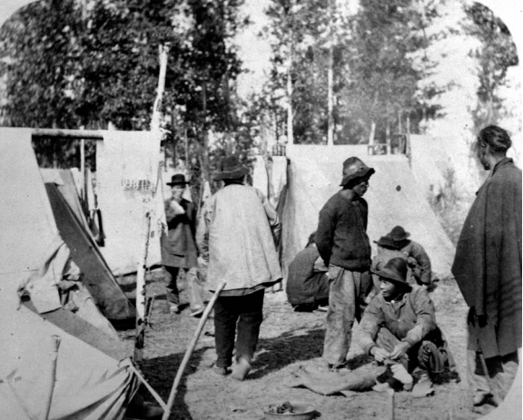
Background to the Chinese Head Tax
By the mid 1800s the population of China was greatly increasing and not enough food could be grown to feed everyone. Many people were without jobs, hungry and poor.
Many decided that going to British Columbia would give their families a better life. However, families often only had enough money to send one male family member. The rest stayed behind. Once the person found work, he sent home what money he could.
Chinese immigrants first came to Canada in 1858 to mine for gold in the Fraser Valley area of B.C.

Slide 4
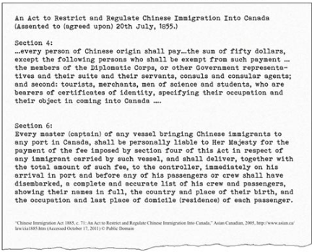
Details of the Chinese Head Tax
About 17,000 Chinese workers came to Canada to build the Canadian Pacific Railway from 1881 to 1885.
When the Canadian Pacific Railway was completed in 1885, the railway workers needed to find new jobs. White workers feared that Chinese workers, who were willing to accept lower wages, would take jobs away from them. They began to pressure the government to restrict Chinese immigration.
The Canadian Government passed The Chinese Immigration Act in 1885. It was designed to slow down Chinese immigration by charging a $50 head tax to any Chinese person wanting to come to Canada.

Slide 5
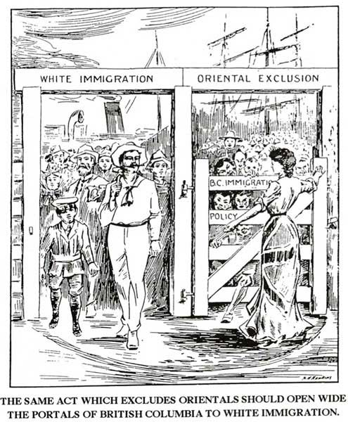
Details of the Chinese Head Tax
The Canadian government kept raising this tax to discourage Chinese people from coming to Canada. It was raised to $100 in 1900, and to $500 in 1903. With few exceptions, Chinese immigrants paid this tax between 1885 and 1923. Approximately 82,000 Chinese immigrants paid nearly $23 million in tax.
The tax was removed from the Chinese Immigration Act in 1923. From 1923 until 1947, Chinese persons were banned from coming to Canada. It even stopped families in China from coming to live with those family members already in Canada.

Slide 6
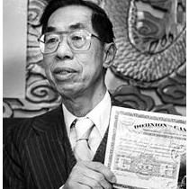
Significance of the Chinese Head Tax
The Chinese Head Tax caused severe financial difficulties for Chinese immigrants to Canada.
Its impacts on family life were devastating. It made it harder for Chinese men already living in Canada to bring their wives and children over from China. Many men lived lonely lives and never saw their families again.
In 1911, the ratio of Chinese men to women was 28 to 1, the highest gender imbalance among any ethnic group in Canada up until the end of the Second World War.

Slide 7
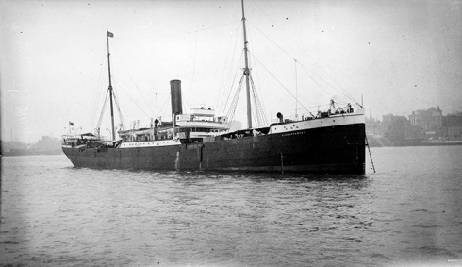
The Komagata Maru

Slide 8
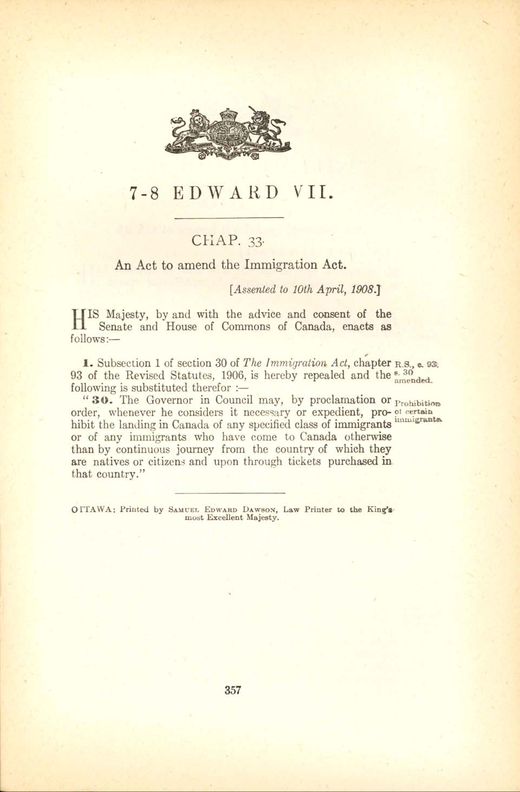
Background to the Komagata Maru
Many Canadians feared that immigrants from India would work for lower wages and take jobs away from them.
To deny Indians entry into Canada, the Canadian government introduced two regulations in 1908.
The Continuous Passage Act required all immigrants to come to Canada via “continuous journey,” directly from their country of origin. The other regulation required “Asiatic” immigrants to possess at least $200 to enter the country.

Slide 9
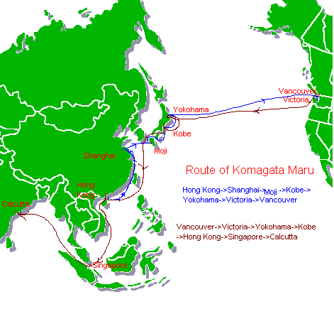
Details of the Komagata Maru
The Continuous Passage Act was challenged on May 23, 1914, when a crowded ship from Hong Kong carrying 376 passengers arrived at the harbour of Burrard Inlet in Vancouver, British Columbia.
The ship’s passengers were hoping to settle in Canada. Most of them were from the northern state of Punjab in India.
Their ship, the Komagata Maru, had not left from India, it had departed from Hong Kong. Also, most of its passengers did not possess the required $200. They were refused entry to Canada.

Slide 10
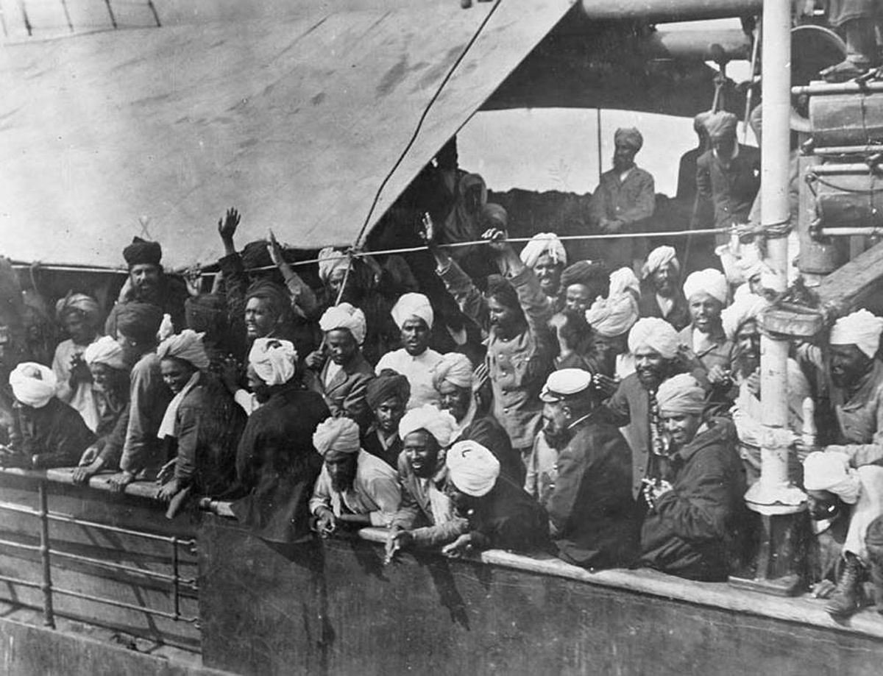
Details of the Komagata Maru
Only twenty returning residents, the ship's doctor and his family were allowed into Canada.
For two months the ship stayed anchored in the harbour and the remaining passengers were confined to the ship. A declining supply of food and water onboard worsened living conditions.
The Vancouver South Asian community formed a committee, raised money, and hired a lawyer to challenge the restrictive immigration laws. A case was put before the courts, but lost in its final appeal.

Slide 11
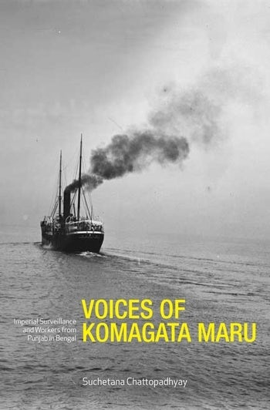
Significance of the Komagata Maru
On July 23, 1914, the ship was escorted out of the Vancouver harbour by the Canadian military and forced to sail back to India.
Back in India, many people regarded the ship’s passengers as dangerous revolutionaries.
British Indian Police suspected that the passengers were arriving to make trouble. On September 26, 1914, while leaving the ship, 20 passengers were killed in an encounter with police. More than 200 of the other passengers were rounded up by police and imprisoned.

Slide 12
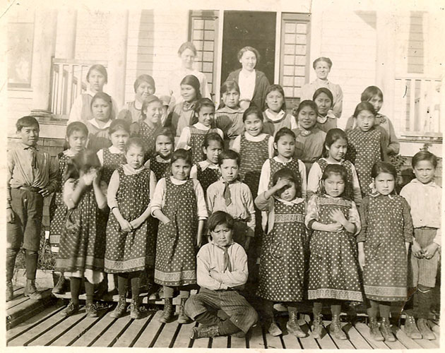
Residential Schools

Slide 13
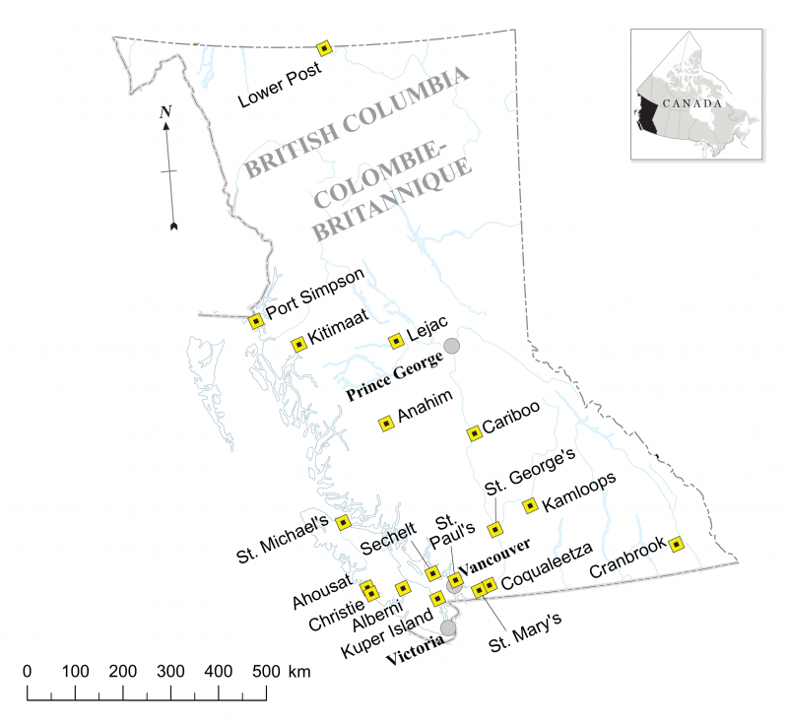
Background to Residential Schools
From 1831 to 1996 over 150,000 First Nations, Inuit and Metis children between the ages of 4 and 16 years old attended residential schools. The schools were run by churches.
There were 139 federally funded Indian residential schools in Canada, 18 of which were in B.C.
The Canadian government established residential schools in an attempt to force Aboriginal children to abandon their cultures and traditions and adopt common ways of life shared by mainstream Canadian society.

Slide 14
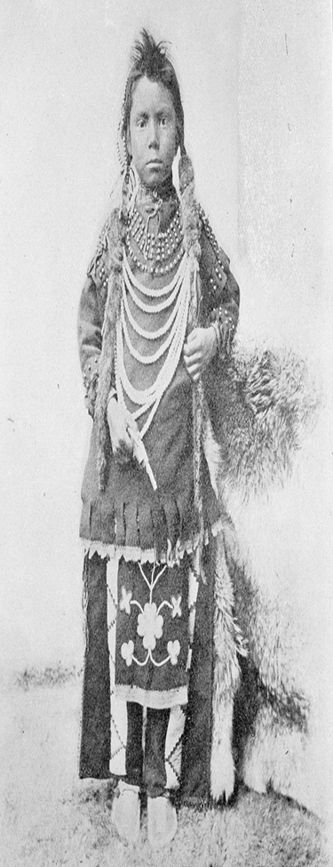
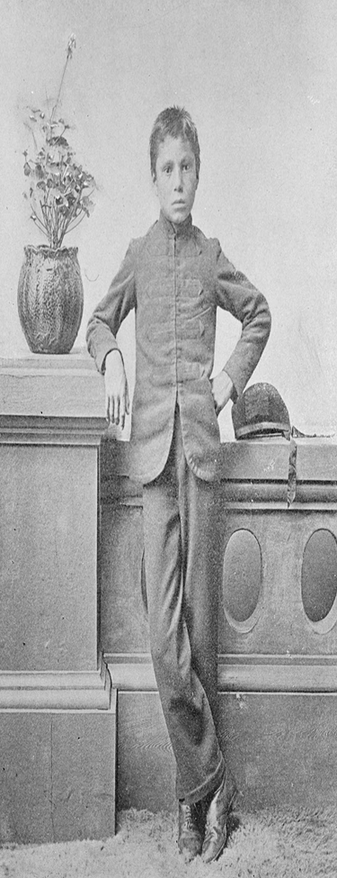
Details Of Residential Schools
Children were taken from their families and communities by Indian agents, police, or priests and transported to schools hundreds of kilometers away.
Attendance at residential schools was made mandatory by law. Parents who refused to send their children were threatened with fines or imprisonment.
Many teachers had not been professionally trained and were unqualified. Most lessons were limited to practical skills such as farming and carpentry for boys and homemaking for girls.

Slide 15
Details Of Residential Schools
The children were denied contact with their families for up to ten months at a time. They were also forbidden to speak their language or practice their culture such as songs and dances.
Braided hair, which often had spiritual significance, was cut.
Many students were physically, emotionally and sexually abused by school staff members.
Overcrowding and unsanitary conditions caused outbreaks of tuberculosis and other diseases.

Slide 16
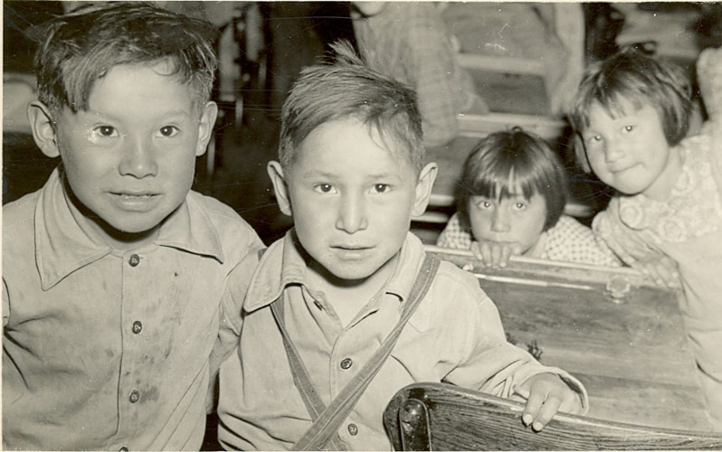
Significance Of Residential Schools
An estimated 6000 children died while in the residential school system as a result of the terrible living conditions, poor diet and inadequate medical care.
Taking children from their homes meant that transmission of language and culture was denied. As a result, many Aboriginal people no longer speak their native languages or know of their traditional cultural practices.
Due to the abuses the students endured, many survivors have traumatic memories and a deep distrust of formal education.

