Slide 1
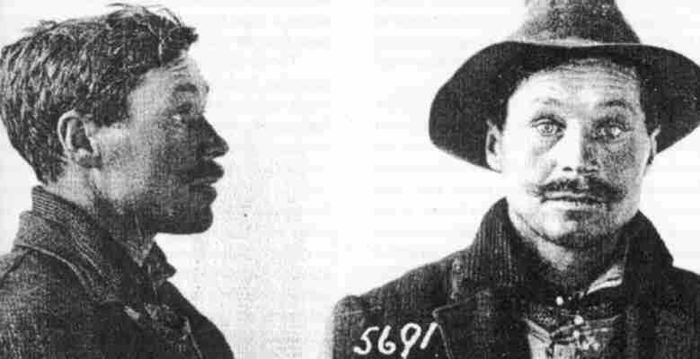
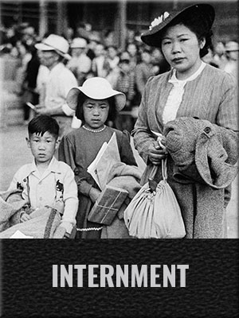
Internment in Canada During World War One and World War Two

Slide 2
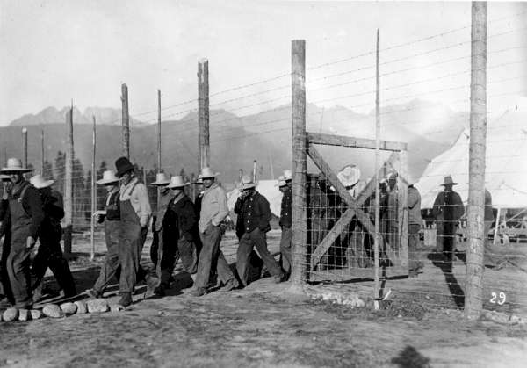
World War One Internment

Slide 3
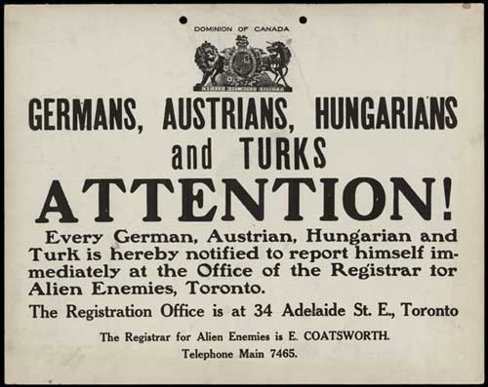
Background To Internment In Canada During World War One
In August 1914, at the beginning of World War One, the Canadian federal government passed the War Measures Act. This act, designed to protect Canada’s security, allowed the government to suspend civil liberties and make laws without the approval of parliament.
Immigrants who had come to Canada from enemy countries such as Germany and the Austro-Hungarian Empire were labelled as “enemy aliens”. They had their movements tracked, were forced to carry identity cards and report regularly to local police.
Many were suspected of being a threat to the government and were arrested and detained in internment camps without trial.

Slide 4
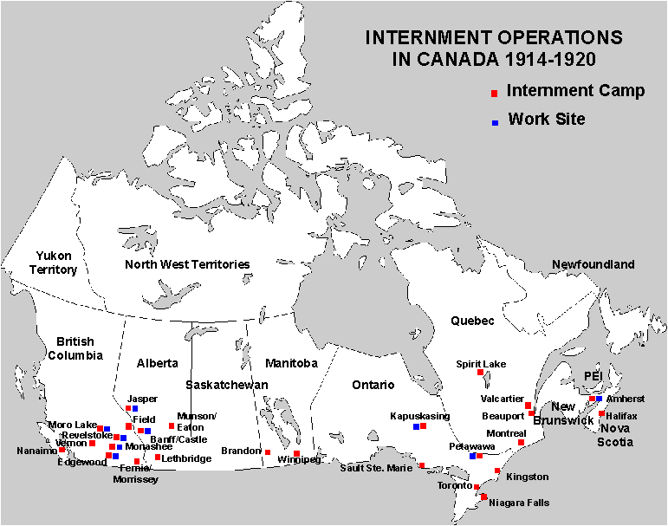
Details Of Internment In Canada During World War One
8,579 Germans, Ukrainians, Turks, Bulgarians and other Europeans were imprisoned in 24 internment camps and receiving stations across Canada from 1914 to 1920.
Women and children were not forced into internment camps. However, 81 women and 156 children voluntarily accompanied their male relatives into the camps. They didn’t have much choice because they were dependent upon their male family members.
Other internees included homeless people, conscientious objectors and members of outlawed cultural and political associations.

Slide 5
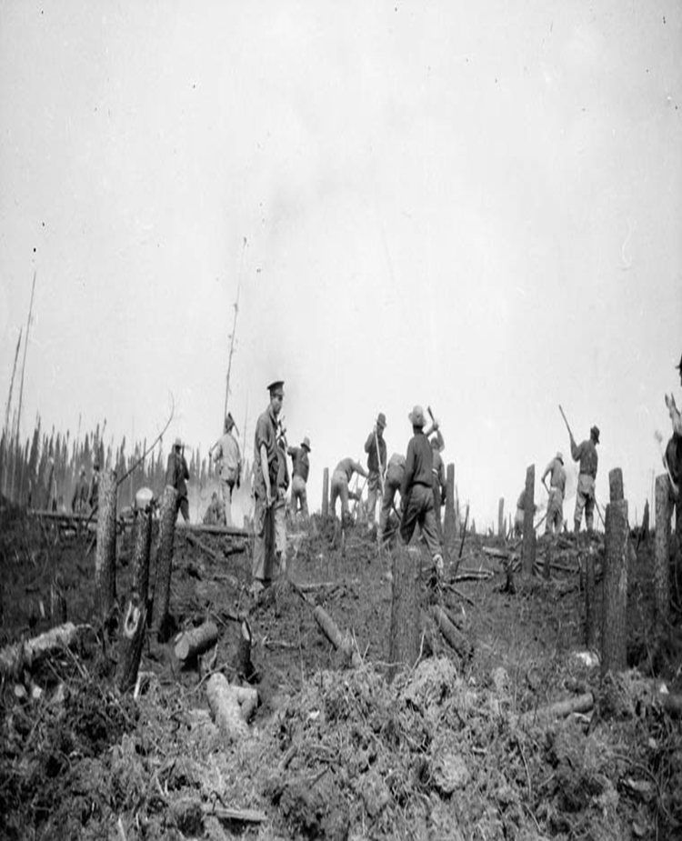
Details Of Internment In Canada During World War One
Internees were taken away from their families and communities when they were interned.
They had their property and money confiscated. Many of their belongings and monies were never returned to them.
They were often required to work on large labour projects such as developing Canada’s National Parks: Banff, Jasper, Mount Revelstoke, and Yoho. Other forced work included building roads, clearing bush, cutting trails and working on logging and mining operations. They were paid $0.25 a day, less than half the daily wage offered to other labourers.

Slide 6
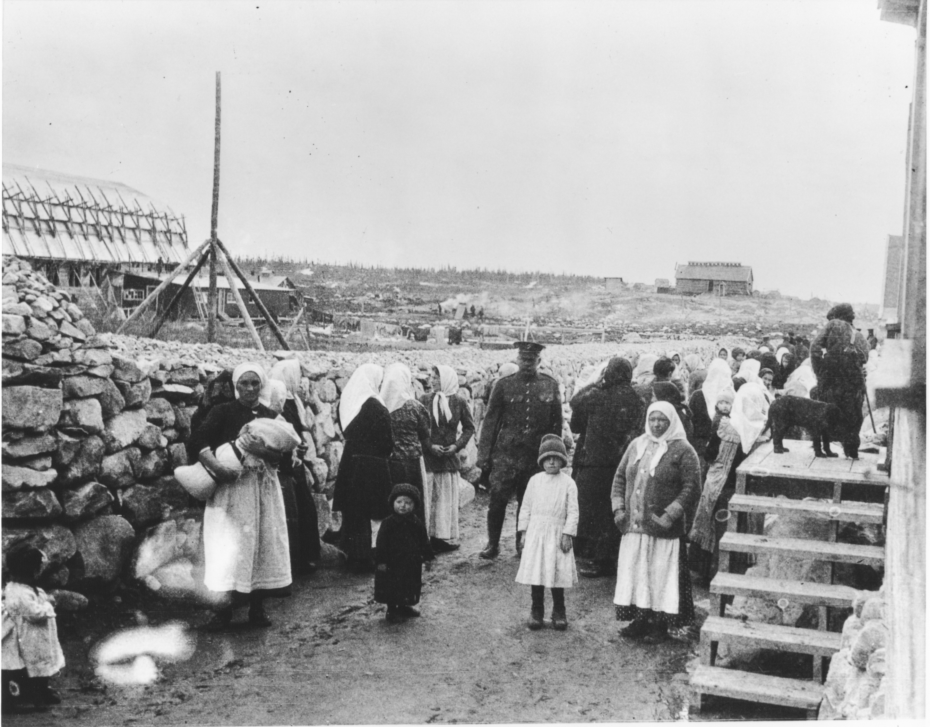
Significance Of Internment In Canada During World War One
No evidence of disloyalty on the part of the internees or the registered “enemy aliens” was ever produced. They had committed no crimes, but were punished because of where they had come from.
In fact, Ukrainians - the largest ethnic group of internees - showed great loyalty to Canada by joining the Canadian army in record numbers. In order to enlist, they often lied about where they were born or changed their first names to “Smith”.
107 internees died while in custody, six were shot dead while attempting to escape, others succumbed to infectious diseases, work-related injuries and suicide.

Slide 7
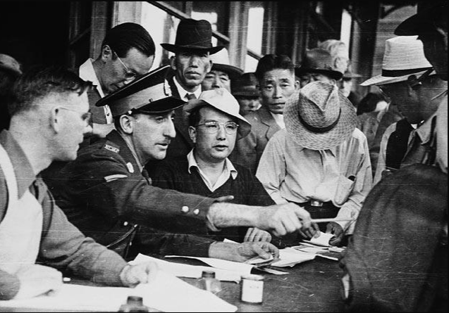
World War Two Internment

Slide 8
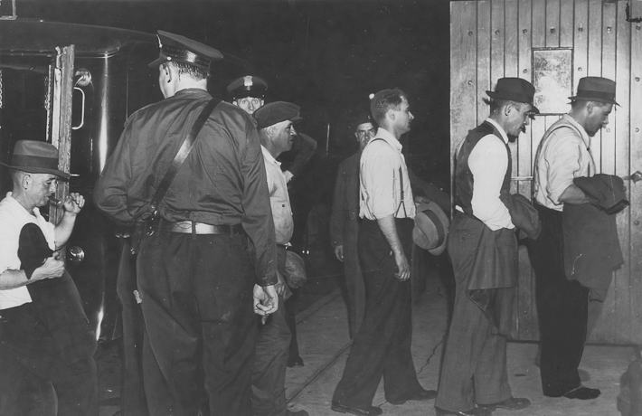
Background To Internment In Canada During World War Two
The War Measures Act was invoked again during World War Two on August 25, 1939. Immigrants who had come to Canada from enemy countries were labelled as “enemy aliens”. They had their movements tracked, were forced to carry identity documents and report regularly to local police.
16,000 German Canadians were registered as enemy aliens and 800 were interned. They were accused of being Nazi spies.
Once Italy entered the war on Germany's side in June 1940, 31,000 Italian Canadians were registered as enemy aliens and 600 were interned. Hundreds were suspected of being fascist sympathizers and saboteurs.

Slide 9
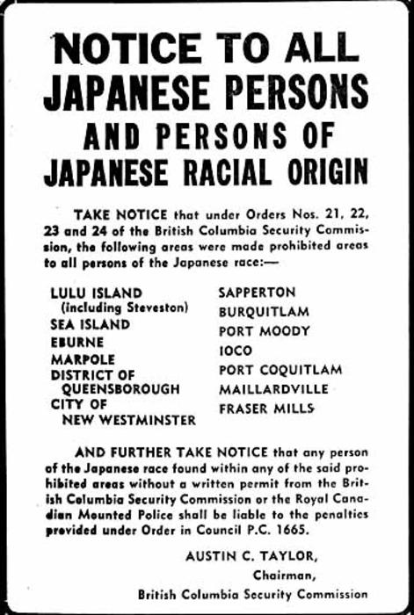
Details Of Internment In Canada During World War Two
After the bombing of Pearl Harbor in 1941, people of Japanese ancestry in Canada with or without Canadian citizenship became enemy aliens.
The Canadian Pacific Railway fired all its Japanese workers, and most other Canadian industries followed suit. 1,200 fishing boats belonging to Japanese fishermen were seized by the Canadian navy. Japanese newspapers and schools were shut down and a curfew imposed.
In early 1942, the Canadian government ordered the removal of Japanese Canadians within a 100 mile radius of the BC coast. 22,000 Japanese Canadians were forced to leave their homes. 75% of them were Canadian citizens.

Slide 10
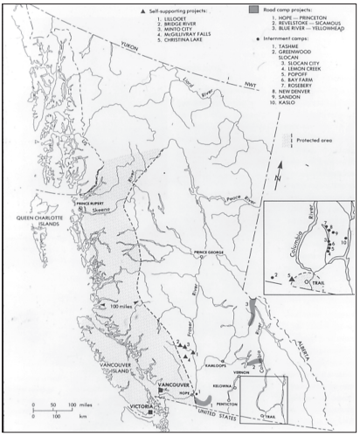
Details Of Internment In Canada During World War Two
Japanese Canadian men were transported to B.C. and Ontario construction projects, their wives and children to abandoned mining camps and villages in the interior of B.C. Any families wanting to remain together were sent across the Rockies to vast, isolated sugar beet farms in Alberta and Manitoba.
To pay for the internment, the Canadian government confiscated and sold all Japanese Canadians’ possessions including homes, businesses, boats and belongings.
Every person of Japanese ancestry in Canada (16 years or older) was forced to choose between deportation to war-ravaged Japan or living somewhere east of the Rockies.

Slide 11
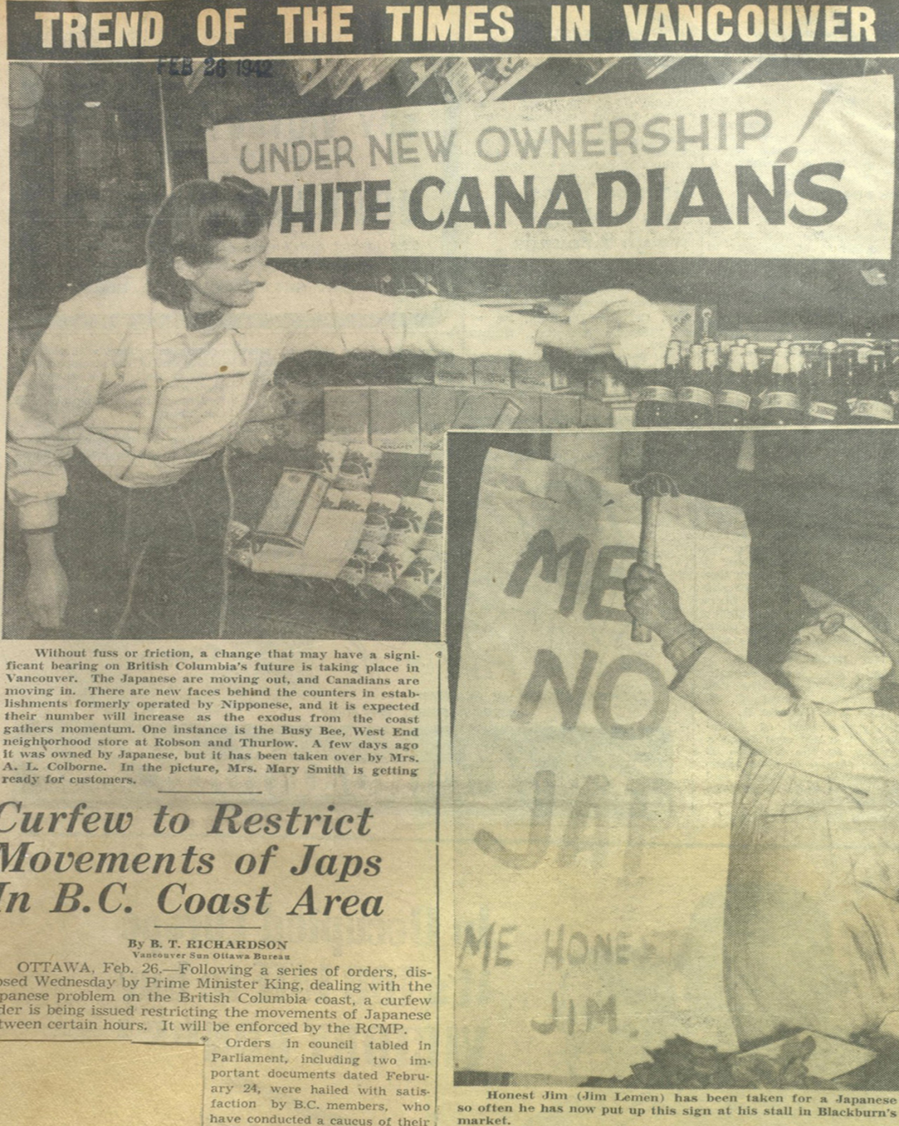
Significance Of Internment In Canada During World War Two
Not a single Canadian of Japanese, Italian, or German ancestry was ever charged with disloyalty to Canada.
Along with mass arrests and internment, many others faced enemy alien designations, loss of work, vandalism and violence. In many cases, families had to cope with husbands and wives, parents and children separations.
The sale without owner’s consent of all the properties seized from Japanese Canadians resulted in economic ruin for the families.
4,000 Japanese Canadians were deported to Japan. They faced starvation conditions and many of the sick and elderly died.

