Slide 1
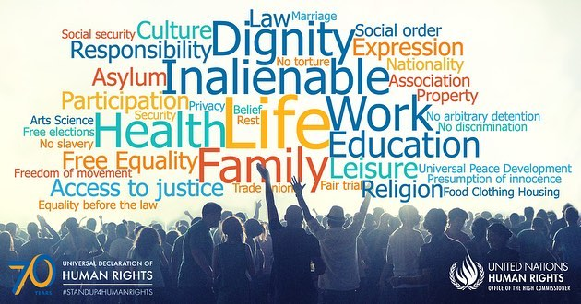
Protecting Human Rights

Slide 2
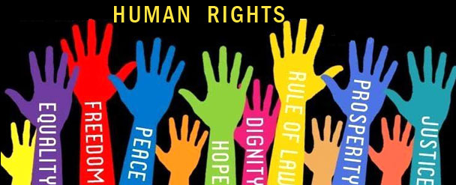
What Are Human Rights?
The term human rights is used so frequently, and in so many different situations, that a simple definition is hard to find. Many believe that human
rights are rights that are considered basic to life in any human society. They include the rights to adequate food and shelter and protection from abuses such as torture.
But we often use the term human rights to describe other rights—such as freedom of speech, thought, expression, and religion, or political and legal protections. While basic human rights are considered “universal” (meaning that they should apply to everyone around the world), they are not necessarily legally sanctioned (protected by law) in all countries.

Slide 3
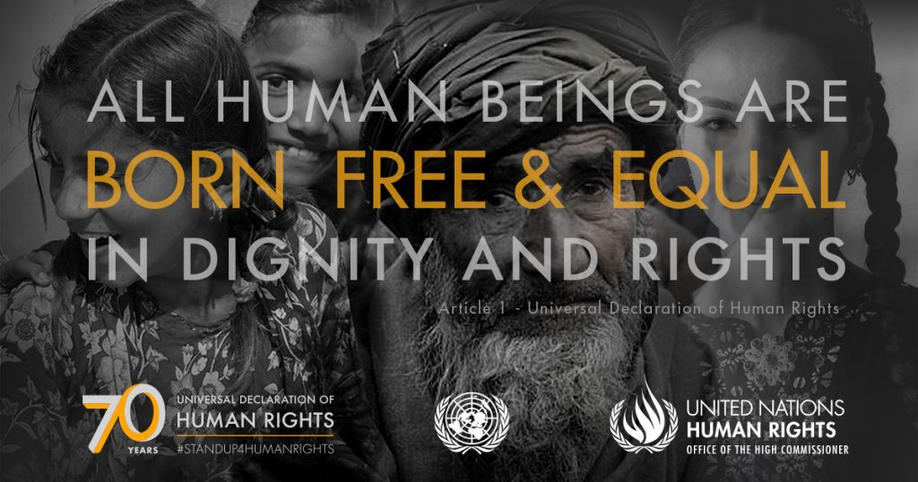
Universal Declaration of Human Rights
The Universal Declaration of Human Rights was proclaimed at the United
Nations General Assembly in 1948. The Declaration is based on the belief
that “all human beings are born free and equal in dignity and rights.” It condemns the “barbarous acts which have outraged the conscience of
mankind,” a reference to the horrors of the Holocaust during the Second World War.
This document is significant because it was the first international statement recognizing that all human beings have specific rights and freedoms. The Declaration was adopted unanimously by UN member states. The Canadian federal and provincial governments have signed and ratified the Declaration, and it is now binding on Canada in international law.

Slide 4
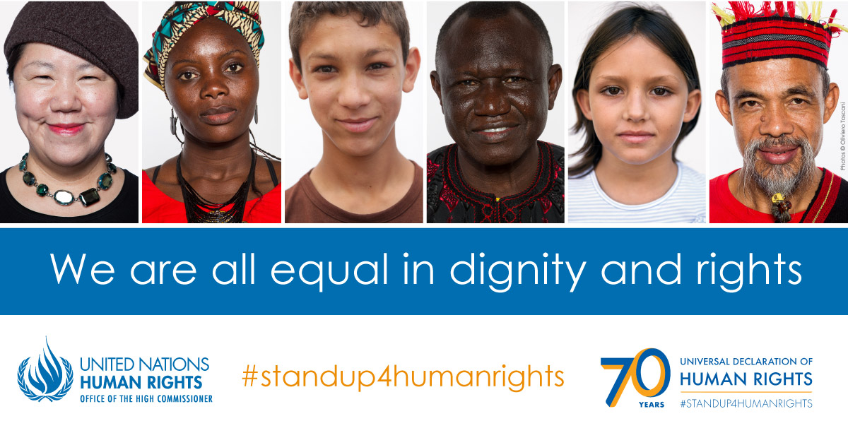
Universal Declaration of Human Rights
The United Nations has succeeded in getting most countries to agree with the general principles of the Universal Declaration of Human Rights. Non-governmental organizations (NGOs) have also played a role in promoting acceptance of the UN Declaration in developing countries.
Yet, the only power the United Nations has to enforce the provisions
of the Declaration is to draw world attention to abuses, putting pressure
on offending countries. The Declaration is not part of binding international law.

Slide 5
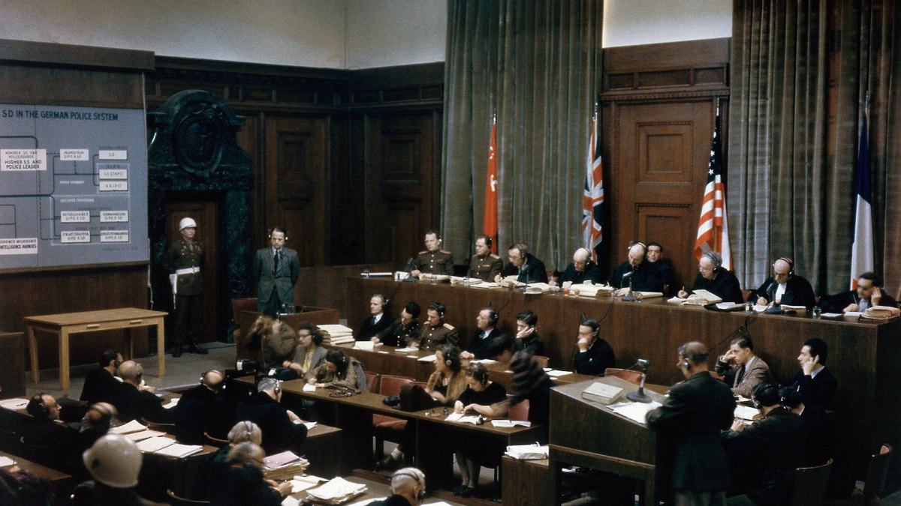
International Courts and Tribunals
In 1946, the United Nations established the International Court of Justice (ICJ) at The Hague, Netherlands, to settle disputes between countries based on international law.
But this court becomes involved only if both sides agree to ask for its help.
The UN also establishes temporary courts, or tribunals, to deal with specific
events. Examples of tribunals include the Nuremberg and Tokyo trials,
which dealt with atrocities committed during the Second World War in
Europe and the Pacific. In the 1990s, temporary tribunals were set up to investigate war crimes in Kosovo, part of the former Yugoslavia, and the genocide in Rwanda.

Slide 6
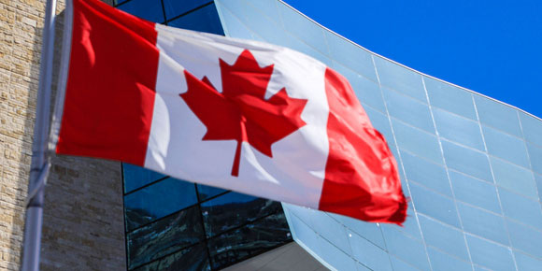
Human Rights Legislation in Canada
In Canada, we are governed by a fixed set of laws that apply to all people
equally, regardless of their position in society. This principle known as the rule of law ensures that no one is above the law. It helps to protect our rights and prevent those in authority from abusing their power. It also means that police can only charge an individual for a specific offence, and then only by following proper legal procedures.

Slide 7
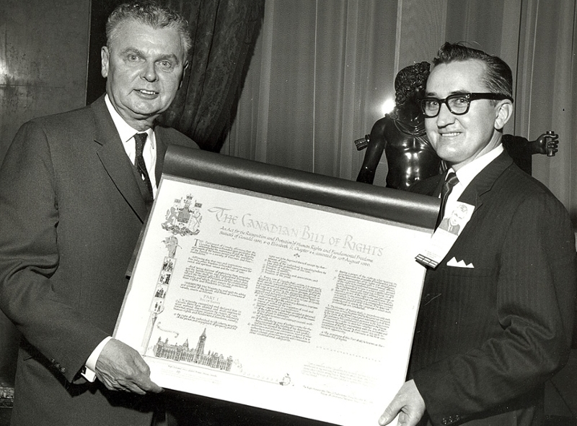
The Canadian Bill of Rights
Since signing the Universal Declaration of Human Rights in 1948, the
Canadian government has taken steps to protect human rights in Canada.
In 1960, Prime Minister John Diefenbaker’s government passed the Canadian Bill of Rights. This bill formally outlined and recognized rights already held by Canadians under common law. However, as an act of Parliament, the Bill of Rights could be amended or changed like any other piece of legislation, and it did not override other federal or provincial laws. Human rights in Canada were not solidly entrenched in our legal system until 1982, when the Canadian Charter of Rights and Freedoms became part of the new Canadian Constitution.

Slide 8
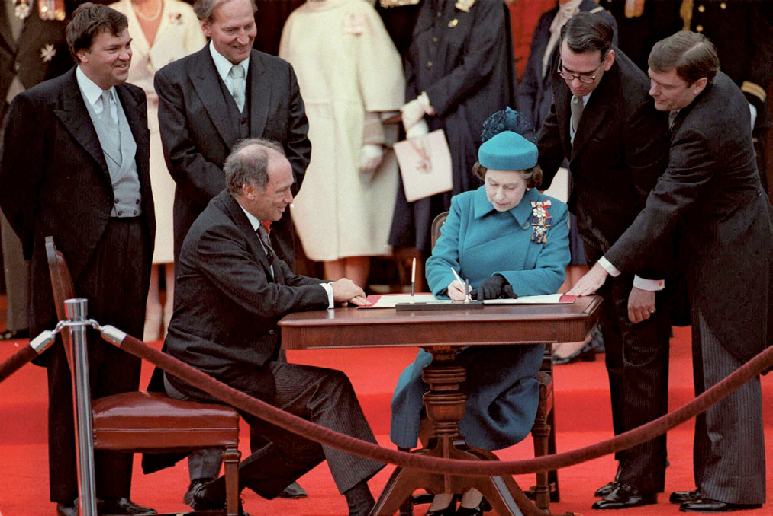
Canadian Charter of Rights & Freedoms
Few laws have had as profound an effect on the life of Canadians as the
Canadian Charter of Rights and Freedoms. Prime Minister Pierre Trudeau led the campaign to amend the Canadian Constitution in 1982 to include the Charter.
The Charter protects the fundamental freedoms of Canadians and guarantees their democratic, mobility, equality, legal, and language rights. The Charter gives Canadians the right to challenge in court any law they believe violates their Charter rights. The courts do not always agree with the challenges made, but Canadians generally believe that the Charter offers them a chance to stand up for their rights, even against powerful government interests.

Slide 9
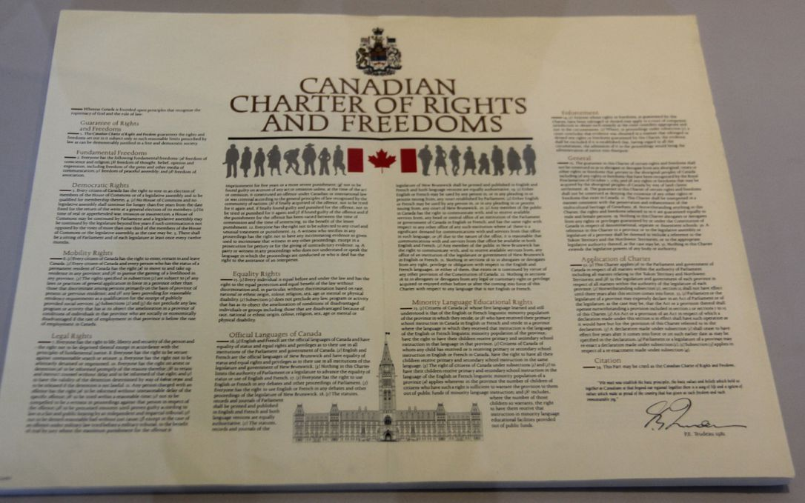
Canadian Charter of Rights & Freedoms
Section 1 of the Charter contains this limiting clause: “the Canadian Charter
of Rights and Freedoms guarantees the rights and freedoms set out in it subject only to such reasonable limits prescribed by law as can be demonstrably justified in a free and democratic society.” This means that the government can limit a person’s rights or freedoms, but it must show that the limit is necessary.
The notwithstanding clause (section 33 of the Charter) allows the federal and provincial or territorial governments to pass a law even if it violates a freedom or right in the Charter. This clause was a compromise. Some provincial politicians felt the Charter, which would be interpreted by justices, would weaken their power as elected lawmakers.

Slide 10
Fundamental Freedoms
Under section 2 of the Charter, Canadians are free to follow the religion of their choice. In addition, they are guaranteed freedom of thought, belief and expression. Since the media are an important means for communicating thoughts and ideas, the Charter protects the right of the press and other media to speak out. Our right to gather and act in peaceful groups is also protected, as is our right to belong to an association like a trade union.
These freedoms are set out in the Charter to ensure that Canadians are free to create and express their ideas, gather to discuss them and communicate them widely to other people. These activities are basic forms of individual liberty. They are also important to the success of a democratic society like Canada.

Slide 11
Mobility Rights
Section 6 of the Charter gives citizens the right to remain in and leave
Canada, and to move and live within the country.
Extradition laws place some limits on these rights; these laws state that persons in Canada who face criminal charges or punishment in another country may be ordered to return to that country. However, the Supreme Court has ruled that people may not be extradited for crimes that might result in the death penalty. Subjecting a Canadian citizen to a possible death penalty in another country would contradict section 7 of the Charter, which entitles each Canadian the right to life, liberty, and security.

Slide 12
Equality Rights
Section 15 of the Charter guarantees equality “before and under the law.”
“Before the law” means everyone must have access to the courts, which is
why we have legal aid programs to make sure that those who cannot afford a lawyer are represented fairly. “Under the law” means that laws passed by the government must treat everyone equally.
Every individual in Canada – regardless of race, religion, national or ethnic origin, colour, sex, age or physical or mental disability – is to be treated with the same respect, dignity and consideration. This means that governments must not discriminate on any of these grounds in its laws or programs.

Slide 13
Legal Rights
Canadians have their legal rights guaranteed by sections 7 to 14 of the
Charter. They ensure that individuals dealing with the justice system are treated fairly, especially those charged with a criminal offence.
Police officers cannot take individuals into custody or hold them without a good reason. Anyone accused of breaking the law is considered to be innocent until proven guilty. Prisoners have the right to know the reason for their arrest and to have a judge decide whether they are being held legally. They also have the right to contact a lawyer to get legal advice about their situation, and the right to a speedy trial.

Slide 14
Democratic Rights
Canadians have their democratic rights guaranteed by sections 3 to 5 of the
Charter. These rights guarantee to all Canadian citizens the right to be involved in the election of their governments. It gives them the right to vote in federal, provincial or territorial elections, along with the right to run as a candidate in elections.
Some limits on these rights may be reasonable, even in a democracy. For example, the right to vote or run as a candidate in an election is limited to Canadians 18 years of age or older.

Slide 15
Official Language Rights
Canadians have their official language rights guaranteed by sections 16 to 22 of the Charter. These rights include being able to communicate with and receive federal government services in English or French and being able to communicate in any federal court in English or French.

Slide 16
Minority Language Education Rights
Section 23 of the Charter gives citizens the right to have their children educated in either English or French where sufficient numbers of students exist.

Slide 17
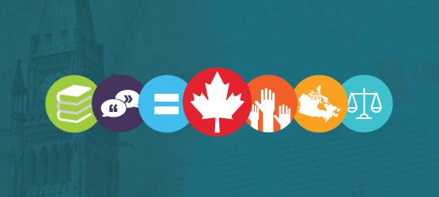
Federal & Provincial Human Rights Law
The federal and provincial governments have passed laws to deal with particular cases of discrimination. These laws are administered by
human rights commissions that investigate complaints and find solutions.
The Canadian Human Rights Act covers all federally regulated agencies and
businesses including banks, the major airlines, Canada Post, and the national media. The Canadian Human Rights Commission administers this Act. In British Columbia, most human rights complaints fall under the British Columbia Human Rights Code. It covers employment, tenancy and property purchases, accommodation, services, facilities available to the public and hate propaganda. The B.C. Human Rights Tribunal deals with complaints.

Slide 18
The Supreme Court and the Charter
The Supreme Court of Canada has been the highest court for all legal issues
in Canada since 1949. It decides on constitutional issues and acts as the final court of appeal for some criminal cases.
The Court’s decisions set precedents (legal decisions that serve as a
rules for future cases) that define our rights and, in some cases, change our legal system. No one can alter the decisions of the Supreme Court, unless Parliament passes a constitutional amendment. The amending formula established in 1982 specifies that at least seven provinces, totalling at least 50 percent of the population of all provinces, must approve such an amendment.

Slide 19
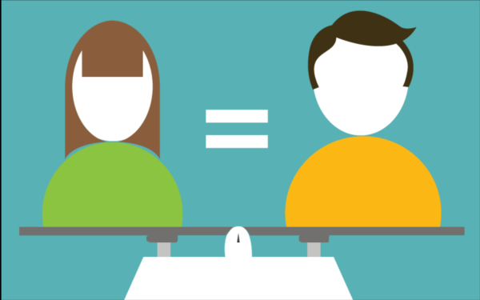
The Charter and Gender Equity
While most Canadians believe in the idea of equality and fairness, opinions differ as to how these goals are realized in the workplace. Women continue to be underrepresented in many traditionally male disciplines, and they are often paid less than men when they perform the same type or an equal amount of work.
Women in the workplace face the challenge of breaking out of traditional
“job ghettoes,” occupations that usually pay poorly and are dominated by
female workers. For example, secretarial and nursing positions were once
overwhelmingly held by female workers, and as a result the average wages
were lower than for equivalent positions held by males.

Slide 20
Children’s Rights
Children are entitled to all the rights guaranteed by the Universal Declaration of Human Rights and the various treaties that have developed from it. Children are also guaranteed additional rights because they need special protection and care.
The British Columbia government established the Ministry of Children and Family Development to help communities and families “care for and protect vulnerable children and youth,” as well as “support healthy child and family development to maximize the potential of every child in B.C.” Social workers have the power—and the obligation—to remove children from unsafe environments.

Slide 21
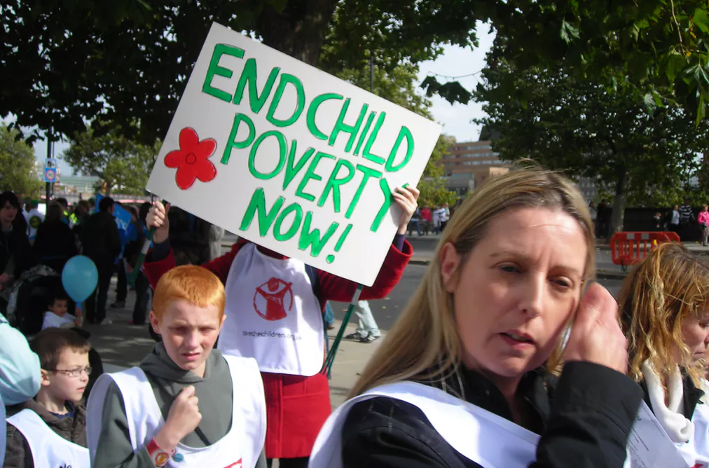
Child Poverty
Child poverty is perhaps the single biggest children’s rights issue in Canada. About 1 in 10 children in Canada were living in poverty in 2007. In First Nations communities, 1 in 4 children were living in poverty.
There is significant disagreement about how to eliminate child poverty in Canada. Some activists feel that parents with low income should pay lower taxes. This would give them more income and allow them and their families a better standard of living. Others emphasize the need for governments to invest in programs and services for poor children and their families, such as good-quality and affordable child care, housing supplements, and allowances (such as the Child Tax Benefit Program) paid directly to low- and middle-income families.

