Slide 1
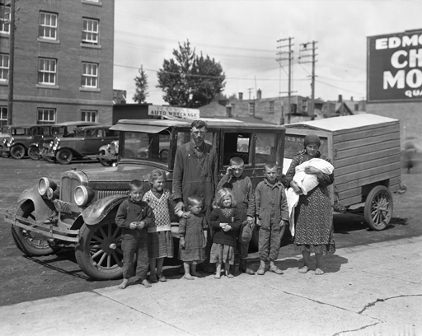
The 1930s: A Decade of Despair

Slide 2
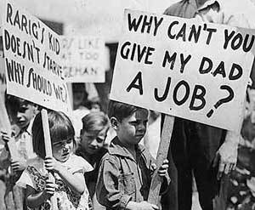
Causes of The Great Depression
Overproduction of goods by companies. Workers were laid off, had less money, bought less goods.
Canada’s dependency on a few primary resource exports. Primary resource producers from other countries generated competition, reducing market demand and price.
High Tariffs – Protectionism. High taxes caused a decrease in exports.
Canada’s dependence on the U.S. for most of its trade and exports.
International debt.
Stock market crash.

Slide 3
Drought on the Prairies
The price of wheat (an important crop) per bushel fell from $1.51 in 1925 to $0.54 in 1932.
There was severe drought on the Prairies from 1929-1935. Land was too dry to grow many crops and families struggled to survive.
Millions of hectares of fertile topsoil – dried up the drought and overfarming – blew away.
Grasshoppers became a problem, as millions ate crops that did grow!
Thousands of farming families were forced to abandon their land.

Slide 4
Unemployment And Collecting Pogey
Factories and businesses closed and people became unemployed. Without a source of income, many people were unable to pay the rent for their homes and were evicted.
Collecting government relief payments (“pogey”) was a humiliating experience. People had to publicly declare their financial failure and swear they had no home and nothing of value.
Private charities opened soup kitchens to feed the poor and homeless.
Young jobless, homeless men “rode the rails” hopping freight trains in search of employment.

Slide 5
The Disadvantaged
Immigrants were viewed with hostility since they competed for the few jobs available. By 1935, more than 28,000 immigrants were deported from Canada.
Most of Vancouver’s Chinese population did not qualify for relief payments.
Jewish people faced anti-Semitism. They were forbidden from applying for many jobs and joining various clubs and organizations.
Aboriginal families on relief were given only $5.00 a month, compared to the $19.00 - $60.00 received by non-Aboriginals.

Slide 6
Prime Minister King’s Response
King believed that the Depression was only temporary and that, in time, the economy would get better without government help.
Provincial governments asked the federal government for financial assistance to help unemployed Canadian. King said he would not even give a Conservative provincial government “a five cent piece.”
Many people thought King did not care about them. In the election of 1930, Canadian voters chose to replace King’s Liberal government with Richard Bedford Bennett’s Conservative government.

Slide 7
Prime Minister Bennett’s Response
Introduced the Unemployment Relief Act, which gave the provinces $20 million for work creation programs. In spite of this spending, the economy did not improve.
Raised tariffs (taxes) on foreign imports in an attempt to protect Canadian industry. In the long run, it did more harm than good, as other nations, in turn, set up trade barriers against Canada.
Introduced the Prairie Farm Rehabilitation Act in 1935 to help farmers build irrigation systems and reservoirs. Unfortunately, drought and poverty had already forced many farmers to abandon their farms.

Slide 8
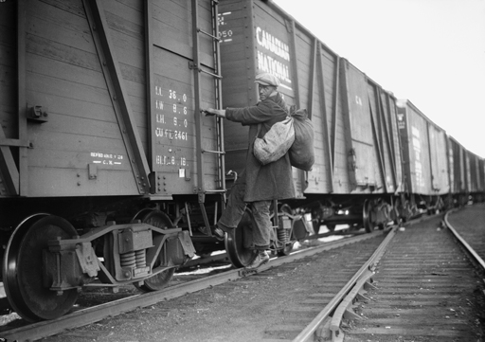
Work Camps And The On-to-Ottawa Trek
To provide relief to the single, unemployed men, Bennett created relief camps. Men worked on building roads, clearing land, and digging drainage ditches.
Workers were paid 20 cents per day and given room and board. The food was terrible, and the bunks were often bug-infested.
In 1935, over a thousand men who were angry about the camp conditions and low rate of pay, boarded trains to go to Ottawa to protest against the federal government. This protest was known as the On-to-Ottawa Trek.
Trekkers were met in Regina by the RCMP. Riots broke out. Many were injured and one officer died.

Slide 9
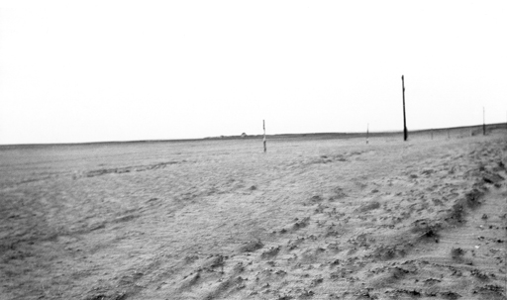
Bennett’s New Deal
Fairer, progressive taxation so that people who earned more money paid more tax.
Insurance to protect workers against illnesses, injury, and unemployment.
Legislation for workplace reforms that regulated work hours, minimum wages, and working conditions.
Revised old-age pensions to help support workers over 65 years of age.
Agricultural support programs to help farmers and the creation of the Canadian Wheat Board to regulate wheat prices.

Slide 10
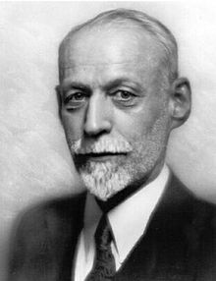
Co-operative Commonwealth Federation
The CCF was founded in the Prairie provinces in 1932 by J.S. Woodsworth.
The CCF wanted to end capitalism. They supported a socialist system in which the government controlled the economy so that all Canadians would benefit equally.
Their party platform opposed free-market economics and supported public ownership of key industries. It advocated social programs to help the elderly, the unemployed, the homeless, and the sick.
The CCF became today’s New Democratic Party (NDP).

Slide 11
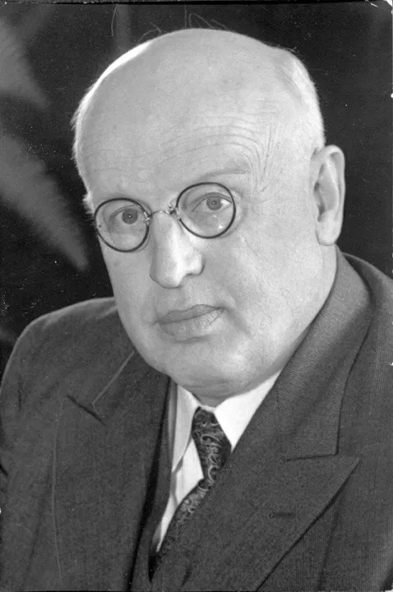
Social Credit Party
The Social Credit Party was founded in Western Canada in 1935 by “Bible Bill” Aberhart.
The Social Credit Party wanted to end capitalism. They supported a system in which the government released money into the economy so that people could spend it.
The Social Credit Party believed that people should decide how to spend money, not the government.
Aberhart promised each citizen $25 a month to buy needed goods. The federal government challenged the right of a province to issue its own currency, and social credit was disallowed by the Supreme Court.

Slide 12
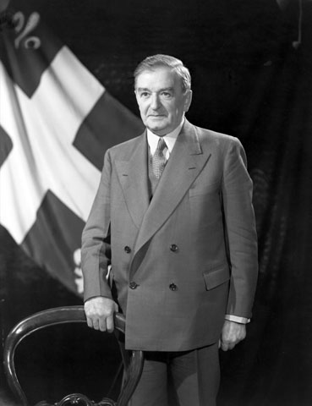
Union nationale
The Union Nationale was founded in Quebec by Maurice Duplessis.
The Union Nationale supported Quebec nationalism – a movement advocating for the protection and development of Quebecois culture and language.
The Union nationale’s political platform was based on improved working conditions, social insurance programs, publicly owned power companies, and a system of farm credits.

Slide 13
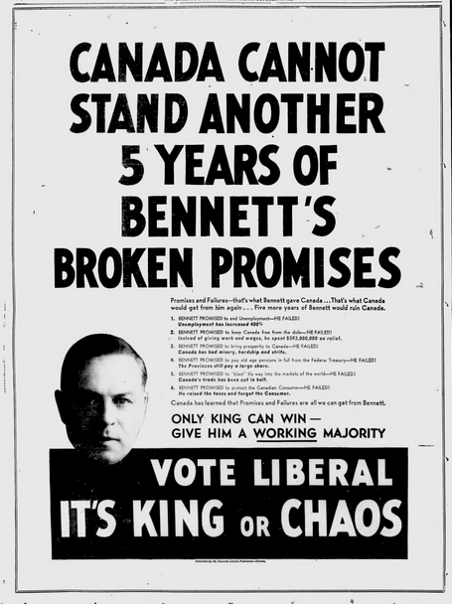
A Change in Federal Government
During the 1935 election campaign voters were frustrated by Bennett’s inability to solve the Depression crisis. The voters chose Mackenzie King to return as Canadian Prime Minister.
King did not support government intervention in the economy. He believed that in time, the economy would improve on its own.
King also felt that spending money on social programs during a depression did not make economic sense, and that it was better to wait until the economy was strong before introducing these expensive programs.

