Slide 1
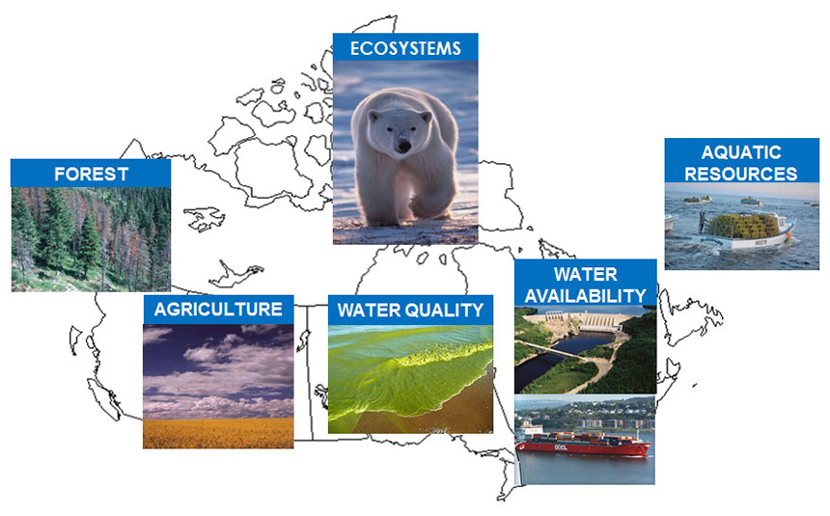
The Environment: Our Challenges and Responsibilities

Slide 2
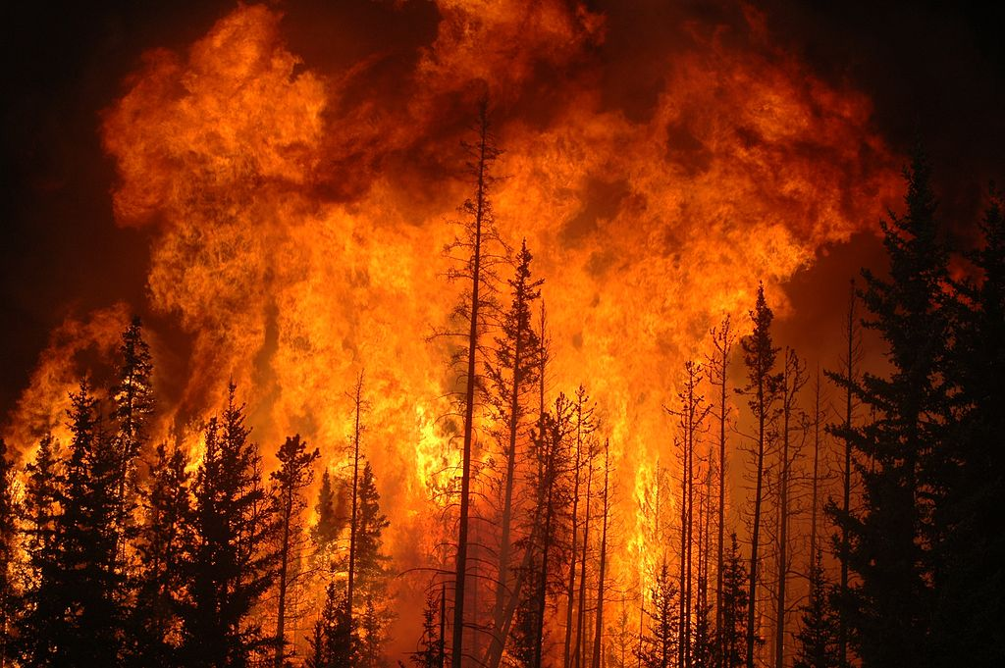
Why Care About the Environment?
People are changing Earth and the effects are seen all over the planet. The
world’s boreal forests are threatened with increased fire risk, water needs are outstripping supply, flooding and storms are more severe, and tropical diseases are affecting people farther north.
Rising temperatures are a problem. Extreme weather conditions, such as the ice storm that hit eastern Ontario and Québec in January 1998, are happening more frequently. Warmer weather brings more droughts that make forest fires more likely. In Canada’s Arctic regions, sea ice is shrinking and the seasonal melt is happening weeks earlier. Polar bears are in danger of extinction as they starve because they cannot use the ice to hunt seals.

Slide 3
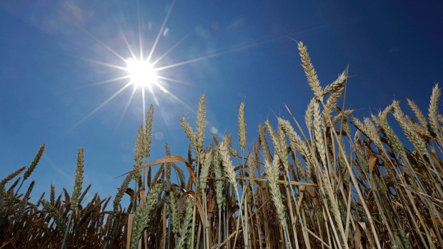
Population Growth & Sustainability
Each year, nearly 80 million people are added to the world’s population,
putting more pressure on Earth’s natural systems.
Massive amounts of land and water are required to feed all these people. For example, 70 percent of the world’s water is used for agriculture. It can take up to 1500 litres of water to produce 1 kilogram of wheat and 500 litres for
1 kilogram of potatoes. As standards of living improve, people are eating more meat and dairy products, which puts the greatest strain on resources. For example, it takes about 1000 litres of water to produce 1 litre of milk, and nearly 16 000 litres to produce 1 kilogram of beef. Added to this are the costs of deforestation to create grazing land and energy use to ship food.

Slide 4
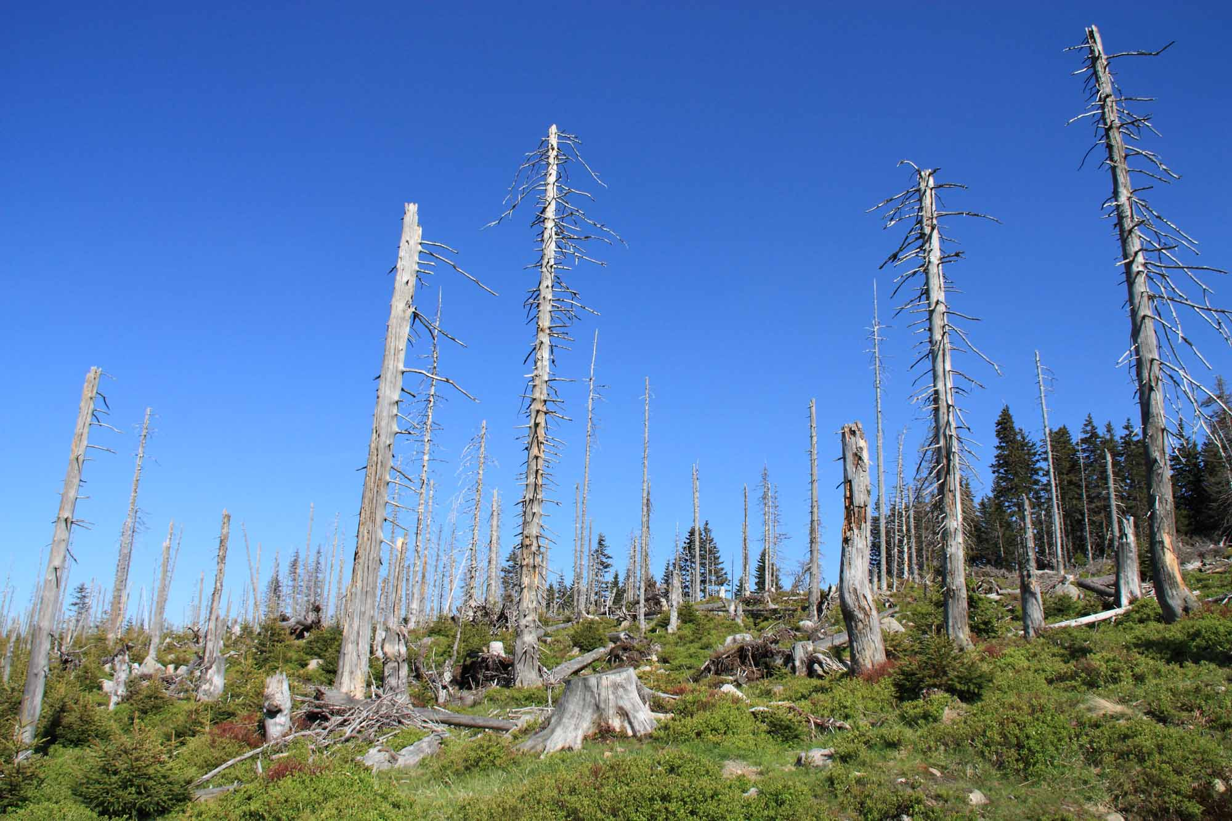
Making Room for People
Forests perform a vital role because they take in carbon dioxide and give off oxygen. Every day, about 350 square kilometres of forest are lost worldwide.
These forests are being turned into agricultural or grazing land, harvested for timber, or cleared to make room for human settlements. Floods are more common when forests are no longer there to absorb and slowly release rainfall. Deforestation also deprives wildlife of habitat. Many forests and natural areas are also suffering from the effects of industrial pollution, such as acid precipitation. When the environment can no longer neutralize the acidic content of the soil and water, plants and animals die, and entire ecosystems are ruined.

Slide 5
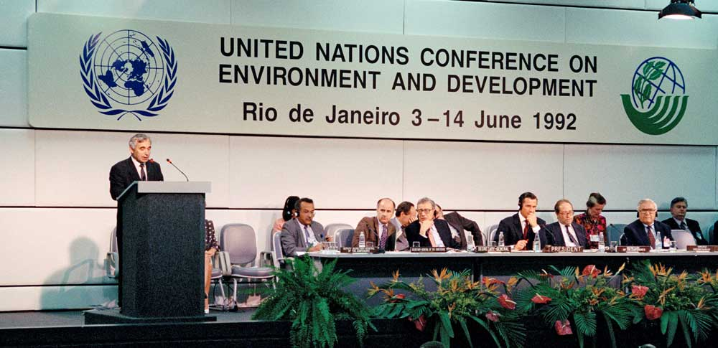
Sustainable Development
In 1987, the UN World Commission on Environment and Development published its report, Our Common Future, asking people in the developed world to reduce resource consumption and develop a sustainable lifestyle.
In 1992, 172 nations participated in the UN’s Earth Summit in Rio de Janeiro, Brazil. International leaders looked at various environmental issues that affect people around the world, including toxic chemicals used in production (for example, lead in gasoline and radioactive waste), alternative energy sources to replace fossil fuels, and the scarcity of water. The conference produced a statement to achieve sustainable development called Agenda 21. However, despite creating this statement, little progress has been made.

Slide 6
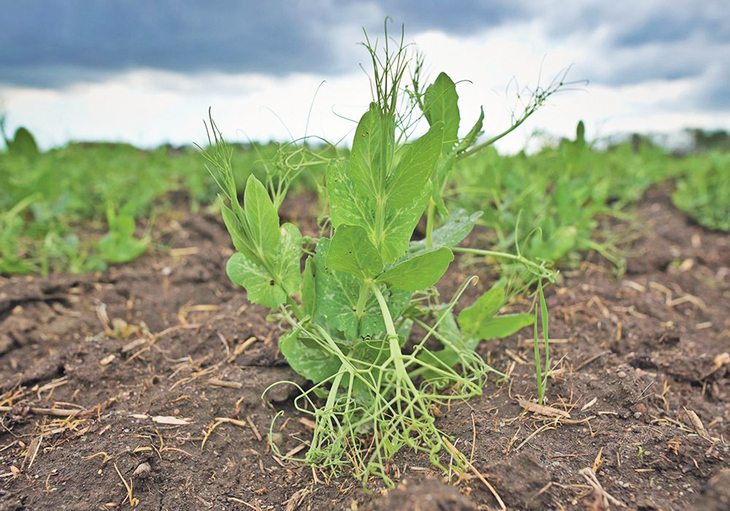
Farming for the Future
Multinational corporations have tried to control markets for their seeds, fertilizers, and pesticides by aggressively promoting the genetically modified (GM) seeds they develop. These companies argue that new biotechnologies are necessary to feed the growing world population. Critics point to the environmental effects of using GM seeds. GM crops depend on herbicides and pesticides, rather than natural defences, and these chemicals can be dangerous as they seep into groundwater and streams.
Increased awareness of the impact food production has on the environment and their health has prompted many people to adopt a more sustainable diet. They buy organic crops grown without chemical fertilizers or pesticides.

Slide 7
Can We Preserve Our Forests?
Several measures have been introduced to preserve and manage the
world’s forests. Some programs focus on reforestation, replanting trees where they have been cut down for timber or paper. Other programs grow trees specifically for these purposes, thus preserving existing forests. Another approach is to show that there is economic value in preserving forests instead of cutting them down.
Ecotourism programs allow people to explore threatened natural environments, while the tours raise money for conservation efforts. Individuals can also help to preserve forests by conserving and recycling paper. One fifth of wood harvested worldwide ends up in paper.

Slide 8
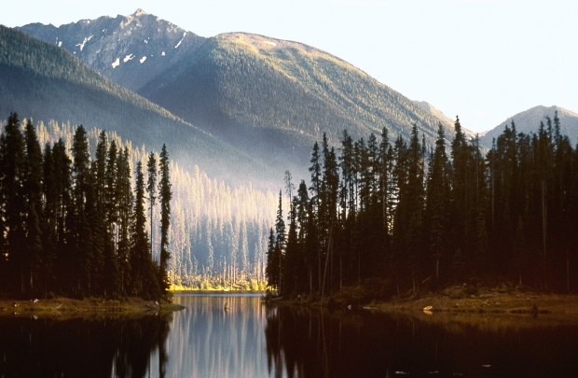
Protecting British Columbia’s Forests
In 1993, the government of British Columbia launched the Protected Areas
Strategy to preserve about 12 percent of provincial land for parks,
recreation, and wilderness.
However, the Protected Areas Strategy only included a portion of B.C.’s coastal old-growth watersheds. Once considered only as a source of revenue, they are now seen as a resource for recreation, research, industry,
and—in the case of First Nations peoples—culture. These diverse needs
must be balanced with careful management and stewardship to ensure the
sustainability of British Columbia’s economic and heritage resources.

Slide 9
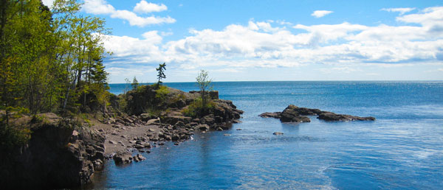
Water: The Indispensable Resource
People cannot survive without water. Every person needs at least 1.8 litres of
fresh water each day for good health. Only 2.5 percent of the world’s water is fresh water. About 70 percent of that is in the form of ice caps and glaciers, and most of the remaining amount is groundwater. Only 0.3 percent of the world’s fresh water is in lakes and rivers.
Much of the demand for freshwater comes from growing populations in the developing world, where water is already scarce. Diets are changing to include more foods, such as meat, that require larger amounts of water to produce. A UN report predicts that if demands for water keep increasing, nearly half of the world’s people will face severe water shortages by 2030.

Slide 10
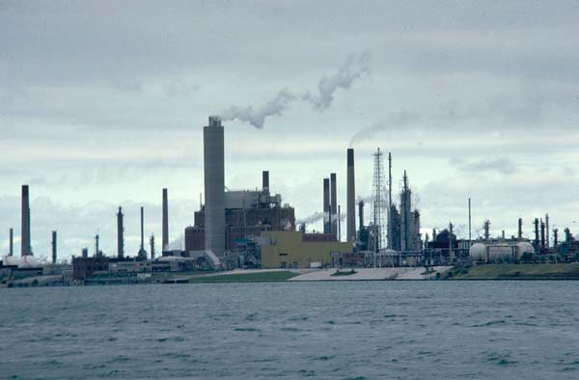
Threats to Our Freshwater Supply
Surface water can be polluted from municipal, agricultural, and industrial sources. Municipal wastewater may contain human waste, detergents, and solvents. Agricultural chemicals like herbicides and pesticides can also make their way into surface water. Industries such as oil refineries, pulp mills, and chemical factories release wastes into rivers and oceans. In lakes near populated areas, chemicals and wastes promote the growth of algae and weeds, which can deplete the lakes’ oxygen supply, harming living things.
Increasing populations are the main threat to the world’s freshwater supply.
Falling groundwater tables and diversion of surface supplies for crop irrigation are the main causes of shortages.

Slide 11
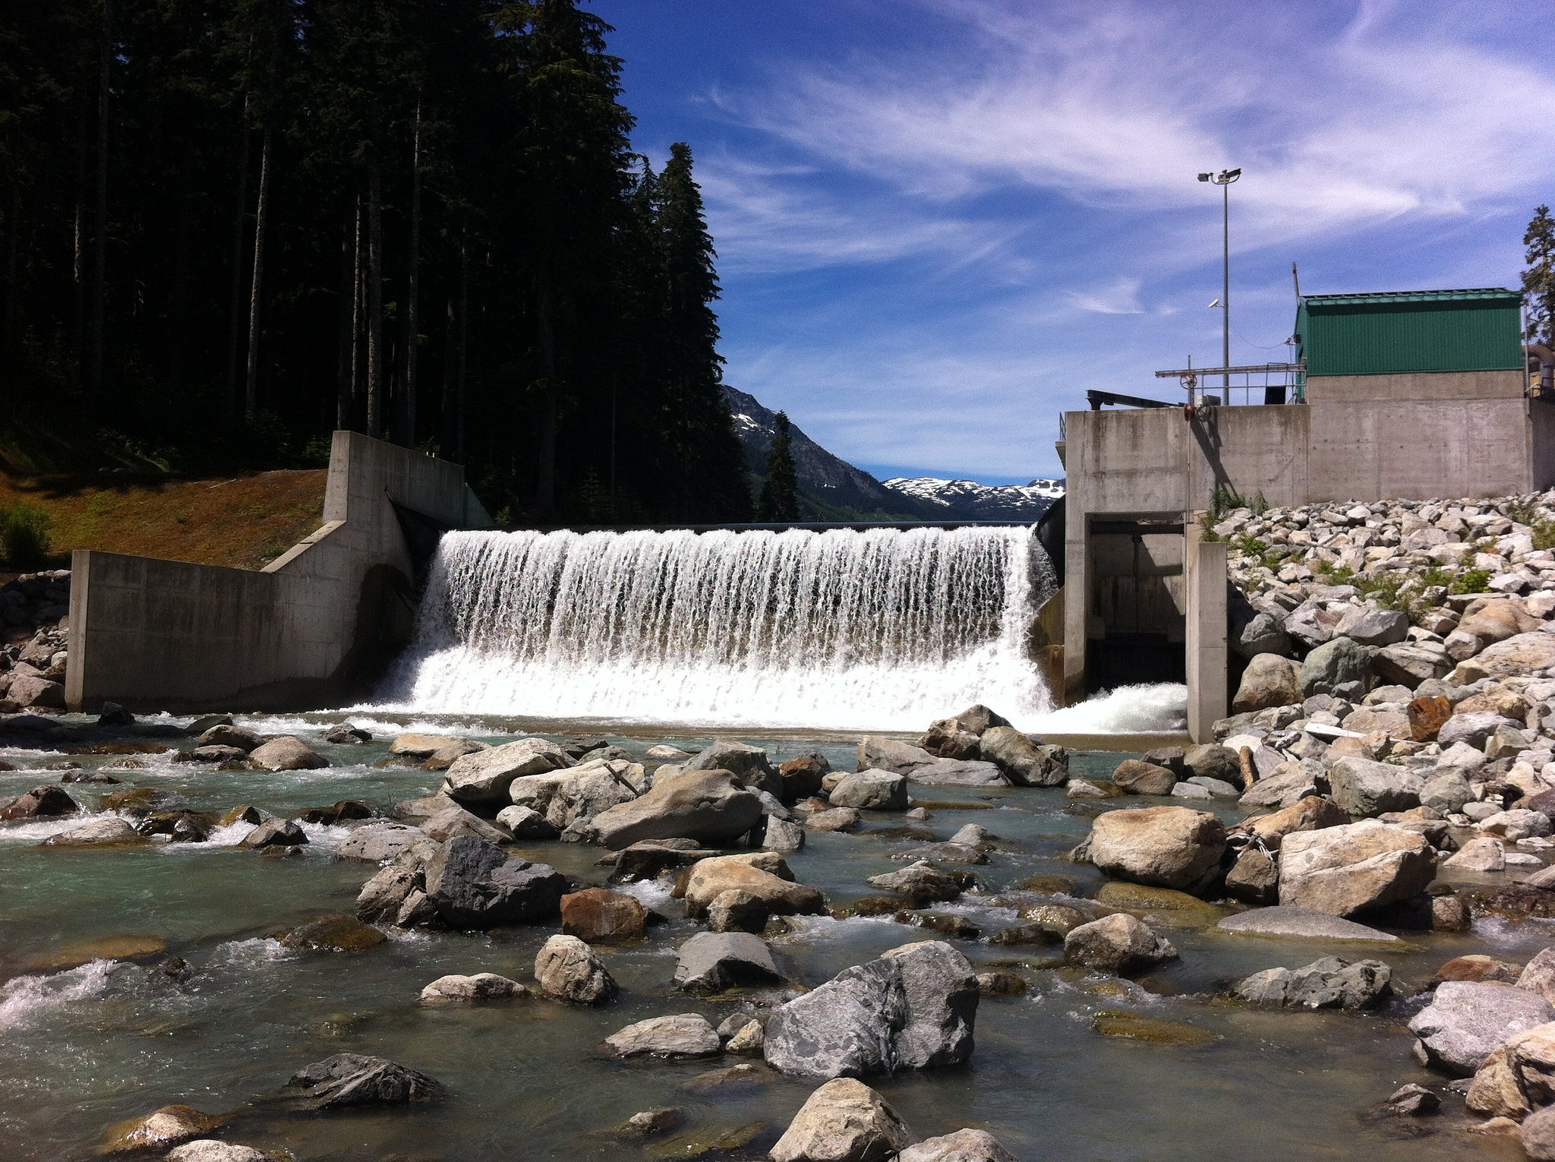
Conserving Our Water Resources
Water development programs are moving toward conservation and efficient
small-scale supply systems. Large-scale projects can be replaced by
micro-dams, hydro systems that run with a river’s natural flow, shallow
wells, and more efficient rainwater harvesting. As technologies develop,
experts believe we will use more reclaimed or recycled water and, to a lesser
degree, desalinated sea water.
In developed countries, industrial and domestic water use can be reduced. For example, high-efficiency and low-flow toilets reduce the amount of water needed to flush millions of toilets by 70 percent.

Slide 12
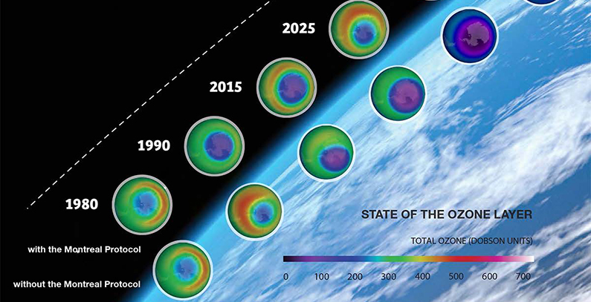
Change is in the Air
Ozone, a special kind of oxygen, is the only gas in the atmosphere that blocks the sun’s ultraviolet rays. Ultraviolet radiation can cause skin cancer in humans, and can damage other animal and plant species. In 1978, satellite observation of the atmosphere revealed that the ozone layer was thinning.
Chemicals, particularly chlorofluorocarbons (CFCs), destroy the ozone layer. CFCs have been widely used since the 1930s in coolants for refrigerators and air conditioners, and in foams, solvents, and aerosol cans. The United Nations Environment Programme created the Montréal Protocol to phase out the use of ozone-depleting chemicals. All industrial nations agreed to it. In 2009, 97% of the chemicals controlled by the protocol had been phased out.

Slide 13
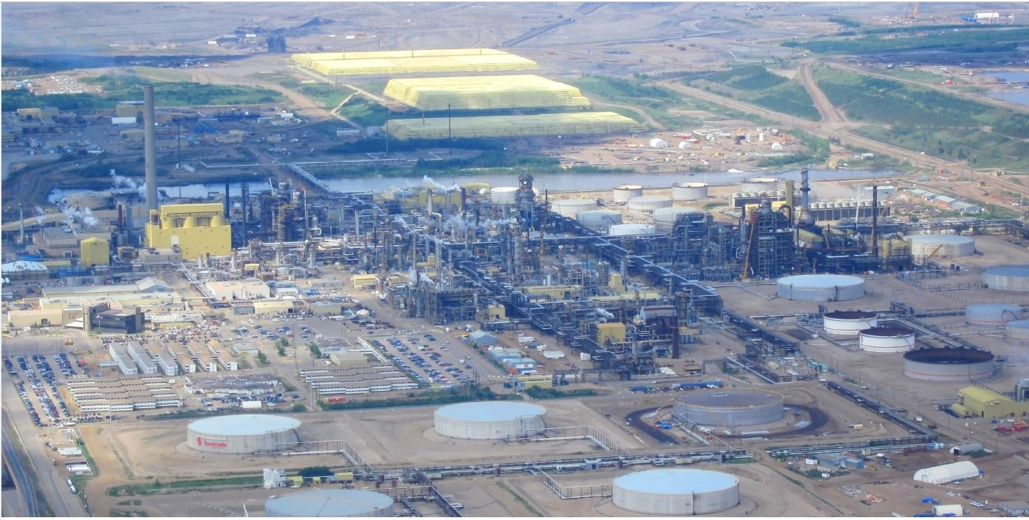
Greenhouse Gas Emissions
Since the Industrial Revolution in the 19th century, industrial and chemical contaminants have polluted the air. These pollutants cause smog, acid rain, and the widening hole in the ozone layer. Fossil fuels—coal, oil, and natural gas—are at the centre of global warming. Coal is widely used outside Canada for heating and energy generation.
Environment Canada reports that there was significant long-term growth in emissions between 1990 and 2007. These emissions came from increases in oil and gas production (much of it for export), motor vehicles, and coal electricity generation. One reason for the increasing emissions is the Alberta tar sands, where natural gas is used to process the tar sands.

Slide 14
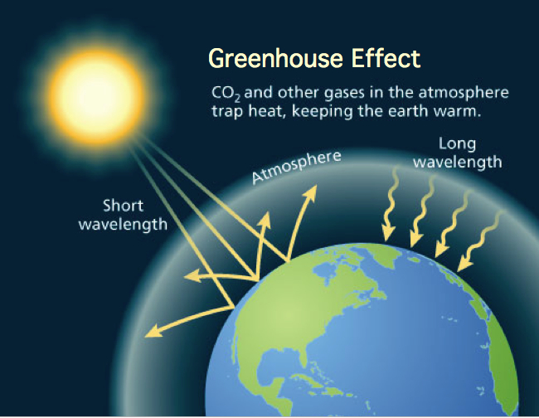
Things Are Warming Up
The gases in the atmosphere work like the glass in a greenhouse. They trap
heat energy from the sun, creating our climate and making life on Earth
possible. If these gases—especially carbon dioxide—are out of balance, they
can cause major changes to our climate.
Scientists estimate that carbon dioxide (CO2) in the atmosphere has increased by 30 percent since the Industrial Revolution and the subsequent burning of massive amounts of fossil fuels. The global temperature has risen by about 0.74˚C in the past 100 years. Scientists predict that it could rise by an additional 0.2˚C every 10 years for the next two decades. Even minor increases in Earth’s temperature can have profound effects on life on Earth.

Slide 15
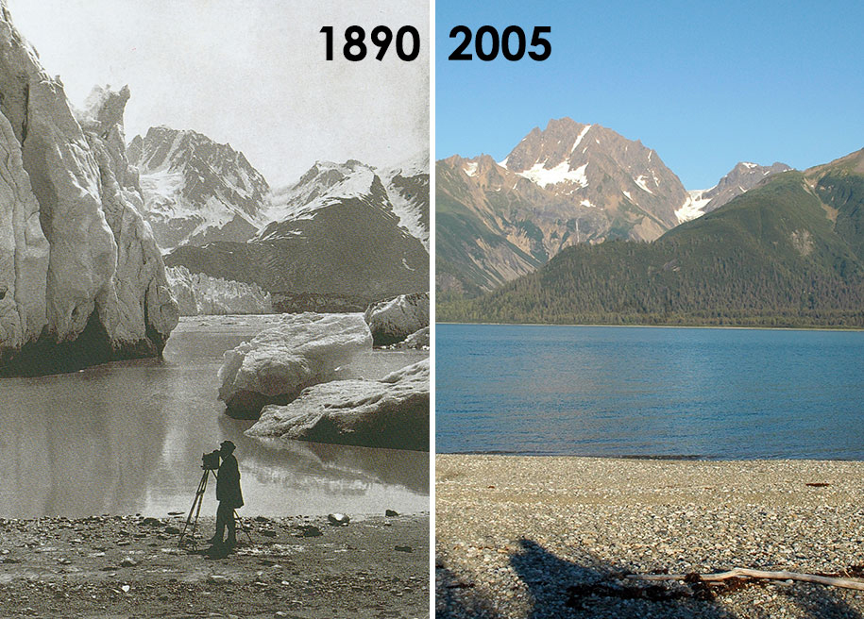
Consequences of Global Warming
Scientists agree that the increased number of heat waves and violent storms
in recent years are linked to global warming. Above-average temperatures in
polar regions are melting glaciers, and sea levels are rising as a result.
Other effects are harder to link directly to global warming. These include diseases extending their ranges because of warmer temperatures, and the earlier arrival of spring in many parts of the world. Plant and animal ranges are shifting as species try to adapt to changing temperatures by moving to different habitats. Coral reefs in more than 30 countries are experiencing coral bleaching as the microscopic algae that give them their colours fail to adapt to warmer water temperatures and die.

Slide 16
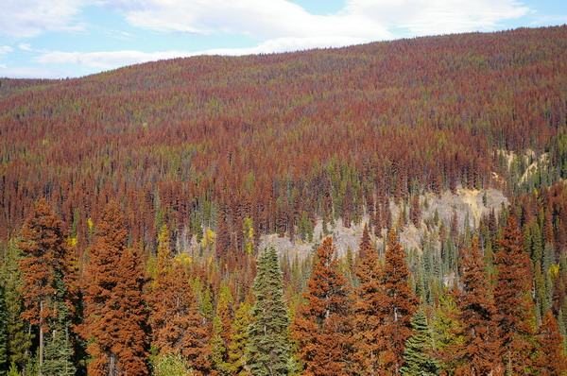
Forests and Climate Change
Warmer temperatures have already had damaging effects on British
Columbia’s pine forests. Warmer winters allowed the mountain pine beetle
to survive in previously inhospitable areas and to extend its range. Westerly
winds have allowed the insect to migrate over the Rockies and take root in
the pine forests of northern Alberta.
The spruce budworm is also a concern in the boreal forests of Western Canada. The effect of these insects goes beyond the loss of wood. Dead trees act as fuel for wildfires that threaten communities. Once a forest dies, it can no longer absorb and store carbon dioxide from the atmosphere, but emits carbon dioxide into the atmosphere instead.

Slide 17
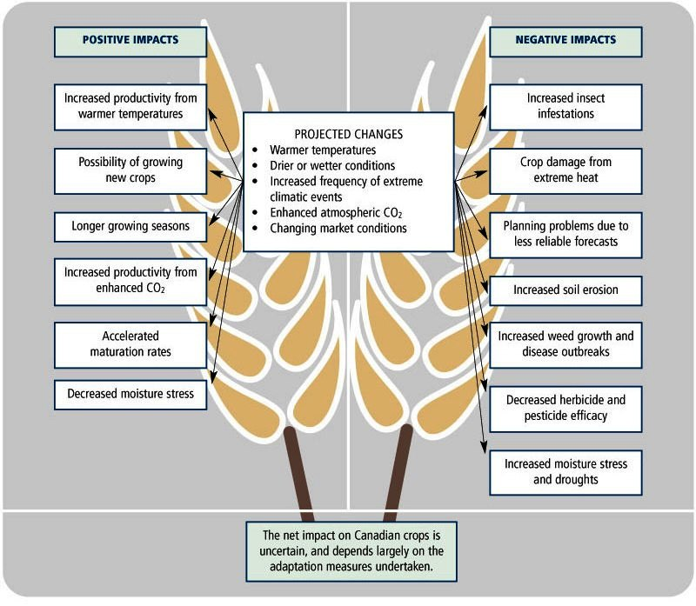
Agriculture and Climate Change
Climate change is expected to impact Canada’s agriculture in both positive
and negative ways. For example, warmer temperatures would make the
growing season longer, but they could also increase crop damage due to heat stress and pest problems. Warmer temperatures may make it possible to grow crops farther north, but the soils will not be as rich.
Global warming will likely affect water supply for agriculture. For example, less meltwater from receding glaciers in the Rocky Mountains will mean less available water for Alberta and British Columbia agriculture during the dry summer months. The benefits of a longer growing season may then be offset by water shortages.

Slide 18
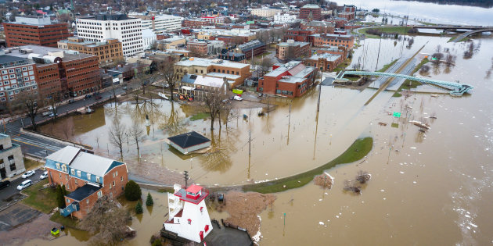
Water and Climate Change
In Canada, changes in temperature and precipitation can affect runoff, evaporation, and the storage of water in lakes, soils, and glaciers. Reduced flows from glaciers and less precipitation will decrease summer flows of rivers, which will in turn affect agriculture and salmon spawning. In winter, less ice cover, winter thaws, and snow-rain precipitation may increase the risk of flooding in many regions.
Melting glaciers and ice caps, and warming oceans, will result in rising sea levels. These changes will have a serious impact on Canada’s coastline. Some effects might include cliff erosion, land destabilization, flooding of low-lying areas, and the disruption of infrastructure.

Slide 19
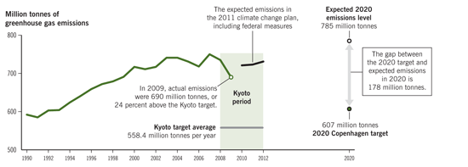
Kyoto Protocol
The United Nations Framework Convention on Climate Change was created at the 1992 Earth Summit in Rio de Janeiro, Brazil. Several protocols that set emission limits came out of this convention, including the Kyoto Protocol.
This document outlined target reductions for Greenhouse gas emissions. It also introduced the system of carbon credits, which allow countries that do not meet their reduction targets to buy credits from countries that keep emissions below their allotted levels. In 1997, Canada signed the Kyoto Protocol, promising to reduce greenhouse gas emissions by 6 percent of its 1990 level by 2012. In 2007, the Canadian government announced it could not meet its Kyoto Protocol targets.

Slide 20
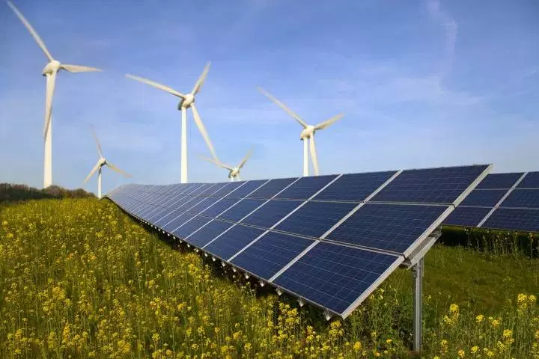
Moving to Sustainable Energy
Most leaders agree that all nations need to move toward sustainable development and clean energy sources to slow down climate change.
There are many sustainable sources of energy that could be used to lessen dependence on fossil fuels. These include wind turbines, solar power panels, tidal power, ground-source energy or geothermal power (which uses heat from underground sources where available), and biofuels derived from biomass (plant or animal material). The environmental group Greenpeace claims that by 2030 wind power could provide 15 percent of the world’s electricity. Although all these alternative sources of energy have drawbacks, they are renewable without harmful emissions.

Slide 21
Doing Our Part for the Environment
Individuals can help fight climate change by recycling, composting, buying local, and using energy-efficient appliances, lights, and transportation. Water can be conserved by installing low-flush toilets and taking shorter showers. Drinking tap water rather than bottled water reduces water consumption and saves the energy needed to make and recycle plastic bottles.
Reuseable shopping bags can help cut down on the billions of plastic bags used worldwide each year. These bags can make their way into oceans and rivers, where they can harm animals and their habitats. Find out about school-based groups or community organizations that are working to help protect the environment, and get involved.

