Slide 1
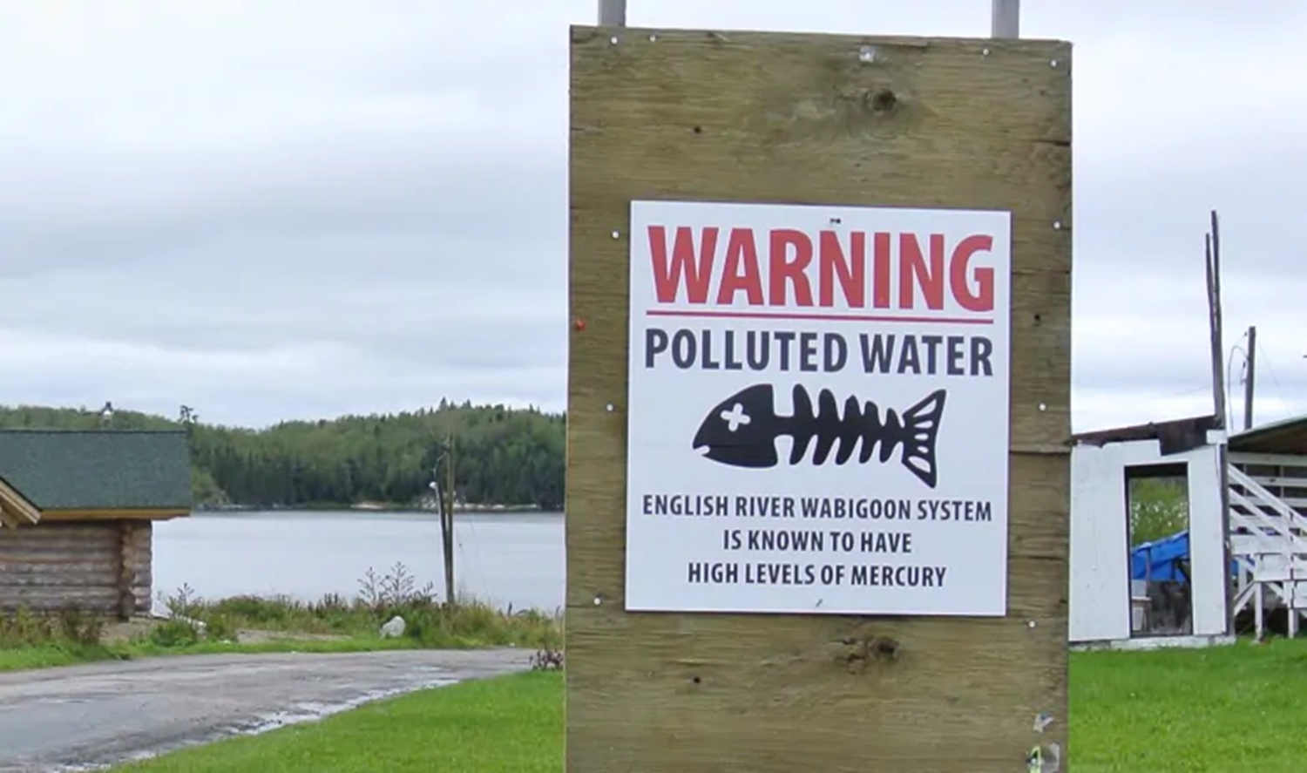
Canadian First Nations Studies: Poisoning of Grassy Narrows and the Oka Crisis

Slide 2
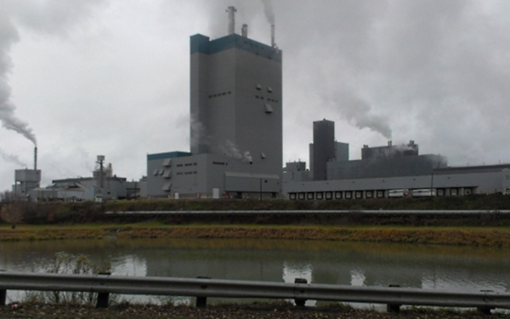
Background: Poisoning of Grassy Narrows
Mercury poisoning, also called Minimata Disease, in the Northwestern Ontario communities of Grassy Narrows (Asupeeschoseewagong) and Wabaseemoong First Nations remains one of Canada’s worst environmental disasters. A pulp and paper mill located in Dryden, Ontario was using mercury to make chlorine for bleaching paper. The mill – owned by Reed Paper Limited – was dumping mercury-contaminated waste material from an on-site chemical plant into the English-Wabigoon river system which runs through the traditional territory of the Grassy Narrows First Nation.
Between 1962 and 1970, the mill dumped about 9000 kilograms of mercury into the English-Wabigoon river system. Airborne emissions of mercury from the mill continued to be released until October 1975.

Slide 3
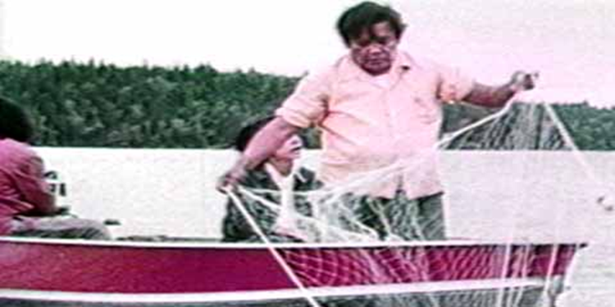
Mercury Poisoning
When dumped into waterways, mercury settles in the top layer of sediment on the lake or river bed. Small organisms in the sediment like plankton absorb it and convert it into methylmercury - more toxic than the inorganic metal form - and it enters the food chain. Live creatures, such as fish and shellfish eat it. Humans and animals in turn eat them.
In 1970, the Ontario government ordered Reed Paper Limited to stop dumping mercury into the river. It also told residents of Grassy Narrows and Wabaseemoong First Nations to stop eating fish – their main food source – from the English-Wabigoon river system since they tested positive for unsafe levels of methylmercury. This warning came too late since people had been catching and eating the poisoned fish for years.

Slide 4
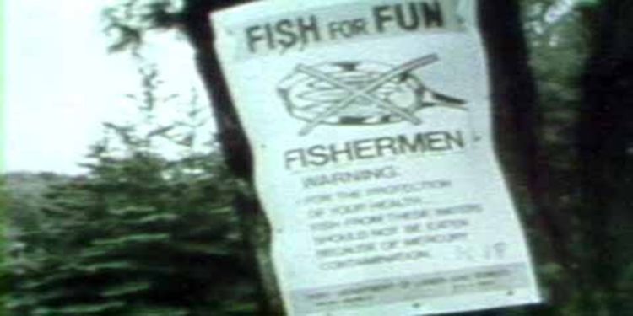
Continued Eating of the Fish
The Ontario government never banned sport fishing on the English-Wabigoon river system. Instead, it put up signs showing an x overtop of fish in a frying pan with the words "Fish for Fun” to warn residents and tourists not to eat the fish. But, at the urging of lodge owners who complained that the signs were scaring away tourists, the government quickly replaced the signs with letters sent to nearby Kenora, Ontario-area residents. Tourists no longer got any official notice about the mercury contamination.
Native leaders said their community members would continue to eat the contaminated fish as long as they saw American tourists doing the same. With few local economic opportunities and little money, residents have continued to eat the fish over the years.

Slide 5
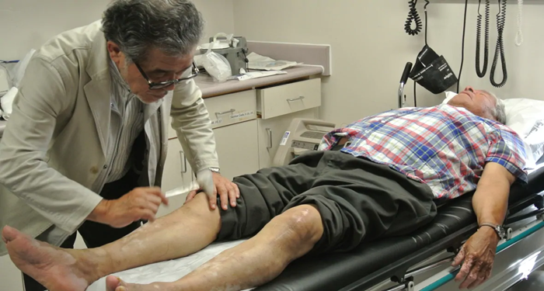
Health Consequences
When humans ingest mercury, they absorb 95-100% of it into the body, excreting it at a very slow rate. Prolonged exposure to mercury can, according to Environment Canada, cause damage to the brain, spinal cord, kidneys, liver and developing fetus. Symptoms include impaired senses and balance, shaking, slurred speech, balance problems, numbness and tunnel vision. Severe, prolonged exposure can cause personality changes, stupor, coma and death.
More than 90% of the population at Grassy Narrows and Wabaseemoong First Nations show signs of mercury poisoning, according to research by Japanese mercury experts released in 2016.

Slide 6
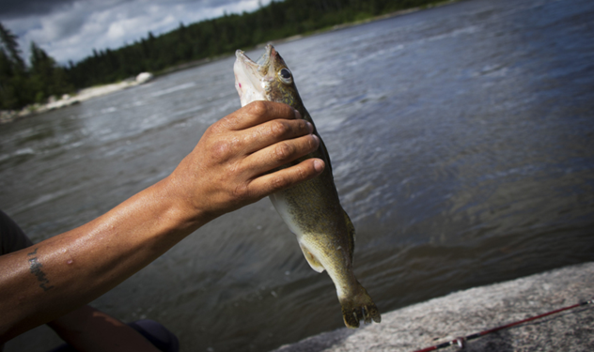
Economic Consequences
In 1970, the Ontario government banned commercial fishing in the mercury-contaminated English-Wabigoon river system. In that same year, Grassy Narrows moved from 95% employment to 95% unemployment. The First Nations commercial fishermen and fishing guides for tourists lost their source of livelihood. Workers who depended on these activities to make their living had to turn to welfare.
Commercial fishing was ruined. Hunting and fishing lodges were closed. For example, the Ball Lake Lodge used to employ almost all of the employable adults at Grassy Narrows, either on a full time or on a part time basis. It was closed in the summer of 1970. The lodge was not re-opened until 1990.

Slide 7
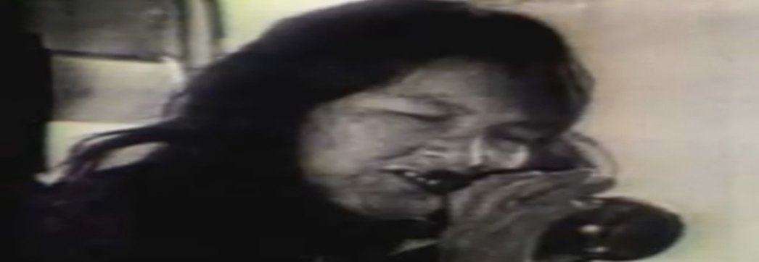
Social Consequences
Their health and jobs destroyed, the communities endured years of alcoholism, depression, violence, child neglect, sexual abuse, and suicide. Visitors to the reserve described a common pattern of binge drinking that often ended in violence. While parents drank, neglected children roamed wild, sometimes dying from exposure. Others became "burnt" - brain damaged - from sniffing gasoline.
In 1977, Grassy Narrows and Wabaseemoong First Nations sued Reed Paper Limited for damages for personal injuries, loss of jobs, and deprivation of their way of life caused by the mercury contamination.

Slide 8
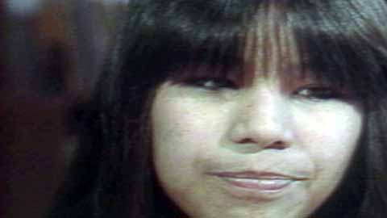
Compensation
In 1986, Grassy Narrows and Wabaseemoong First Nations negotiated an out-of-court settlement with the federal government, Ontario government, Great Lakes Forest Products Ltd. (which bought the mill in 1979), and Reed Paper Limited (the mill’s previous owner) for claims due to mercury contamination in the English-Wabigoon River Systems. A key part of the deal was the creation of a Mercury Disability Board to give compensation from a $2 million fund to people whose health was affected by mercury poisoning.
Community members who displayed symptoms of mercury poisoning could apply to the board to receive between $250 and $800 a month. However, due to strict eligibility requirements, most applicants have been denied. Based on 2014 numbers, nearly 75% of the claims were rejected.

Slide 9
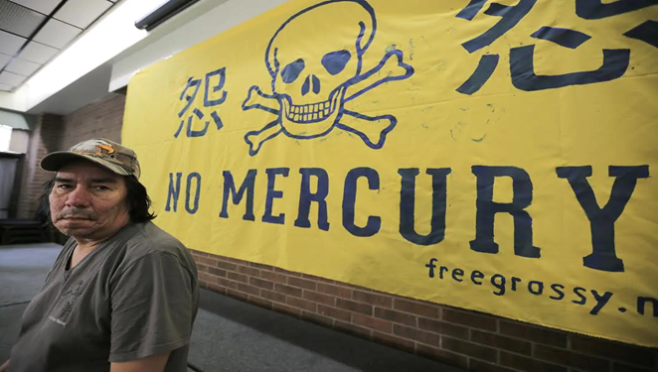
Compensation
The 1985 settlement also awarded the Grassy Narrows First Nation almost $9 million and the Wabaseemoong First Nation $8 million in compensation. The federal government paid $2.75 million, the Ontario government paid $2.17 million, Great Lakes Forest Products Ltd. paid $6 million, and Reed Paper Limited paid $5.75 million. Both communities agreed to withdraw lawsuits against Great Lakes Forest Products Ltd. and Reed Paper Limited.
In 1997, the Ontario Government contributed $6 million to the Mercury Disability Board fund.

Slide 10
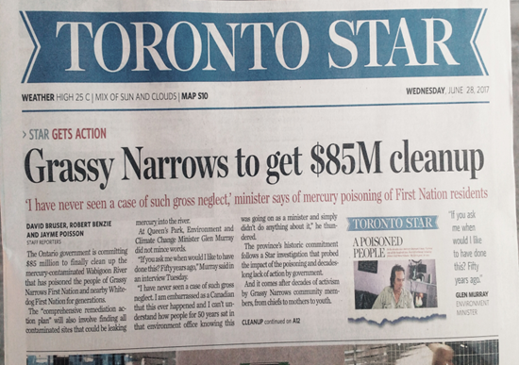
Resolution?
The Ontario government declined to take action for decades, largely ignoring the suffering of the Grassy Narrows and Wabaseemoong peoples. In 2017, the Ontario government pledged $85 million to fund clean up and remediation efforts in the English-Wabigoon river system. Also in 2017, the federal government made a commitment to fund the construction of a medical treatment facility in Grassy Narrows for people suffering the effects of mercury poisoning.
Despite the federal government’s commitment, as of 2019, no agreement had been signed between it and Native leaders to fund the construction of a medical treatment facility in Grassy Narrows.

Slide 11
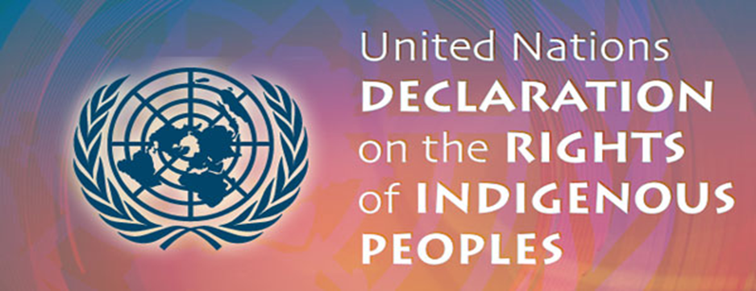
Significance
The United Nations Declaration on the Rights of Indigenous Peoples, of which Canada is a signatory, states in Article 25, “Indigenous peoples have the right to maintain and strengthen their distinctive spiritual relationship with their traditionally owned or otherwise occupied and used lands, territories, waters and coastal seas and other resources to uphold their responsibilities to future generations in this regard.”
The people of Grassy Narrows and Wabaseemoong have suffered for over 50 years. Frustrated by the Canadian government’s inaction, they have communicated to the United Nations that their rights have been violated.

Slide 12
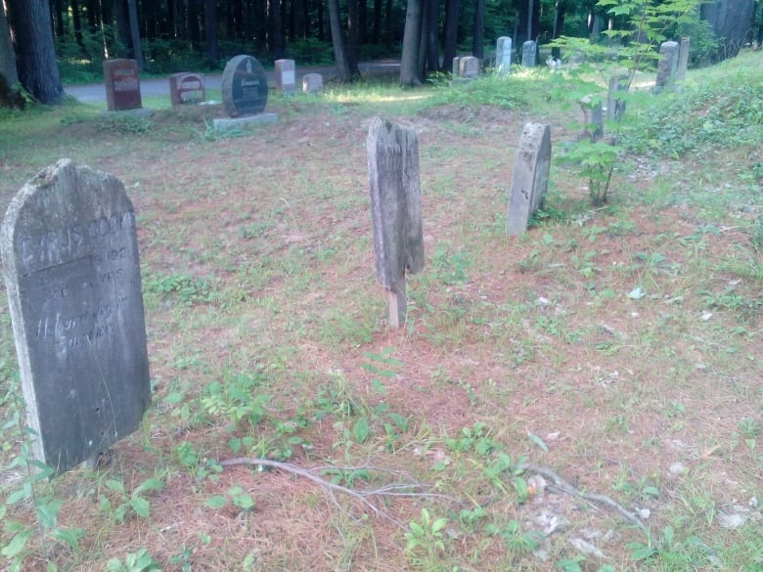
Background: The Oka Crisis
The Oka Crisis of 1990 involved the Mohawk territories of Kanesatake and Kahnawake, both located near Montreal, Quebec. The Mohawk nation had claimed for centuries that a forested area called, “the Pines” was ancestral land unlawfully taken from them in 1717 when the governor of New France gave the land to the Church. In 1977, the federal government rejected the Mohawk band's formal claim to the land because the claim did not meet its criteria.
The Mohawk nation had a land dispute over control of the Pines with the nearby town of Oka. The Mohawk peoples were strongly opposed to the development of this land since it contained a Mohawk burial ground.

Slide 13
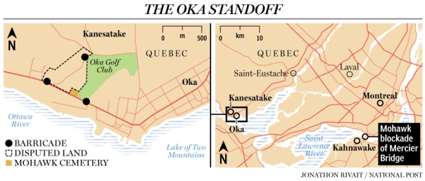
Blockade
In March 1990, the mayor of Oka, Jean Ouellette, gave the go-ahead for construction to begin on a golf course expansion and condominium complex within disputed the Pines territory. To halt this development, Mohawk warriors from the Kanesatake reserve set up a barricade across a road leading to the Pines to prevent bulldozers from accessing the site.
“No one would be permitted to enter the Pines,” they said. “We are prepared to fight... and if necessary, to die... in defense of our land.” On July 10th, after four months of the roadblock being up and after two court ordered injunctions to remove the roadblock were ignored, the mayor of Oka asked the provincial police, the Sûreté du Québec, to tare it down.

Slide 14
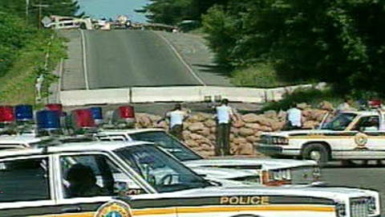
Police Raid
On July 11th, 100 police officers armed with concussion grenades and tear gas, some with assault rifles, took up positions around the blockade. Tear gas and concussion grenades were thrown by the police at protestors (although the gas blew back towards the police). Nearly seventy Mohawk warriors were armed with rifles, machine guns, shotguns, and pistols.
It is unclear who fired first, but a brief gunfight occurred between both sides and one police officer, Corporal Marcel Lemay, was shot dead. The police retreated immediately. They abandoned six vans & cruisers, including a front-end loader that the police intended to use to dismantle the barricades.

Slide 15
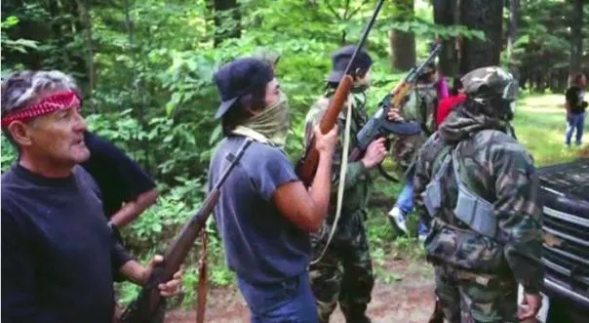
Escalation of the Conflict
Throughout summer tensions increased. Police constructed their own blockades on roads leading to Oka and the Kanesatake reserve. Mohawks at the nearby reserve of Kahnawake showed their support for the protest by erecting a blockade on the Mercier Bridge, closing the road that carried commuters from the south shore of the St. Lawrence to Montreal.
After a month of the bridge blockade, tempers were flaring among commuters. Relations between Aboriginal and non-Aboriginal people in the area worsened. There were other incidents of violence, and pressure grew on the Quebec government to resolve the crisis, which had now become a rallying cry for Natives frustrated with political marginalization.

Slide 16
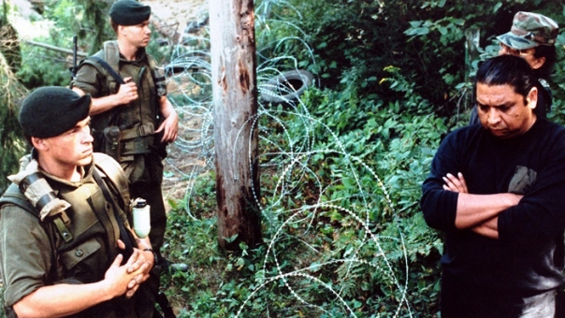
Federal Involvement
On August 8th, after a series of almost daily violent incidents, Quebec Premier Robert Bourassa asks for military intervention in Oka. On August 20th, about 800 members of the Royal 22e Regiment (the “Van Doos”) replaced the police at the Kahnawake and Kanesatake barricades, assuming a position only metres from the warriors.
Fearing an imminent invasion of the community by Canadian troops, the people of Kahnawake evacuate their women, children and elders. A convoy of 75 cars leave Kahnawake and cross the Mercier Bridge into Montreal. They encounter a furious mob that throws rocks at the passing vehicles. Several people are injured.

Slide 17
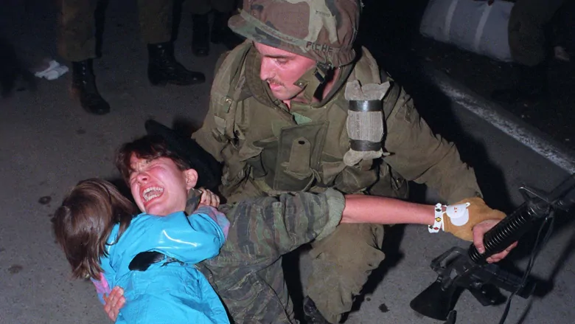
The Oka Crisis Ends
On August 29th, Mohawk warriors in Kahnawake negotiate a deal that leads to the reopening of the Mercier Bridge. The Mercier Bridge barricades are dismantled, defusing tension among commuters and leaving the Kanesatake Mohawks isolated.
On September 26, after a 78 day long standoff, the Kanesatake Mohawks surrender. Five warriors are handed over to the police for arrest while the rest are put onto military buses. Most of them are released the next day. 14-year-old Waneek Horn Miller is accidently stabbed in the chest by a soldier’s bayonet while carrying her four-year-old sister to safety after weeks behind the barriers. She survived.

Slide 18
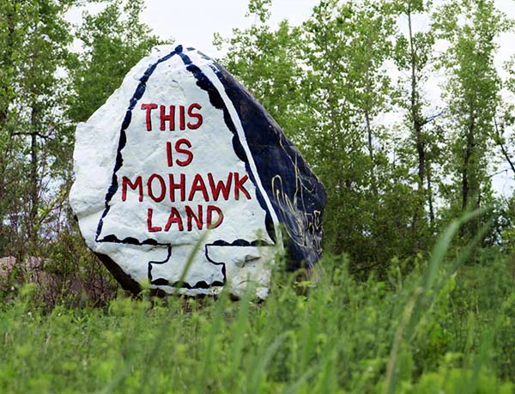
Resolution?
During the crisis, the federal government agreed to purchase the Pines in order to prevent further development. The golf course expansion and condominium construction were cancelled. In 2001, the Kanesatake Interim Land Base Governance Act confirmed that the land was to be reserved for the Kanesatake Mohawk. However, it did not establish the land as a reserve, and there has been no organized transfer of the land.
The government still has not given ownership of the land to the Kanesatake community. Instead, the government fined many of the Indigenous protestors, convicted five of criminal charges, and sentenced one individual to jail.

Slide 19
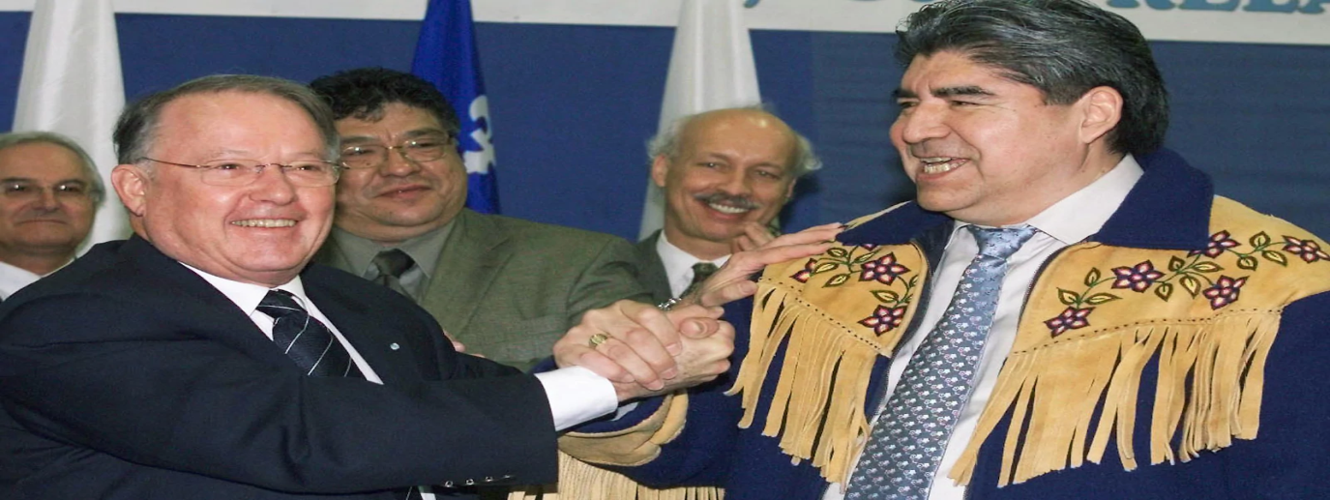
Significance
The Oka Crisis led to the Royal Commission of Aboriginal Peoples, which helped bring in new agreements between indigenous and non-indigenous people such as the resource-sharing deal in 2002 called the Paix des Braves (Peace of the Braves) between the Quebec government and the Grand Council of the Crees.
Since Oka, federal and provincial governments have developed greater awareness of the territorial rights of First Nations and the need to consult Indigenous peoples when considering development projects. The crisis also illustrated the potential for future conflict if land claims were not resolved in a timely, transparent and just manner.

