Slide 1
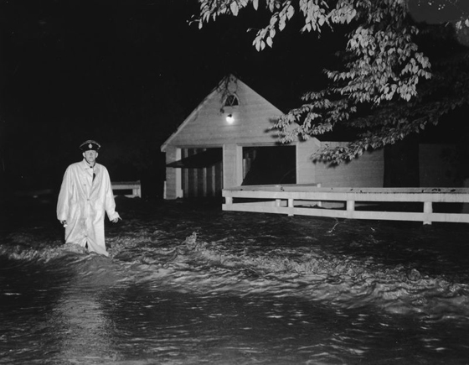
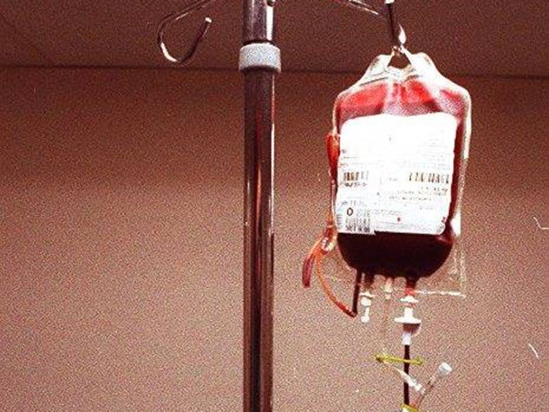
Disasters in Canada: Hurricane Hazel and the Tainted Blood Scandal

Slide 2
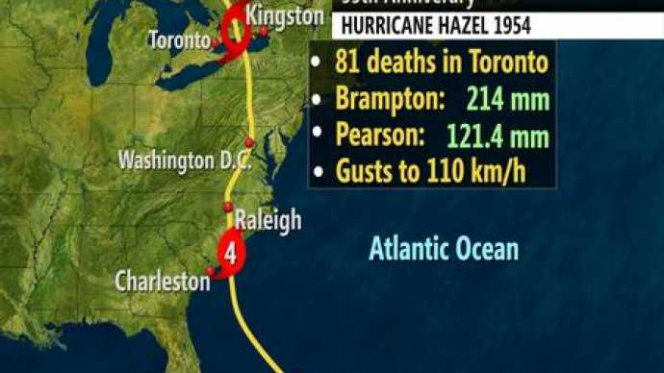
Background to Hurricane Hazel
Between October 5 and October 16, 1954, Hurricane Hazel formed in the Caribbean, tracked through the western tip of Haiti, several American states along the eastern seaboard, and across Lake Ontario where its warm moisture-laden air merged with a cold front and poured record rainfall on the Greater Toronto Area.
As Hurricane Hazel approached Toronto on October 15th, the weather office warned citizens throughout the day, stressing the impending heavy rainfall. Although their forecasts were quite accurate, few people had experience with hurricanes and were unaware of how to prepare, leaving them vulnerable to the storm's power. Hurricane Hazel blew in to Toronto at night on October 15th, 1954, bringing with it wind which whipped through the city reaching 110 kilometres per hour and record rainfall of over 200 millimeters of rain in just 24 hours. It remains Canada's deadliest hurricane and Toronto's worst natural disaster.

Slide 3
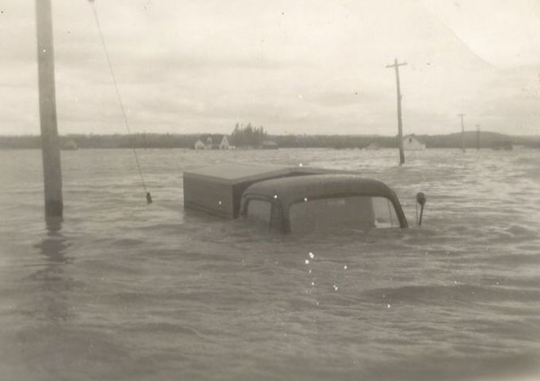
Flooding
The Toronto area had experienced above average rainfall in the preceding month, especially in the two weeks prior to Hazel’s arrival. This accumulated rainfall had thoroughly soaked soils, thus preventing the absorption of any significant portion of Hurricane Hazel's downpour. Therefore, when Hazel dropped the record amount of rain (over 200 millimeters in 24 hours) on the region, most of the water simply ran off the surface and into rivers and creeks, rapidly filling them to capacity and causing them to overflow. The Humber River, Highland Creek, Don River, Etobicoke Creek, Credit River, and 16 Mile Creek all overflowed.
Areas that are vulnerable to flooding are called 'floodplains'. These are lands adjoining a river, lake or other watercourse, which have been, or may be covered by floodwaters. In 1954, many Toronto residents lived on the city’s floodplains, placing them directly in the path of Hurricane Hazel’s fast-moving floodwaters.

Slide 4
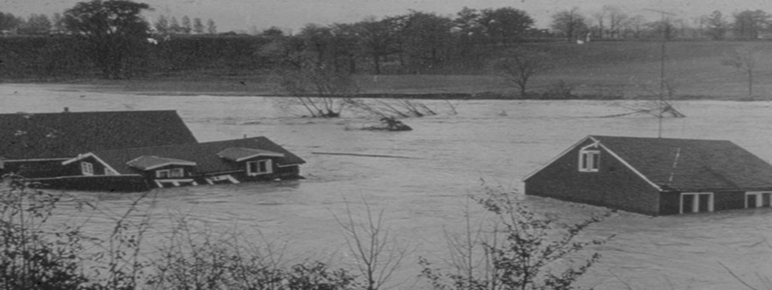
Infrastructure and Property Damage
As the waters rose, cars and mobile homes were submerged and swept away, trains were knocked off their tracks, bridges collapsed, roads were washed out, and houses were torn from their foundations. Strong winds also caused havoc, toppling trees and downing power lines.
Hazel caused a housing crisis in Toronto with 180 houses destroyed, 1175 houses seriously damaged, 801 houses damaged, 16 trailers destroyed, and 169 trailers damaged. 1868 families were left homeless. A central housing registry was created to help assist flood victims find accommodation. According to a royal commission that studied the effects of the hurricane, the total estimated cost of the disaster was $100 million in 1954; that would translate into over $1 billion today.

Slide 5
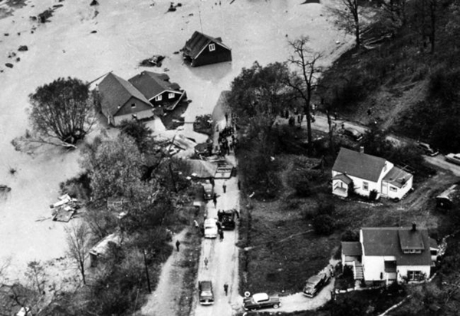
Fatalities
Many people were drowned attempting to escape from their homes, were washed off roads, or were washed down the river while still in their homes. The first deaths were reported on October 15th, at 11:00 P.M. as a car was swept into the Humber River, killing the occupants. A group of volunteer firefighters attempted to rescue three men trapped atop a car by flood waters from the Humber River. The fire truck the firefighters were driving became stuck on a flooded street and overturned, tossing the men into the water. Five of the nine men on board died.
However, the largest death toll would be realized on a single street called Raymore Drive, located on a floodplain of the Humber River, at the western edge of Toronto. Here 35 people were killed as a result of the Humber River rising rapidly and with immense force smashing into a full block of fourteen homes, ripping them from their foundations and washing them downstream.

Slide 6
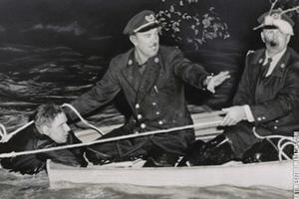
Rescues
Police, firefighters and citizens combined in a tremendous rescue operation that saved many lives. In the darkness of night, many brave rescue efforts were undertaken. Among the hurricane's casualties were brave would-be rescuers who, like the five firefighters, were swept to their deaths in ill-fated efforts to reach stranded and endangered citizens.
Even though the fast-moving current was strong enough to endanger most boats, rescuers launched whatever boats they could find into the waters and attempted to locate survivors. Many of the stranded were trapped atop cars and rooftops by the raging waters. Sometimes rescue attempts were successful in transporting survivors to the safety of higher ground. But sometimes on the very brink of saving a life the rescuers were battered by a sudden surge of water and the ones they sought to save were swept away.

Slide 7
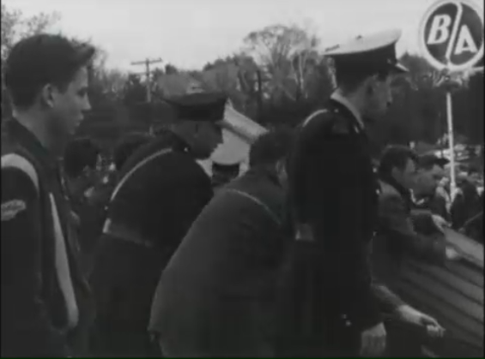
Recovery
When the waters receded, the enormous task of cleaning up and recovering from the disaster remained. The storm brought out the best of community spirit in many. Relief organizations such as the Salvation Army and the Red Cross very quickly organized shelters and clothing drives, and people in Toronto rushed to contribute what they could. The offices of the Salvation Army were filled with donations of clothes, footwear, blankets, food and cash. The Red Cross quickly assembled shelters in the effected areas of Ontario sheltering 90 people in Port Credit, 30 in Lambton, and 300 people in Bradford.
800 militia troops were deployed to Toronto for two weeks to assist in searching for bodies of the deceased flood victims and cleaning up debris. Many remained after their deployment or returned on their time off to continue to assist recovery efforts.

Slide 8
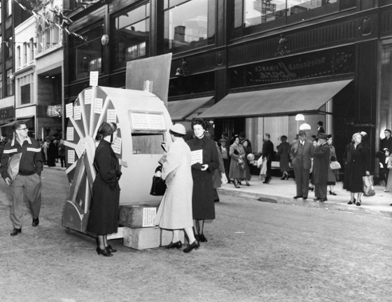
Hurricane Relief Fund
Financial donations poured in from all over Toronto, across Canada, and from around the world. On October 18, 1954, the hurricane relief fund was created to collect all the financial donations and see that the fund was distributed properly to people in need. In total, 250,000 donors contributed to the fund which distributed $5,132,024.40 to 3425 people affected by the storm.
Businesses sent cash donations to the fund in addition to offers of goods, services, or labour. Notable contributions to the fund included: $20,000 from the City of Hamilton, Ontario, $25,000 from the Ford Motor Company, $5000 from the United Church of Canada, $1000 from Laura Secord Candy Shops ltd., $250,000 from the Atkinson Charitable Foundation, and $20,000 from the British American Oil Company. The pope sent his “deepest sympathy” and $10,000.

Slide 9
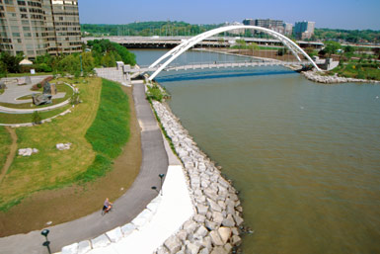
Significance of Hurricane Hazel
Hurricane Hazel inspired a revolution in Toronto regarding flood control and floodplain management. Privately owned property located along floodplains was purchased by the Ontario government. Since 1957, all Toronto floodplain land has been managed by the Toronto and Region Conservation Authority (TRCA). Existing developments were removed and the land has been converted to parkland and dams.
Hurricane Hazel left 81 dead in Ontario, most of them in Toronto. Today Toronto is better prepared. In all, the course of 7 rivers has been changed as part of the flood control measures. The TRCA has acquired more than 14,000 acres of floodplain, including nearly all the land where homes were destroyed by the flood. Zoning regulations ban development in floodplains, allowing rivers to flow naturally and reducing the risk to people and their property during flooding.

Slide 10
Background to the Tainted Blood Scandal
From 1946-1998 the Canadian national blood supply was managed by the Canadian Red Cross. In the late 1970s, 1980s and the early 1990s, Canada experienced its worst ever preventable public health disaster. Blood contaminated with two infectious diseases: human immunodeficiency virus (HIV) and hepatitis C virus was given to Canadian patients to treat their illnesses or during surgery, even after tests were available to detect the presence of both diseases in blood donations.
The effects of delaying to test donated blood and blood products caused untold damage and death to the lives of innocent people who sought out medical assistance and damaged the public trust in the medical system in Canada.

Slide 11
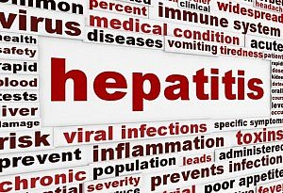
What are HIV and Hepatitis C?
HIV is a virus that attacks and destroys white blood cells and makes copies of itself in these cells, which are our body’s natural defence against illness. As the white blood cells are destroyed and more copies of the HIV are made, a person’s immune system is broken down. This makes it harder for the person to fight off infections and diseases. A person can contract the virus by having unprotected sex and oral sex with someone who is HIV-positive, receiving contaminated blood, and sharing contaminated needles, syringes, or other sharp instruments.
Hepatitis C is a viral infection that causes liver inflammation, sometimes leading to serious liver damage or liver cancer. A person can contract the virus by having unprotected sex with someone who has hepatitis C, receiving contaminated blood, and sharing contaminated needles, syringes, or other sharp instruments.

Slide 12
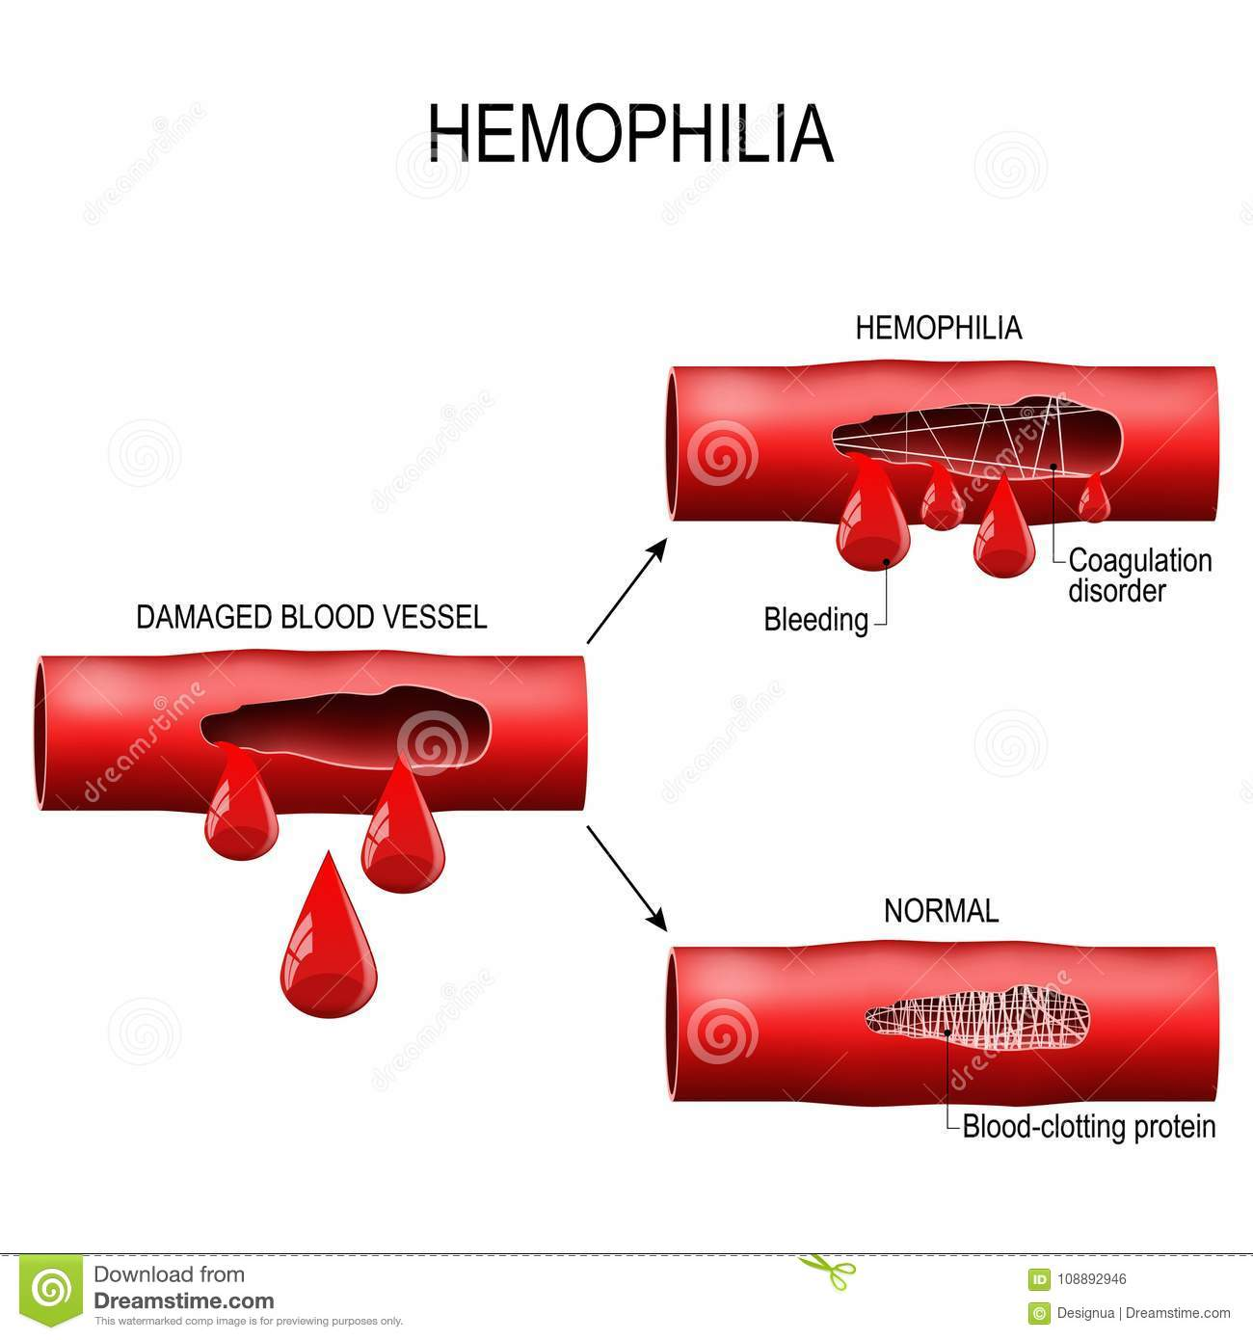
Methods of Transmission and Infection
There were two main ways that people became infected with one or both viruses during the tainted blood scandal. The first method was from blood transfusion usually in a hospital environment. The transfusions provided patients with red blood cells, platelets and plasma and were usually given to surgery patients.
The second infection method occurred with patients receiving blood factor concentrates. The main patients requiring these blood products were hemophiliacs (people with a bleeding disorder in which their blood doesn't clot normally.) Blood factor concentrates replace a component of blood that hemophiliacs lack -- factor VIII or factor IX – which help the blood clot properly. Furthermore, since many of those who were infected were not notified promptly, they were unaware of their own infection and they passed on their infection to their sexual partners.

Slide 13
Detecting and Testing Blood Donations
Although a test to detect HIV in blood had been available since march 1985 and was already in use in both the U.S. and Australia, it took eight months - until November 1985 - for the Red Cross to begin testing all blood donations for HIV. Toronto epidemiologist Robert S. Remis has estimated that about 133 cases of HIV transmission could have been prevented had testing been introduced in March of 1985 rather than November.
Although a test to detect hepatitis C in blood had been available since 1986, it took until June 1990, for the Canadian Red Cross to begin testing all blood donations for hepatitis C. Unscreened plasma continued to be used by the Red Cross for up to two more years before all blood products were tested. An estimated 95% of hemophiliacs who used blood products before 1990 contracted hepatitis C.

Slide 14
The Krever Inquiry
On October 4, 1993, the federal government appointed justice Horace Krever to lead a public inquiry to investigate what went wrong with Canada’s blood supply. After months of hearings (which included tearful statements from victims) and years of investigations and legal battles with government over the commission’s ability to name publicly or assign blame to those who had failed in their duties, Krever released his final report on November 21, 1997.
The report came down hard on the Red Cross and the federal and provincial governments for ignoring warnings and acting irresponsibly as HIV and hepatitis C transmissions continued. Krever recommended compensation for “all blood-injured persons.”

Slide 15
The Krever Inquiry
Krever found that the relationship between the Red Cross and the federal and provincial governments was dysfunctional, and as a result, the country lacked a national blood policy. That lack of a clear policy, he found, resulted in a series of disastrous decisions, including:
The failure to screen out high-risk blood donors; importing plasma collected from high-risk prison populations in the U.S.; delays in testing blood donations for HIV due to spending restrictions; not using a test that may have caught as many as 90% of hepatitis C cases; delaying the purchase of safer, heat-treated blood products for hemophiliacs out of a desire to use up inventory of potentially contaminated products; and a failure to track down all those who might have been infected.

Slide 16
RCMP Investigation
On November 20, 2002, the Royal Canadian Mounted Police (RCMP) laid criminal charges against the Red Cross, four doctors, and a U.S.-based pharmaceutical company. They alleged that the accused failed to properly screen blood donors, failed to test blood properly, and failed to warn the public that there were risks associated with blood products.
In the end, there was only a single criminal prosecution. On May 30, 2005, the Red Cross pleaded guilty to violating the food and drug regulation act by distributing an adulterated or contaminated drug. It was fined $5,000, which was the maximum penalty for the offence under the act. The four doctors and the U.S.-based pharmaceutical company were acquitted of all criminal charges.

Slide 17
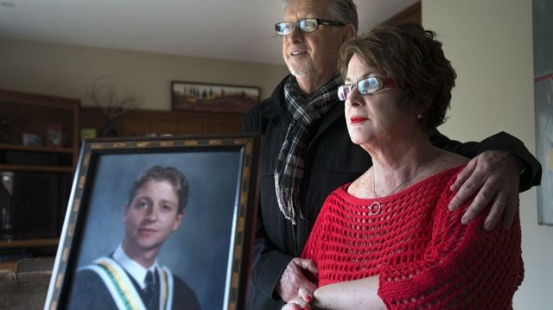
Compensation
On December 14, 1989, the federal government announced $150 million in compensation ($120,000 each) for 1,250 Canadians who contracted HIV from contaminated blood in exchange for a promise that they would not sue. In 1993, the provinces extended the compensation plan, offering $30,000 a year to all those who had contracted HIV from blood.
On March 27, 1998, provincial and federal health ministers announced $1.1 billion in compensation for people who contracted hepatitis C from tainted blood - but only those who were infected between 1986 and 1990. Those who were infected outside those dates - an estimated 20,000 people – were outraged. On July 25, 2006, the federal government announced a $1 billion compensation package for 5,500 people – the “forgotten victims” who contracted hepatitis C before 1986 and after 1990.

Slide 18
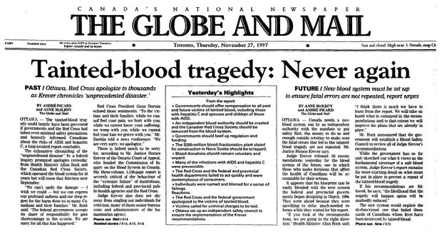
Significance of the Tainted Blood Scandal
At least 2000 recipients of blood and blood products contracted HIV and another 30,000 transfusion recipients were infected with hepatitis C. About 8000 Canadians are expected to die as a direct result of contaminated blood.
In September 1998, the Red Cross was stripped of its control over Canada’s blood system. It was replaced by a new federal agency, Canadian Blood Services (except in quebec where Héma-Québec was established). Since Canadian Blood Services began managing Canada’s blood system in 1998, there has not been a single recorded instance of blood-borne infection from either hepatitis C or HIV. Canada’s blood supply is recognized as one of the safest in the world.

