Slide 1
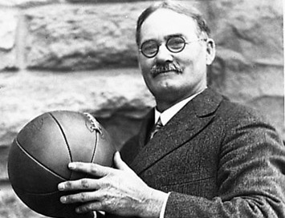
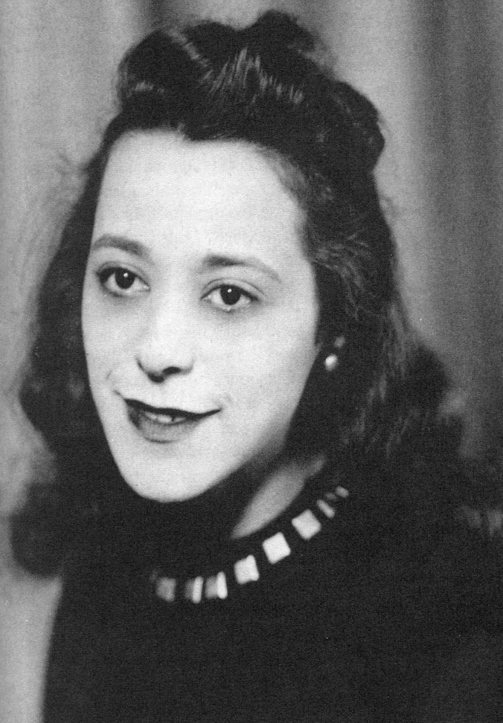
Famous Canadians: James Naismith, Terry Fox, and Viola Desmond

Slide 2
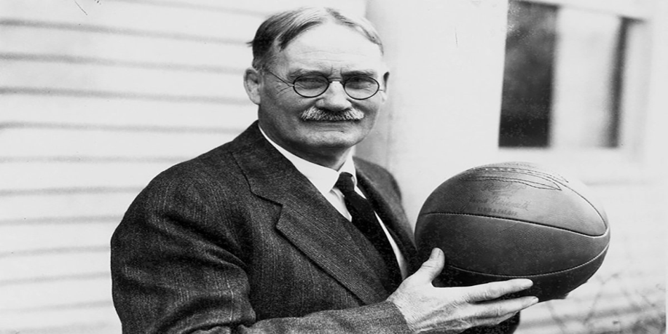
James Naismith
James Naismith was born on November 6th, 1861, in Almonte, Ontario. Naismith is best known as the inventor of the sport of basketball.
As a young boy, he and his friends would gather near a large stone near the school they attended and play a game called, “Duck on a Rock”. A rock (called the duck) was placed on the stone while one person acted as a guard. The others stood 10–15 feet away, trying to knock it down by hurling rocks of their own. they began lobbing them high in the air, arcing over the guard. The development of the lob shot stuck with Naismith and later became the basis of basketball.

Slide 3
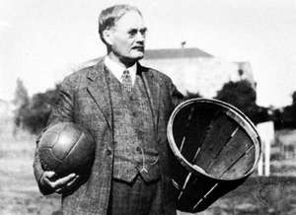
Inventing Basketball
While working as an instructor at the International YMCA Training School in Springfield, Massachusetts, Naismith was given the task of creating a fair and non-violent indoor game that could be played in the school’s gymnasium during the winter months.
Using “duck on a rock” as inspiration, Naismith developed a game in which players scored by throwing a soccer ball in an arcing motion into a peach basket guarded by an opposing team. he decided the basket would be placed above the players’ heads. Naismith also made sure that fair play and sportsmanship were reflected in the game’s thirteen rules he created.

Slide 4
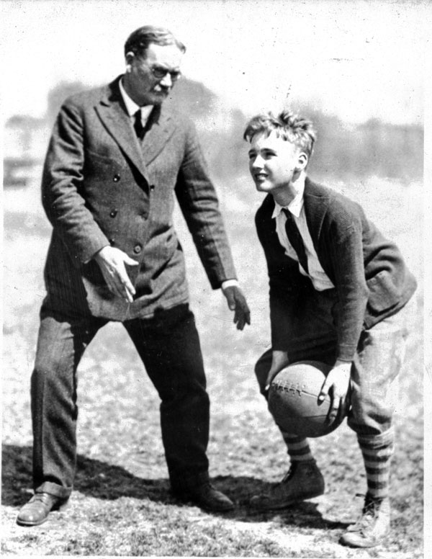
First Basketball Game
The first game of basketball was played at Springfield College on December 21st, 1891. Naismith recalled the experience in a 1939 radio interview:
“One day I had an idea. I called the boys to the gym, divided them up into teams of nine, and gave them an old soccer ball. I showed them two peach baskets I’d nailed up at each end of the gym. I told them the idea was to throw the ball into the opposing team’s peach basket. I blew a whistle and the first game of basketball began.”

Slide 5
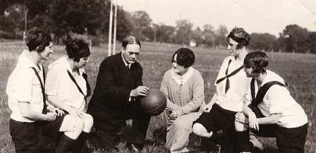
Significance
Naismith’s legacy is reflected in the popularity of the game of basketball around the world. It has grown into a game that more than four hundred million people play worldwide, making it the second-most popular sport in the world, according to the International Basketball Federation.
due to Naismith’s thirteen rules, the spirit of fair play and sportsmanship lives on in the game. By not allowing players to run with the ball, he also eliminated the violent tackling found in rugby and football. Even today, basketball has far less group violence than other active sports.

Slide 6
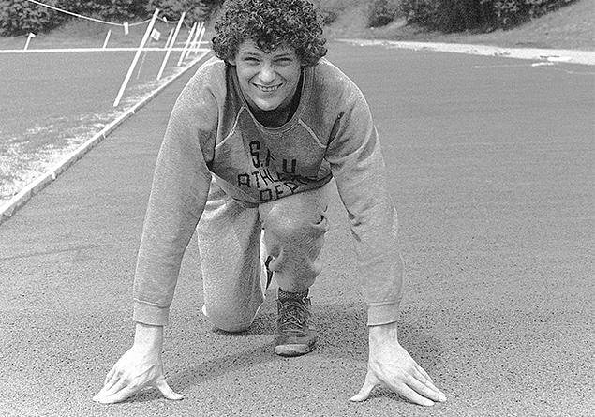
Terry Fox
Terry Fox was born on July 28th, 1958, in Winnipeg, Manitoba. He inspired the nation and the world through his courageous struggle against cancer and his determination to raise funds for cancer research.
Terry was an athletic boy. He played a variety of sports in school including: basketball, baseball, soccer, and rugby. He particularly loved basketball. In Grade eight he worked hard to make his school basketball team, practicing every morning before school and throughout the summer. despite being only five feet tall and possessing little natural ability, he accomplished his goal.

Slide 7
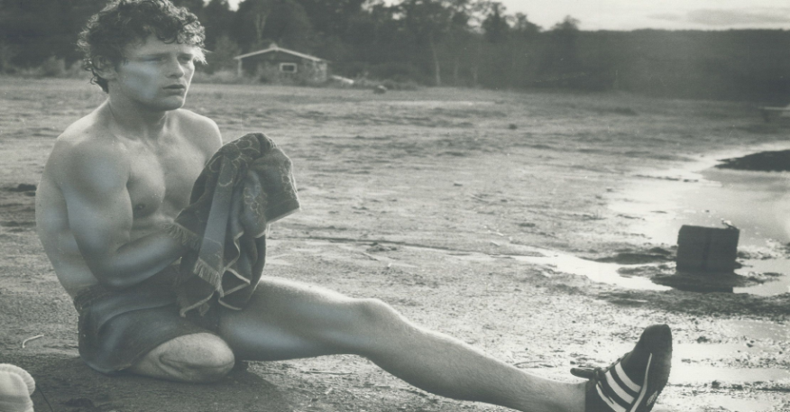
Cancer Diagnosis
When Terry was 18, he was diagnosed with osteogenic sarcoma, a type of bone cancer that often starts in the knee. Because the cancer spreads quickly, doctors decided to amputate his right leg and put him through chemotherapy. During chemotherapy, he witnessed the suffering of many others afflicted with cancer and was determined to do something to help.
On the night before his surgery, Terry had read an article about Dick Traum, an amputee who had run the New York City Marathon; inspired by Traum’s example, Terry decided he would run across Canada to raise awareness and funds for cancer research.

Slide 8
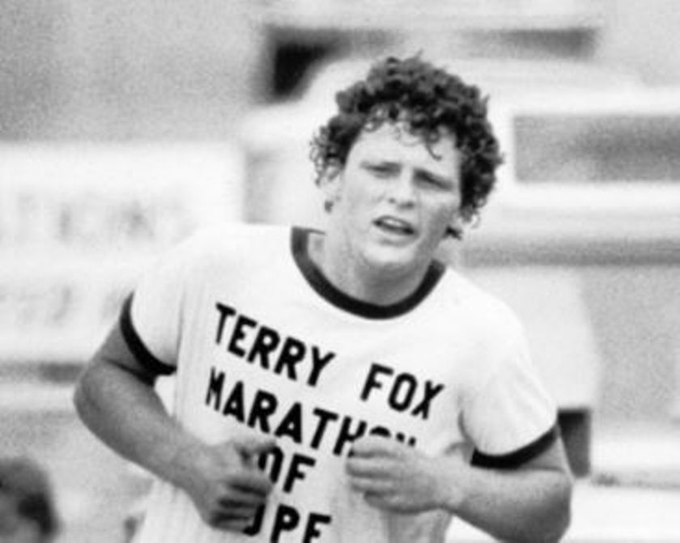
Marathon of Hope
Terry began his cross-country Marathon of Hope on April 12th 1980, dipping his artificial leg in the Atlantic Ocean near St. John’s, Newfoundland. Terry ran for 143 days and covered 5,373 kilometers. He persevered through pain, fatigue, and harsh weather in pursuit of his goal to raise one dollar for every Canadian, or about $24 million, for cancer research.
Terry was forced to stop running just outside Thunder Bay, Ontario, on September 1st, 1980, because the cancer had invaded his lungs. He passed away on June 28th, 1981, at the age of twenty-two.

Slide 9
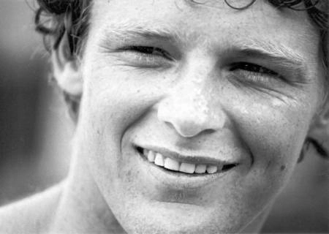
Significance
Terry changed people’s attitudes towards individuals with disabilities. In his own words, he proved that “anything’s possible if you try.”
Fundraising continues in his name. The Terry Fox Foundation, which now organizes the annual Terry Fox Run, has raised over $700 million for cancer research. Millions of people in Canada and around the world participate every year in the Terry Fox Run. money has been used to produce better treatments for many different types of cancers. These newer treatments reduce suffering and prolong life and bring us closer to an eventual cure for cancer.

Slide 10
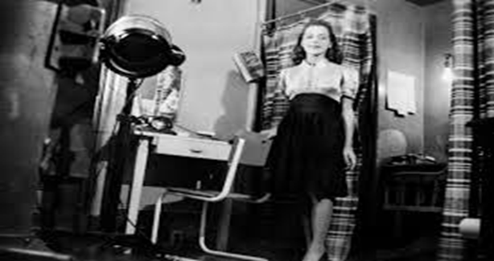
Viola Desmond
Viola Desmond was born on July 6th, 1914, in Halifax, Nova Scotia. Desmond’s courageous refusal to accept an act of racial discrimination provided inspiration to later generations of Black persons in Nova Scotia and in the rest of Canada.
On the evening of November 8th, 1946, thirty-two-year-old Desmond decided to see a movie at the Roseland Theatre in New Glasgow, Nova Scotia. the theatre had a policy of segregation. In this case, black patrons were expected to sit upstairs in the balcony, while white patrons were expected to sit downstairs in the main-floor seats.

Slide 11
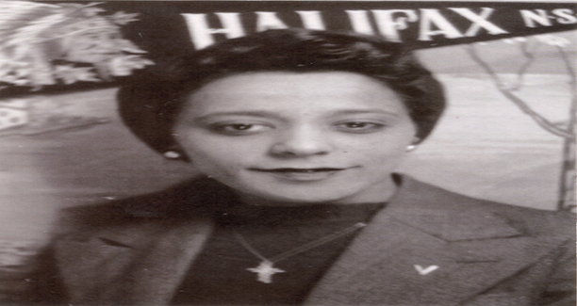
Challenging Segregation
Desmond asked for a main-floor movie ticket, paid, and walked into the main-floor seating area of the theatre. The cashier, who had given her a balcony ticket instead, followed her, and told her that she could not sit there. Desmond went back to the cashier and said she wanted to exchange her ticket for one on the main-floor. The white ticket seller said: “I’m not permitted to sell downstairs tickets to you people.”
Desmond returned to a main-floor seat anyway. The manager was called and a policeman. When Desmond refused to leave her seat, she was dragged out of the theatre, injuring her hip and knee, and taken to jail.

Slide 12
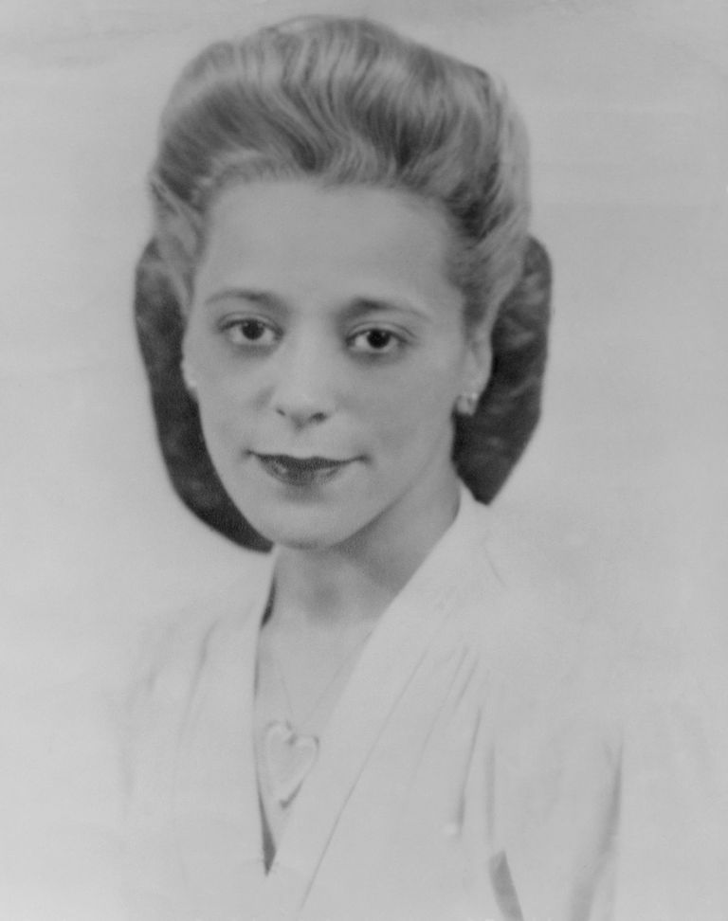
The Trial
After spending one night in jail, Desmond was brought to court and then charged, tried, convicted of tax evasion, and fined twenty-six dollars. The tax evasion charge was based on the one cent difference in tax between main-floor and balcony theatre seats.
Clearly, the issue was about her being African Canadian and there being a racist seating policy in place. it was not about tax evasion. Desmond knew this and decided to appeal her conviction, and it was eventually brought before the Supreme Court of Nova Scotia. Despite the efforts of the Nova Scotian Black community to assist her appeal, Desmond lost.

Slide 13
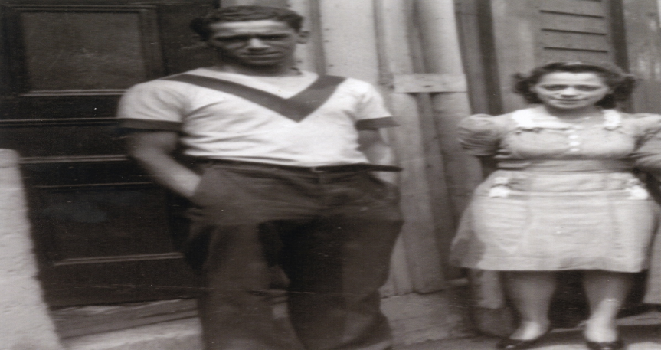
Significance
By refusing to change seats and by fighting her conviction in court, Desmond challenged segregation in Canada. Despite losing her appeal, her stand against discrimination and hatred generated a lot of attention in Nova Scotia’s Black community and helped inspire Canada’s civil rights movement.
In 1954, segregation was legally ended in Nova Scotia, due to the courageous determination of Desmond and others like her who fought to be treated as equal human beings. In 2010, the Lieutenant Governor of Nova Scotia posthumously pardoned her, removing her conviction from the historical record.

