Slide 1
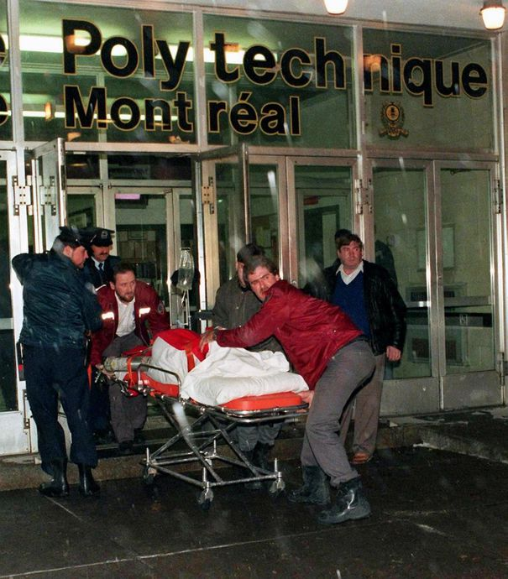
Terrorism in Canada: Polytechnique Tragedy and the Air India Flight 182 Bombing

Slide 2
Background to the Polytechnique Tragedy
For students at École Polytechnique (the engineering department of the University of Montreal) December 6, 1989, was the last school day before the winter holidays. On the second floor of the building, room 230 was filled with mechanical engineering students, many of them were final year students about to graduate. They were sitting through a final round of oral presentations in class.
A hate-filled 25 year old man armed with a semi-automatic rifle entered École Polytechnique with a specific target in mind: women. He would go on to commit Canada’s deadliest mass shooting.

Slide 3
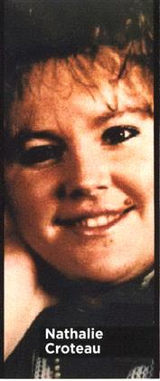
Mass Shooting
The gunman walked into the mechanical engineering classroom and told everyone to stop everything. He ordered the women to move to the left side of the room and the men to the right. Then he told the men to leave. Alone with the female students, he shouted, “you’re all a bunch of feminists! I hate feminists!” He then fired on the women.
The violent rampage lasted for about 20 minutes as the shooter yelled, “I want women” and moved through classrooms, corridors and the cafeteria specifically targeting his victims based on their gender. 14 women were killed, 14 others were injured (including 4 men caught in the crossfire). The gunman later turned the gun on himself.

Slide 4
The Weapon
On August 29th, 1989, the killer went to the Quebec provincial police headquarters to get an application form for a firearms acquisition certificate. He met the legal requirements: he was older than 16, had no criminal record, and checked a box on the firearms acquisition certificate indicating he was not mentally ill. He was issued with his permit 6 weeks later.
On November 21st, he went to Checkmate Sports and bought a Sturm-Ruger Mini-14 rifle and ammunition. Several North American SWAT teams use the rifle and it was used during the Vietnam War. The weapon is a semi-automatic and he attached a high-capacity magazine to it so he could fire 30 bullets in quick succession.

Slide 5
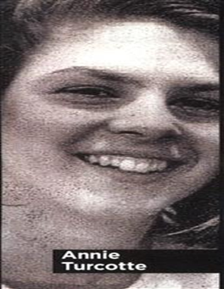
Motivated by Sexism and Misogyny
The shooter had a history of making sexist comments. He complained that women had been taking employment opportunities away from men. Some of his hatred was directed at women on the police force because he didn’t think they had the physical strength to do the job.
In a suicide note he blamed feminists for his personal failures and listed nineteen prominent Quebec women (including six female police officers) as targets on his hit list. The gender of the killer’s victims, the words he spoke, as well as the words he wrote in his suicide note, led to the massacre being seen as a misogynistic, antifeminist attack.

Slide 6
The Police Response
The Quebec provincial police received criticism regarding how they responded to the attack. Instead of immediately entering the building upon arrival to confront the active shooter, they assembled outside and established a security perimeter around the building, only entering it after receiving details about the suicide. Coroner Teresa Z. Sourour implied in her report that police could have done more. She said the shooter had 60 bullets left he could have used because "no police assault was in progress or in any obvious state of preparation."
A faster intervention may have limited the number of human casualties. Emergency response strategies to shootings in Canada changed after the massacre. Police are now trained to swarm similar situations to immediately confront and neutralize armed gunmen.

Slide 7
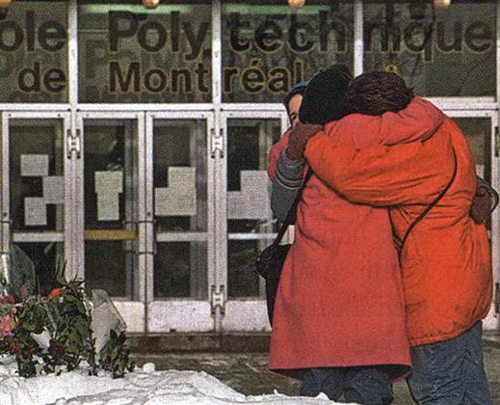
Firearm Laws
Survivors, parents of the victims and other students at École Polytechnique directed their grief towards affecting positive change. They organized themselves under the Coalition for Gun Control and have been influential in lobbying for stricter gun control laws in Canada.
Their activism led to the passage of Bill C-17 in 1991. This banned most military-style rifles, all high-capacity magazines for automatic and semi-automatic firearms, and introduced new regulations such as requiring new firearm licence applicants to provide two references, complete a safety training course and pass an examination.

Slide 8
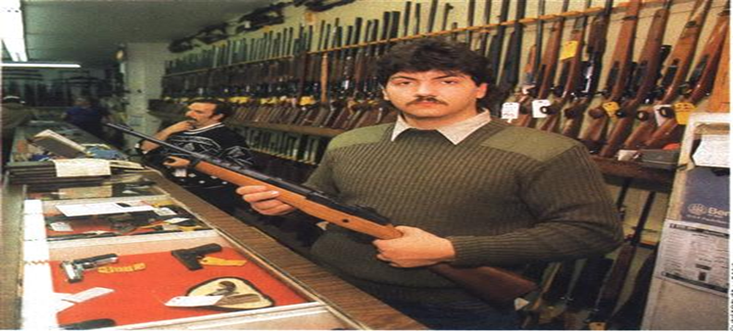
Firearm Laws
The Coalition for Gun Control also successfully lobbied for the passage of Bill C-68 (the Firearms Act) in 1995. The main feature of this act was a long gun registry which was a centralized database that linked all long guns – hunting rifles, sports rifles, and shotguns - with their licensed owners. (Laws requiring handguns in Canada to be registered have existed since 1934). The registry has been used as a tool by police to remove guns from people who shouldn’t have them.
In 2012, however, with the passage of Bill C-19, the long gun registry was eliminated. The federal conservative government claimed it was too expensive and had little impact on crime.

Slide 9
Violence Against Women
In 1991, Canada declared December 6 as a National Day of Remembrance and Action on Violence Against Women. As well as commemorating the 14 bright and talented women whose lives ended in an act of gender-based violence at École Polytechnique, it is a day to speak out against misogyny, sexism, and hate, and take action to eliminate all forms of violence against women and girls.
Gender-based violence is not limited to physical abuse but includes words, actions, or attempts to degrade, control, humiliate, intimidate, coerce, deprive, threaten, or harm another person.

Slide 10
How Can We Help?
There are several actions we all can take towards eliminating gender-based violence in our society. Some ways you can help include:
If you hear abusive language being used against a woman, speak up! Say something like, “it's just wrong to talk about women that way."
If you have a female friend who you believe is being physically or emotionally abused by her partner or an ex, ask her about it. Breaking the silence may be just what she needs to start getting help.
If you have a male friend who you believe is physically or emotionally abusing a woman, let him know that you value his friendship but you are troubled by his behaviour.

Slide 11
Background to Air India Flight 182 Bombing
Prior to the bombing of Air India flight 182, Sikh separatists in India rallied for the creation of an independent Sikh province named Khalistan in the northwestern province of Punjab in India. This group of militant Sikhs used the Golden Temple – Sikhism’s holiest site - in Amritsar, India as its base. In June 1984, the government in India sought to crush this movement and ordered a military assault against the separatists occupying the temple. In the ensuing battle, 1200 people were killed.
Among those calling for retaliation against the Indian government was the leader of a militant Sikh extremist organization called the Babbar Khalsa – Talwinder Singh Parmar. The Babbar Khalsa also advocated for a separate Sikh province in the Punjab. Their members devised a plan to bomb two Air India flights.

Slide 12
Testing The Bomb
Parmar and his associates were under surveillance by members of the Canadian Security Intelligence Service (CSIS). CSIS agents were following Parmar and intercepting his phone calls using a wiretap from March to June 1985.
On June 4, they tailed him to Duncan, on Vancouver Island, where he met Inderjit Singh Reyat, a local marine mechanic, and also a mystery man dubbed Mr. X. Parmar, Reyat and Mr. X drove to a wooded area outside of town, got out and went into the trees. The agents could no longer see them. But minutes later, they heard an explosion as the trio tested materials to be used in the Air India bombing. When an explosion took place, CSIS agents mistakenly believed that it was the sound of a rifle.

Slide 13
Suitcase Bombs Planted
On June 19, one of Parmar's associates bought two Canadian Pacific Airlines (CP) tickets. These were booked in the names of L. Singh, who was booked on CP flight 003 (Vancouver to Tokyo) connecting to Air India Flight 301 (Tokyo to Bangkok,) and M. Singh, who had a seat on CP flight 060 (Vancouver to Toronto) connecting with Air India Flight 181/182 (Toronto to Montreal and Montreal to New Delhi).
Parmar, Reyat and others were involved in the building of bombs. These explosive devices were placed in suitcases. On June 22, the suitcases were taken to Vancouver International Airport, checked in as luggage, and sent on to the two CP flights and for the two connecting Air India flights. Neither passenger, whose names appeared on the tickets used to check the suitcases, showed up to board the airplanes.

Slide 14
Explosion at Tokyo’s Narita Airport
L. Singh’s suitcase with a bomb in it made its way onto CP Flight 003 departing from Vancouver bound for Narita Airport in Tokyo, Japan. After the plane landed in Tokyo, the suitcase was in the process of being transferred onto the connecting Air India Flight 301 from Tokyo to Bangkok, Thailand.
Although the terrorists intended for this bomb to explode onboard Air India Flight 301 (which would have killed 177 people), it exploded at the Narita Airport baggage terminal at approximately 11:15 P.M. on June 22, 1985, while luggage was being transferred from Canadian Pacific Flight 003 to Air India Flight 301. Two Japanese baggage handlers Hideharu Koda and Hideo Asano were killed instantly and four other baggage handlers were injured.

Slide 15
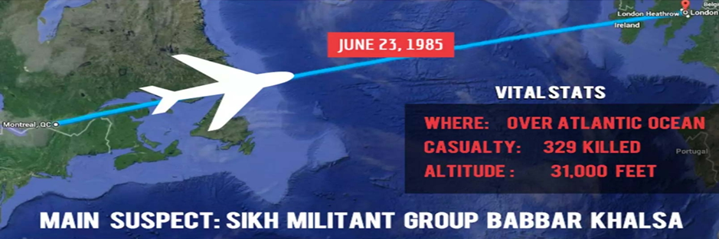
Explosion Onboard Air India Flight 182
M. Singh’s suitcase with a bomb in it made its way onto CP Flight 060 departing from Vancouver bound for Pearson International Airport in Toronto. After the plane landed in Toronto, the suitcase was transferred onto the connecting Air India Flight 181/182 from Toronto to Montreal and from Montreal to New Delhi, India.
At approximately 12:14 a.m., on June 23, 1985, the bomb exploded in the rear cargo hold and blasted open a hole in the left aft fuselage of the plane. The aircraft was blown apart, falling approximately 31,000 feet below into the Atlantic Ocean off the south-west coast of Ireland. All 329 people on board were killed, 280 of which were Canadians. This incident remains the largest mass murder in Canadian history.

Slide 16
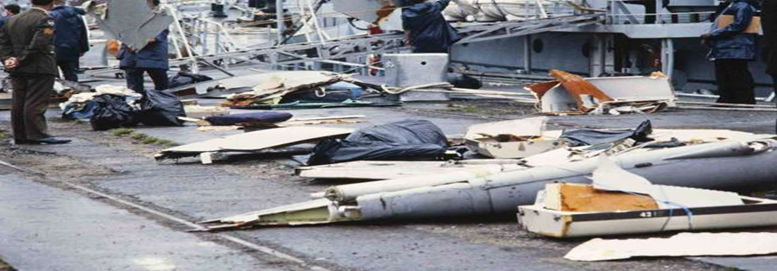
Criminal Investigation Begins
After the bombings, more than 200 RCMP investigators and support staff were deployed to the investigation of the Air India and the Narita Airport bombings. The investigation was national and international in scope. The majority of the physical evidence was uncovered at the Narita blast site and investigation surrounding Reyat's acquisition of bomb components. Searches and communication intercepts of suspects were numerous.
The Air India Flight 182 crime scene generated only a minimal amount of physical evidence as the wreckage was located over 6,000 feet below the ocean's surface and only a very small portion was ever recovered.

Slide 17
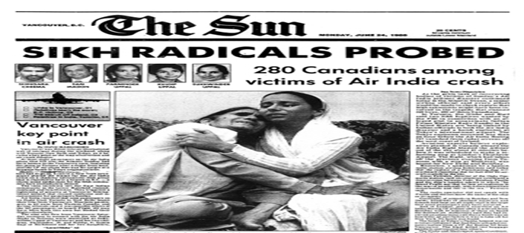
Parmar and Reyat
On November 6, 1985, the Royal Canadian Mounted Police (RCMP) conducted a search of the homes of Parmar, Reyat and three others. Following the sweep, Parmar and Reyat were arrested on weapons, explosives and conspiracy charges.
The charges against Parmar were dropped due to lack of evidence. Although investigators initially failed to link Reyat to the Air India bombing, he was charged with three counts relating to the ignition of an explosive device in the woods outside Duncan, British Columbia and a fourth count related to a weapon found in his home during a search by police. Reyat eventually pled guilty to two counts, paid a fine of $2,000 and a stay of proceedings was entered with respect to the other two counts. Shortly after that, he moved his family to Coventry, England.

Slide 18
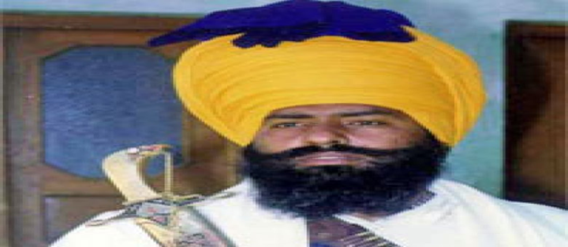
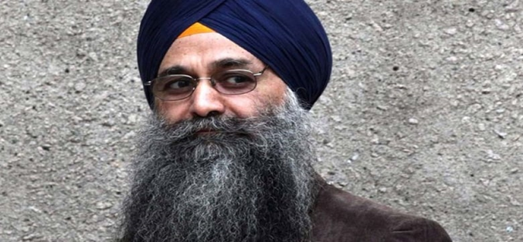
Parmar and Reyat
In February 1988, police in Britain arrested Reyat and charged him with making the bomb that exploded at the Narita Airport. He was extradited to Canada on December 13, 1989. His trial began on September 17, 1990, and lasted eight months. Evidence showed that in 1985 Reyat purchased components to make the bomb such as a rare adhesive, a Micronta car clock and a 12-volt battery. On May 10, 1991, he was found guilty of manslaughter in the deaths of the two baggage handlers. Justice Paris of the British Columbia Supreme Court sentenced Reyat to 10 years in prison.
Despite the arrest of Reyat, the investigators were having difficulty finding sufficient proof to charge others. While Parmar was clearly identified as a member of the conspiracy, he was killed in India in an encounter with Indian police in 1992.

Slide 19
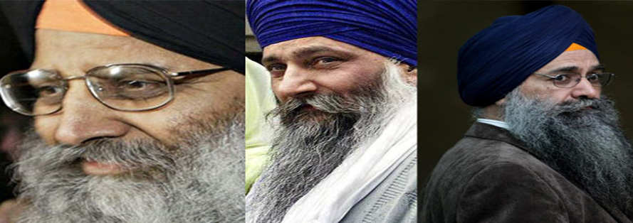
Murder Charges Laid
On October 27, 2000, two of Parmar’s associates, Ripudaman Singh Malik and Ajaib Singh Bagri were arrested in relation to the bombings. Malik and Bagri were charged jointly with eight counts under the Criminal Code of Canada. On June 5, 2001 Crown Counsel filed a new indictment, adding Reyat to those already charged on October 27, 2000. Malik, Bagri and Reyat were jointly charged with the following:
1 count of first degree murder
1 count of conspiracy to commit murder
1 count of attempted murder of the passengers and crew of Air India Flight 301
1 count of conspiring to cause bombs to be placed on board various aircraft
3 counts of causing a bomb to be placed on an aircraft

Slide 20
Trial for Mass Murder
On February 10, 2003, Reyat pled guilty and was sentenced to five years in prison for manslaughter, the murder charges against him were dropped. He confessed to building both bombs. The trial of the other accused, Bagri and Malik, began in British Columbia Supreme Court on April 28, 2003. On March 16, 2005, Justice Josephson released his decision finding Malik and Bagri not guilty on all counts.
Josephson found that the evidence against Malik and Bagri did not prove guilt beyond a reasonable doubt. There was no physical evidence that could link these two individuals to the conspiracy. Josephson criticized CSIS for erasing hundreds of hours of wiretap conversations between Parmar and the suspects. He deemed the destruction of this potentially crucial evidence “unacceptable negligence.”

Slide 21
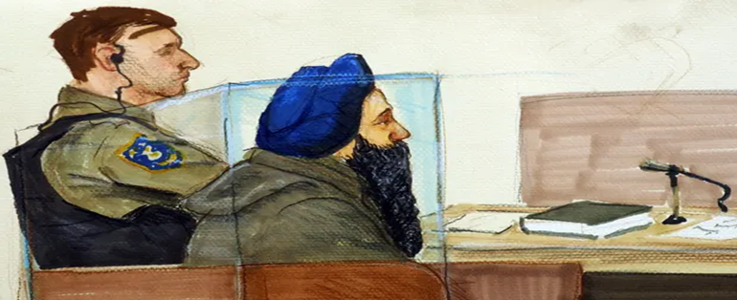
Perjury
Reyat testified at the 2003 trial of Malik and Bagri. He was called as a witness for the prosecution but claimed that he could not remember anything about the conspirators. Reyat testified that he never learned details of the plot, and did not know the name of a man who spent a week at his home in Duncan, B.C., building the explosive devices. The prosecution called his testimony “a pack of lies.”
On January 7, 2011, Reyat was sentenced to another nine years in jail for perjury in the trial of Malik and Bagri. It is impossible to know if Malik and Bagri would have been convicted if Reyat had cooperated with prosecutors, but police and the victims’ relatives said they believe they would have been. Reyat is the only person ever convicted in connection with the Flight 182 bombing or the Narita bombing.

Slide 22
Inquiry and Federal Apology
In January 2006, the federal government appointed Justice John Major to lead an inquiry to investigate the bombing. On June 17, 2010, Major released his report.
He concluded that government agencies were in possession of information that revealed that flight 182 was at high risk of being bombed by known Sikh terrorists in June 1985. The failure to prevent the bombing was "inexcusable." CSIS was "ineffective." There was a "lax security culture" at airports. Successive governments treated the victims' families "like adversaries, as if they had somehow brought this calamity on themselves.” He said they deserved an apology and compensation – a recommendation Prime Minister Harper accepted. On June 24, 2010, Harper apologized on behalf of the government to the families of the victims.

Slide 23
Compensation
In 2011, The Government of Canada announced it would provide a one-time ex gratia payment of $24,000 to the families of the passengers and crew who died on Air India Flight 182.
Ex gratia payments are voluntary, symbolic payments. The Air India Flight 182 Ex Gratia Payment was provided to families in recognition of the suffering families had to endure due to years of unanswered questions relating to the tragedy. This payment was not compensation for the tragedy itself, but to demonstrate solicitude, recognition and acknowledgement for what families had to endure following the tragedy.

Slide 24
Significance of Air India Flight 182 Bombing
Transport Canada enacted additional security measures for all Canadian and foreign carriers for all international flights from Canada on June 23, 1985, as an immediate response to the Air India Flight 182 tragedy and the baggage cart explosions at Narita Airport. These measures included:
More rigorous screening of all passengers and carry-on baggage.
The physical inspection or x-ray inspection of all checked baggage.
The acquisition and deployment of additional carry-on luggage x-ray units.
The Air India and Narita disasters transformed Canada's civil aviation program. These two events also changed the international environment and generated new approaches to protecting passengers, airports and aircraft around the world.

