Slide 1
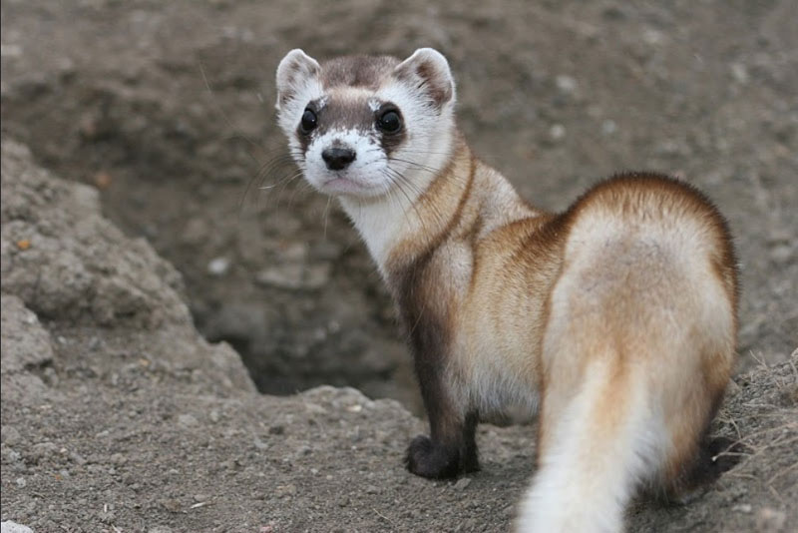
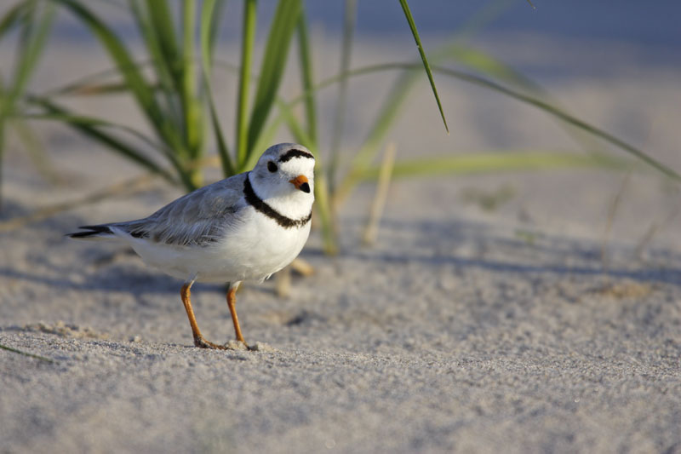
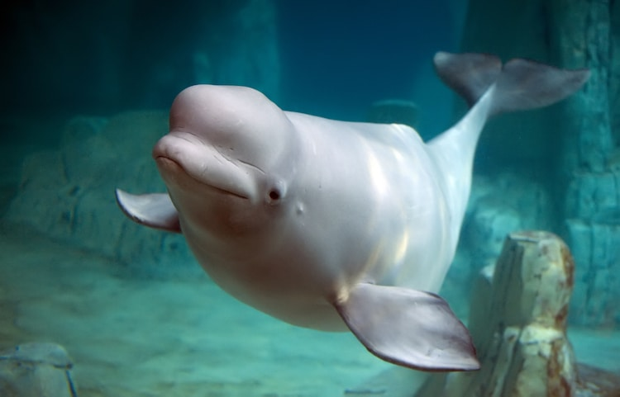
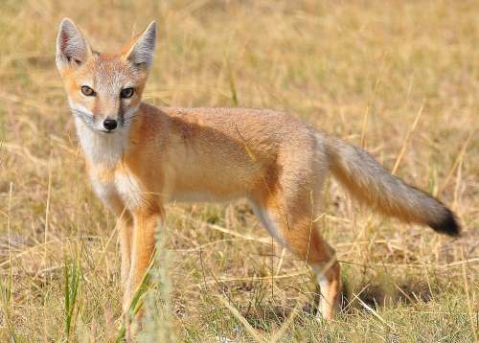
Species at Risk in Canada

Slide 2
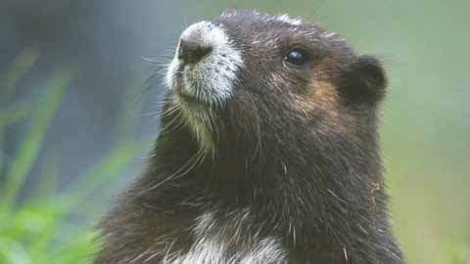
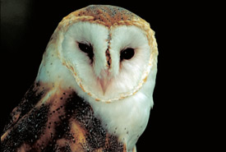
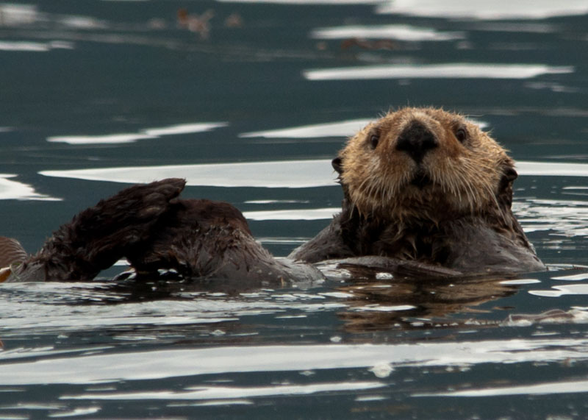
What Are Species At Risk?
Animals live in habitats - areas with food, water, shelter and space essential for species survival - such as grasslands, wetlands, temperate rainforests, and marine environments. Various negative impacts can result in populations of species being unable to continue to grow and thrive in their habitats. This can lead to a decrease in the numbers of a species placing it in danger of becoming extinct (no longer existing) or extirpated (no longer existing in Canada, but existing elsewhere). Any animal that is in danger of becoming extinct or extirpated is a species at risk.
As of 2018, 531animals were considered at risk in Canada. Some of these species live in and around Vancouver Island such as:
Vancouver Island Marmot | Barn Owl | Sea Otter

Slide 3
Why Do Species Become At Risk?
Many factors impact the survival of species by causing their populations to decline, but habitat loss and degradation is the main cause. While this can be the result of natural disasters – such as wildfire, flooding, drought, or hurricanes – it is more often due to human actions. As the human population grows, we use more land and resources. We drain wetlands to build housing developments, schools, businesses and roads. We turn grasslands and wooded areas into farms. We cut forests for wood or pulp and paper. Habitats which species depend on are lost or damaged. Other factors include:
Overharvesting | Climate change | Disease
Genetic and reproductive isolation due to fragmentation of habitat | Invasive species | Environmental contamination such as chemicals like herbicides and pesticides

Slide 4
What Is COSEWIC?
The Committee on the Status of Endangered Wildlife in Canada (COSEWIC) was created in 1977 to identify wildlife species that are at risk across Canada. The assessment process is based on a combination of science, Aboriginal Traditional and community knowledge about a wildlife species' biology, population status, range, and threats. COSEWIC’s experts assign species to one of the following categories: not at risk, data deficient, special concern, threatened, endangered, extirpated, or extinct.
The Canadian federal government takes COSEWIC assessments into consideration when establishing the official list of wildlife species at risk. Wildlife species that have been identified as at risk by COSEWIC may then qualify for legal protection and recovery under the Species at Risk Act.

Slide 5
How Are They Categorized?
Species that are in decline or at risk of extinction are put into different groups based on their level of risk of further decline, so that ideally, protection and recovery efforts can be prioritized. The Species at Risk Act defines the level of risk in four categories:
Special concern – a wildlife species that may become a threatened or an endangered species because of a combination of biological characteristics and identified threats. | Threatened – a wildlife species that is likely to become endangered if nothing is done to reverse the factors leading to its extirpation or extinction. | Endangered – a wildlife species that is facing imminent extirpation or extinction. | Extirpated – a wildlife species that no longer exists in the wild in Canada, but exists elsewhere.

Slide 6
What is the Species At Risk Act?
The federal government passed the Species at Risk Act (SARA) in 2002. It is designed to prevent Canadian wildlife species from becoming extinct or extirpated, provide for the recovery of species that are endangered or threatened as a result of human activity, and manage species of special concern to prevent them from becoming endangered or threatened. There are also requirements that recovery strategies or management plans be developed for all listed species, and that critical habitat for listed species be defined and protected. It is prohibited under SARA to:
Kill, harm, harass, capture or take individuals of extirpated, endangered or threatened species. | Possess, collect, buy, sell or trade individuals or parts of extirpated, endangered or threatened species. | Damage or destroy an individual’s residence or part of the species’ legally identified critical habitat.

Slide 7
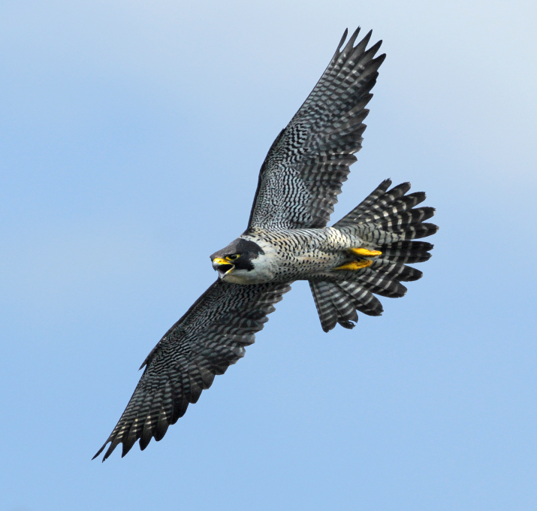
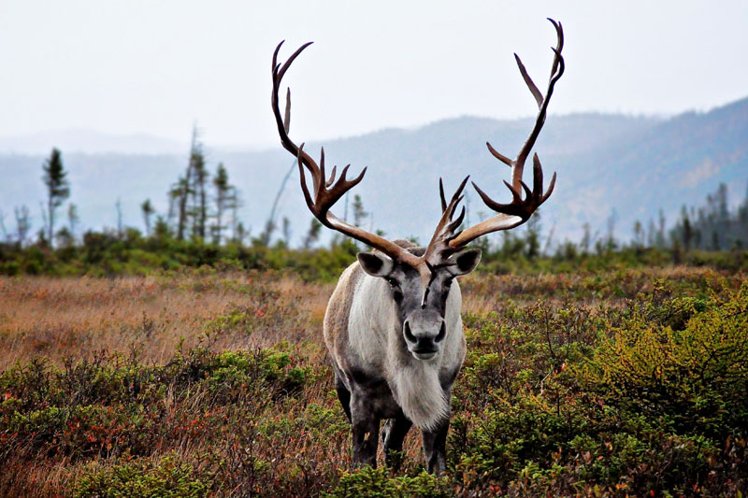
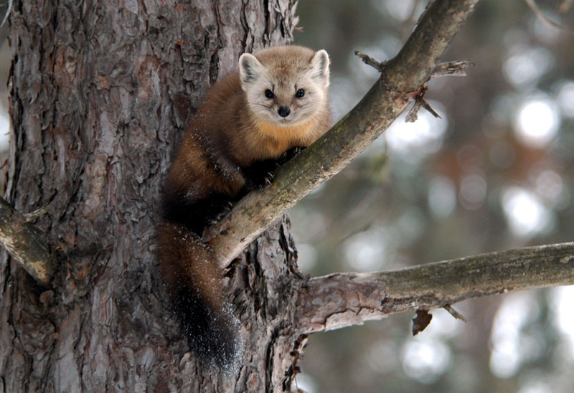
What Is Being Done?
Canadian federal, provincial/territorial and municipal government agencies create and enforce laws regulating everything from hunting and fishing to resource extraction and land development. Protected areas are set aside such as national and provincial parks, marine conservation areas and wildlife reserves. These provide habitats for thousands of species (plants, animals, insects, etc.) across Canada, including species at risk. Protected areas ensure that special habitats are preserved for the long-term survival of species that rely on them. Examples of species at risk inhabiting a protected area are:
Peregrine Falcon – Fundy National Park (NB) | Woodland Caribou – Jasper National Park (AB) | Newfoundland Marten – Terra Nova National Park (NL)

Slide 8
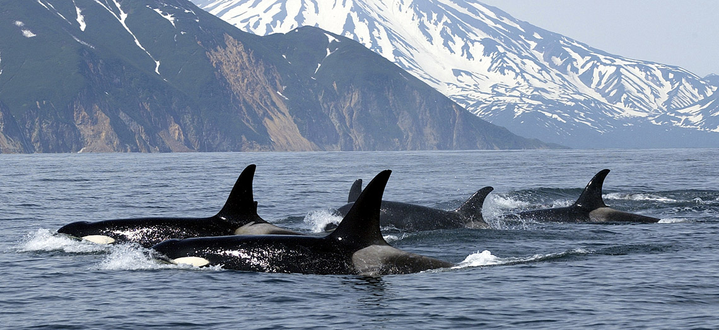
Why Should We Care?
In medicine, the development of new drugs and treatments depends greatly on wildlife and wildlife habitat. Most pharmaceutical products were discovered or developed by studying wild species, not invented on the basis of the principles of chemistry.
Wildlife recreation is an important part of Canada’s economy. Hundreds of thousands of visitors come in search of wildlife experiences such as bird watching, whale watching, and polar bear watching every year. This influx of visitors generates income for the tourism industry, creates job opportunities and benefits local economies.
We all lose in a number of ways when a species vanishes from earth. We may have lost something with spiritual and traditional significance for First Nations or a species that may hold the potential for future scientific or medical breakthroughs.

Slide 9
How Can We Help?
In order to reverse the declining populations of species at risk, we need to act now. There are many actions we can take to protect species at risk. Here are a few ideas:
Reduce, reuse and recycle | Grow native plants in your garden | Buy organic fruits and vegetables
Install bird feeders, nest boxes and bird baths in your yard | Donate to a non-profit organization that supports species at risk | Reduce pollution by walking, riding a bicycle, or taking a bus
Volunteer for a species at risk recovery effort in your community | Participate in land-use planning processes in your community to ensure that wildlife habitat is protected | Avoid using herbicides, pesticides, or chemical fertilizers in your yard

Slide 10
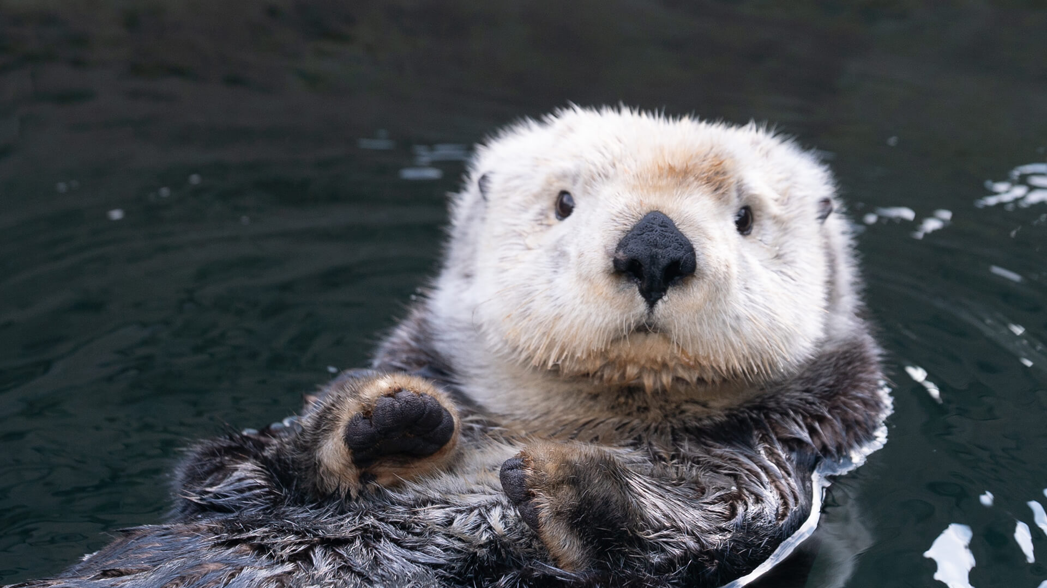
Sea Otter
This species had been extirpated in British Columbia by the fur trade by the early 1900s, and was re-introduced from 1969-72. It has since repopulated 25-33% of its historic range in British Columbia, but is not yet clearly secure. Numbers are small (less than 3,500) and require careful monitoring. Their susceptibility to oil and the proximity to major oil tanker routes make them particularly vulnerable to oil spills.
COSEWIC range - BC, Pacific Ocean | COSEWIC status – Special Concern | COSEWIC assessment date – April 2007

Slide 11
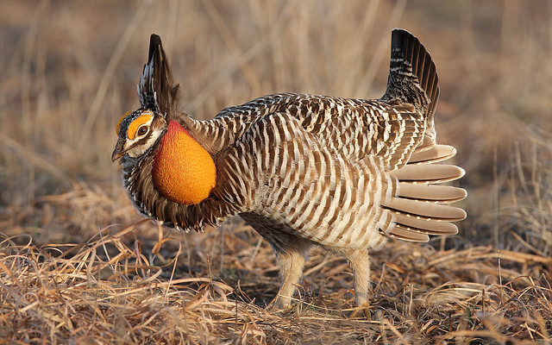
Greater Prairie-Chicken
This species was once an abundant breeder in prairie habitats of Alberta, Saskatchewan, Manitoba and Ontario. New genetic evidence indicates that the species was a native of Canada for the past 9000 years and did not colonize the prairies habitat with European settlement as previously thought. However, when vast amounts of prairie grassland were converted to cultivated crops, the habitat was no longer suitable and the species disappeared from its Canadian range. Habitat loss and degradation and hybridization with the Sharp-tailed Grouse contributed to its extirpation from Canada.
COSEWIC range – AB, SK, MB, ON | COSEWIC status – Extirpated | COSEWIC assessment date – November 2009

Slide 12
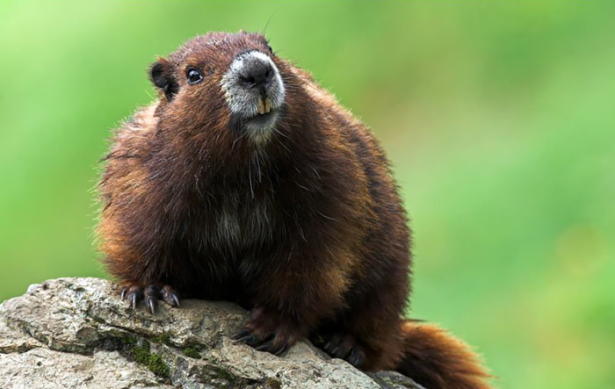
Vancouver Island Marmot
This species is found only on Vancouver Island, British Columbia. Since the last assessment in 2008, the species has demonstrated a rapid population increase and then a subsequent decline; there are currently an estimated 88–101 mature animals in the wild. Ongoing predation remains high and there are potential threats from inbreeding and climate change. The major current threat to Vancouver Island marmots is predation, largely by wolves, cougars, and golden eagles. A population viability analysis suggests that there is a high probability of extinction if there are extended periods of low adult survival, as observed during previous and most recent declines, and there are relatively few captive-bred animals introduced into the extant wild colonies.
COSEWIC range – BC | COSEWIC status – Endangered | COSEWIC assessment date – May 2019

Slide 13
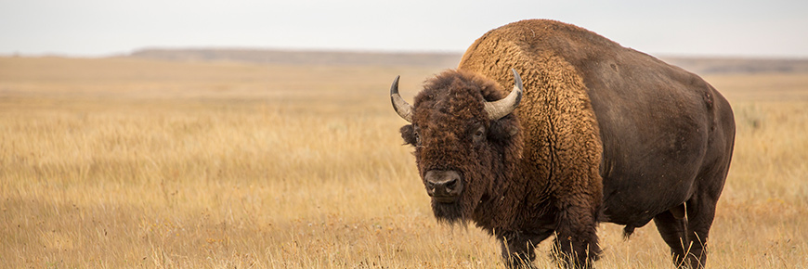
Plains Bison
This bison occurs in only five isolated wild subpopulations in Canada. There are approximately 1,200 to 1,500 mature individuals, of which about half occur in one subpopulation located outside of the historical range. The total number of individuals has increased by 36% since the last assessment in 2004, but the total remains a tiny fraction of their numbers of 200 years ago. This animal continues to face a number of threats to its persistence. Lack of habitat is the greatest impediment to the conservation of the Plains Bison. The major part of its original range has been lost to agriculture and urbanization. Additional threats include domestic cattle diseases and the risk of genetic pollution from escaped ranched bison.
COSEWIC range – BC, AB, SK | COSEWIC status – Threatened | COSEWIC assessment date – November 2013

Slide 14
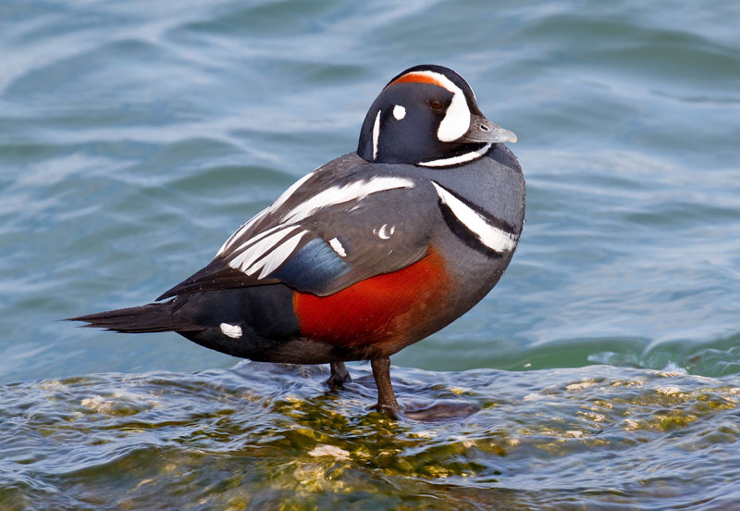
Harlequin Duck
Though increases have been recorded in southern parts of its breeding range, the population size of this sea duck remains relatively small. Its tendency to congregate in large groups when moulting and on its marine wintering areas makes it susceptible to catastrophic events such as oil spills. Such threats are substantial and are likely increasing, and are of particular significance for populations of long-lived species such as this sea duck, which can be slow to recover. Its population also appears to rely on continued management efforts, particularly those involving restrictions on hunting.
COSEWIC range – NU, QC, NB, NS, NL | COSEWIC status – Special Concern | COSEWIC assessment date – November 2013

Slide 15
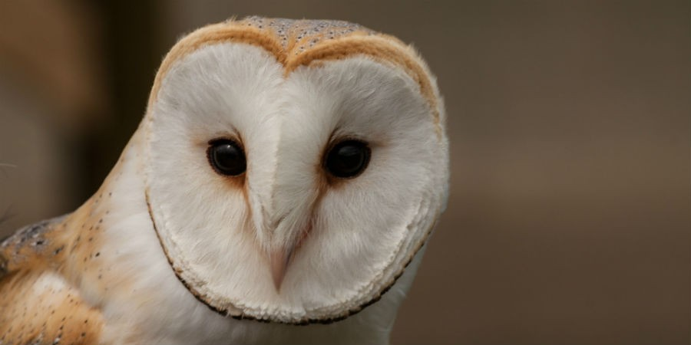
Barn Owl
Eastern Canada supports a tiny fraction of the global population of this charismatic nocturnal raptor that preys on small rodents. Owing to its intolerance of cold climates and deep snow cover, populations in Canada are restricted to parts of southern British Columbia and southwestern Ontario, where the species is now close to being extirpated. Across the northern extent of its eastern North American breeding range, the species is declining and is threatened by ongoing loss and degradation of grassland and old field habitat and by the conversion of old wooden barns and other rural buildings to more modern structures. This owl is also exposed to increasing levels of road-kill mortality owing to expansion of the road network and increases in traffic.
COSEWIC range – ON | COSEWIC status – Endangered | COSEWIC assessment date – November 2010

Slide 16
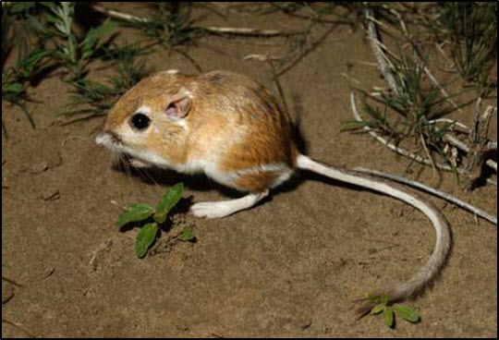
Ord’s Kangaroo Rat
This small, nocturnal rodent is restricted to 12 active sand hill complexes in southeastern Alberta and southwestern Saskatchewan. Its small population (fewer than 1,000 mature individuals in most years) varies unpredictably over short periods of time. It is threatened by cumulative human impacts including installation and maintenance of roads and service corridors, energy production, changing land uses, and light and noise pollution. These threats may exacerbate the other limiting factors of vegetation encroachment and stabilization of open sand dune habitats. Standardized annual population monitoring of the species in Alberta has revealed a 72% decline in abundance between 2006 and 2015, likely due to habitat decline.
COSEWIC range – AB, SK | COSEWIC status – Endangered | COSEWIC assessment date – April 2017

Slide 17
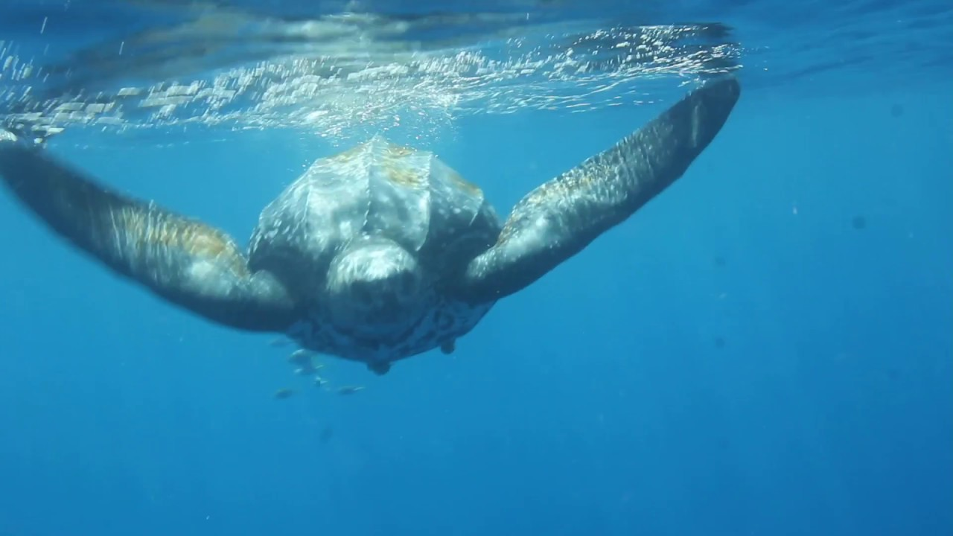
Leatherback Sea Turtle
In the Atlantic, this species continues to be impacted by fisheries bycatch, coastal and offshore resource development, marine pollution, poaching of eggs, changes to nesting beaches and climate change. Canadian waters provide an important foraging area for these turtles. There they are threatened by entanglement in longline and fixed fishing gear. The Pacific population of this species has collapsed by over 90% in the last generation. Continuing threats include fisheries bycatch, marine debris, coastal and offshore resource development, illegal harvest of eggs and turtles, and climate change.
COSEWIC range – Atlantic and Pacific Ocean | COSEWIC status – Endangered | COSEWIC assessment date – May 2012

Slide 18
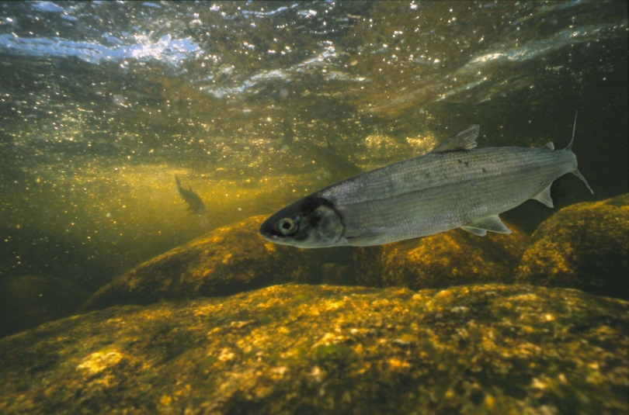
Atlantic Whitefish
This species is unique to this country. It is found only in the Tusket River and Petite Riviere watersheds in southern Nova Scotia. The Tusket River dam and its ineffective fish ladders have posed barriers to the migratory Atlantic Whitefish. Parts of this river are also very acidic, which may have affected the species’ reproductive ability. The spread of introduced fish predators (e.g. chain pickerel) appear to have posed significant threats to Atlantic Whitefish. The possible spread of introduced fish (e.g. smallmouth bass) in the Petite Riviere watershed poses significant threats to the Atlantic Whitefish. Poaching, incidental fishing, and the restricted distribution of the animals also limit the recovery of the species.
COSEWIC range – NS | COSEWIC status – Endangered | COSEWIC assessment date – November 2010

Slide 19
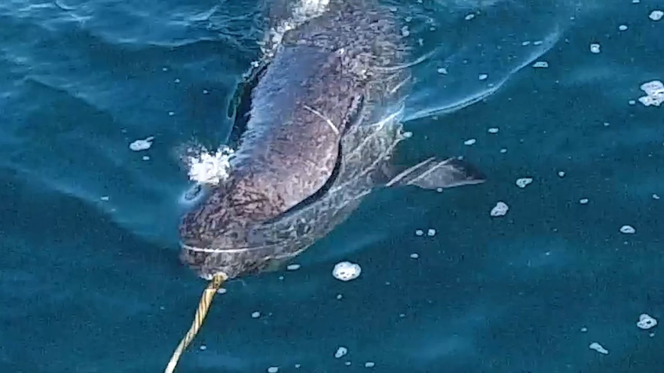
Narwhal
The Baffin Bay population appears to be large (~45,000), although there is uncertainty about numbers, trends, life history parameters, and levels of sustainable hunting. There is similar uncertainty about the much smaller Hudson Bay population (~2,100 mature individuals). Narwhals have been traditionally hunted for over a thousand years by Inuit people in northern Canada and Greenland for food and their tusks. Potential effects of changes in ice coverage caused by climate trends are unknown. The Hudson Bay population could decline by 30% in 30 years if hunting is not closely regulated. Similarly, the Baffin Bay population could be affected if hunting in Greenland is not effectively managed. Numbers removed by hunting increased during the 1990s.
COSEWIC range – Artic Ocean | COSEWIC status – Special Concern | COSEWIC assessment date – November 2004

Slide 20
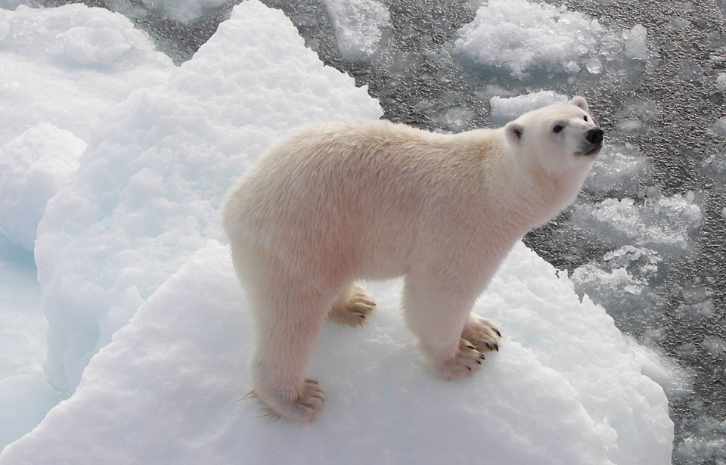
Polar Bear
This apex predator depends on the availability of sea ice from which to hunt its preferred prey—ice-adapted seals. Reduction in the area and period of sea ice coverage due to climate warming in the Canadian Arctic, with consequent reductions in feeding opportunity, is the primary threat to the persistence of this species. The Canadian population is predicted to decline over the next three generations (35 years) due to a reduction in seasonal coverage of sea ice. This species may become threatened in the future because the effects of sea ice loss on this species will be extensive and ongoing.
COSEWIC range – Artic Ocean, YT,NT,MB,ON,QC | COSEWIC status – Special Concern | COSEWIC assessment date – November 2018

