Slide 1
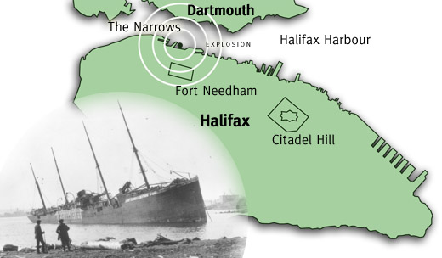
The Halifax Explosion

Slide 2
Collision
On December 6, 1917, a French munitions ship, the Mont-Blanc arrived outside the mouth of the busy wartime Halifax Harbour to join a convoy (a group of ships travelling together) across the Atlantic Ocean en route to Bordeaux, France. It carried a highly explosive cargo of picric acid, TNT, gun cotton and benzol.
A Norwegian vessel, the Imo, departed from Halifax Harbour bound for New York to pick up a cargo of relief supplies for war-torn Belgium. At the entrance to the Narrows, the Imo struck the Mont-Blanc on the bow. The collision caused a fire on board the Mont-Blanc.

Slide 3
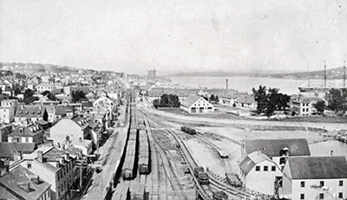
Prior To The Explosion
The crew of the Mont-Blanc, aware of their cargo, immediately took to the lifeboats and rowed for Dartmouth, abandoning the ship. The French sailors came ashore and shouted at onlookers to flee, but they did not understand French. The adrift ship came to rest at Pier 6 in the industrial neighbourhood of Richmond.
There were about 20 minutes between the collision and the explosion at 9:05 a.m. It was enough time for spectators, including many children who were on their way to school, to run towards the harbour to watch the ship burning, thus coming into close range. In schools, factories and houses, people gathered at windows to watch. Thus many people were injured by flying glass.

Slide 4
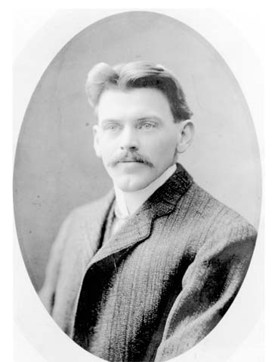
Vincent Coleman
Vincent Coleman, a railway dispatcher in the nearby railway yards, learned that an explosion was imminent. Coleman controlled the busy freight- and passenger-rail traffic coming and going from the Halifax peninsula.
He was about to flee his office when he realized that trains were due to arrive — including the 8:55 a.m. train from Saint John, New Brunswick, with hundreds of passengers on board. As the Mont-Blanc burned and the minutes ticked by, Coleman stayed at his post, tapping out a message on his telegraph key, warning stations up the line to stop any trains from entering Halifax. "Munitions ship on fire. Making for Pier 6. Goodbye.” He was killed at his desk when the explosion occurred.

Slide 5
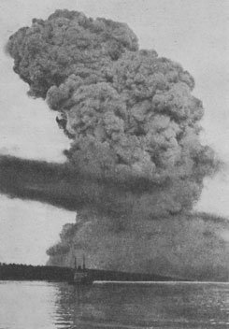
The Explosion
A supersonic shockwave killed more than 1,600 people instantly, destroying their internal organs or throwing them like rag dolls against brick and stone walls, fences and trees, or mortally wounding them with flying shards of glass, wood and metal.
Buildings and houses were blown apart. Whole families were killed as their houses collapsed one storey onto another. People were crushed and battered and slashed, on the street, in schools and factories, foundries, breweries, rail yards and dockyards. The official death toll was 1,963 with another 9,000 injured. 1,630 homes were destroyed, 12,000 houses were damaged and 6,000 people were left without shelter.

Slide 6
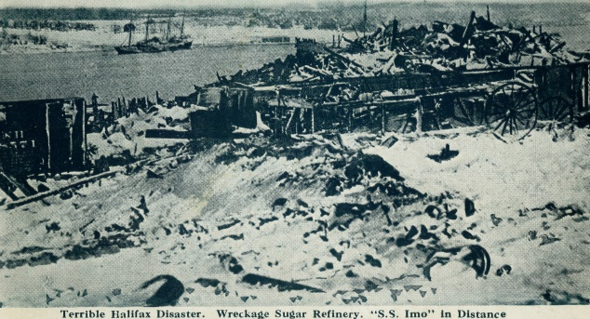
James Pattison
Thirteen-year-old James Pattison was walking to Richmond School with his two brothers when the ships collided. He said: "We didn’t hear the explosion, we felt the concussion. Knocked us unconscious. It did come into my mind - is this the end of the world? You couldn’t hear a sound. Then of course things cleared off a little and you could hear noises - people screaming and of course you could hear the places burning.”
James Pattison lost half of his family. His brother, Alan, died on the way to school. His ten-year-old sister Catherine was killed instantly at home. It was four months before his father's body was pulled from the wreckage of the sugar refinery where he worked.

Slide 7
Rescue and Relief
Hospitals were unable to cope with so many wounded. Rescue efforts to free those trapped in collapsed buildings were hampered by the blizzard that struck the city the following day, dumping 16 inches of snow.
Military and naval personnel worked with civilians in the relief effort. Money poured in from as far away as China and New Zealand. The Canadian government gave $18 million, the British government almost $5 million, but most Haligonians remember the generosity of the state of Massachusetts, which donated $750,000 in money and goods and in volunteer assistance. Nova Scotia sends a Christmas tree every year to the city of Boston, Massachusetts as a token of appreciation.

Slide 8
Inquiry and Prosecution
A Nova Scotia judge presiding over the inquiry, found the Mont-Blanc solely at fault for the disaster. In 1919, the inquiry's conclusions were appealed to the Supreme Court of Canada, which declared that both the Mont-Blanc and Imo were equally at fault.
In 1958, Francis Mackey, the harbour pilot on board Mont-Blanc, told CBC Radio: "[Imo] come out on his wrong side. Broke the rules, come on the wrong side of a steamer on the wrong side up above in the Narrows, and then come down on the wrong side again and struck me… There was no ship allowed to come out when a ship incoming was bound in. Had the right-of-way myself but she come out."

Slide 9
Significance
Though the explosion was a terrible dark moment for the city, the response of the numerous towns, cities and countries who offered relief is an inspiring story of compassion, human generosity, and the willingness of many to work together to help repair a “Shattered City”.
The Halifax explosion was the most devastating disaster on Canadian soil. It was the largest man-made explosion the world had known until the first atomic bomb was detonated over Hiroshima, Japan, in 1945.

