Slide 1
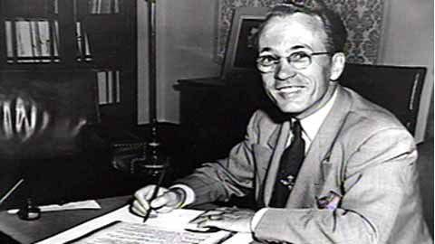
Tommy Douglas and Medicare in Canada

Slide 2
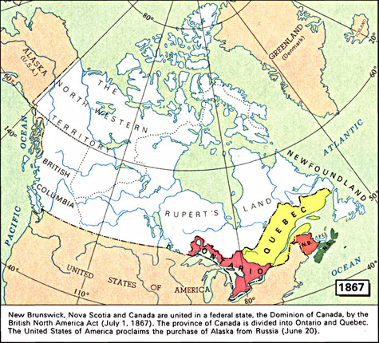
British North America Act
On July 1, 1867, the country of Canada was created when the British Parliament passed The British North America Act. Initially there were four provinces: Ontario, Quebec, Nova Scotia and New Brunswick. The Act laid out the structure of the government of Canada and listed the division of powers between the federal government and the provincial governments.
Early attempts to involve the federal government in the delivery of social services, such as health care, failed because the British North America Act made health care a provincial responsibility.

Slide 3
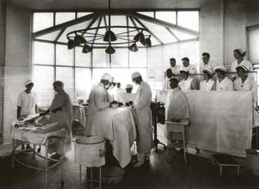
Beginnings of Healthcare
In the early 1900s, large cities such as Toronto, Montréal and Halifax had large modern hospitals that were closely linked to their university medical faculties. Hospitals enabled doctors to move childbirth and surgery out of their patients’ homes and into sterile, scientific surroundings staffed by experts. People who could afford it increasingly chose to go to a hospital.
In rural areas in other provinces, doctors continued to make house calls, to deliver babies and to conduct operations for relatively limited pay. They were on call twenty-four hours a day, seven days a week and went to their patients’ homes by car, horse and buggy, or sleigh to provide care.

Slide 4
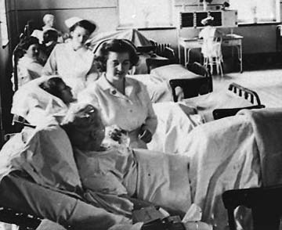
Paying for Healthcare
Traditionally, medical care required payment from the patient to the practitioner at the time the service was provided. Municipalities, however, recognized the poverty of many working people and provided some money to local hospitals for institutional care. Churches and charitable organizations had encouraged doctors to provide their services for free to the poor.
To compensate for the loss of these fees, most doctors charged different rates depending on their assessment of a patient's ability to pay. Doctors charged their wealthy and middle class patients more money than their lower class patients. Thus, the middle class and the wealthy were supporting care for the poor.

Slide 5
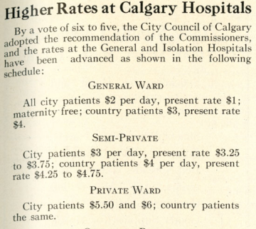
Paying for Healthcare
This 1924 schedule for Calgary hospitals shows that rates varied according to patient category. Patients who lived in the country and did not pay city taxes were charged higher rates.
Immigrants, the poor and many urban workers could not afford medical services, particularly once expensive diagnostic tools such as X-rays and additional hospital accommodation became more readily available in the 1920s. Even though many doctors generously agreed to provide their services free of charge to the poor, many people decided not to make use of medical services. Many people - too proud to accept medical help for nothing - felt that relying on charity would be a humiliating experience.

Slide 6
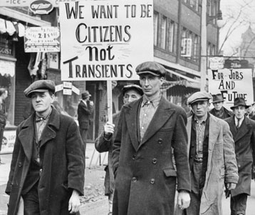
The Great Depression
The collapse of the Canadian economy after the stock market crash on October 29, 1929 challenged all levels of government to respond to their citizens’ needs for many forms of social assistance.
Between 1929 and 1932, Canadians of all social classes were experiencing the worst decline in their incomes ever. The average per capita income fell 48 per cent during the worst years of the Great Depression, with professional incomes declining by 36 per cent between 1928 and 1933. As factories and businesses closed, many workers became unemployed and struggled to buy food for their families and pay medical bills.

Slide 7
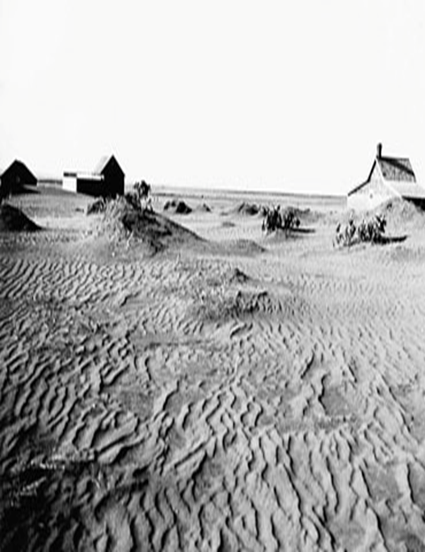
Medical Care in the Dust Bowl
There was a severe drought on the Prairies from 1929-1935. Land was too dry to grow many crops and families struggled to survive. Millions of hectares of fertile topsoil – dried up by the drought and overfarming – blew away.
In Saskatchewan, the sustained failure of the wheat crop meant that many communities could not afford to pay the salaries of their municipal doctors, who were then collecting government relief payments like the majority of their patients. Many hospitals too were unable to collect payment for their services. As the number of paying patients declined, their revenues fell, but their costs increased as they continued to serve the poor.

Slide 8
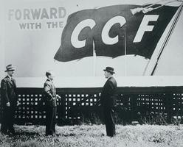
The Founding of the CCF
Farmers, workers and members of the League for Social Reconstruction united to form the Co-operative Commonwealth Federation (CCF) in 1932. Led by J. S. Woodsworth, the party advocated for the expansion of crown corporations, and social welfare programs like public health insurance, a pension plan, unemployment insurance, and workers’ compensation.
In contrast, after R. B. Bennett and the Conservatives won the federal election in 1930, the new prime minister offered the provinces $20 million for direct relief only, and no funding for medical and hospital costs. The federal government claimed that healthcare was a provincial responsibility.

Slide 9
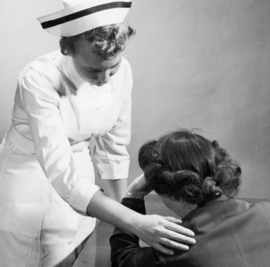
Commercial Insurance Plans
As profit-generating corporations, insurance companies entered the health insurance market in the 1940s and 1950s. But, as many discovered when they attempted to use their coverage, these plans often failed to cover all the costs of a hospital stay.
Employees of these insurance companies worked diligently to enroll healthy Canadians. Most plans had age limits. Insurance companies would not enroll or cancel existing coverage for older individuals since they were at a stage in their lives when the odds were rising that they would need to use health insurance. In addition, for many Canadians the existence of a medical problem meant that they would not be eligible for coverage.

Slide 10
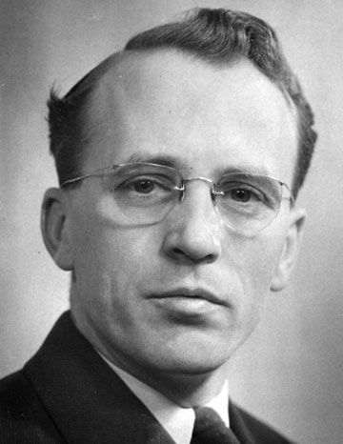
Tommy Douglas
As a child, Douglas injured his leg and developed osteomyelitis, an inflammation of the bone. His family’s inability to afford medical care would have cost him his leg, except that Dr. R. J. Smith, a distinguished surgeon, offered to operate for free if his students could watch. Although grateful for Dr. Smith’s help, Douglas later said: “I felt that no boy should have to depend either for his leg or his life upon the ability of his parents to raise enough money to bring a first class surgeon to his bedside”
Douglas’s feeling that the inability of people to pay for medical care should not be a barrier to people’s health and well-being developed into a belief in socialism and led to a life in politics.

Slide 11
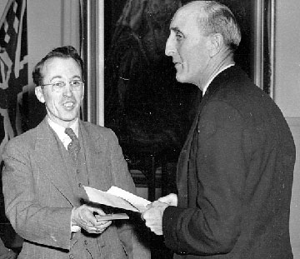
Saskatchewan Leads the Way
On June 15, 1944, Tommy Douglas and the CCF were elected to government in Saskatchewan. Healthcare was his first priority. In 1947, Saskatchewan’s Hospital Services Plan came into effect, the first hospital insurance plan in Canada.
In 1962, The Saskatchewan Medical Care Insurance Act introduced a universal, provincially funded medical insurance plan to provide doctors' services to all its residents. This act meant medical care costs were covered not just in hospitals, but also in clinics and doctors offices. Doctors were to be paid on a fee-for-service basis, and patients would pay a small portion of the cost to ensure that no one perceived this as charity.

Slide 12
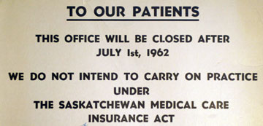
Saskatchewan Doctors' Strike
The College of Physicians and Surgeons of Saskatchewan opposed The Saskatchewan Medical Care Insurance Act on the grounds that it violated doctors’ rights to treat their patients and that it would lower the quality of service by forcing doctors who believed in free market principles to leave the province.
On July 1, 1962, when the Act came into effect, 90% of Saskatchewan’s doctors closed their offices in protest, and only limited emergency services were available. Some families had seriously ill members who were discharged from hospital and sent home. Concerns grew as papers reported that 100 or more of the province’s doctors had left to seek positions elsewhere.

Slide 13
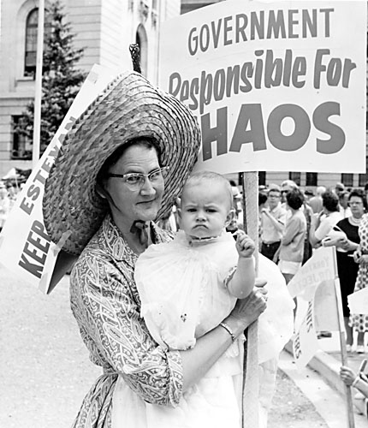
Keep Our Doctors Committees
Initially the doctors had some public support. A group of mothers who were worried about the loss of their doctors organized the first “Keep Our Doctors” Committee. Similar committees were formed throughout Saskatchewan, encouraged by doctors and joined by political opponents of the government.
These committees, with support from the media, launched a campaign against the government and its medicare plan. Rallies were held, petitions were circulated, and advertisements were placed in newspapers. The government responded by bringing in doctors from Britain and encouraging others to come from the U.S. and other parts of Canada to meet the emergency.

Slide 14
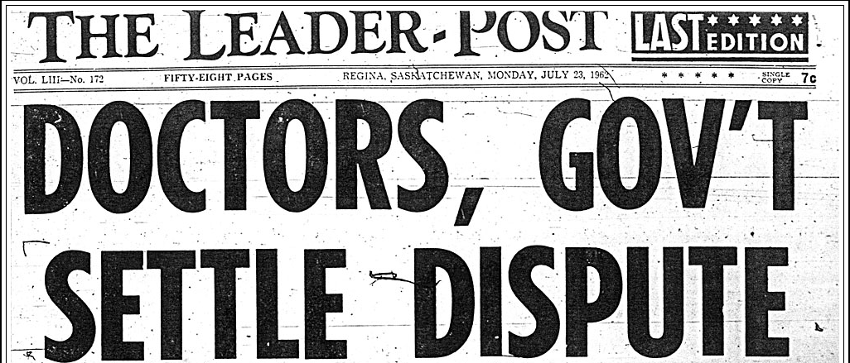
Resolving the Doctors’ Strike
The strike ended on July 23, 1962, through the mediation efforts of Lord Stephen Taylor, a doctor who helped introduce Britain's health-care program. Under the compromise, private plans could continue, although most citizens were expected to join the public plan; doctors could opt out of the plan, but the Saskatchewan Medical Care Insurance Act would remain.
Even the doctors who had been so sure that their independence and clinical expertise would be undermined discovered that, rather than experiencing government direction in their practices, they were finally being paid for all the services that they rendered and not just those that their patients could afford.

Slide 15
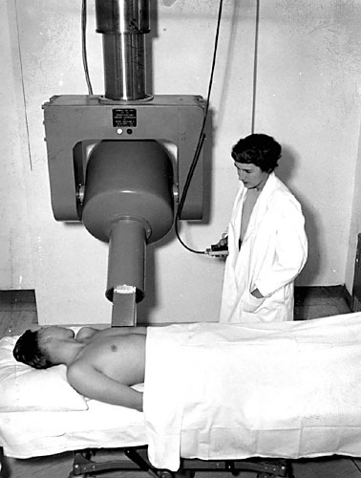
Developing Medicare
The success of Saskatchewan’s Hospital Services Plan prompted the federal government to pass The Hospital Insurance and Diagnostic Services Act in 1957. It offered to reimburse, or cost share, one-half of provincial and territorial costs for diagnostic and radiological services and for standard ward in-patient costs. By 1961, all the provinces had hospital plans in place and 99% of the population was covered.
The federal government passed the Medical Care Act in 1966, which offered to reimburse, or cost share, one-half of provincial and territorial costs for medical services provided by a doctor outside hospitals. By 1972, all the provinces had joined in.

Slide 16
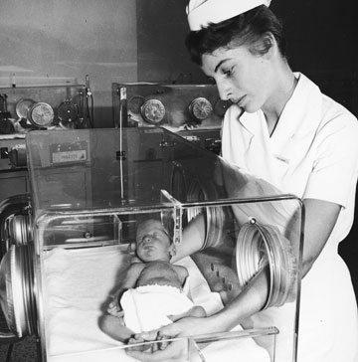
Medicare Federal Funding
From 1957 to 1977, the federal government's financial contribution in support of health care was determined as a percentage (one-half) of provincial and territorial expenditure on insured hospital and doctor services.
In 1977, cost sharing was replaced with a block fund under the Federal-Provincial Fiscal Arrangements and Established Programs Financing Act. A block fund is a sum of money provided from one level of government to another for a specific purpose. This new funding arrangement meant that the provincial and territorial governments had flexibility to invest health care funding according to their needs and priorities.

Slide 17
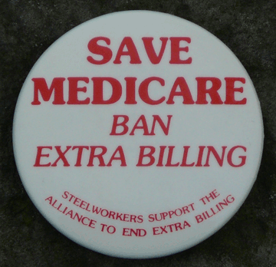
Canada Health Act
During the 1980s, some provinces and territories tried to introduce user fees and extra-billing. Extra-billing is billing for an insured health service rendered to an insured person by a medical practitioner in an amount in addition to any amount paid for that service by the provincial healthcare insurance plan.
The Canada Health Act came into effect on July 1, 1984. This legislation blocked extra billing and user fees for insured services. It also replaced the original federal hospital and medical insurance acts, set standards for the operation of provincial and territorial health insurance plans, and promoted these standards by linking federal health funding to them.

Slide 18
Canada Health Act Standards
To be eligible for federal block funds, provincial and territorial health insurance plans must meet the following standards:
Public administration: Plans must be administered and operated on a non-profit basis by a public authority.
Comprehensiveness: Plans must cover the full cost of any service that is considered medically necessary.
Universality: Plans must cover all residents.
Portability: Plans must cover residents when they travel within Canada. Limited coverage is required for travel outside Canada.
Accessibility: Plans must provide all residents reasonable access to medically necessary hospital and physician services.

