Slide 1
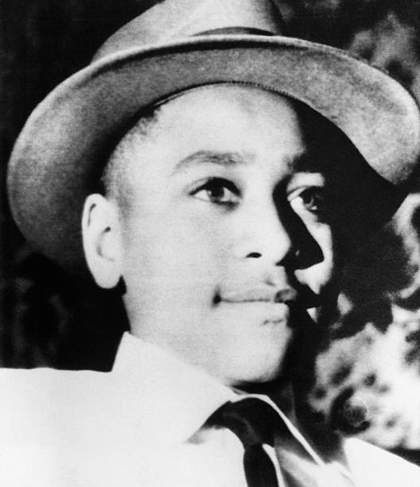
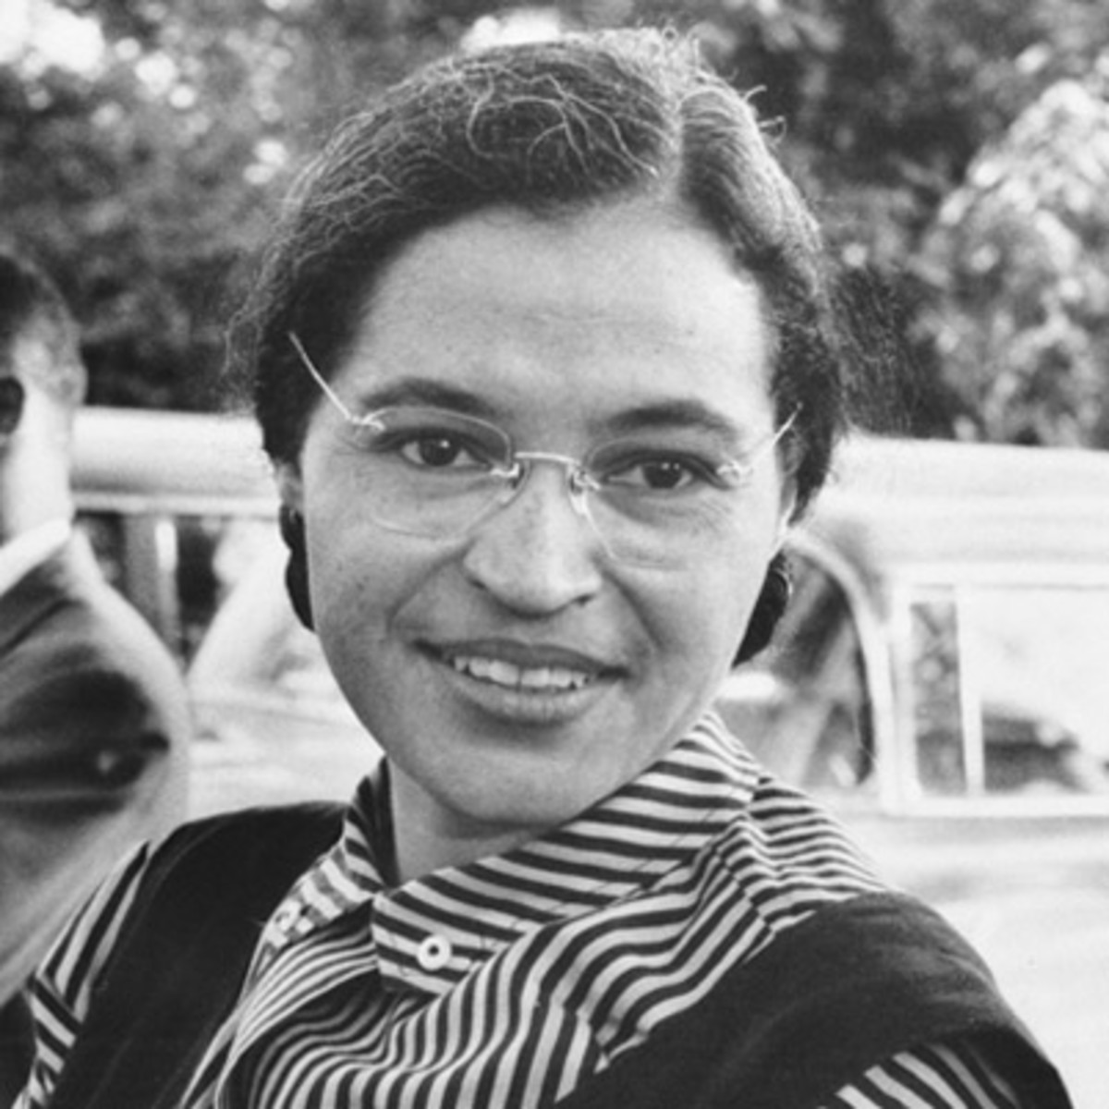
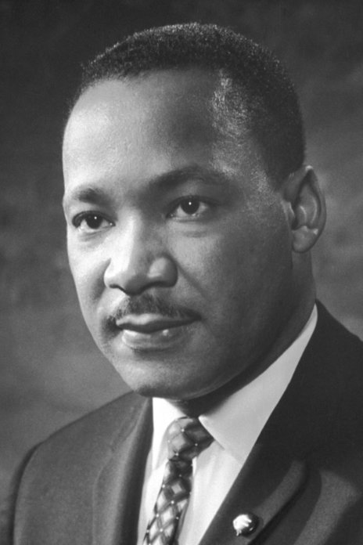
Famous People of the American Civil Rights Movement: Emmett Till, Rosa Parks, and Martin Luther King Jr.

Slide 2
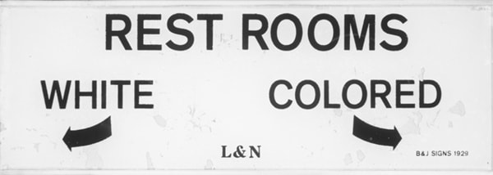
Discrimination in America
The U.S. Declaration of Independence declared that “all men are created equal, that they are endowed by their Creator with certain unalienable rights, that among these are Life, Liberty and the pursuit of Happiness.” Yet, African Americans have historically been denied these essential rights. Prior to the American Civil War, blacks in southern states were enslaved and prohibited from voting. When the war ended in 1865, slavery was abolished and the right to vote was given to black men. Still, many whites, particularly in the south, refused to recognize blacks as their equals.
Over the next several decades many cities and states in the American South enacted racist laws known as “Jim Crow” to enforce segregation between blacks and whites. Nearly every aspect of life for the black population was affected: they were forced to drink from separate fountains, eat in separate restaurants, learn at separate schools, read at separate libraries, sleep at separate hotels, use separate restrooms, sit in separate sections of buses and trains, among other restrictions. They were further oppressed by being denied the right to vote and hold particular jobs.

Slide 3
Background on Emmett Till
Emmett Till was born on July 25, 1941, in Chicago, Illinois. His mother, Mamie, and father, Louis, separated in 1942 after she discovered he had been unfaithful. Louis, a private in the U.S. Army, was executed in 1945 for the rape of two women and the murder of another in Italy. As a single mother, Mamie raised Emmett on the South Side of Chicago while working long hours as a clerk for the U.S. Air Force. His mother fondly recalled his willingness to help with chores around the house such as cleaning, cooking and doing the laundry. He also enjoyed playing baseball and making people laugh by pulling pranks and cracking jokes. He attended a segregated all-black elementary school.
On August 20, 1955, at the age of fourteen, Till rode a train from his home in Chicago, Illinois to visit his great-uncle, Mose Wright, who was a minister and sharecropper near the town of Money, Mississippi. The day before Till left, his mother gave him a silver ring once owned by his deceased father, Louis Till, with the initials “L.T.” and “May 25, 1943” engraved on it. During the first three days of Emmett’s stay with his great-uncle, he helped with the cotton harvest.

Slide 4
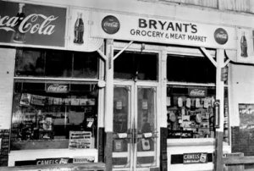
Abduction and Murder
On the evening of August 24, 1955, Till joined a group of other teenagers to go to a local grocery store, Bryant’s Grocery & Meat Market, to buy candy. He entered the store and paid a twenty-one-year-old white cashier named Carolyn Bryant for a pack of bubble gum. She alleged that he made sexual advances towards her, grabbed her by the hand and around the waist, uttered obscenities, and wolf-whistled at her. Roy Bryant, the woman’s white husband and owner of the store, returned from a business trip a few days later and was furious when he heard about this.
At about 2:30 a.m. on August 28, 1955, Roy Bryant and his half-brother, J.W. Milam, forced their way into the home of Till’s great-uncle and abducted Till at gunpoint. Bryant and Milam viciously beat the fourteen-year-old boy, gouging out one of his eyes, and then killed him with a gunshot to the head. The two men disposed of Till’s lifeless body by dumping it in the Tallahatchie River, weighed down by a seventy-five pound cotton-gin fan strung around his neck with barbed wire. Mose Wright reported the kidnapping to police and Bryant and Milam were arrested the next day.

Slide 5
Open-Casket Funeral
Till had been beaten so badly that his face was unrecognizable when his corpse was pulled from the river on August 31, 1955. His face was crushed in, his ear was severed, and his left eye was hanging out. Mose Wright could only identify his nephew by the etched silver ring worn on his finger. Authorities in Mississippi wanted to bury the body immediately, but Till’s mother, Mamie Bradley, insisted that it be sent back to Chicago.
After viewing the mutilated remains, Mamie Bradley did something that changed history: she decided to have an open-casket public funeral service. She wanted everyone to see the severity of the injuries inflicted upon her only child. Tens of thousands of people came to the Roberts Temple Church of God in Chicago to pay their respects. Two African American publications, Jet and The Chicago Defender, posted graphic photographs of Till’s mangled body. Soon afterwards, newspapers across America began writing about the murder. The shocking brutality of the attack outraged African Americans and brought nationwide attention to the racist and violent treatment of blacks in the American south.

Slide 6
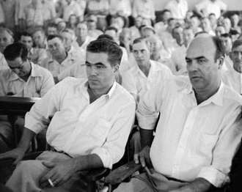
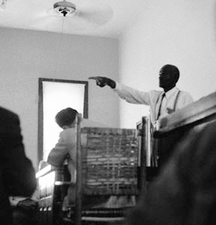
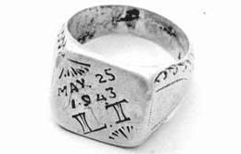
The Trial
On September 19, 1955, in Summer, Mississippi, the murder trial of Roy Bryant and J.W. Milam began. The defence attorneys claimed that Till’s great-uncle Mose Wright could not identify both men as the two assailants who kidnapped his nephew from his home and that the dead body dragged from the Tallahatchie River was not Till’s. But, as a witness for the prosecution, Wright told the court that he could identify both men and stood up and pointed a finger directly at the defendants. Wright also testified that the dead body pulled from the Tallahatchie River was indeed his nephew’s.
Another witness for the prosecution, deputy sheriff John Ed Cothran, testified that after he arrested J.W. Milam, he had a conversation with him in jail and Milam freely confessed to the kidnapping. The prosecution’s assertion that the corpse was Till’s was bolstered by one of its key exhibits: the engraved silver ring. Wright, Cothran and undertaker Chester Miller identified it in the courtroom as the ring they saw on the finger of the deceased. Till’s mother, Mamie Bradley, also identified it as the ring worn by her son that she had received with her husband’s other effects after he was killed.

Slide 7
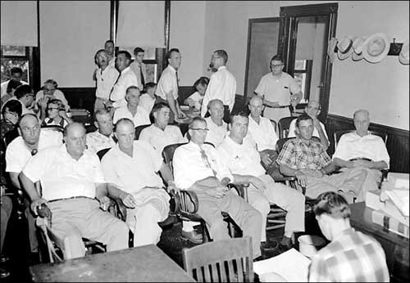
Getting Away With Murder
Women and African Americans were not allowed to serve as jurors in Mississippi at the time, so Roy Bryant and J.W. Milam were tried by an all-male, all-white jury. Despite compelling evidence from the prosecution of the defendants’ guilt, on September 23, 1955, the jury issued a verdict of “not guilty.” Six weeks afterwards, a grand jury declined to indict the pair on the separate charge of kidnapping, even though the two had already confessed to having taken Till from his great-uncle’s house. Both were subsequently released from custody and spent the rest of their lives in freedom.
Knowing that they were legally protected from further prosecution due to the rule of “double jeopardy,” (which means that a person cannot be tried twice for the same crime,) Roy Bryant and J.W. Milam made a deal to tell their story to a reporter from Look magazine for four-thousand dollars. Published on January 24, 1956, the Look magazine interview titled, “The Shocking Story of Approved Killing in Mississippi” caused an uproar as the two men publically admitted to abducting, beating and murdering Till.

Slide 8
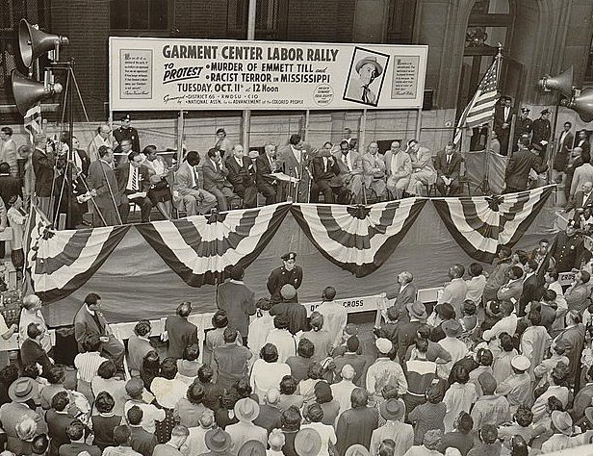
Significance
No one was ever held accountable for the kidnapping and murder of Emmett Till. But, the widely publicized story of the fourteen-year-old’s death, images of his tortured body, and miscarriage of justice at his trial attracted international attention to the hatred and racism against blacks in the segregated American South.
The murder motivated people across America to push for action on civil rights across the country, in much the same way as the recent slayings of unarmed Black Americans such as George Floyd, Breonna Taylor and Trayvon Martin. The National Association for the Advancement of Coloured People (NAACP) organized mass protests featuring Till’s mother, Mamie Bradley, as a speaker. Large crowds staged demonstrations and marched in rallies across America demanding justice and equal rights for all. One of the activists who was inspired to take action was civil rights pioneer Rosa Parks. Just four months after Till’s killing, while riding a bus in Montgomery, Alabama, she refused to give up her seat to a white passenger and move to the back of the bus. She later said, “I thought of Emmett Till and I just couldn’t go back.”

Slide 9
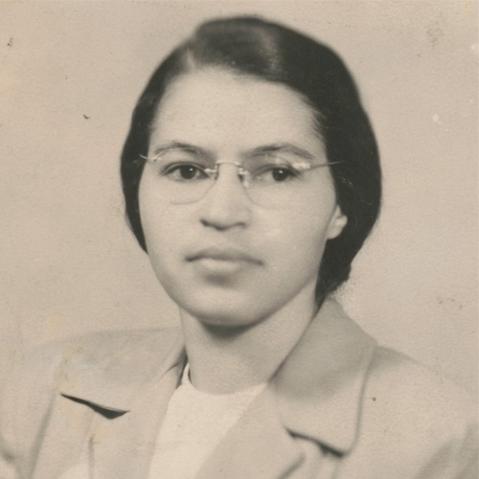
Background on Rosa Parks
Rosa McCauley was born on February 4, 1913, in Tuskegee, Alabama. At two years of age, her parents, James and Leona McCauley, separated. Rosa, with her mother and brother, went to live with her grandparents in the nearby town of Pine Level. Her mother was a teacher and she taught Rosa how to read. Rosa enjoyed reading very much. Throughout her childhood, Rosa attended segregated all-black schools. African American students like Rosa had to walk to school, no matter how far away they lived. White children, on the other hand, were provided with school bus transportation by the city. Rosa recognized that black people were treated unfairly, and that bothered her.
In the eleventh grade, Rosa left school to care for her mother and grandmother who were ill. In 1932, at the age of nineteen, she married Raymond Parks, a barber and member of the National Association for the Advancement of Colored People (NAACP). The following year, she completed her high school studies and graduated. In 1943, she joined the Montgomery, Alabama, branch of the NAACP, and was elected secretary.

Slide 10
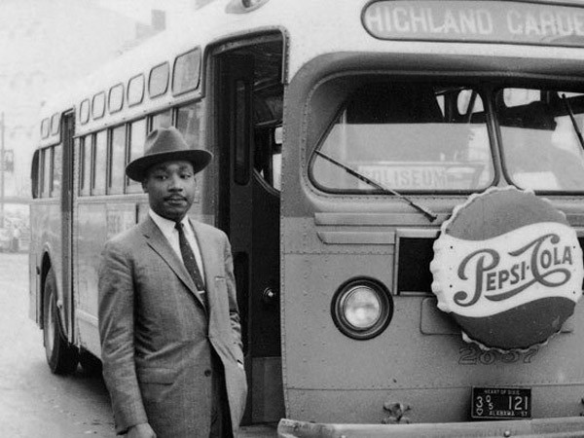
Discriminatory bus laws and customs
As in many cities in the American South, Montgomery, Alabama, had segregated bus laws stating that bus passengers were to be separated by race. This meant that black individuals were not permitted to sit in the same row as white people. Bus seating was divided into two sections: one at the front of the bus for “whites only,” and one at the back for “coloured.” African American bus riders were required to board a bus at the front door to pay their fare and then exit and re-enter the bus at the rear door. Moreover, African Americans were not hired as bus drivers.
Though the racial separation line was generally the middle of a bus, Montgomery, Alabama, bus drivers adopted the custom of adding an additional row to the “whites only” section whenever all the “whites only” seats had been taken. They accomplished this by moving the “coloured” section sign further back and ordering black passengers occupying what had previously been “coloured” rows to leave their seats and move to the rear of the bus so that the white riders could take their seats. If no other seats were available, blacks were to stand, or, if there was no room, leave the bus.

Slide 11
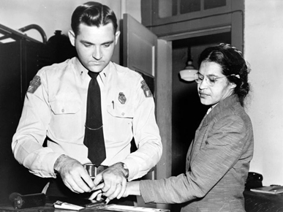
Refusing to Move
On the evening of December 1, 1955, after her day’s work as a seamstress at the Montgomery Fair department store, forty-two-year-old Rosa Parks boarded a city bus to return home. She paid her fare and took a seat near the middle of the bus in the first row of the “coloured” section. As the bus continued travelling along its regular route stopping to pick up more passengers, it began to fill. Eventually all the “whites only” seats had been taken, leaving a white male passenger standing in the aisle.
The bus driver stopped the bus and moved the “coloured” section sign back one row and demanded that Parks and three other black passengers seated in the row move to the rear of the bus so that the white passenger could sit down. The three others obeyed, but Parks refused and remained seated. This courageous act of civil disobedience, she later recalled, was inspired by her thoughts about Emmett Till and the unjust acquittal of his killers, as well as her feeling of being “tired of giving in.” The bus driver called police and Parks was arrested for violating the city’s segregation laws.

Slide 12
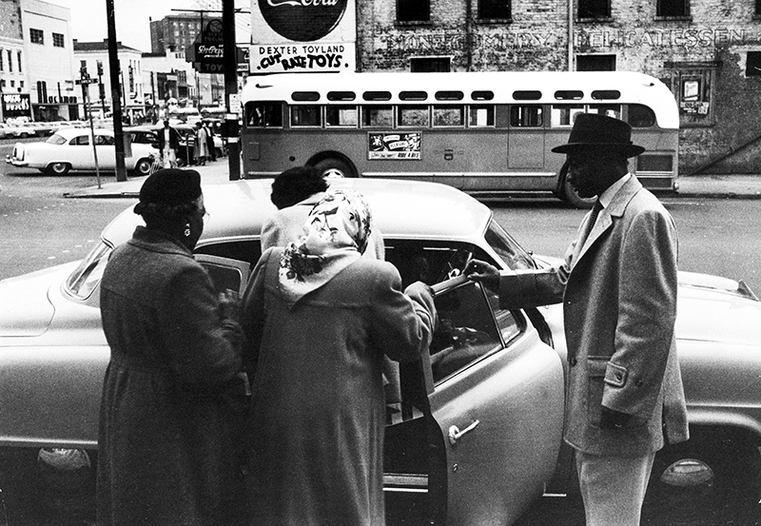
The Montgomery Bus Boycott
Edgar Nixon, president of the Montgomery branch of the National Association for the Advancement of Colored People (NAACP), and Jo Ann Robinson, leader of the Women’s Political Council (WPC), considered Parks’ arrest as an opportunity to challenge the legality of the city’s bus laws. They agreed that Parks – a woman of good character with a husband, a steady job, and a political conscience – was an ideal candidate to rally support for a public campaign.
With support from the NAACP and WPC, requests were made to African American citizens of Montgomery in leaflets, local newspapers, and at black churches to protest Parks’ arrest by boycotting public buses on the day of her trial, December 5. Rather than ride in the back of buses, blacks were urged to use other transportation for their commutes to and from work, school, or anywhere else. Though few in Montgomery’s black community owned cars, the city-wide one-day boycott succeeded as most chose to walk, cycle, carpool, or take taxis. Meanwhile at her trial, Parks was found guilty of disorderly conduct and violating segregation laws, and fined fourteen dollars. Parks appealed her conviction.

Slide 13
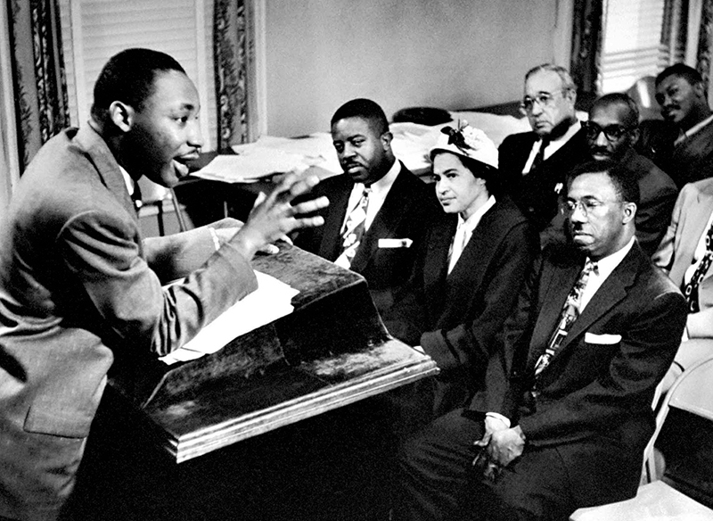
The Montgomery Improvement Association
The boycott was so successful that Edgar Nixon, Jo Ann Robinson and other local civil rights and religious leaders decided to extend it indefinitely. To manage the boycott and the legal challenge to the bus segregation laws, they agreed to create a new organization called the Montgomery Improvement Association (MIA). They chose as their leader a twenty-six-year-old church pastor from Montgomery’s Dexter Avenue Baptist Church, Martin Luther King Jr.
The MIA assisted the boycotters with coordinating carpools and filed a separate federal court case known as Browder v. Gayle to challenge city and state bus segregation laws on behalf of four other black female Montgomery residents who had been arrested for violating these laws. Furthermore, the MIA issued a list of demands to the bus company and city officials: enact a first-come first-served bus seating policy, require bus drivers to treat all passengers courteously, and hire blacks as bus drivers. Representatives of the bus company and city did not budge, despite suffering severe financial losses as the city-owned buses that normally rolled by filled with black passengers were virtually empty.

Slide 14
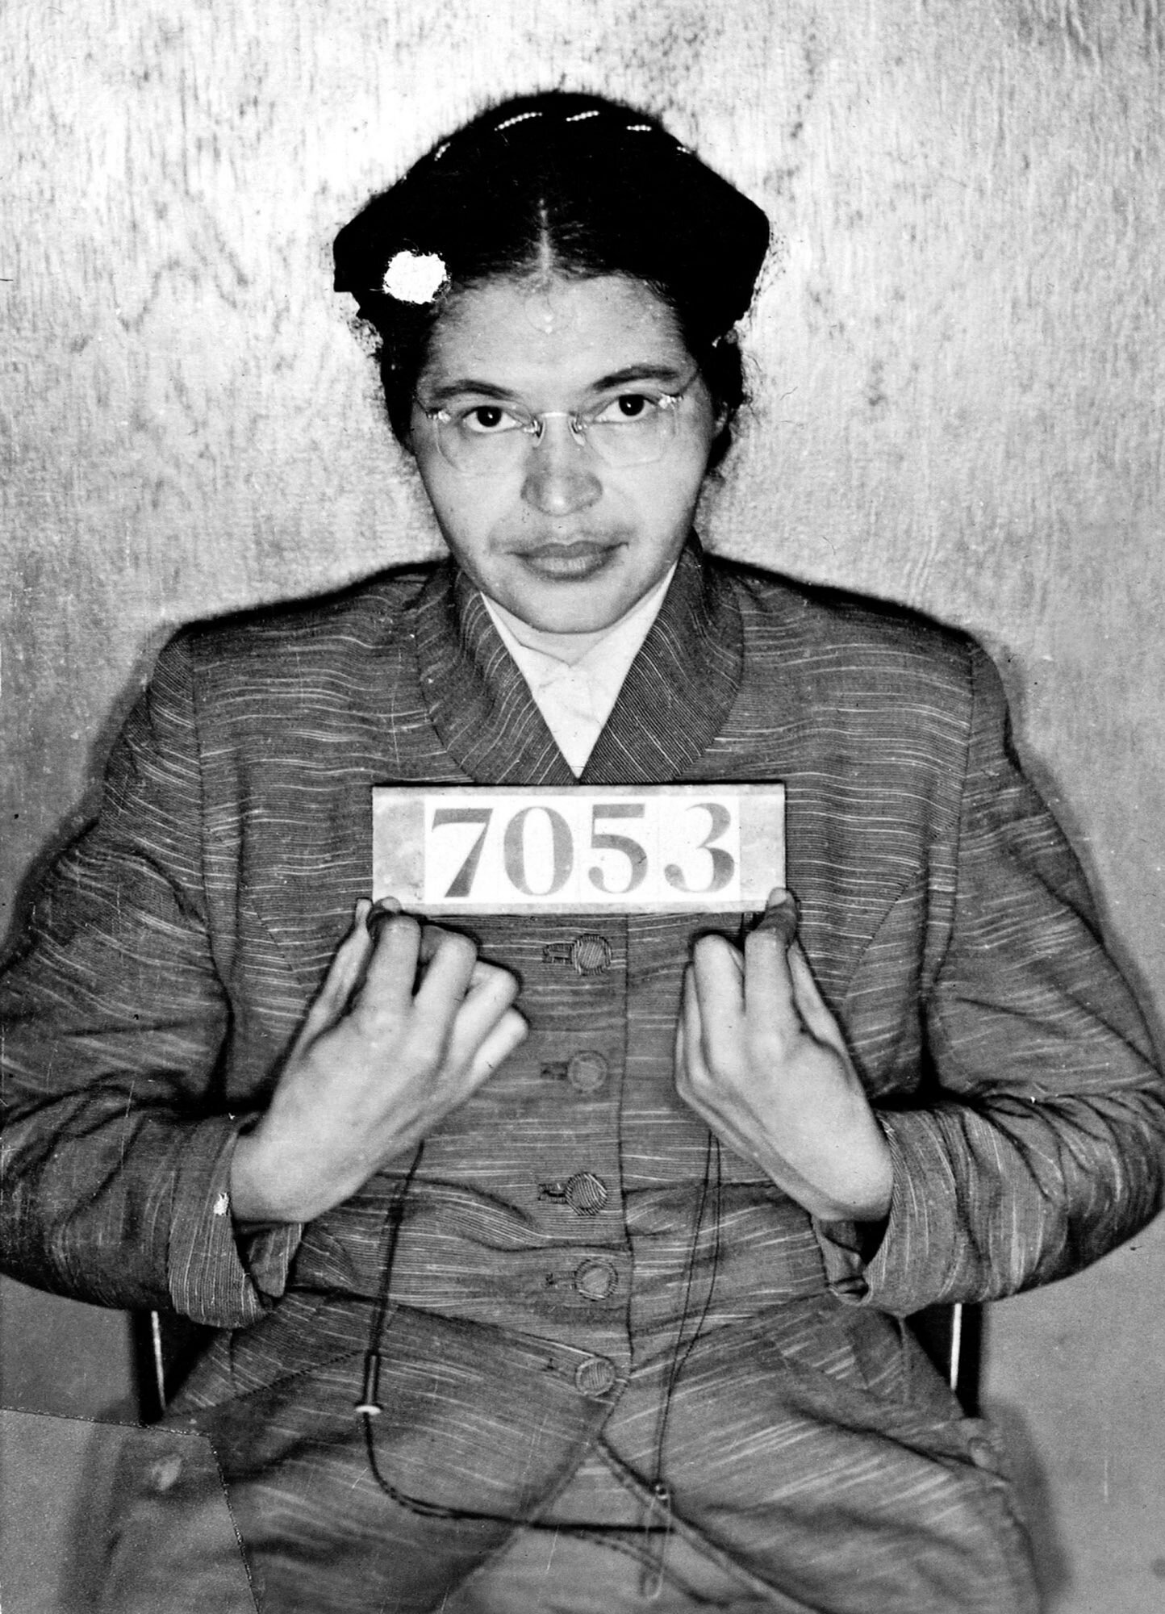
The Resistance
As the boycott continued on, it encountered strong resistance. Some segregationists sought to disrupt the peaceful protest by resorting to acts of violence and intimidation against the boycotters such as physical assault, harassment, threats of having them fired from their jobs, even burning black churches and bombing the homes of Nixon and king. Parks was the target of countless death threats and was fired from her job at the Montgomery Fair department store.
Black taxi drivers attempted to assist former bus passengers by lowering the price to ten cents per ride, matching the cost of riding a bus. However, city officials sabotaged this strategy by enforcing an order to fine any cab driver who charged a passenger less than forty-five cents. This made taxi rides unaffordable for many working-class blacks. To block African Americans from carpooling, the city pressured local insurance companies to revoke or refuse insurance to black car owners. Next, the city indicted eighty-nine boycott leaders, including Parks and King, for violating the Alabama Anti-Boycott Act. Rather than wait to be arrested, many turned themselves in to police as an act of defiance.

Slide 15
Significance
On June 5, 1956, a panel of three judges in a federal court ruled in the Browder v. Gayle case that Alabama’s racial segregation laws for public buses were unconstitutional. The city and state appealed to the U.S. Supreme Court, but the ruling was upheld by the Supreme Court on November 13, 1956. The 381 day-long boycott ended victoriously on December 20, 1956, when the ruling integrating Alabama’s public buses came into effect. Through their collective action and legal challenges, black citizens of Montgomery, Alabama, had won the right to ride the buses as equals.
This victory for equality and justice sparked a movement that changed race relations in America. Rosa Parks’ brave act of defiance demonstrated the power of non-violent protest to affect lasting change. She inspired African Americans across the nation to mobilize and peacefully protest against racial discrimination. Parks became known as the “mother of the civil rights movement.” Martin Luther King Jr. also rose to prominence as a nationally recognized leader of the civil rights movement.

Slide 16
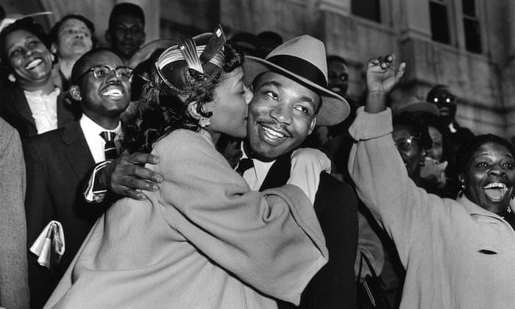
Background on Martin Luther King Jr.
Martin Luther King Jr. was born on January 15, 1929, in Atlanta, Georgia. His father was a pastor at a local church. King attended segregated all-black elementary and secondary schools. In high school, King developed a talent for public speaking and spoke eloquently about racial inequality in America. In 1944, at the age of fifteen, King enrolled at Morehouse College in Atlanta. Four years later, he graduated with a Bachelor of Arts degree in sociology. He also completed a Bachelor of Divinity degree in 1951 from the Crozer Theological Seminary in Chester, Pennsylvania.
King continued his education at Boston University and earned a doctorate degree in systematic theology. While in Boston, he met Coretta Scott, a singer who was studying at the New England Conservatory of Music. The couple married in 1953. The following year, they moved to Montgomery, Alabama, where King became pastor of the Dexter Avenue Baptist Church. He joined the local branch of the National Association for the Advancement of Colored People, served as leader of the Montgomery Improvement Association, and successfully managed the Montgomery Bus Boycott.

Slide 17
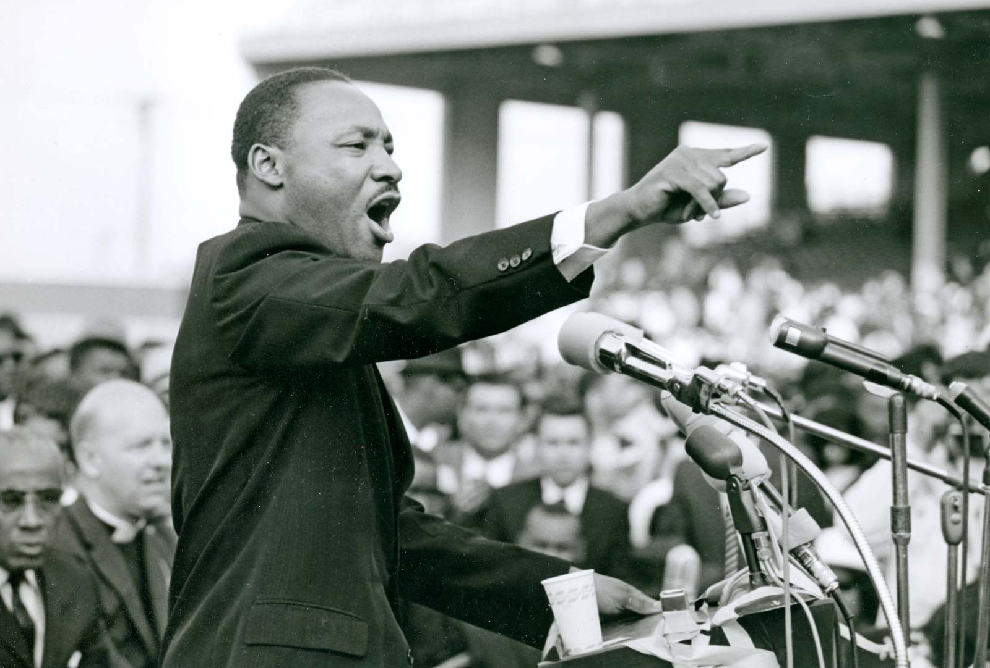
Southern Christian Leadership Conference
Empowered by the successful conclusion of the Montgomery Bus Boycott, King and other civil rights and religious leaders were determined to continue the struggle for equality. In 1957, they formed a new organization dedicated to promoting nonviolent protests against discrimination, the Southern Christian Leadership Conference (SCLC). The SCLC supported communities across the American south to organize peaceful protests such as sit-ins, boycotts, and marches. Their motto was: “Not one hair of one head of one person should be harmed."
As leader of the SCLC, King travelled across America and around the world utilizing his exceptional oratorical skills to give public speeches on civil disobedience and civil rights. To spread his message further, he wrote articles and books, and met with religious figures, activists and political leaders. Influenced by both his Christian faith and the ideals of nonviolent resistance (pioneered by Mahatma Gandhi in India), King gave hope to people everywhere that civil rights reforms could be achieved through nonviolent actions, even when met with violence from white supremacists and police.

Slide 18
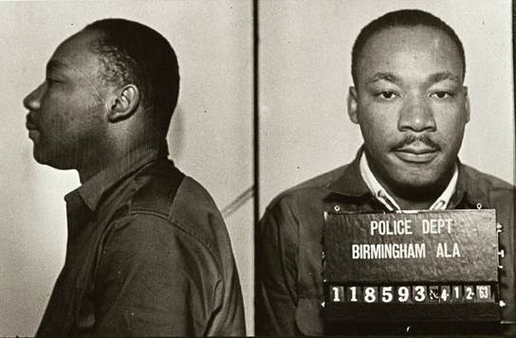
Birmingham Campaign
In April 1963, King and the Southern Christian Leadership Conference began a nonviolent campaign for civil rights in a city regarded as the most segregated city in America: Birmingham, Alabama. They sought the desegregation of lunch counters, restrooms, drinking fountains, and fair hiring practices. Masses of African American demonstrators marched through the streets, sat-in at “whites only” lunch counters, and boycotted stores with segregated facilities and policies.
Birmingham’s white police officers responded to these black peaceful protesters, some of whom were children, by spraying them with high-pressure water hoses and assaulting them with police dogs. Images of demonstrators being knocked off their feet, hurled against buildings and asphalt streets, and bitten, captured worldwide attention, appearing on television and in newspapers. People were outraged. More and more African Americans were inspired to join the cause. Arrested during the protests, King and large numbers of his supporters filled the local jail. Under sustained pressure, the city’s business leaders relented and agreed to desegregate their stores and hire more blacks.

Slide 19
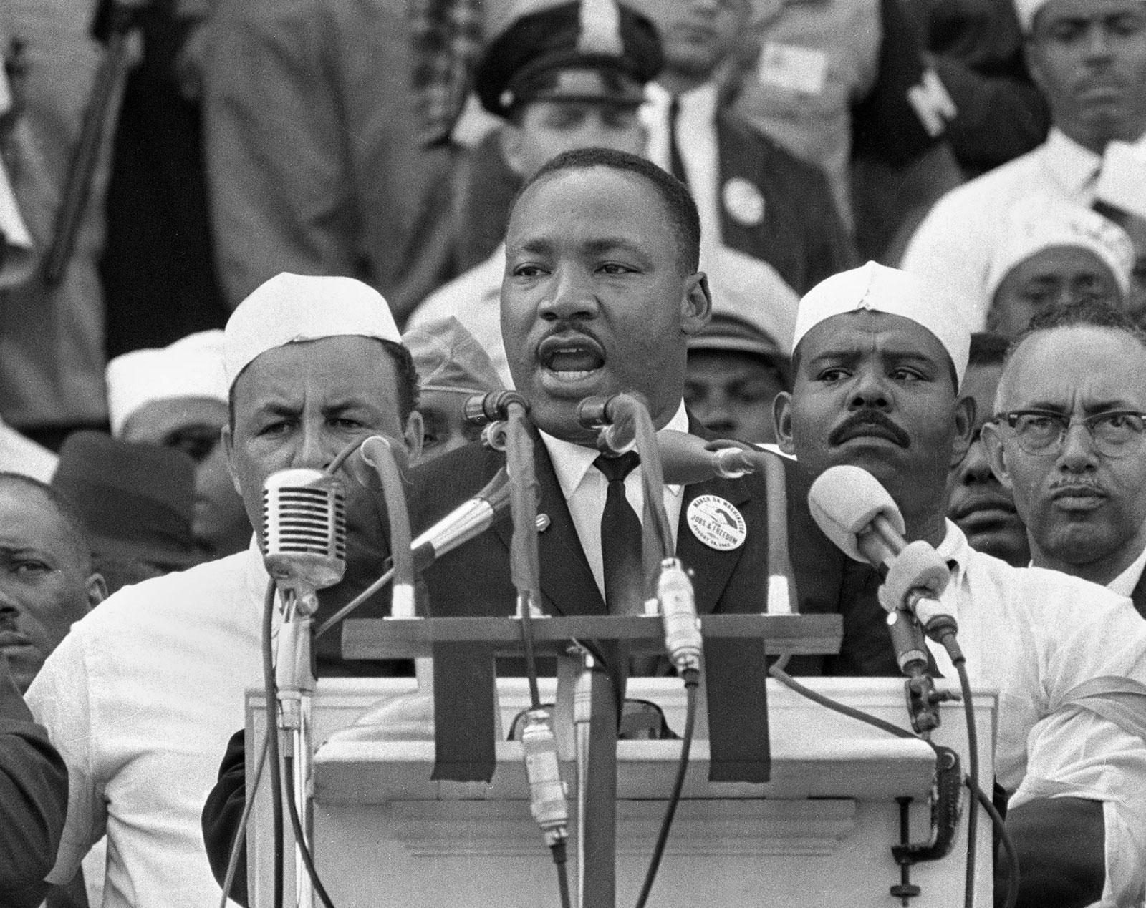
March on Washington
King and other civil rights, labor, and religious leaders organized the March on Washington for Jobs and Freedom - a peaceful rally to protest employment and housing discrimination, public accommodation and school segregation, and economic and voting injustice. It attracted over 250,000 individuals from all across America to gather at the Lincoln Memorial in Washington, D.C. on August 28, 1963, to hear speeches from prominent civil rights leaders. Here, King delivered his famous “I Have a Dream” speech, describing his vision for America where all citizens are united and free.
The following is an excerpt of that speech: “I have a dream that one day this nation will rise up and live out the true meaning of its creed: ‘We hold these truths to be self-evident: that all men are created equal.’ I have a dream that one day, on the red hills of Georgia, the sons of former slaves and the sons of former slave owners will be able to sit down together at the table of brotherhood… I have a dream that my four little children will one day live in a nation where they will not be judged by the colour of their skin, but by the content of their character. I have a dream today!”

Slide 20
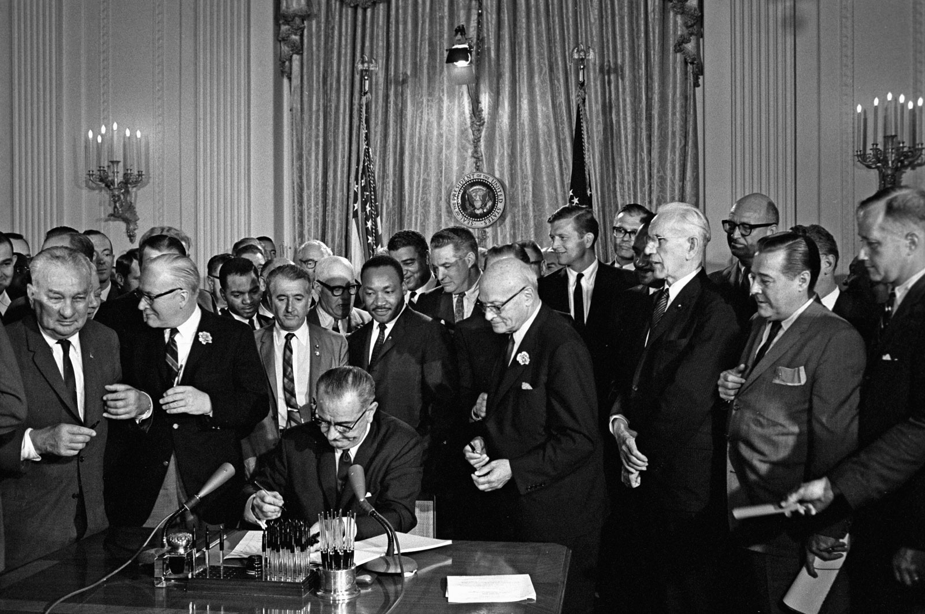
Significance
King’s vision of an America no longer divided by race came closer to being realized as the growing movement he led convinced government to pass the Civil Rights Act in 1964. This act made segregation illegal in businesses and public places. It also banned discriminatory hiring practices in employment. This was followed one year later by the passage of the Voting Rights Act, which made discriminatory barriers to voting such as poll taxes and literacy tests illegal.
In recognition of his contribution towards racial equality and justice, Martin Luther King Jr. was awarded the Nobel Peace Prize in 1964. The prize included money totaling $54,123, which he donated towards the civil rights movement. Unfortunately, his life ended tragically on April 4th, 1968, when he was assassinated at the Lorraine Motel in Memphis, Tennessee. Nevertheless, his legacy of racial equality and nonviolent social change continues to inspire people today. A law creating an American national holiday in his honour was signed by President Ronald Reagan in 1983. Martin Luther King Jr. Day is celebrated every year on his birthday on the third Monday in January.

