Slide 1
Genocide Studies: The Armenian Genocide and The Holocaust

Slide 2
Genocide
The United Nations defines genocide as “any of the following acts committed with intent to destroy, in whole or in part, a national, ethnical, racial or religious group, as such:
Killing members of the group;
Causing serious bodily or mental harm to members of the group;
Deliberately inflicting on the group conditions of life calculated to bring about its physical destruction in whole or in part;
Imposing measures intended to prevent births within the group;
Forcibly transferring children of the group to another group.”

Slide 3
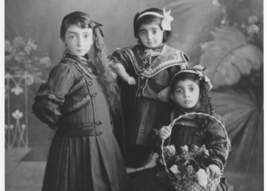
the Armenians
In 1914, Armenia was part of the Ottoman Empire. Armenians predominately believe in the Christian religion and have lived for over 3,000 years in Eastern Anatolia (modern-day Turkey). The Ottoman rulers, like the majority of their citizens, were Muslim Turks. People of non-Muslim faith within the Ottoman Empire (such as the Armenians, Assyrians, and Greeks) were viewed as “infidels” or non-believers who were inferior to Muslims. They were subjected to unequal and discriminatory treatment including being forced to pay higher taxes than Muslims.
Despite experiencing unfair treatment, many Armenians were well educated professionals who prospered in the arts, architecture, manufacturing, and the silk trade. Muslims began to resent the Armenians’ economic successes as a challenge to Muslim superiority. This, combined with a suspicion that Armenians would be more loyal to Christian governments like Russia, contributed to a growing sense among Muslims that Armenians were a dangerous threat within their society.

Slide 4
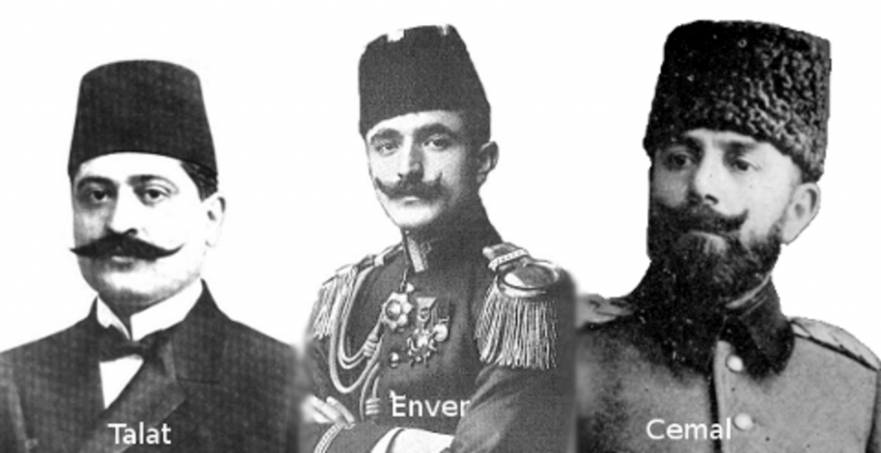
The Young Turks
The worst atrocity committed against civilians during the First World War was the Armenian Genocide. It was planned and organized by the rulers of the Ottoman Empire between the years 1915 and 1918. The ruling political party in the Ottoman Empire was the Committee of Union and Progress, known as the Young Turks.
Three members of the Young Turks controlled the government: Mehmet Talaat (Minister of the interior), Ismail Enver (Minister of War), and Ahmed Jemal (Minister of the Navy). They believed in an ideology of Pan-Turkism, a nationalist vision of a non multi-ethnic, non multi-religious Ottoman Empire that was purely Turkish Muslim. The Armenians (primarily, but also the Assyrians, and Greeks) were an obstacle preventing them from realizing these ambitions. Thus, the Young Turk rulers decided to annihilate them.

Slide 5
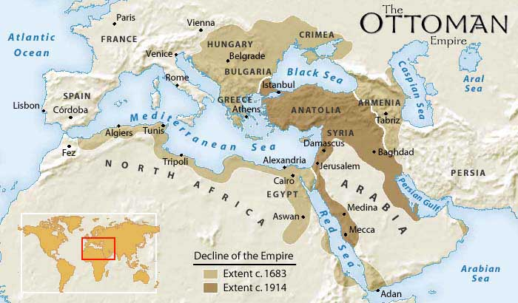
the OttoMan Empire Enters WWI
On October 29, 1914, the Ottoman Empire entered the First World War on the side of the Central Powers (Germany and Austria-Hungary) against the Triple Entente (Great Britain, France, and Russia). The Ottomans attacked Russia to the east. In January 1915, they were disastrously defeated at the Battle of Sarikamish, losing more than 45,000 men. Although Armenian men had joined the Ottoman Army and generally fought loyally and bravely, Ottoman Minister of War, Ismail Enver, chose to publicly blame the defeat on supposed Armenian traitors who had revolted and joined (enemy) Russian forces.
Under pressure, Ottoman military chiefs pressed for the deportation of Armenians from the war zone on the grounds that they could betray the empire by acting in (enemy) Russian interests.

Slide 6
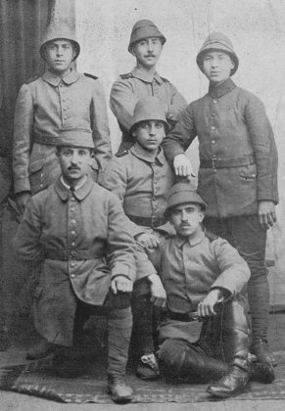
Target: Armenian Soldiers
Suspicious that the entire Armenian population could pose a security threat, the Young Turk leadership attempted to squash any potential resistance by first exterminating Armenian soldiers. Although the approximately 250,000 Armenians serving in the Ottoman Army generally fought bravely and loyally, the Young Turk Minister of War, Enver, issued a law in February 1915, disarming them, removing them from active duty and forcing them into labor battalions. While performing hard labor, the Armenians were denied food and water. They subsequently succumbed to starvation, dehydration, and disease. Others who managed to fulfill their duties were executed.
By organizing the mass murder of Armenian soldiers, the Young Turks brutally deprived the Armenians of a possible armed resistance.

Slide 7
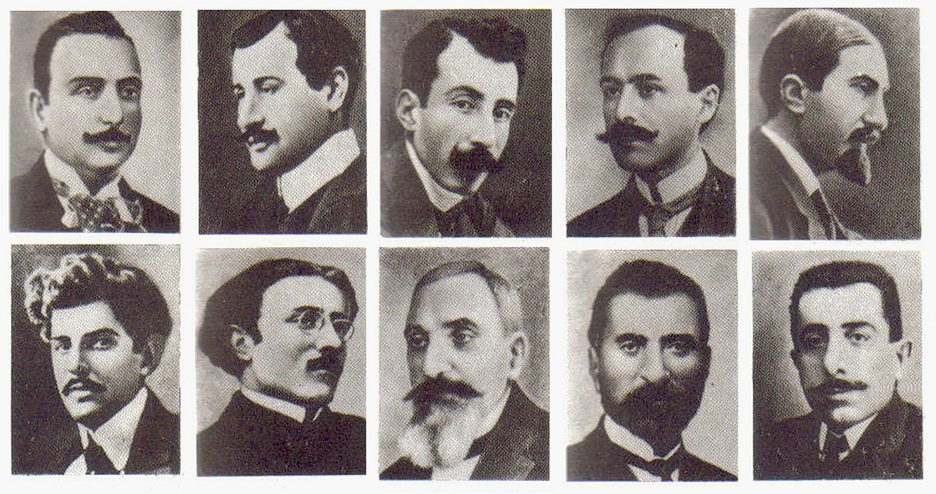
Target: Armenian Intellectuals
April 24th, 1915, known as Red Sunday, is generally considered to be the beginning of the Armenian genocide. On that day, the Ottoman government rounded up, arrested and imprisoned an estimated 250 Armenian intellectuals – including members of the Turkish parliament, writers, public figures, lawyers, teachers, doctors, and journalists - in the Ottoman capital of Constantinople (modern-day Istanbul). The majority of them were later executed.
Without a military force, political and intellectual leadership, the Armenians lost any capability to organize and muster any kind of resistance.

Slide 8
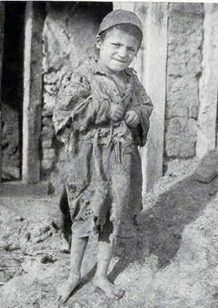
Target: Armenian Boys and Men
The Ottoman Parliament issued the Temporary Law of Deportation (Tehcir Law) on May 29, 1915, authorizing the Ottoman government and military to remove from the empire anyone it considered a security threat. Under the guise of a “deportation”, Armenian children, women, men, and the elderly were evicted from their homes, and marched out of their towns and villages. Boys and men were quickly separated from the other deportees and killed in mass shootings.
With the eradication of able-bodied Armenian boys and men, deportations of the remaining members of Armenian society were able to proceed with little resistance. The vast majority of those who could effectively engage in self-defence had already been taken away and murdered.

Slide 9
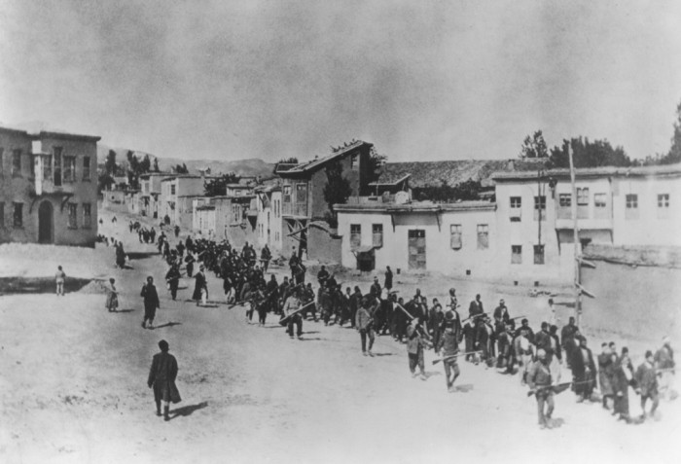
Target: Armenian Women, Children, and the Elderly
Women, children, and the elderly were forced to flee their homes and march under the scorching sun through hundreds of miles of desert without adequate food, water, or shelter needed for survival. Armenians from each village and town eventually merged together marching southward, toward concentration camps in the desert regions of modern-day Syria.
The deportees dropped dead en route under conditions of starvation, dehydration, exposure, and disease. During forced marches through the desert, people were exposed to arbitrary attacks from local officials, nomadic bands, criminal gangs, and civilians. This violence included robbery, rape, abduction of young women and girls, extortion, torture, and murder. Hundreds of thousands of Armenians died before reaching the designated concentration camps. Most of those who miraculously made it to Syria were eventually killed there.

Slide 10
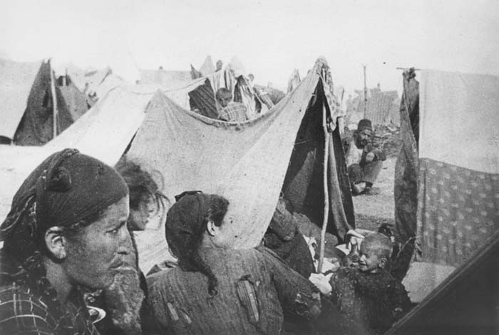
Confiscation of Property
The Tehcir Law was followed in September 1915 by the “Temporary Law of Expropriation and Confiscation” which officially took away Armenians’ property rights.
All private property owned by Armenians (including land, homes, businesses, livestock, and personal belongings) as well as Armenian community properties (such as churches and schools) were officially taken by the government. This property was either auctioned off and distributed to Turks for profit or destroyed.

Slide 11
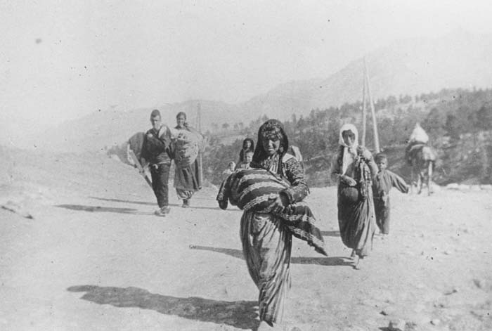
“Special Organization”
The Young Turks created a “special organization,” which organized killing squadrons. The government gave orders for prisons to release their inmates so that these criminals, many of whom were convicted of murder, could be recruited as fighters for the special organization. Financed and armed with weapons supplied by the government, this force operated independently from the regular army with orders to kill Armenian civilians.
Around 10,000 ex-convicts drowned Armenians in rivers, threw them off cliffs, crucified them and burned them alive. In short order, the Ottoman countryside became a wasteland of corpses. Special organization squadrons also abducted children, sold them as (domestic or sexual) slaves, forcibly converted them to Islam, and gave them to Muslim families for assimilation purposes. In some places, they raped women, sold them as (domestic or sexual) slaves, and forced them to marry Muslim men for assimilation purposes.

Slide 12
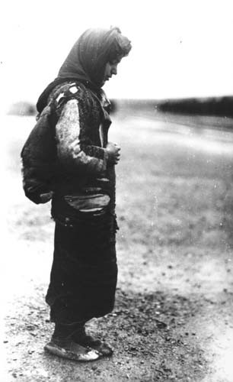
The Denial
To this day, the Government of Turkey has denied that the Armenian Genocide ever happened. Despite overwhelming photograph and document evidence, scholarly research, and survivor and witness testimony confirming the mass-murder of Armenians as a genocide, the Turkish Government refuses to acknowledge its past crimes. Instead, they argue that the Armenians were an enemy force that had to be slaughtered as a necessary war measure.
In Turkey today, engaging in education or public debate on the topic of the Armenian Genocide is a serious crime punishable by six months to two years imprisonment. A law known as Article 301 – “insulting Turkishness” – is used to prosecute anyone who dares speak or write about the Armenian Genocide. This restriction on freedom of speech has become controversial and is widely criticized outside of Turkey.

Slide 13
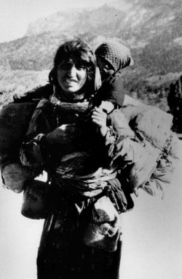
Significance
It is estimated that up to 1.5 million Armenians were killed. In an attempt to hold Young Turk leaders and other government officials responsible for their heinous crimes against the Armenians following the Ottoman Empire’s surrender in 1918, the Triple Entente countries demanded that the Ottoman Government launch military trials. Although the main perpetrators were found guilty, they evaded justice by fleeing the country. No one was ever punished and no compensation was ever provided to the victims.
In September 1939, before the Nazi invasion of Poland and the beginning of the Holocaust, German leader Adolf Hitler asked his generals, “who after all, speaks today of the annihilation of the Armenians?” He had learned that like the Ottomans before, he too could kill mercilessly without incurring any consequences.

Slide 14
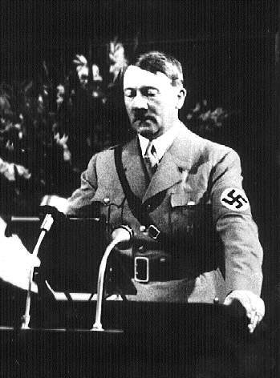
Post-War Chaos in Germany
The First World War ended in 1918 with the defeat of the Ottoman Empire and its Central Powers allies (Germany and Austria-Hungary). Germany was forced to accept the harsh terms of The Treaty of Versailles (1919) peace agreement which reduced German territory and armed forces, stripped it of all its colonies, and burdened it with the cost of war reparation payments to Britain and France totalling 33 billion dollars.
As a result, Germany suffered from terrible inflation and mass unemployment which grew worse when The Great Depression began in 1929. Dissatisfied with their newly formed democratic government, Germans looked to the Nazi Party (National Socialist German Workers Party) for economic stability. Its leader, Adolf Hitler, blamed the country’s defeat and economic hardship on Communists and Jews, and promised to make Germany great again.

Slide 15
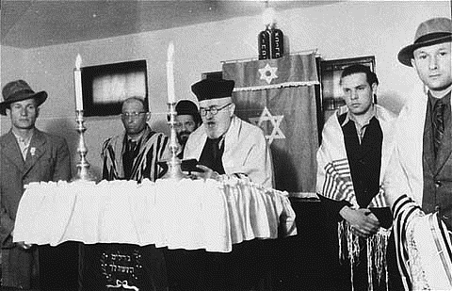
The Jews
The Jews follow the religion of Judaism. Judaism originated about three thousand years ago. According to Judaism, God created the world and everything in it. God values justice and mercy, and cares about all humanity. The synagogue is one of the most important institutions in Judaism. It is viewed as the centre of the community.
The German Jewish community had contributed a great deal to German society culturally, economically and socially. Many Jews were patriotic Germans, and had sacrificed their lives for their country in the First World War.

Slide 16
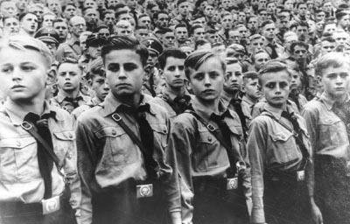
Nazi Racism
Hitler and the Nazis came to power in Germany in January 1933. They believed in two main concepts: German territorial expansion and German racial supremacy. According to their racist ideology, German people belonged to a “master race” of Aryans, a “pure” Germanic race that was superior to all others. Non-Aryans, including Roma (“Gypsies”), Slavic peoples (Poles, Russians, and others), and blacks were inferior. Jewish people, who the Nazis considered as a race rather than as a religious group, were the most despised of all by the Nazis.
The Nazis also labelled other groups as inferior based on biological, ideological, and political factors. Among them were people with mental or physical disabilities, homosexuals, Jehovah’s Witnesses, and political opponents of the Nazi Party (including Communists and Socialists). Hitler wanted to rid Germany of all these individuals.

Slide 17
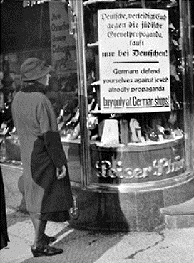
Anti-Semitic Laws aGainst Jews
Nazi Laws designed to exclude Jews from German society were introduced including: the Law for the Restoration of the Professional Civil Service (April 7,1933), which prohibited Jews from working for the civil service, the Law Against Overcrowding in Schools and Universities (April 25, 1933), which denied many Jewish students access to public education by restricting their enrollment in German schools to a maximum of 1.5% of the total intake, and the Hereditary Farm Law (September 29, 1933), which banned Jews from owning or operating farms.
Jewish marginalization intensified with the passing of he Nuremberg Laws (September 15, 1935), which stripped German Jews of their citizenship, banned marriages and sexual relations between Jews and non-Jews, and forbade Jews from employing in their homes Aryan women under the age of 45.

Slide 18
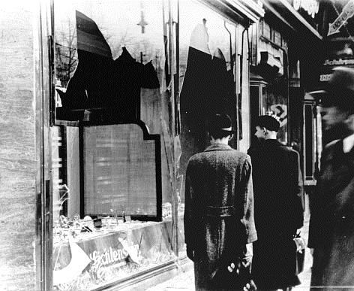
Night of Broken Glass
Anti-semitism became increasingly accepted in Nazi Germany. When the Nazis organized a series of violent anti-Jewish attacks on the nights of November 9 and 10, 1938, there was terror. Rioters broke windows, vandalized, looted, and set fire to homes, businesses, and religious places of worship belonging to Jewish communities throughout Germany and Austria (which Germany occupied in March 1938). It became known as the “Night of Broken Glass” due to all the smashed glass that littered the streets from the Jewish-owned businesses.
As a result, more than 1,000 synagogues and 7,500 businesses were damaged or destroyed, at least 90 Jews were murdered, and 30,000 boys and men were arrested and sent to concentration camps. The Jews were victimized further when the Nazis ordered them to clean up and pay for all the damage that had been caused.

Slide 19
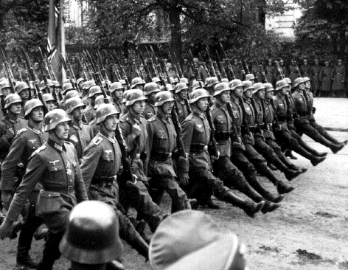
Germany Enters WWII
On September 1, 1939, Nazi Germany triggered the Second World War by invading Poland. Two days later, Britain and France declared war on Germany. The Polish resistance effort was squashed in less than one month.
Much to the Nazis’ displeasure, German territorial expansion meant it increasingly had more Jews under its control. Following the occupation of Poland, German authorities confiscated Polish Jews’ property and segregated them from the rest of society by removing them from their homes and deporting them to ghettos. Armed guards ensured that no one left these run-down, fenced-off, and prison-like districts of Polish cities without a permit. Inadequate food rations causing starvation, coupled with overcrowded and unsanitary living conditions bringing outbreaks of diseases such as typhus and tuberculosis resulted in an estimated 500,000 Jewish deaths.

Slide 20
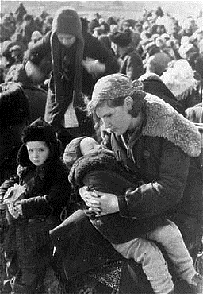
A New Level of Brutality
Hitler expanded his empire throughout 1940. The Nazis conquered Denmark, Norway, the Netherlands, Belgium, Luxembourg and France. Jews from territories under Nazi rule were rounded up and deported to Polish ghettos.
The mass murder of Jews began following the German invasion of the Soviet Union on June 22, 1941. As the German Army fought its way eastwards, special units of the German security police called Einsatzgruppen followed behind. Their primary mission to eliminate the Soviet Jew population was carried out with the assistance of local collaborators and the German Army. Typically, victims were murdered in mass shootings where they were forced to undress and hand over their valuables before being lined up beside a ditch to be shot. These massacres are estimated to have claimed the lives of more than 1.3 million Jews.

Slide 21
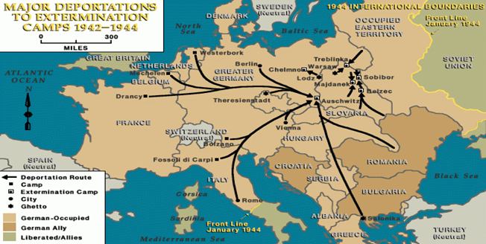
“Final Solution”
On January 20, 1942, Nazi leaders gathered together at the Wannsee Conference in Berlin and agreed upon a murderous scheme known as the “Final Solution” with the aim of annihilating every Jewish person in Europe. In order to carry it out, the Nazis created six extermination camps: Auschwitz, Belzec, Chelmno, Majdanek, Sobibor, and Treblinka, all of which were located in occupied Poland.
To facilitate the transportation of Jews from ghettos and other holding centres in German-controlled territories as well as those countries allied with Germany to extermination camps, these camps were placed next to major railway lines. Jews endured long, overcrowded train rides, often in cattle cars, with no sanitation, food or water. Journeys lasted days, sometimes weeks. Many did not survive, succumbing to starvation, dehydration and disease.

Slide 22
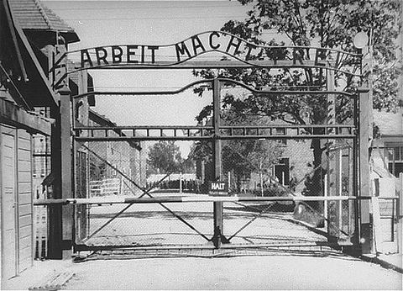
Extermination Camps
New arrivals at the camps were separated into two groups. Those in one group (which usually included mothers, children, pregnant women, the elderly, and the sick) were forced to undress and hand over their valuables before being herded into the gas chambers. To prevent any acts of disobedience, camp officials deceived the victims by telling them that they were being taken for a shower. Instead, they were killed with poison gas. Ovens were used afterwards to cremate the corpses in an effort to hide evidence of these mass killings.
Those in the other group (which usually included able-bodied men) were temporarily spared from the gas chambers in order to be used as slave labourers. Food was scarce and workers perished due to starvation and disease or were killed when they became too weak to work. Over 3 million people died in extermination camps.

Slide 23
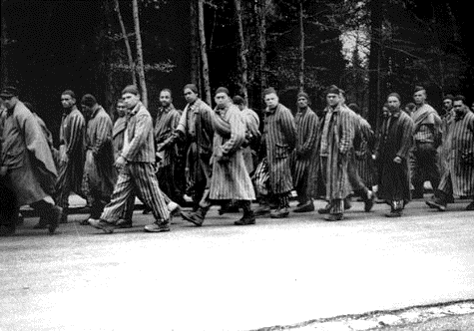
The Death Marches
On June 6, 1944, the Allies (including British, Canadian, and American forces) launched the D-Day invasion of Nazi-occupied Normandy in France. Following the success of this offensive, between July 1944 and May 1945 the Allies fought their way eastwards towards Germany, liberating from Nazi occupation the conquered people of Europe. Similarly, Soviet forces (also at war with Germany) marched westwards liberating as they advanced.
The German Army was in retreat. The Nazis, desperate to prevent the liberation of their slave labourers, and to ensure there were no witnesses to their crimes, ordered the evacuation of camps across occupied Europe. Inmates were forced to travel on foot hundreds of miles to camps in Germany, often in freezing temperatures, without adequate clothing, food or water. Whoever fell behind was shot. Up to 250,000 people perished on these treks.

Slide 24
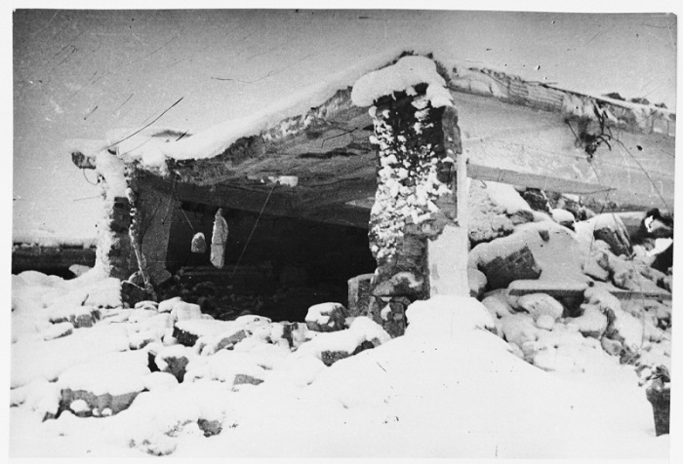
The Denial
By the end of 1944, with the Allied armies closing in, Nazi extermination camp officials preparing to evacuate tried frantically to destroy evidence of the crimes against humanity they committed. In several instances, incriminating documents were burned, gas chambers were dismantled, crematoria were blown up, and mass graves were dug up and corpses were cremated.
Despite their efforts, the Nazis were not able to hide what they had done. Documents, photographs, film, and perpetrator and survivor testimony provide undeniable proof that the Holocaust happened.

Slide 25
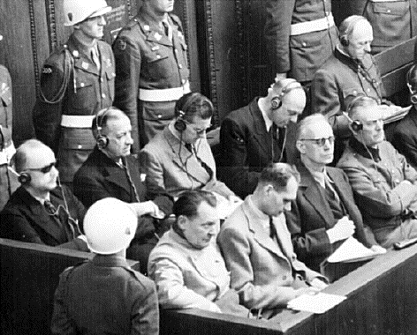
Seeking Justice
Adolf Hitler committed suicide on April 30, 1945, so it was not possible to bring him to justice. However, several high-ranking Nazi political, military, and economic figures accused of war crimes were prosecuted during a military trial in Nuremberg, Germany, between November 20, 1945, and October 1, 1946. Follow-up Nuremberg trials continued until 1949 prosecuting other groups involved such as police, Einsatzgruppen, and extermination camp guards and commandants. Other countries also held trials to prosecute Nazi war criminals.
Ultimately, about 150 German Nazi leaders were convicted on charges of crimes against peace, war crimes, and crimes against humanity, and conspiracy to commit such crimes. They were punished with jail sentences and 12 were executed. Nevertheless, most of the perpetrators went into hiding after the war and evaded justice.

Slide 26
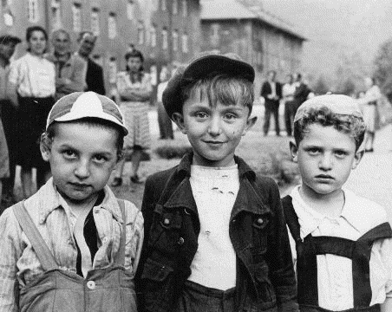
Significance
Six million Jewish men, women, and children had been murdered by the Nazis and their collaborators by the end of the Second World War. For survivors, liberation did not bring an end to the suffering. Most struggled to recuperate from starvation, disease, as well as trauma associated with the loss of friends and family members. Dispossessed of their properties and homes, Jews had nowhere to go. Therefore, many ended up in displaced person camps administered by the Allied Powers waiting years before they could eventually emigrate or settle elsewhere.
Beginning in 1953, the German government made reparation payments to individual Jews and to the Jewish people as a way of acknowledging the German people’s responsibility for the crimes committed in their name.

