Slide 1
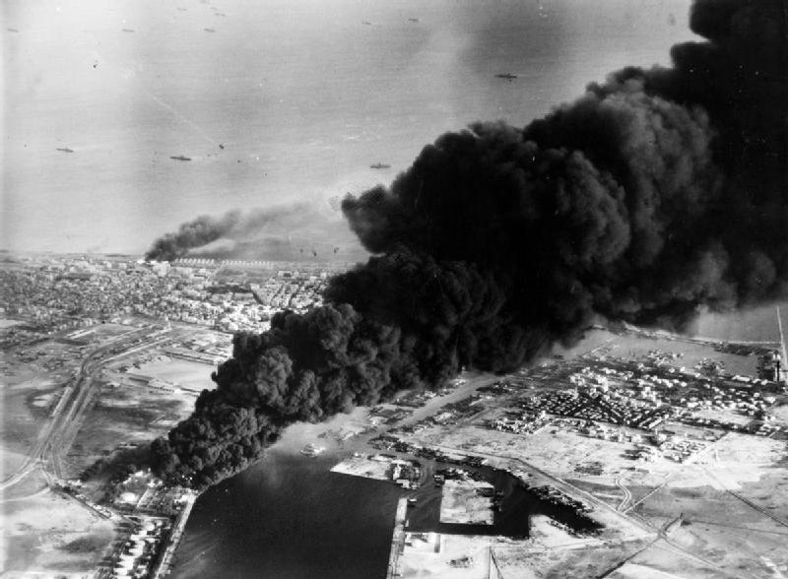
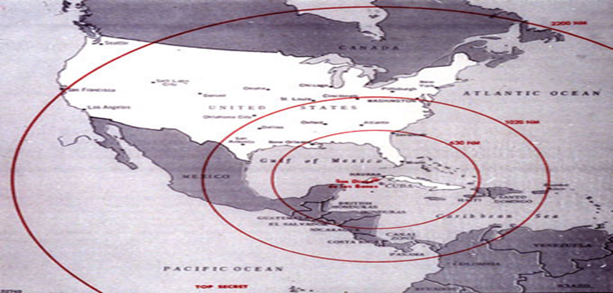
Nuclear Close Calls of the Cold War: The Suez Crisis and the Cuban Missile Crisis

Slide 2
Background to the Suez Crisis
The Suez Canal opened in 1869 when Britain controlled Egypt. Built by Egyptian workers under the French and British-owned Suez Canal Company, this man-made waterway links the Mediterranean and Red Seas. By shortening the sea route between Europe and East Asia, the Suez Canal became a critical shipping route for international trade.
When Egypt achieved independence in 1922, the British took measures to ensure they maintained control over the canal. In 1936, the Anglo-Egyptian Treaty was signed by Britain and Egypt allowing British troops to remain in the canal zone until 1956.

Slide 3
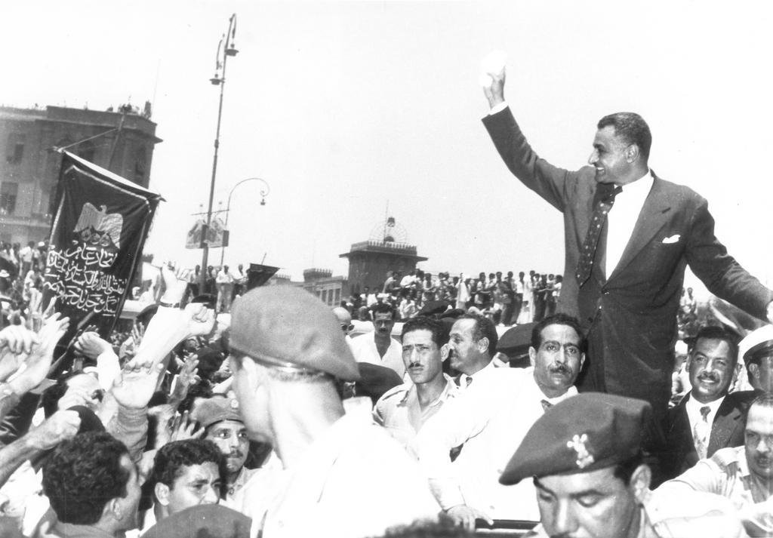
Rising Tensions
But things were changing in Egypt. Under the leadership of military officers, Egyptians deposed their monarchy and Gamal Abdel Nasser became the country’s new president. By 1954, Nasser started to pressure the British to end their military presence in the Suez Canal zone.
Nasser’s anti-imperialist agenda also gained him the approval of the Soviet Union’s communist government and their leader, Nikita Khrushchev. Soviet influence in the region grew in September 1955, as Nasser purchased Soviet-made fighter aircraft, bombers and tanks from communist Czechoslovakia in preparation for an attack on Israel.

Slide 4
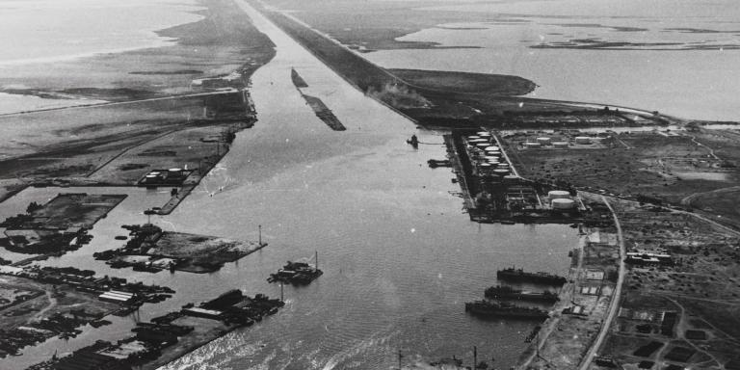
Seizing the Canal
U.S. President Dwight Eisenhower was opposed to the close relationship developing between Egypt and the Soviet Union. In July 1956 he cancelled a promised grant of 56 million dollars towards the construction of a new hydroelectric power project on the Nile River, the Aswan Dam. The British followed suit and withdrew their offer of financial aid as well.
Nasser retaliated on July 26, 1956, by ordering Egyptian forces to seize the canal and nationalize it (which means he made it Egypt’s public property). Revenue to finance the building of the dam, Nasser declared, would be acquired by charging tolls on ships passing through the canal.

Slide 5
Britain, France, and Israel
The Egyptian takeover of the canal angered Britain and France. As it was a vital shipping route for oil travelling to these countries, a potential blockage of the waterway posed a serious economic threat. A closure would also endanger efficient British access to the remains of its empire.
France’s relationship with Egypt was already strained. It opposed the Egyptian president for supporting rebels trying to overthrow French rule in Algeria. Meanwhile Israel, concerned about Egypt’s acquisition of Soviet weaponry from Czechoslovakia and engaged in a series of battles with Egypt along its border, was purchasing weaponry from France.

Slide 6
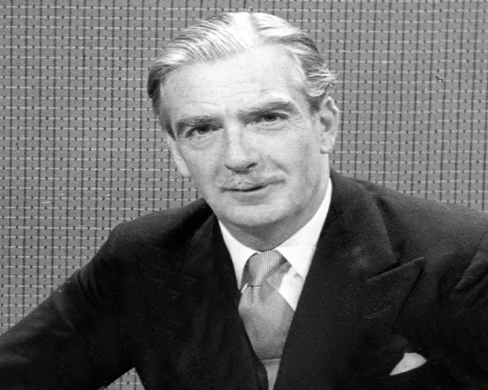
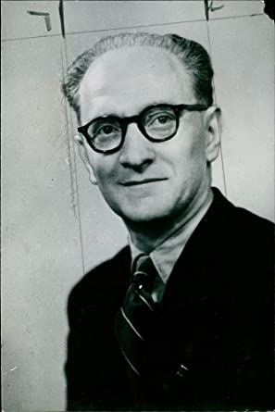
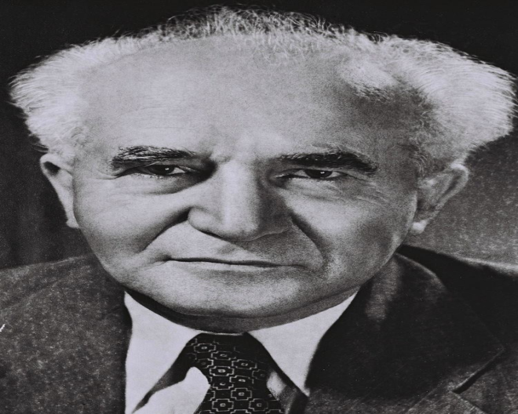
Planning the Attack
Military intervention by the three countries to retake the canal in Egypt, however, would violate the United Nations charter and risk angering the U.S. and damaging Anglo-Arab relations. Seeking to avoid these ramifications, the governments of Britain, France, and Israel reached a secret agreement in Sevres, France, known as the Protocol of Sevres.
Under the protocol, Israel would invade Egypt advancing toward the canal on October 29. The next day, British and French forces would intervene as ‘peacemakers’ to separate the combatants and demand that both sides cease fighting and withdraw from the canal zone.

Slide 7
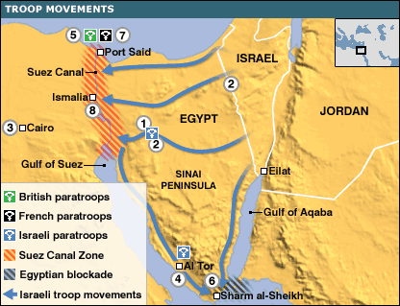
The Attack on Egypt
According to plan, Israel began its attack across Egypt’s Sinai Peninsula toward the eastern side of the canal on October 29, 1956. The following day, France and Britain, as members of the United Nations Security Council, called for a cease-fire and demanded that both warring nations withdraw from either side of the canal. Nasser, however, refused.
Tensions increased as Britain and France launched aerial bombardments on Egyptian airfields. This was followed on November 5 and 6 by the aggressors landing troops at Port Fuad and Port Said, occupying the northern end of the canal in an offensive known as Operation Musketeer

Slide 8
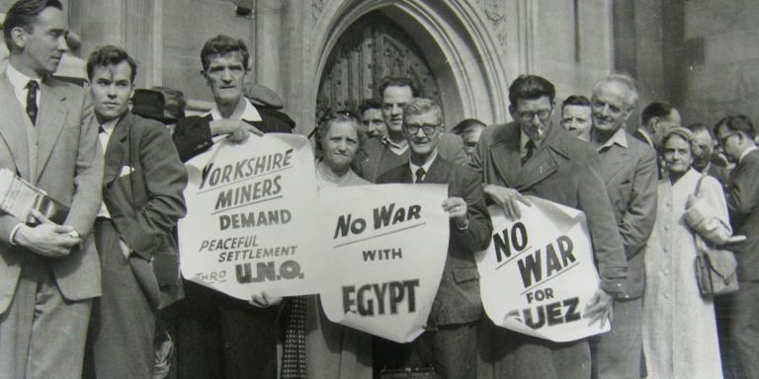
International Backlash
The aggression and disregard of Egyptian sovereignty demonstrated by the three nations triggered international outrage. Nikita Khrushchev, the Soviet leader, threatened to send troops to Egypt to fight the Allies and defend Egypt. He even threatened to rain down nuclear missiles on Western Europe if Britain, France, and Israel did not withdraw from Egypt.
A cease-fire resolution passed in the United Nations General Assembly by a vote of 64-5. Pressured by this unified international response, economic threats by the U.S. and public protests in Britain against the conflict, British Prime Minister Anthony Eden agreed to the cease-fire on November 6.

Slide 9
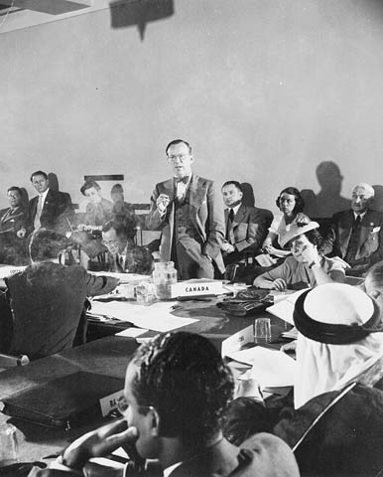
A Canadian Solution
Canadian secretary of state for external affairs, Lester Pearson, proposed a solution at the United Nations to deescalate hostilities in the region. He suggested sending a multinational peacekeeping force to supervise the cease-fire. On November 4, 1956, with 57 votes in favour, 0 against and 19 abstentions, the United Nations General Assembly passed the idea.
A peacekeeping force called the United Nations Emergency Force was established and deployed to Egypt. By mid-November, it had arrived in the canal zone. Britain and France withdrew their troops from Egyptian territory by the end of 1956. Israel later removed its troops in March 1957.

Slide 10
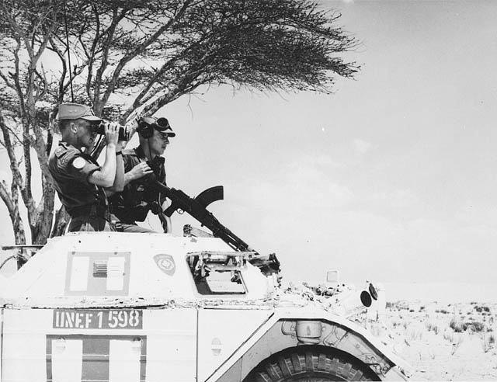
Significance
The Suez Crisis revealed who the real superpowers were in the world, the U.S. and the Soviet Union. Both took a more powerful role in world affairs, whereas Britain and France’s influence as world powers diminished. Meanwhile in Egypt and throughout the Arab world, Nasser was widely viewed as a hero who had prevailed over British and French imperialism.
Canadian troops participated in the United Nations Emergency Force mission in Egypt and earned global respect. Canada gained a reputation as a peacekeeping country. For his role in defusing the conflict, Lester Pearson was awarded the Nobel Peace Prize in 1957.

Slide 11
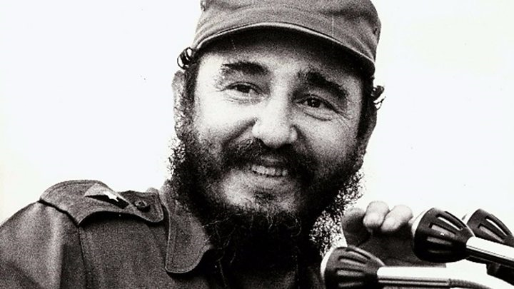
Background to the Cuban Missile Crisis
Fidel Castro seized power in Cuba in January 1959, after leading an armed revolution against the regime of dictator Fulgencio Batista. Under Castro’s leadership, all American-owned companies in Cuba were nationalized. The U.S. severed diplomatic ties with Cuba in retaliation and imposed trade embargos on its goods such as sugar and tobacco.
U.S. President John F. Kennedy ordered an invasion of Cuba in April 1961. The attack took place on the southern coast of Cuba at the Bay of Pigs and ended in the defeat of 1,400 American-trained Cuban exiles. Castro was convinced that the U.S. was trying to overthrow his government.

Slide 12
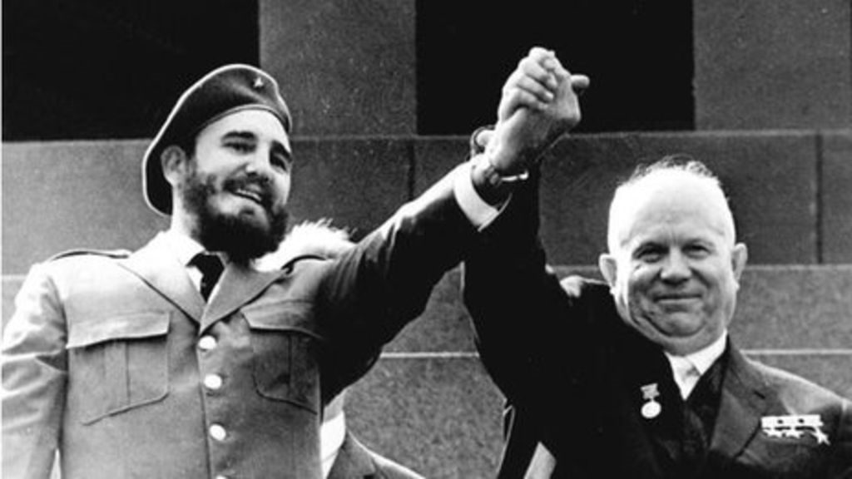
Deploying the Missiles
For trade and protection against future U.S. aggression, Castro sought support from the Soviet Union. Soviet leader Nikita Khrushchev approved trade agreements and weapons deals with Cuba. Rising communist influence led to the creation of a communist government in the region.
Western areas of the Soviet Union were within range of missiles the U.S. had placed in Turkey and Italy. However, the continental U.S. was out of reach for missiles in the Soviet Union. To correct this imbalance and deter the U.S. from initiating another invasion of Cuba, Khrushchev made a secret agreement with Castro in July 1962 to send Soviet missiles to Cuba

Slide 13
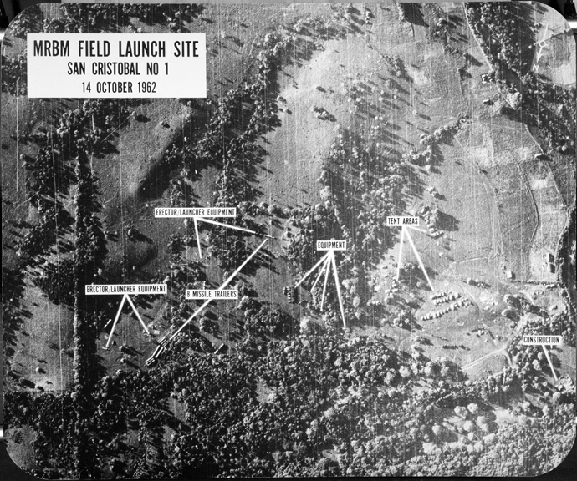
Discovering the Missiles
On October 14, 1962, an American U-2 spy plane flying over Cuba secretly took several photographs. These images revealed that the Soviet Union was constructing medium and intermediate-range ballistic missile launch sites in Cuba. Two days later, the pictures were shown to U.S. President John F. Kennedy and he was informed about the situation.
Once operational, missiles equipped with nuclear warheads in Cuba – only 90 miles off the coast of Florida – could strike and inflict mass destruction upon targets in the U.S., including major cities such as Washington D.C. and New York. Millions of American lives were at stake.

Slide 14
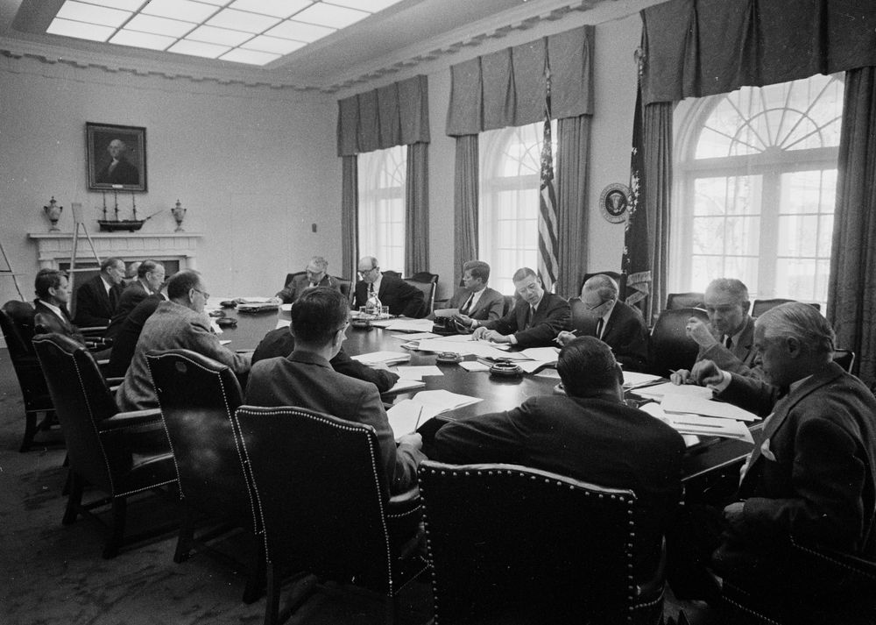
A Fateful Decision
To help him decide how to respond to this dangerous situation, President Kennedy assembled a group of advisors at the White House. These officials, known as the “ExComm” - Executive Committee of the National Security Council, discussed several options for the president to consider, including aerial bombardments of missile sites and an invasion of Cuba.
With Soviet ships bound for Cuba carrying missiles, Kennedy chose to impose a naval “quarantine,” or blockade of the island to prevent any more missile shipments from arriving there. He also demanded that the missiles already in Cuba be removed, and the launch sites be destroyed.

Slide 15
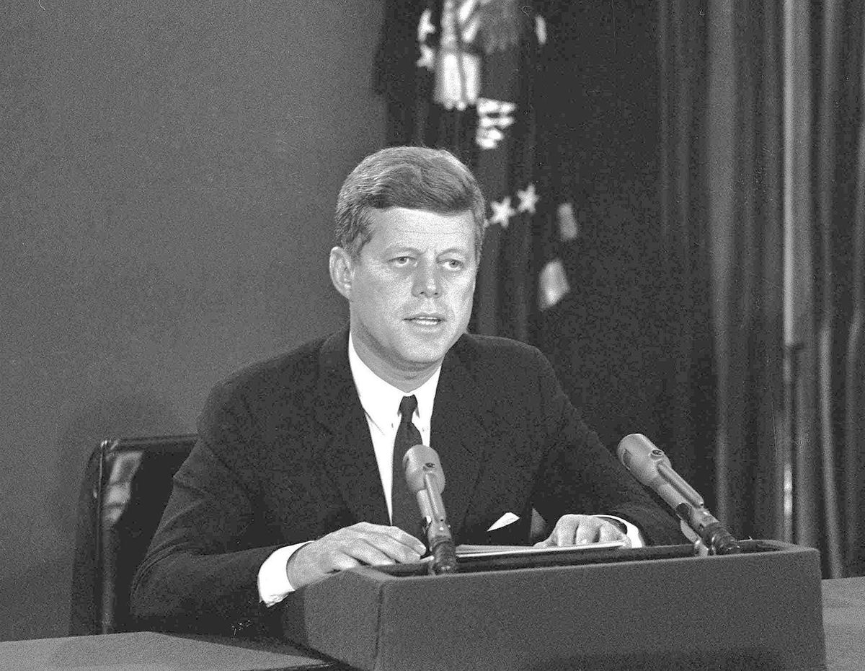
The American Response
In a televised address on October 22, President Kennedy informed the U.S. public about the presence of Soviet missiles in Cuba and called for their removal. Any ship delivering offensive military weapons to Cuba, he declared, would be turned back by U.S. vessels enforcing a quarantine.
The president issued a stern warning to the Soviet government announcing that: “it shall be the policy of this nation to regard any nuclear missile launched from Cuba against any nation in the western hemisphere as an attack by the Soviet Union on the United States, requiring a full retaliatory response upon the Soviet Union.”

Slide 16
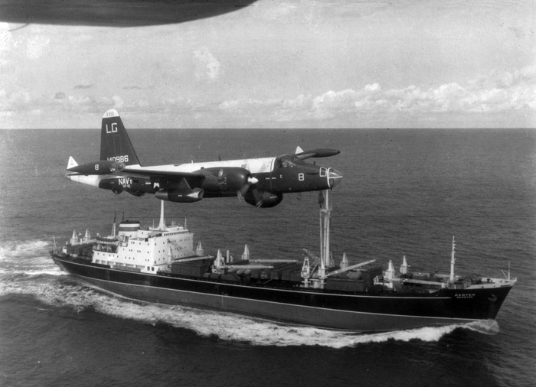
The Soviet Response
In telegrams sent to President Kennedy on October 24, Soviet Leader Khrushchev denounced the naval blockade as an “act of aggression” that would lead to war. He declared that captains and sailors of Soviet vessels would be instructed to ignore it and proceed to Cuba anyway. Despite Khrushchev’s bold claim, he ultimately reversed this order.
During October 24 and 25, several Soviet ships that were presumably carrying offensive weapons halted their voyages to Cuba and turned back. Other vessels were stopped by the U.S. naval forces, but they contained no offensive weapons and so were allowed to proceed.

Slide 17
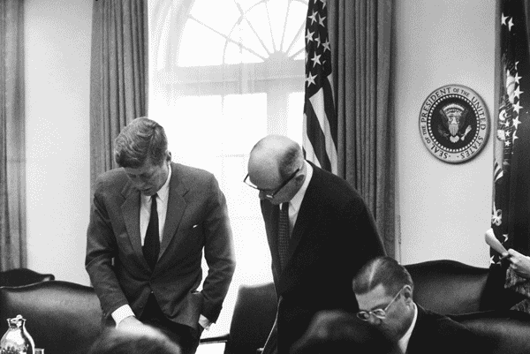
Peace Proposals
On October 26, Kennedy received a letter from Khrushchev proposing a resolution to the crisis. The Soviet leader offered to withdraw the missiles from Cuba in exchange for the U.S. lifting the quarantine and promising not to invade Cuba.
This was followed on October 27 by a second letter from Khrushchev in which he upped his demands to Kennedy. He indicated that any agreement would have to include the removal of U.S. missiles from Turkey.

Slide 18
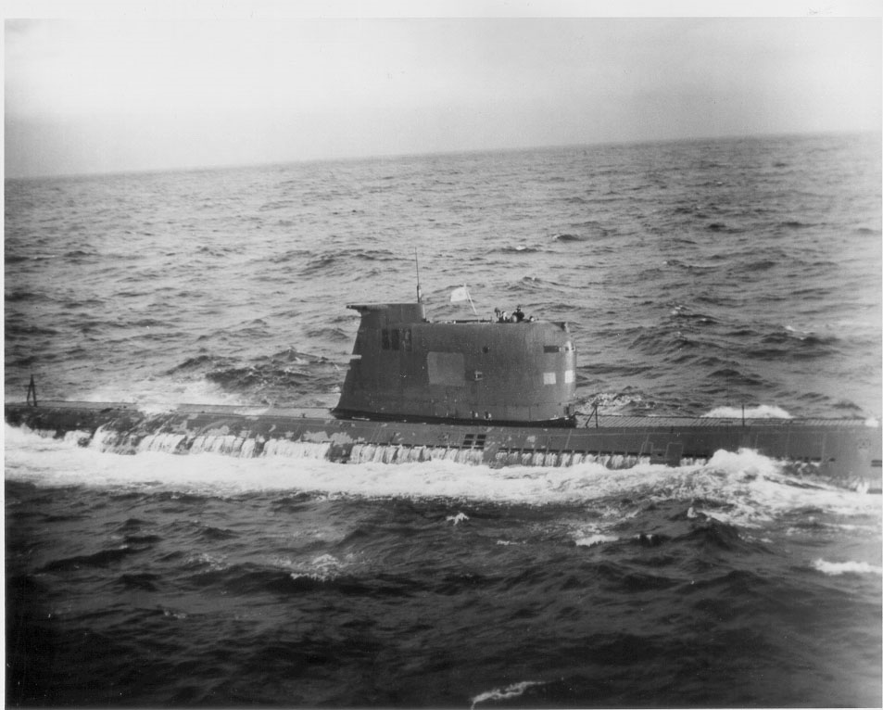
Rising Tensions
While flying a photo reconnaissance mission over Cuba on October 27, U.S. pilot Major Rudolf Anderson was killed when his U-2 spy plane was shot down by a Soviet surface-to-air missile. Showing restraint, Kennedy decided not to respond militarily unless another attack was made.
Later that same day, a Soviet B-59 submarine approaching Cuba was detected and warning depth charged by U.S. Navy warships patrolling the quarantine zone. Unaware of the blockade, the submarine’s crew thought that maybe war had been declared. A nuclear-tipped torpedo launch was averted due to the objections of one officer, Vasili Arkhipov.

Slide 19
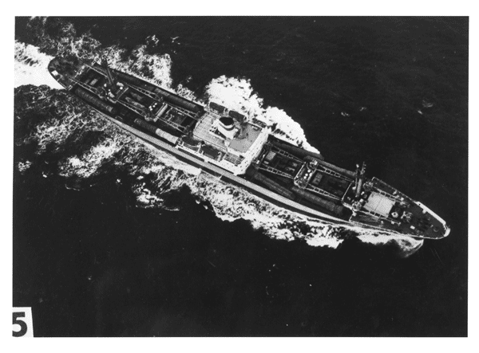
The Crisis Ends
On the night of October 27, U.S. President Kennedy sent his brother, Attorney General Robert Kennedy, to meet with Soviet Ambassador Anatoly Dobrynin. They reached a basic understanding: if the missiles in Cuba were returned to the Soviet Union, the U.S would guarantee never to invade Cuba. In addition, missiles in Turkey would be returned to the U.S. on the condition that this part of the deal not be disclosed publicly.
The next day, Khrushchev announced his acceptance of the proposal. Under United Nations supervision, the missiles were removed from Cuba. President Kennedy ended the quarantine on November 20, 1962.

Slide 20
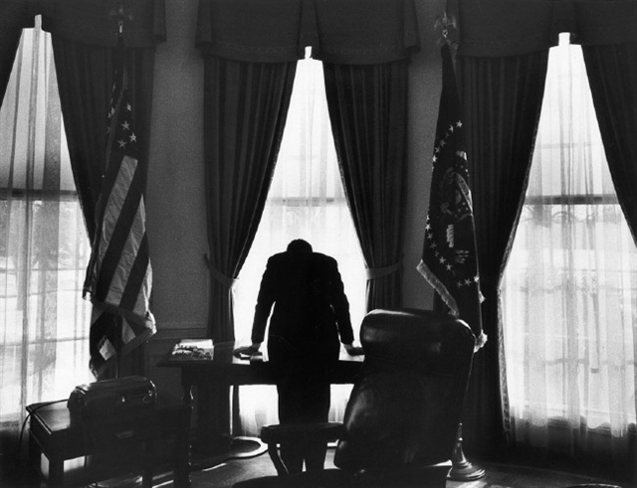
Significance
The crisis prompted the creation of a direct telephone link between the Kremlin and the White House known as the “Moscow-Washington hotline.” It ensured that Soviet Union and U.S. government leaders could communicate instantly to negotiate a resolution to any future conflict.
Recognizing how close the world had come to the brink of nuclear war, the U.S., Soviet Union and Britain signed the Test Ban Treaty in 1963. This began the process of ending nuclear weapons testing by prohibiting test detonations in the atmosphere, outer space and underwater, though it permitted underground testing. The treaty was signed by many countries

