Slide 1
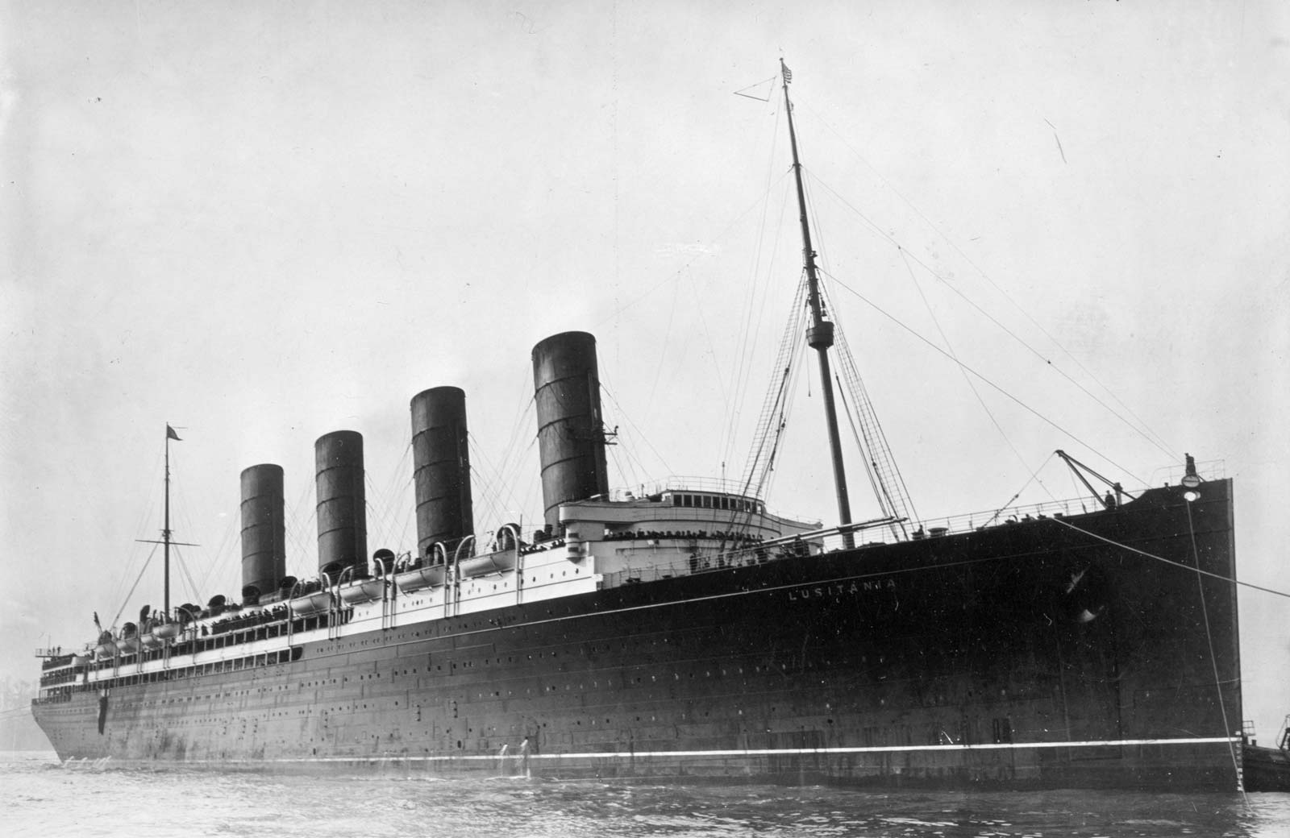
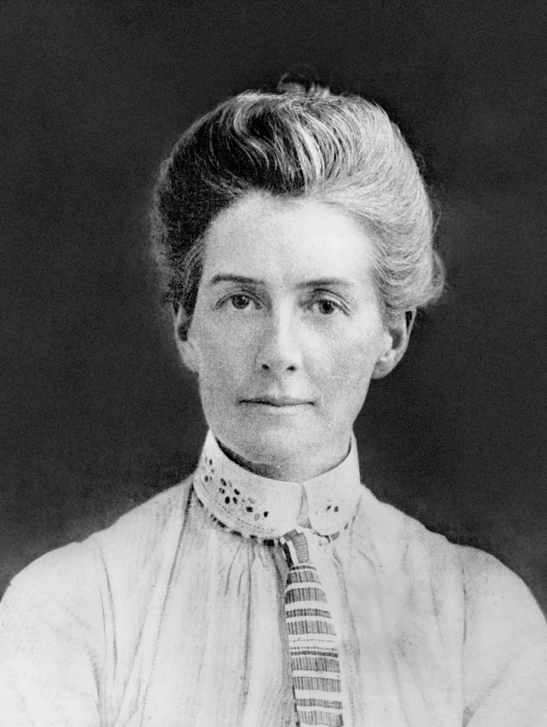
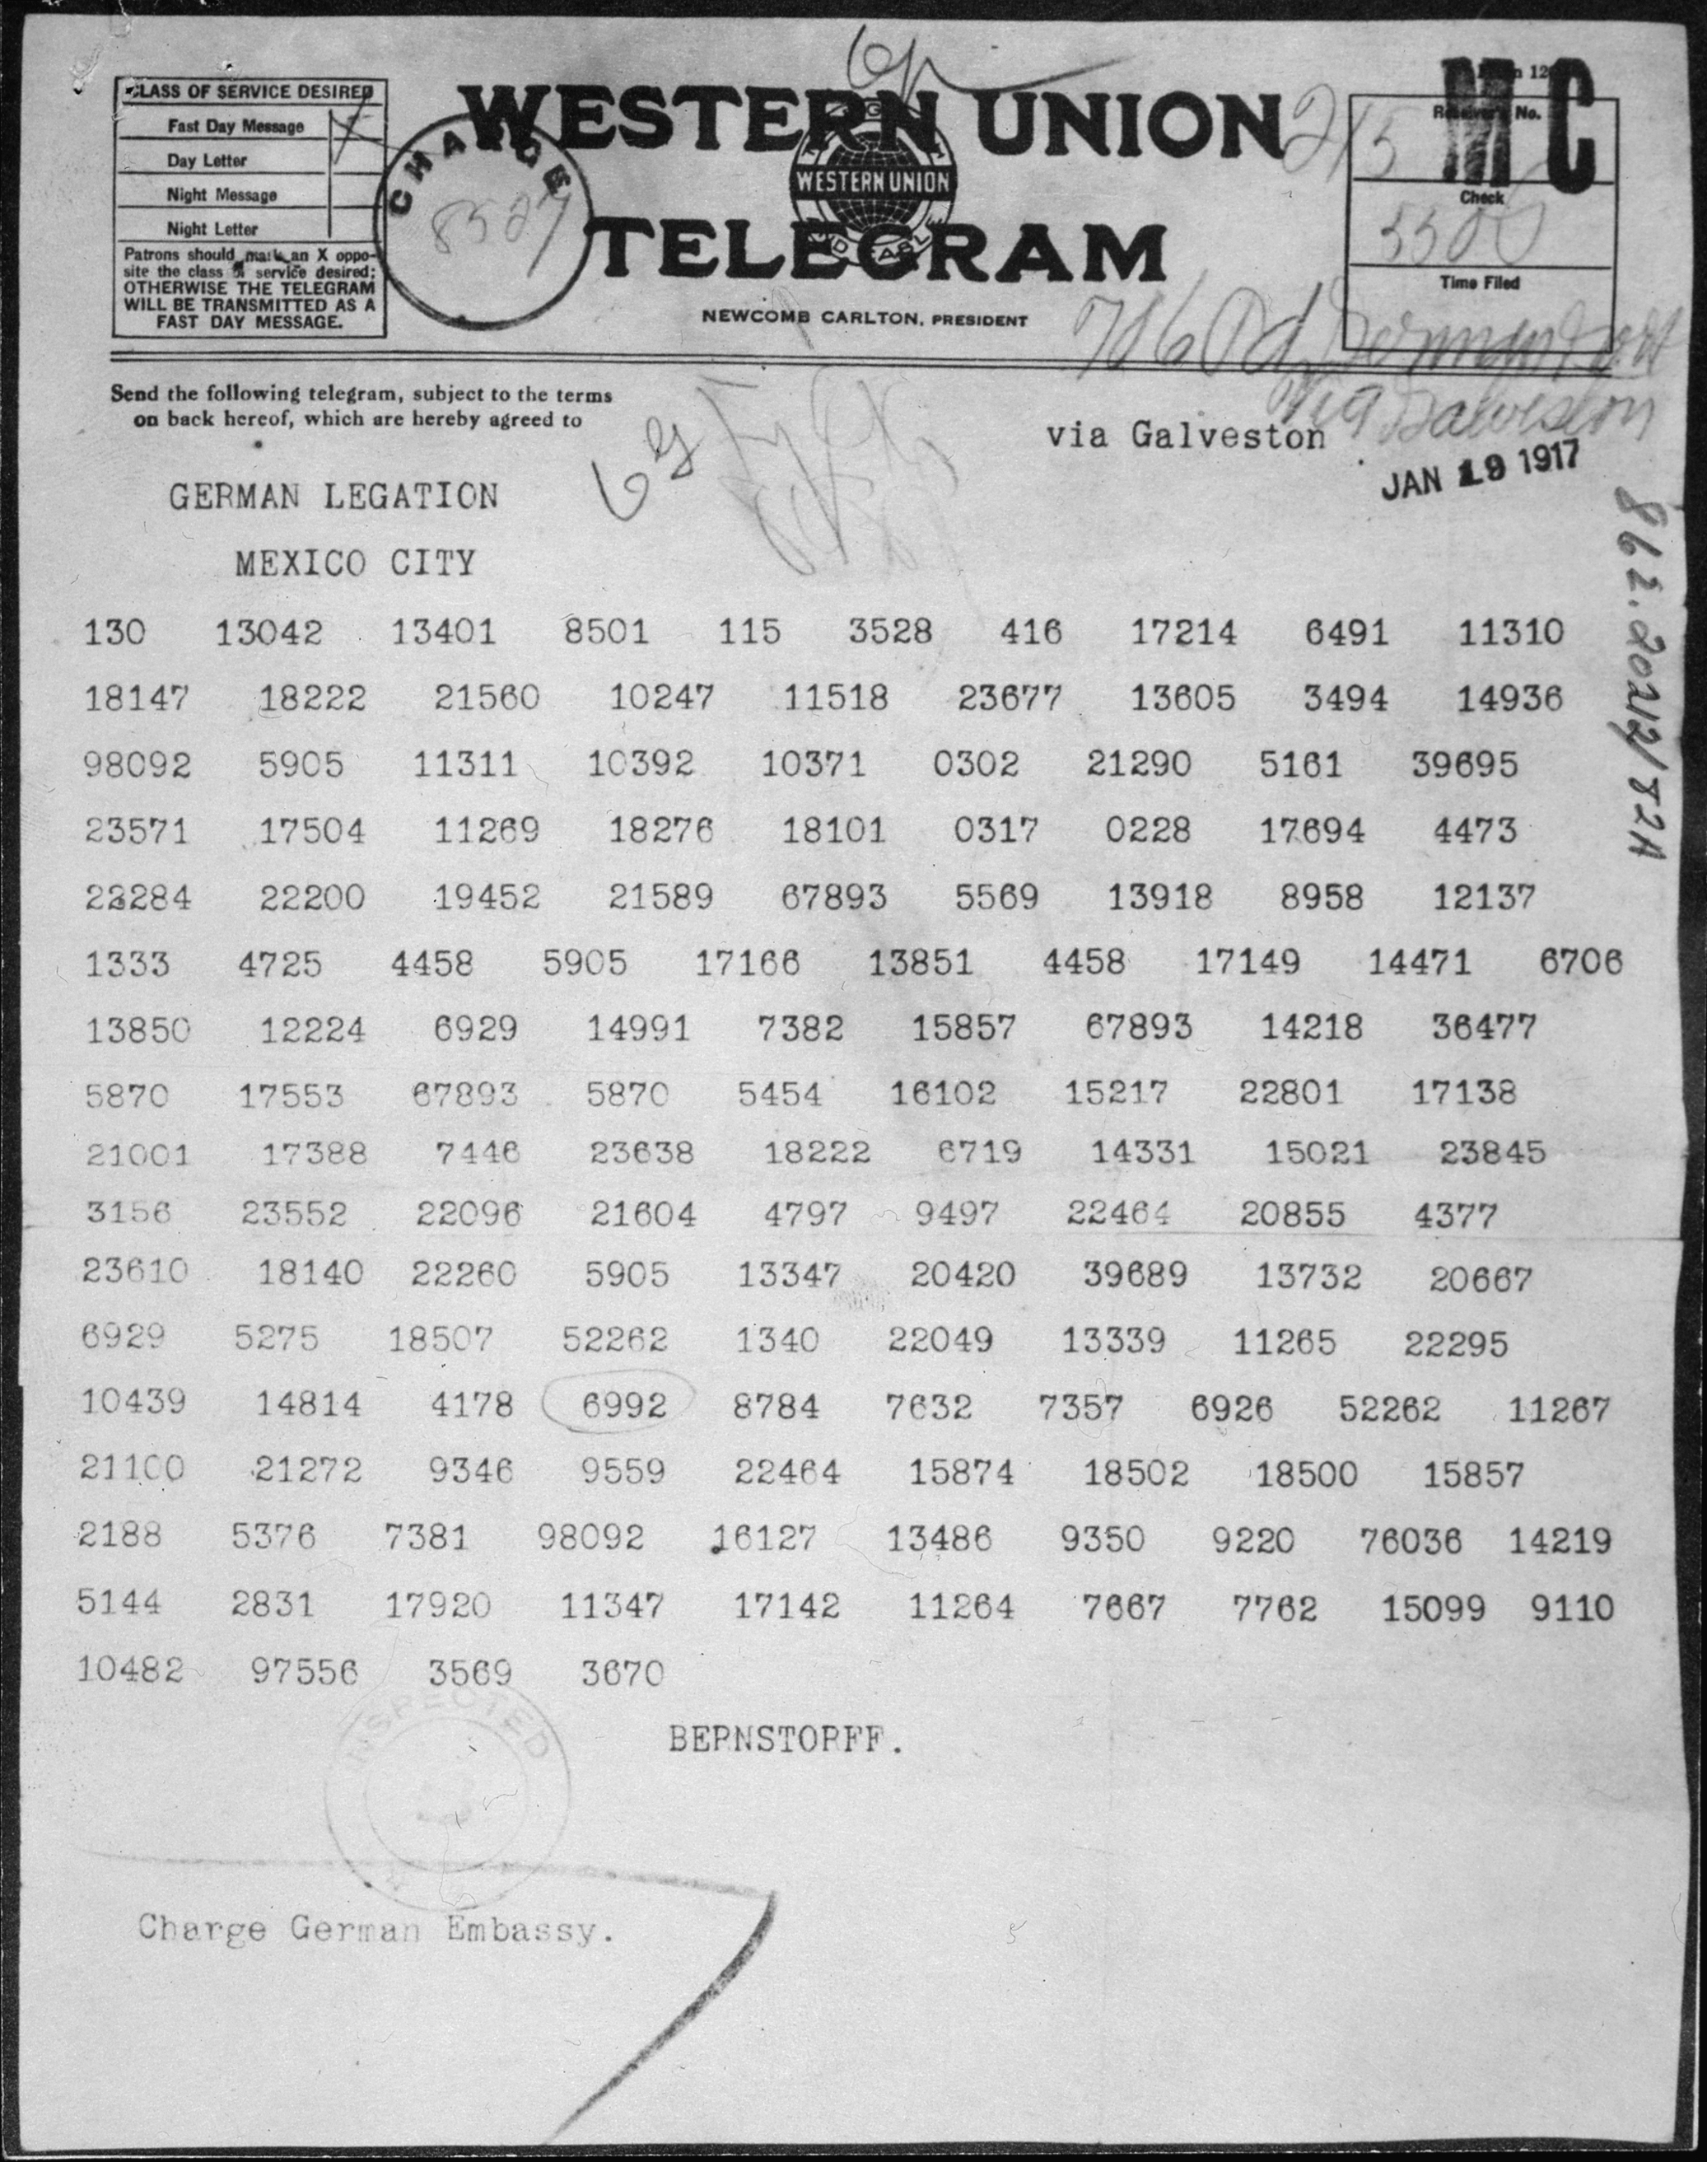
Special Topics of the First World War: The Sinking of the Lusitania, Execution of Edith Cavell, and the Zimmermann Telegram

Slide 2
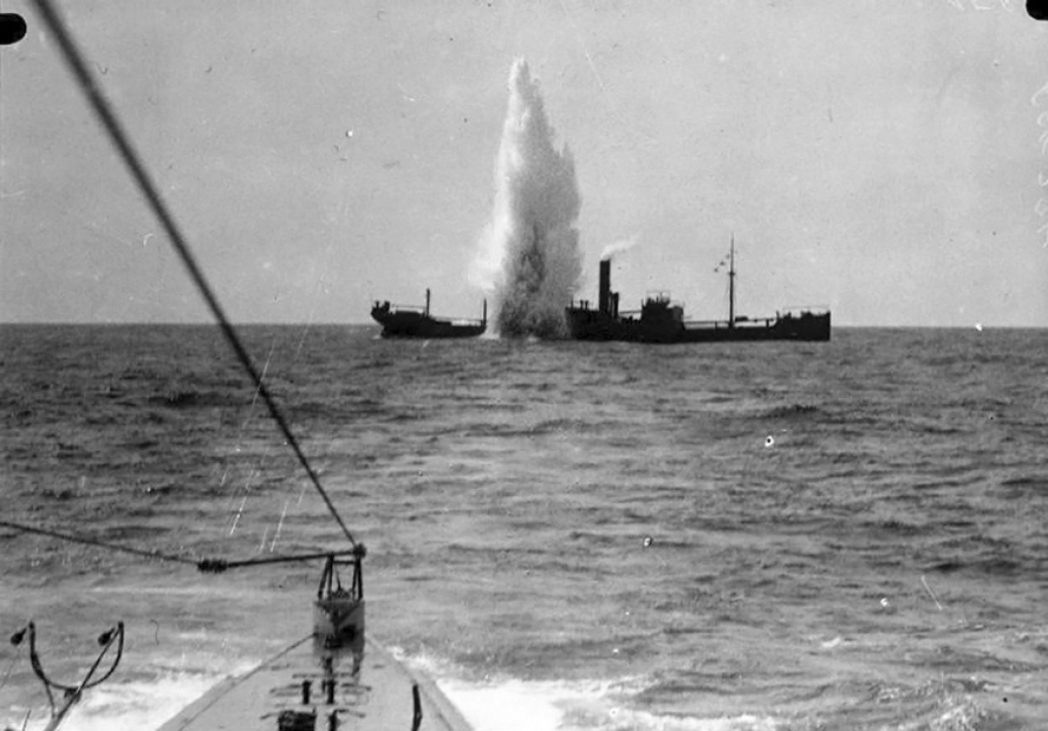
The War at Sea
On August 4, 1914, after Germany violated the neutrality of Belgium, the British government declared war on Germany. That same day, American President Woodrow Wilson issued a proclamation on the neutrality of the United States. Britain, as the world’s strongest naval power of the First World War, launched a campaign to blockade Germany’s ports beginning in November 1914. This effectively cut off trade supplies such as food, fuel, and munitions to Germany resulting in severe shortages.
Although Germany’s access to the open ocean was blocked by the British Royal Navy and they could not match Britain’s navy in size and strength, they were able to experiment with a new weapon, the submarine. German submarines, called U-boats, were dangerous because they could travel under water without being detected. Equipped with torpedoes, U-boats destroyed many Allied warships and merchant ships. Germany, realizing how heavily the British relied upon the United States for trade supplies, particularly munitions for the war effort, launched a campaign of submarine warfare aimed at disrupting Britain’s sea trade.

Slide 3
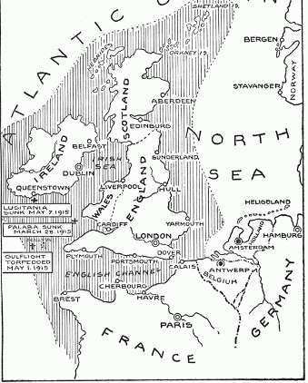
Breaking the Naval Rules
During the early stages of the war, the German navy endeavored to sink only enemy naval ships. U-boats followed international ‘prize laws'. This meant that the attacking submarine would issue a warning to an enemy ship, such as a shot across the bow. The enemy ship would then be boarded, inspected, and taken as a prize. If military necessity required it, the enemy ship could be sunk, but only after the passengers and crew were evacuated. To follow these rules, a U-boat would have to surface which left them vulnerable to attack. This became even more dangerous
after the British introduced ‘Q-ships’ – disguised warships with concealed deck guns intended to lure U-boats in close and then sink them. The use of Q-ships contributed to Germany’s eventual abandonment of prize rules.
German naval commanders knew British merchant and passenger ships were transporting weapons and supplies from the United States to Europe. As a result, on February 4, 1915, Germany declared the waters surrounding the British Isles a war zone in which any ship regardless of military status – including neutral, merchant, and passenger vessels – would be sunk without warning. This policy which showed a disregard for innocent lives and naval protocol angered neutral countries, especially the United States and became known as unrestricted submarine warfare.

Slide 4
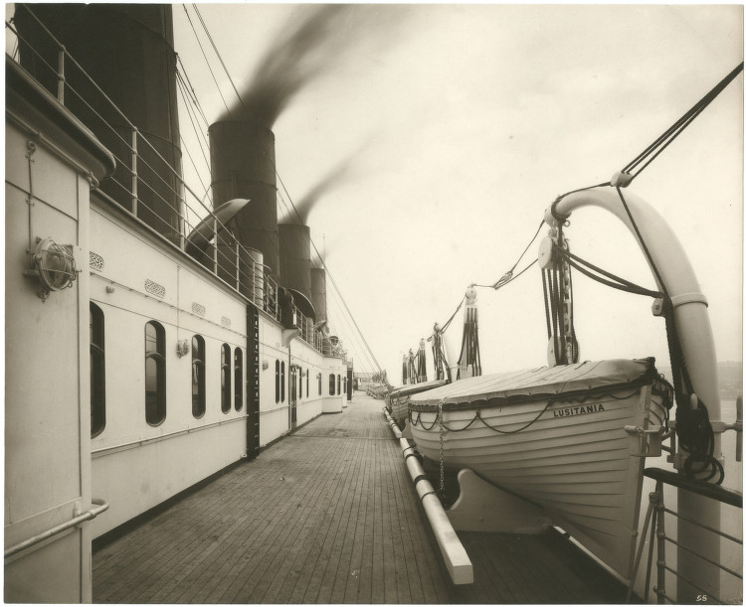
RMS Lusitania
The RMS Lusitania was a luxurious British passenger ship owned by the Cunard Line. When it entered service in September 1907, it claimed the title of world’s largest ship (measuring 787 feet in length and weighing approximately 31,550 tons). It mostly carried passengers across the Atlantic Ocean between Britain and the United States. To help finance the ship’s construction, Cunard signed an agreement with the British Navy. In return for the navy’s funding, Cunard agreed to make the ship available for military service if war broke out. Accordingly, the ship was registered on an official list as an auxiliary cruiser for the British Navy.
When the First World War began in 1914, the British Navy allowed the Lusitania to remain a passenger ship. However, the British Navy used the ship’s cargo space to smuggle American made ammunition and other war materials to assist them in their war effort. The details of this operation were kept secret. The British Navy believed that the Lusitania would not be a target for German U-boats since it was capable of going very fast and carried civilians on board.

Slide 5
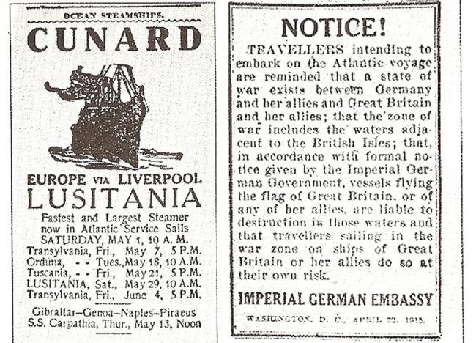
Warnings
In an effort to avoid controversy if the Lusitania was attacked by a U-boat, the German Embassy in Washington took the precaution of publishing advertisements on April 22, 1915, in fifty American newspapers, including those in New York, warning American transatlantic travelers that due to the state of war existing between Great Britain and Germany, ships flying the flags of its enemies - Great Britain and her allies - sailing through the British Isles war zone were “liable to destruction” and that passengers aboard these vessels sail “at their own risk”. In a number of newspapers, this alert was printed right next to sailing notices for the Lusitania. However, it did not appear in newspapers until May 1, 1915, the date of Lusitania’s sailing.
The sinking of merchant ships off the south coast of Ireland and reports of submarine activity there prompted the British Admiralty to warn the Lusitania to avoid the area and to recommend evasive maneuvers, such as zigzagging (meaning to change course every few minutes at irregular intervals) to confuse potential U-boats attempting to plot her course for torpedoing. The ship’s captain, William Turner, chose to ignore these recommendations.

Slide 6
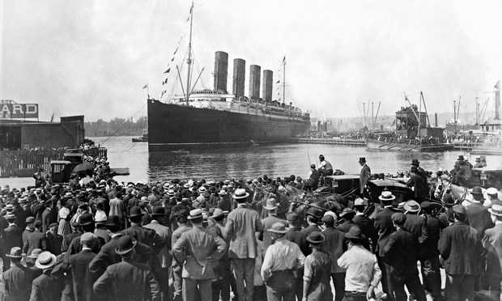
The Voyage
Many people did not believe that the Germans would attack a passenger ship – especially with neutral American citizens on board. Even if it encountered a submarine, the popular opinion was that the Lusitania was so fast that no U-boat could catch her.
On May 1, 1915, the Lusitania departed from New York bound for Liverpool, England with 1959 passengers and crew aboard.

Slide 7
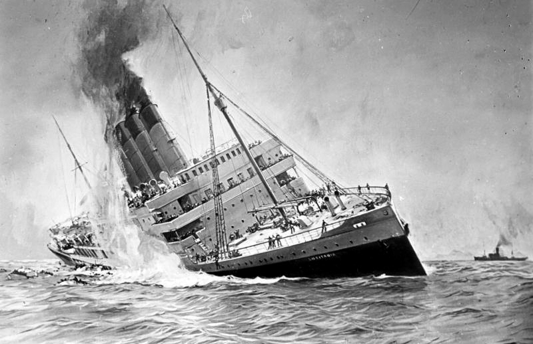
Sinking
On May 7, 1915, at 2:10 pm, the Lusitania was torpedoed without warning by the German submarine U-20 inside the declared war zone, 18 kilometers off the southern coast of Ireland. The commanding officer of the U-boat, Walther Schwieger, gave the order to fire a single torpedo which caused an explosion on the starboard bow of the vessel. A second more powerful explosion followed moments afterwards although controversy remains today regarding what caused it. The German Government insisted that this subsequent explosion was proof that the Lusitania was carrying munitions, a claim which was vigorously denied by the British Government.
Evacuation of the ship was chaotic. Electricity failed, plunging interior decks and cabins into darkness. Deprived of power, elevators became stuck, trapping those inside. The ship sharply tilted on her starboard side, making the loading and lowering of its lifeboats perilous or impossible. The rapid speed at which the vessel sank – eighteen minutes – made escape even more difficult. Only six of the ship’s forty-eight lifeboats launched successfully, leaving countless people stranded in the cold water, where they clung to wreckage or overturned lifeboats.

Slide 8
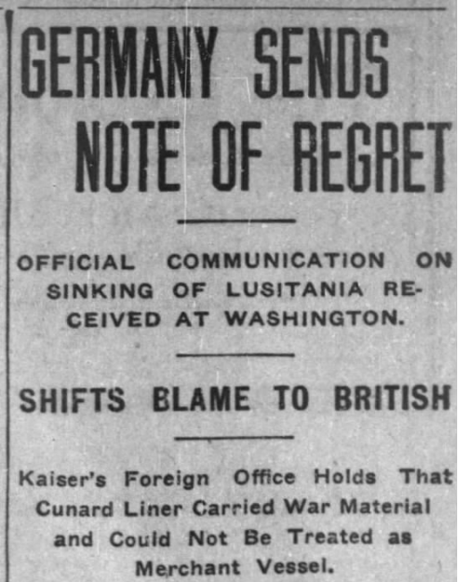
Was the Sinking Justified?
Germany remained steadfast in asserting that the Lusitania was a legitimate target since it was being used to smuggle munitions. It also maintained that it provided fair warning through the advertisement it placed in American newspapers alerting passengers to the risks of travelling aboard British or British-allied ships on transatlantic voyages. This, combined with the fact that it was registered with the British Admiralty as an “auxiliary cruiser” and had been sailing in a declared war zone, made it a perfectly reasonable target regardless of any passengers aboard, the Germans claimed.
Britain was outraged at the intentional sinking of its unarmed passenger ship and the resulting deaths of nearly 1200 innocent civilians. It denied that the boat was carrying munitions, but admitted that she was carrying small-arms ammunition. The ship’s cargo manifest indicates that the ship was carrying: 4,200,000 rounds of rifle cartridges, 18 cases of non-explosive fuses, and 1,250 empty shell cases.

Slide 9
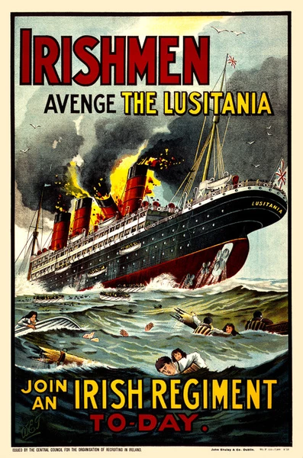
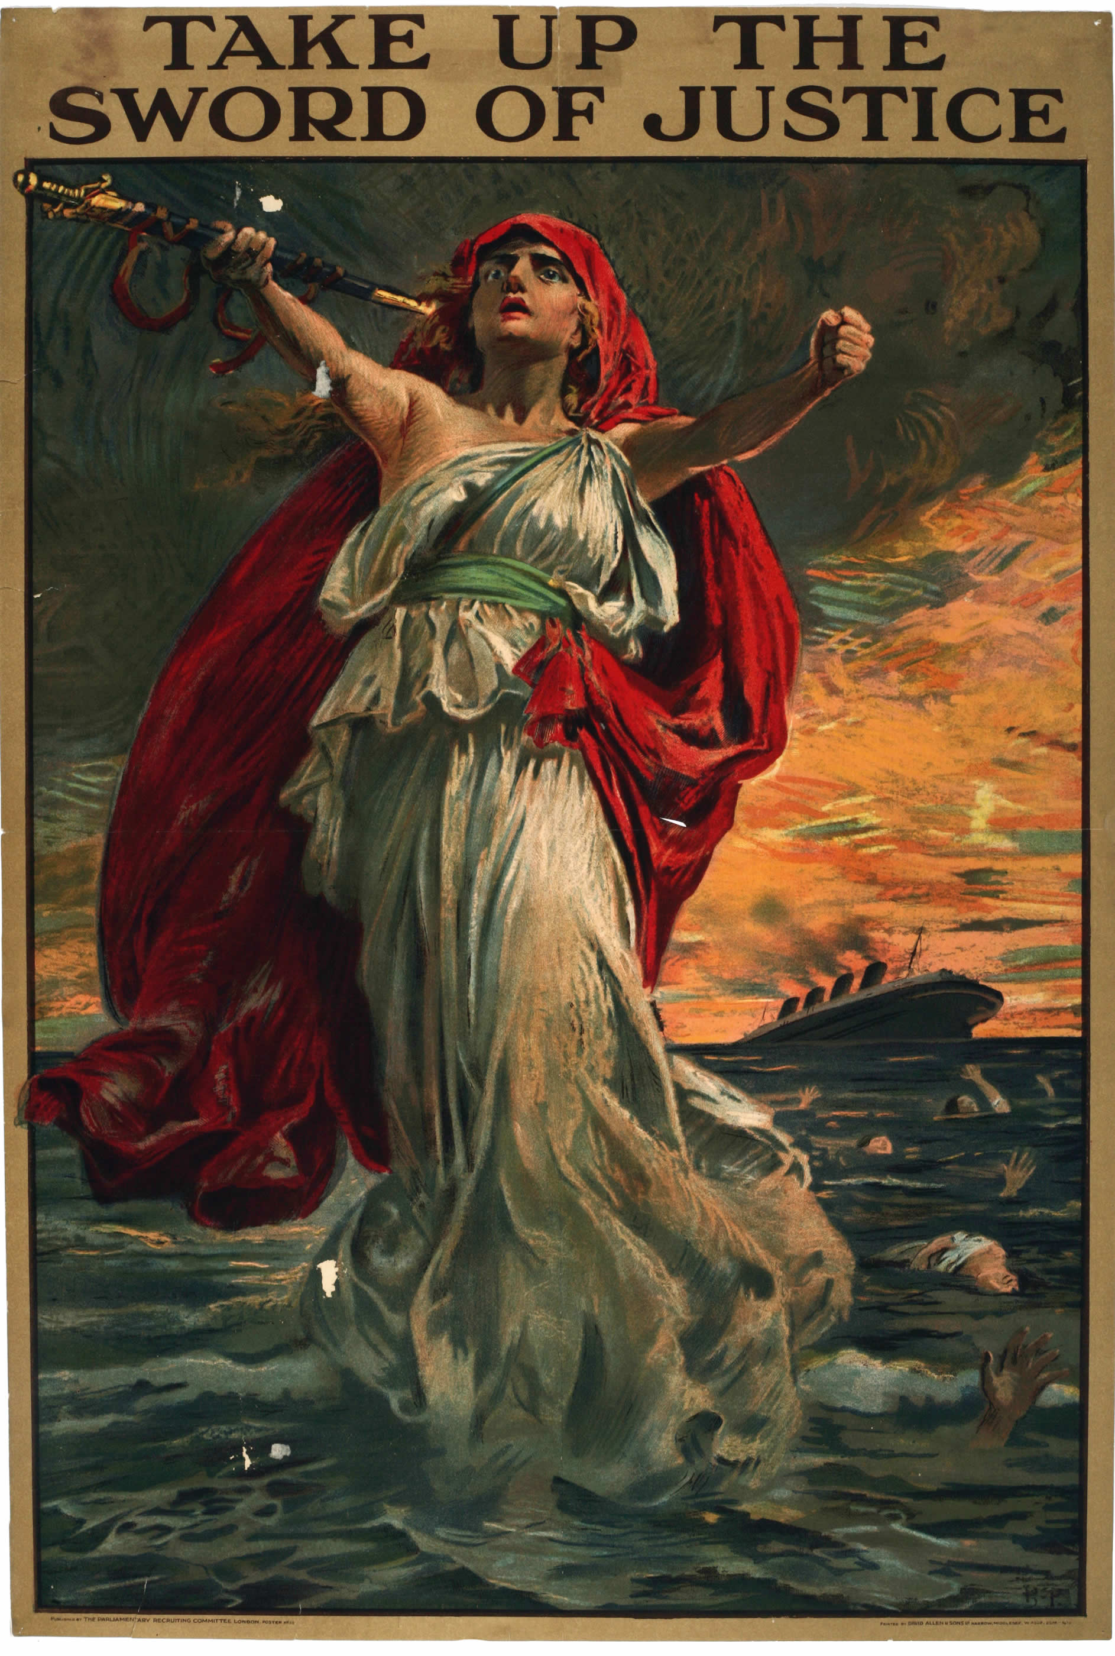
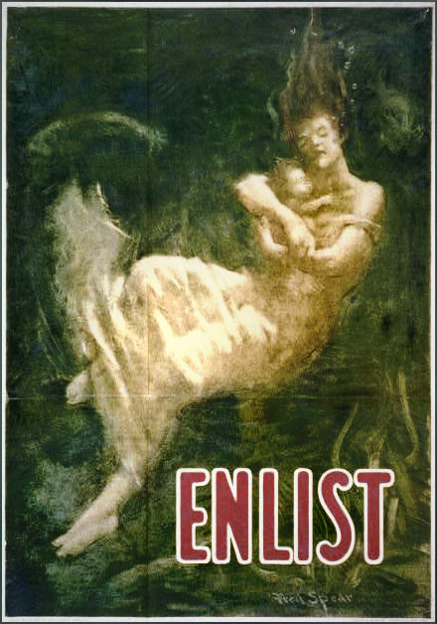
Propaganda
Following the sinking of the Lusitania, the British capitalized on the tragedy by publishing propaganda posters representing the loss of the ship and its passengers as a rallying call to men to enlist in the armed forces. British posters such as: “Irishmen - avenge the Lusitania. Join an Irish regiment to-day”, and “Take Up the Sword of Justice” successfully convinced many to avenge the sinking by joining the British war effort.
Although the United States waited until April of 1917 to declare war against Germany, it too referred to the Lusitania on propaganda posters as a reason for men to sign up to fight. One recruitment poster showed a woman and baby drowning above the single blood-red word “Enlist”.

Slide 10
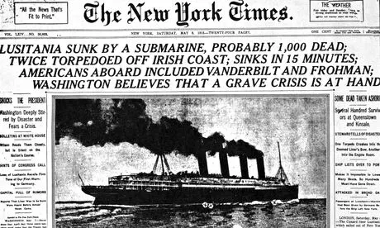
Significance
As a result of this tragedy, 1,198 passengers and crew were killed, including 128 American citizens. International public opinion, particularly in the then-neutral United States, swung in favor of the British. The Germans, on the other hand, became considered by most as cold-blooded murderers. Although the incident did generate anti-German sentiment, it did not immediately cause the United States to enter the war. Instead, the American government issued a letter of protest to Germany while maintaining its policy of neutrality. Under immense pressure from the United States, Germany promised to abandon unrestricted submarine warfare in September 1915. But, this promise was broken in February 1917.
Nearly two years after the sinking on April 6, 1917, the United States declared war on Germany. The three main factors that led to this declaration of war were the sinking of the Lusitania, Germany’s campaign of unrestricted submarine warfare, and the interception of the Zimmermann telegram.

Slide 11
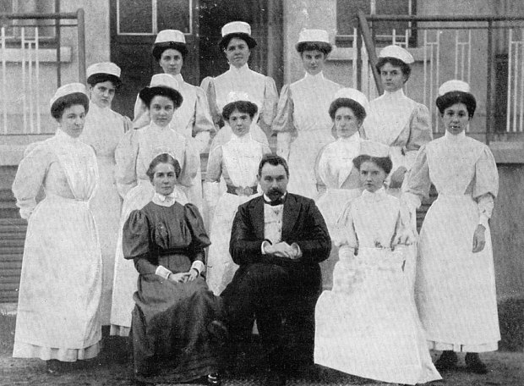
Edith Cavell Background
British nurse Edith Cavell was the matron, or supervisor, of a nurse training school in Brussels, Belgium when the German army, in a maneuver to take France, invaded neutral Belgium on August 4, 1914. In the Brussels suburb of Ixelles, Cavell was quietly training Belgian nurses at the Birkendael Medical Institute, while the Belgian army, dreadfully outnumbered and equipped with obsolete guns, made a stand to protect their territory from enemy occupation. By August 20, Germany had squashed the resistance and Belgium became occupied territory.
Three days afterwards, the British waged a fierce battle near Mons; a town just thirty-five kilometers south of Brussels. The day before, the French army was overwhelmed by a larger German force at the Battle of Charleroi, a village not far from Mons. Some wounded and stranded allied soldiers from these two battles found themselves behind enemy lines and eventually found their way to the Birkendael Medical Institute. Under Cavell’s direction, the nurse training school was converted into a Red Cross hospital. There, in addition to treating civilians, she and her nursing staff healed any soldier that came through their doors, regardless of which side they were fighting on.

Slide 12
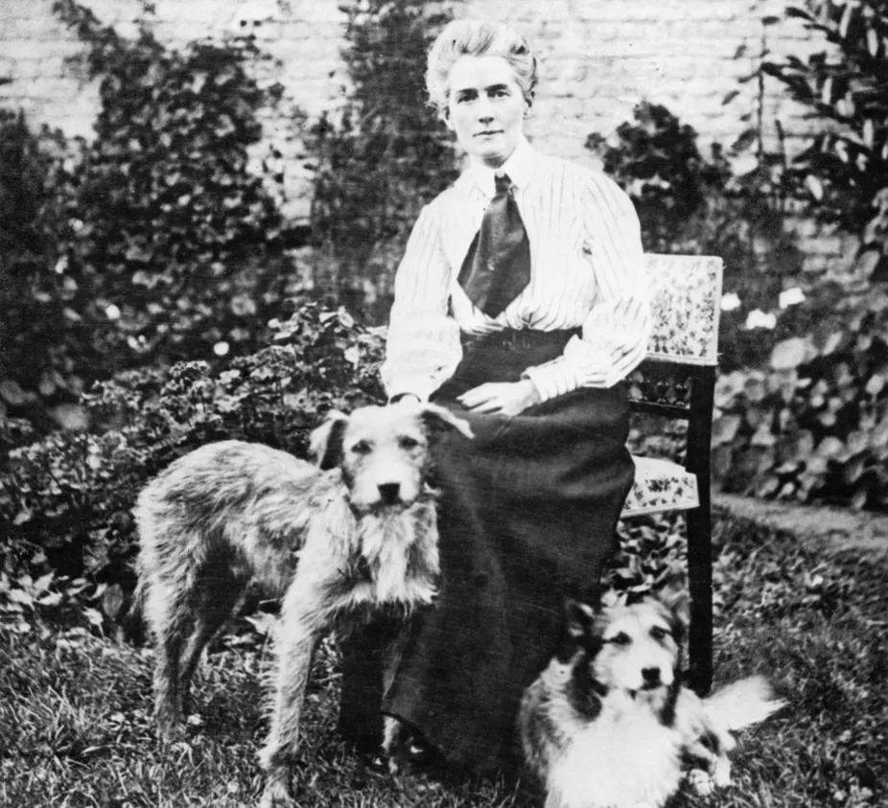
Joining the Resistance
Besides providing medical care as a nurse, Cavell became involved with an underground resistance group of Belgian civilians that was sheltering British and French soldiers and Belgian and French civilians eligible for military service and helping them escape from German-occupied Belgium into neutral Netherlands (where most would eventually make it to Britain). Defying an order from German authorities that anyone sheltering Allied troops would be shot, Cavell hid Allied soldiers in her hospital, risking her life to save the lives of Allied soldiers who, if caught, would face harsh internment conditions or even be shot as spies.
When the German military police arrived to conduct inspections of her hospital, she would help soldiers evade capture by leading them out the back door or covering them up in sickbeds. During one surprise search, Cavell hid a British private in a barrel and covered him with apples. When the time came to hand her refugees over to their border guides, she would personally lead them to the drop-off point by pretending to take her dog (Jack, pictured here on the right) for a walk through the city— all the while watching for spies in the reflections of shop windows.

Slide 13
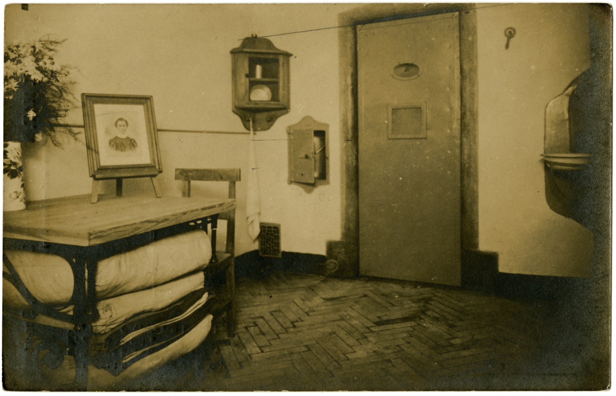
Arrest, Trial and Execution
Eventually Cavell and her underground collaborators were betrayed by a Frenchman named George Gaston Quien, a German secret agent. During his stay at the hospital, he gathered information about the secret organization and provided it to the German authorities. On August 5, 1915, after almost a full year of helping allied soldiers escape into Holland, Cavell was arrested and charged with conducting soldiers to the enemy. For ten weeks, she was held in solitary confinement at St. Gilles prison in Brussels. When interrogated by German officials, she confessed. Cavell even declared that soldiers that had arrived safely in Britain had sent her letters, thanking her for helping them to escape. With this admission, the German authorities concluded that Cavell had helped soldiers escape to a country at war with Germany – in order, presumably, to fight once more against the German army. The penalty for this under German military law was death.
Cavell and thirty-five of her underground colleagues were put on trial in a German military court. On October 11, 1915, Cavell was pronounced guilty and sentenced to death. Despite appeals for mercy from diplomats from the neutral countries of America and Spain, Cavell was executed by a firing squad on the morning of October 12, 1915.

Slide 14
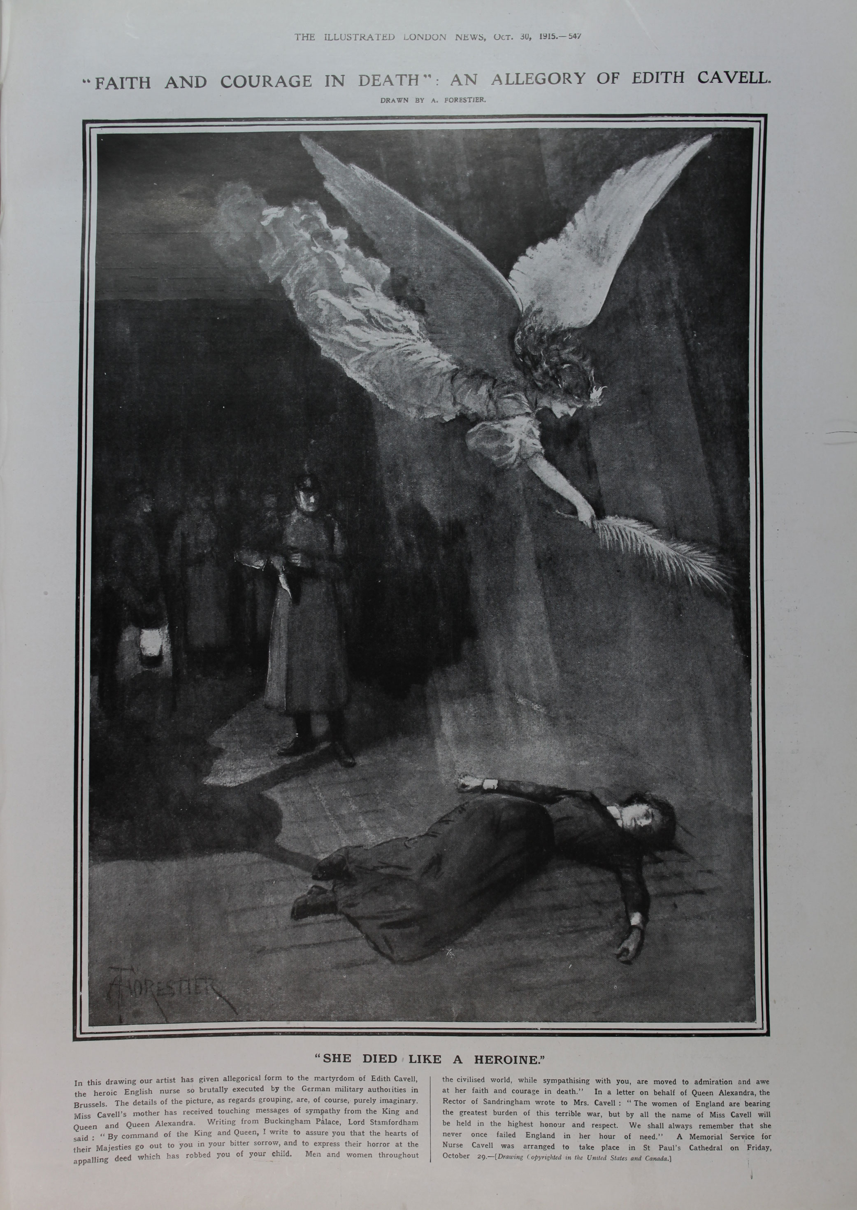
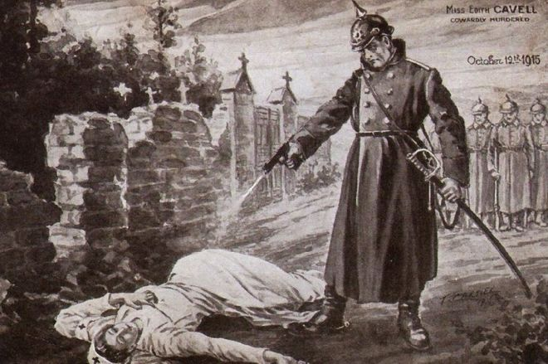
Propaganda
When the British home front heard of Cavell’s execution, it hit close to home because the nurse herself was a proud British citizen. The drive to avenge her was announced in London’s ‘Daily Graphic’ newspaper on October 23rd as it announced: “let Cavell be the battle cry; let Cavell battalions be raised, pledged to avenge her.” In the months following her execution, British recruitment numbers shot up dramatically as a substantial number of men rushed to join the British armed forces in a quest for revenge.
British and American newspapers heightened public outrage against the Germans by portraying Cavell as a young, innocent nurse and the Germans as brutal and cruel. A drawing from the Illustrated London News called: “Faith and Courage in Death, an Allegory of Edith Cavell” depicts the German firing squad men in darkness off to the edge of the image, as an angel shines a heavenly beam of light on Cavell’s dead body. In the New York Tribune, a cartoon was published showing Cavell being shot while she lay on the ground by a tall German officer standing over her wielding a pistol.

Slide 15
Significance
Ultimately, with the help of the underground resistance network, Cavell succeeded in smuggling around 200 British, French and Belgian men out of German-occupied Belgium. Additionally, through her work as a nurse, she is credited with saving the lives of many soldiers, regardless of which side they were fighting for, during the First World War. Her last words were spoken to Stirling Gahan, an Anglican reverend in Brussels and they represent exactly how she lived her life in the service of others: “I realize that patriotism is not enough. I must have no hatred or bitterness towards anyone.”
Cavell’s death caused such a storm of protest that Germany’s leader, Kaiser Wilhelm II, ordered that no more women were to be executed without his approval. But the damage was already done. The Germans had intended for Cavell’s execution to function as a deterrent to discourage others from aiding the enemy and thus maintain order in occupied Belgium, but it proved to be a massive misstep. Her execution became one of the most shocking atrocity stories of the war – much the same as the sinking of the Lusitania. It was used to sway neutral opinion against Germany and was an important factor in bringing America into the war.

Slide 16
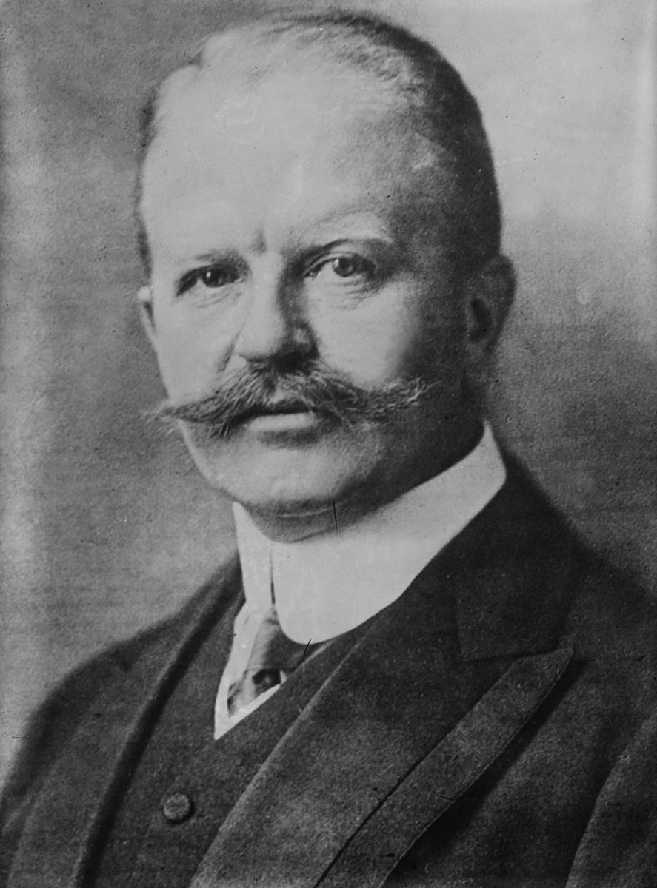
Zimmermann Telegram Background
At the beginning of 1917, the United States remained neutral in the First World War. In fact, it was on the platform that he kept America out of the war that President Wilson successfully won re-election in November 1916. Though the German sinking of passenger ships carrying American citizens (such as the Lusitania) and German atrocities (such as the execution of Edith Cavell) caused waves of anti-German public opinion, American neutrality was maintained largely due to the Germans agreeing to abandon their campaign of unrestricted submarine warfare.
However, the German high command was prepared to gamble with a new plan. On February 1, 1917, they restarted unrestricted submarine warfare, hoping to restrict food supplies in to Britain and lead to its surrender. As ships would be sunk regardless of their military status or national origin, the Germans knew they risked infuriating the United States and provoking them into the war by causing the deaths of American citizens. Realizing this threat, Arthur Zimmermann, the German Foreign Secretary, proposed a German military alliance with Mexico.

Slide 17
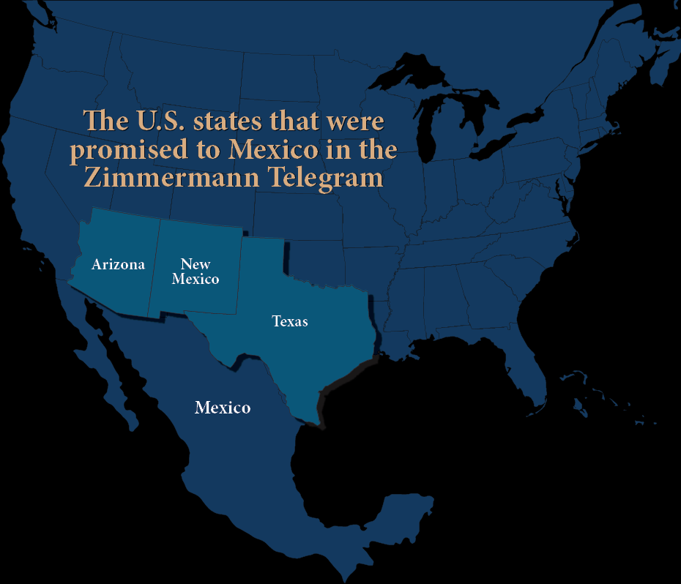
Proposing an Alliance
On January 16, 1917, German foreign secretary Arthur Zimmermann sent a secret coded message to the German ambassador to Mexico, Heinrich von Eckardt. The note informed him that on February 1, 1917, Germany intended to resume unrestricted submarine warfare. If the neutral United States entered the war on the side of the Allies, Eckardt was to approach Mexico’s president with an offer of a military alliance. The Germans would provide military and financial support for a Mexican attack on the United States, and in exchange Mexico would reclaim territory it previously lost to the U.S. during the Mexican-American War of 1846-48: Texas, New Mexico and Arizona. In addition, Eckardt was told to persuade Mexico to help Germany and Japan negotiate an alliance.
The main purpose of the alliance was to tie down American forces on the southern border and slow the export of American supplies, munitions and troops to assist the Allies. The German High Command believed they would be able to defeat the British and French on the Western Front and strangle Britain with unrestricted submarine warfare before American forces could be trained and shipped to Europe in sufficient numbers to aid the Allied Powers.

Slide 18
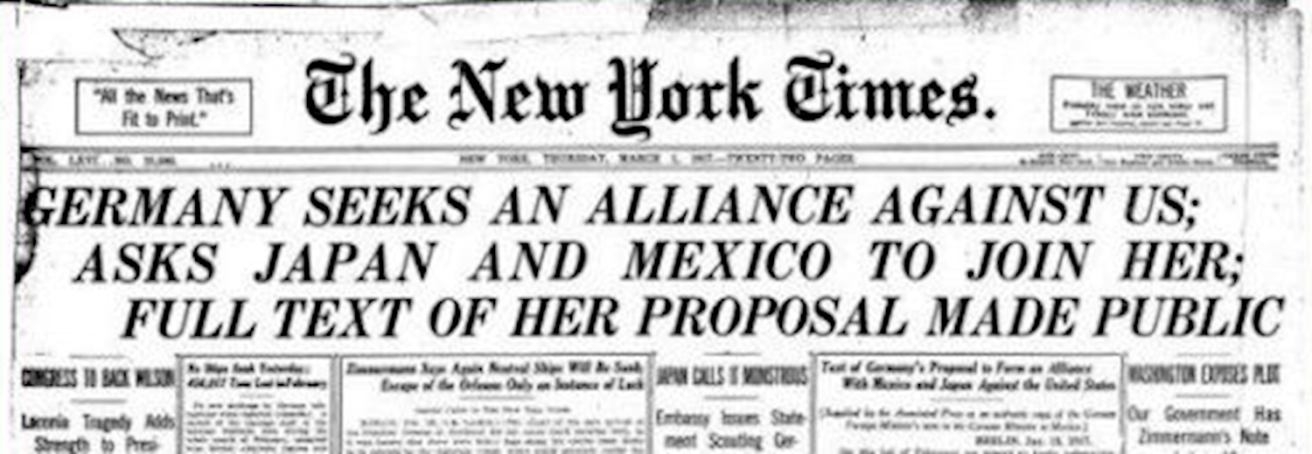
Decoding the Zimmermann Telegram
Since the British Royal Navy had cut German transatlantic undersea telegraph cables between Germany and North America at the start of the war, Germany was forced to send its diplomatic messages through neutral countries. Zimmermann’s coded message was thus transmitted through the American embassy in Berlin, then forwarded by the German ambassador in Washington D.C. to Heinrich von Eckardt, the German ambassador in Mexico City, on January 19, 1917. Unfortunately for the Germans, British Naval Intelligence officials had been secretly tapping into the U.S. state department’s transatlantic cables and intercepted the telegram.
British code-breakers at the office known as “Room 40” decoded Zimmermann’s Telegram. Recognizing the effect it would have on U.S. public opinion, they released the message to President Wilson on February 24. On March 1, news of the secret alliance proposal made the front pages of American newspapers across the country. The initial public reaction was disbelief. Suspicions arose that British intelligence forged the telegram in order to drag the U.S. into the war. But in an astonishing move, on March 3, Zimmermann admitted that the telegram was genuine.

Slide 19
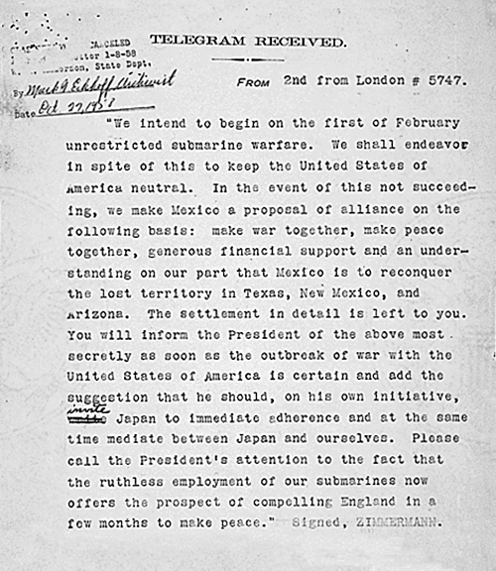
Full Text of the Zimmermann Telegram
We intend to begin on the first of February unrestricted submarine warfare. We shall endeavor in spite of this to keep the United States of America neutral. In the event of this not succeeding, we make Mexico a proposal or alliance on the following basis: make war together, make peace together, generous financial support and an understanding on our part that Mexico is to reconquer the lost territory in Texas, New Mexico, and Arizona. The settlement in detail is left to you.
You will inform the President of the above most secretly as soon as the outbreak of war with the United States of America is certain and add the suggestion that he should, on his own initiative, invite Japan to immediate adherence and at the same time mediate between Japan and ourselves. Please call the President’s attention to the fact that the ruthless employment of our submarines now offers the prospect of compelling England in a few months to make peace. Signed, ZIMMERMANN.

Slide 20
Propaganda
Even the large segment of the American public who opposed American entry into the First World War recognized that the war was no longer just a European problem. Americans feared the threat of invasion and were concerned about what consequences could arise if Americans chose not to support the Allies’ war effort in Europe. A worst case scenario was depicted in a Washington Evening Star cartoon published in March 1917, titled, “Hand carving up a map of the Southwestern U.S.”. This political cartoon shows a hand with a knife carving out Arizona, New Mexico, and Texas, which are labelled “For Mexico”, California which is labelled “For Japan?”, and the rest of the United States which is labelled “For Myself”. The symbol of the German Empire coat of arms on the cuff of the glove indicates the owner is a German official.
A cartoon titled, “The Temptation” appeared in the Dallas Morning News on March 2, 1917. It shows Germany as the devil, tempting Mexico to declare war against the United States in exchange for a bag, presumably filled with money, and the return of land formerly belonging to Mexico: Arizona, New Mexico, and Texas.

Slide 21
Significance of the Zimmermann Telegram
Unconvinced by the German promise of generous financial support and unable militarily to match far superior U.S. forces, Mexican President Venustiano Carranza rejected the alliance proposal. The U.S. government and its citizens considered the Zimmermann telegram as more evidence of German aggression. The provocative plan to persuade Mexico to invade the U.S., coupled with the promise of “ruthless employment of [German] submarines” swung American public opinion decisively against Germany and sparked a nationwide demand for war with Germany.
As stated in the Zimmermann Telegram, Germany resumed unrestricted submarine warfare on February 1, 1917. President Wilson responded by breaking off diplomatic relations with Germany on February 3, 1917. On April 2, 1917, President Wilson abandoned his policy of neutrality and asked Congress to declare war against Germany and the Central Powers. On April 6, 1917, the United States Congress formally declared war. The Zimmerman telegram clearly had helped draw the United States into the war – a move that ultimately ensured a victory for the Allies.

