Slide 1
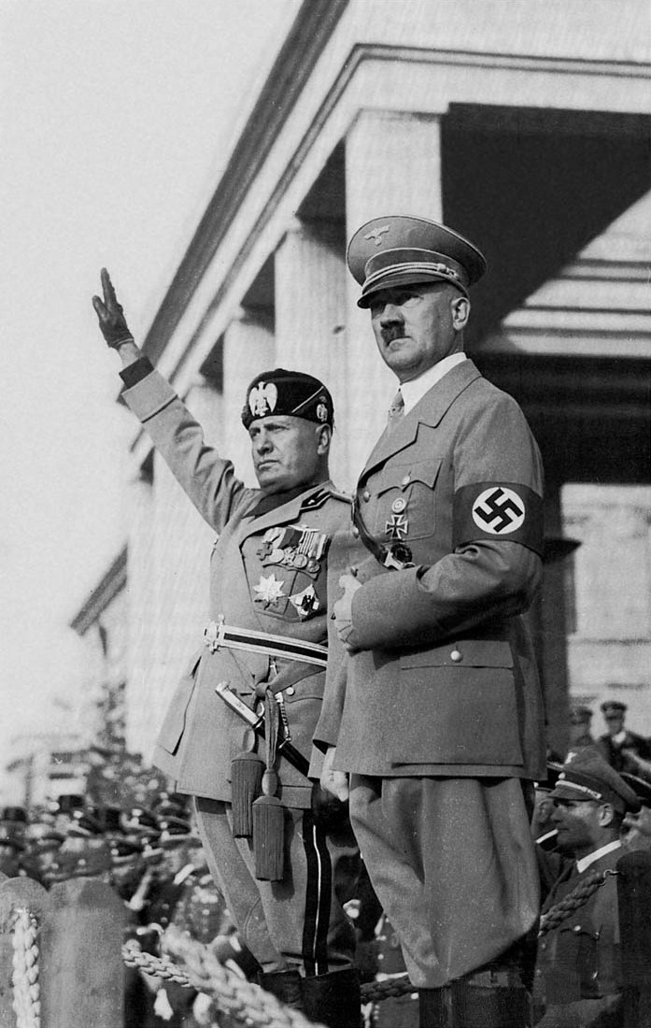
The Rise and Fall of Authoritarian Regimes: Fascism in Italy and Germany

Slide 2
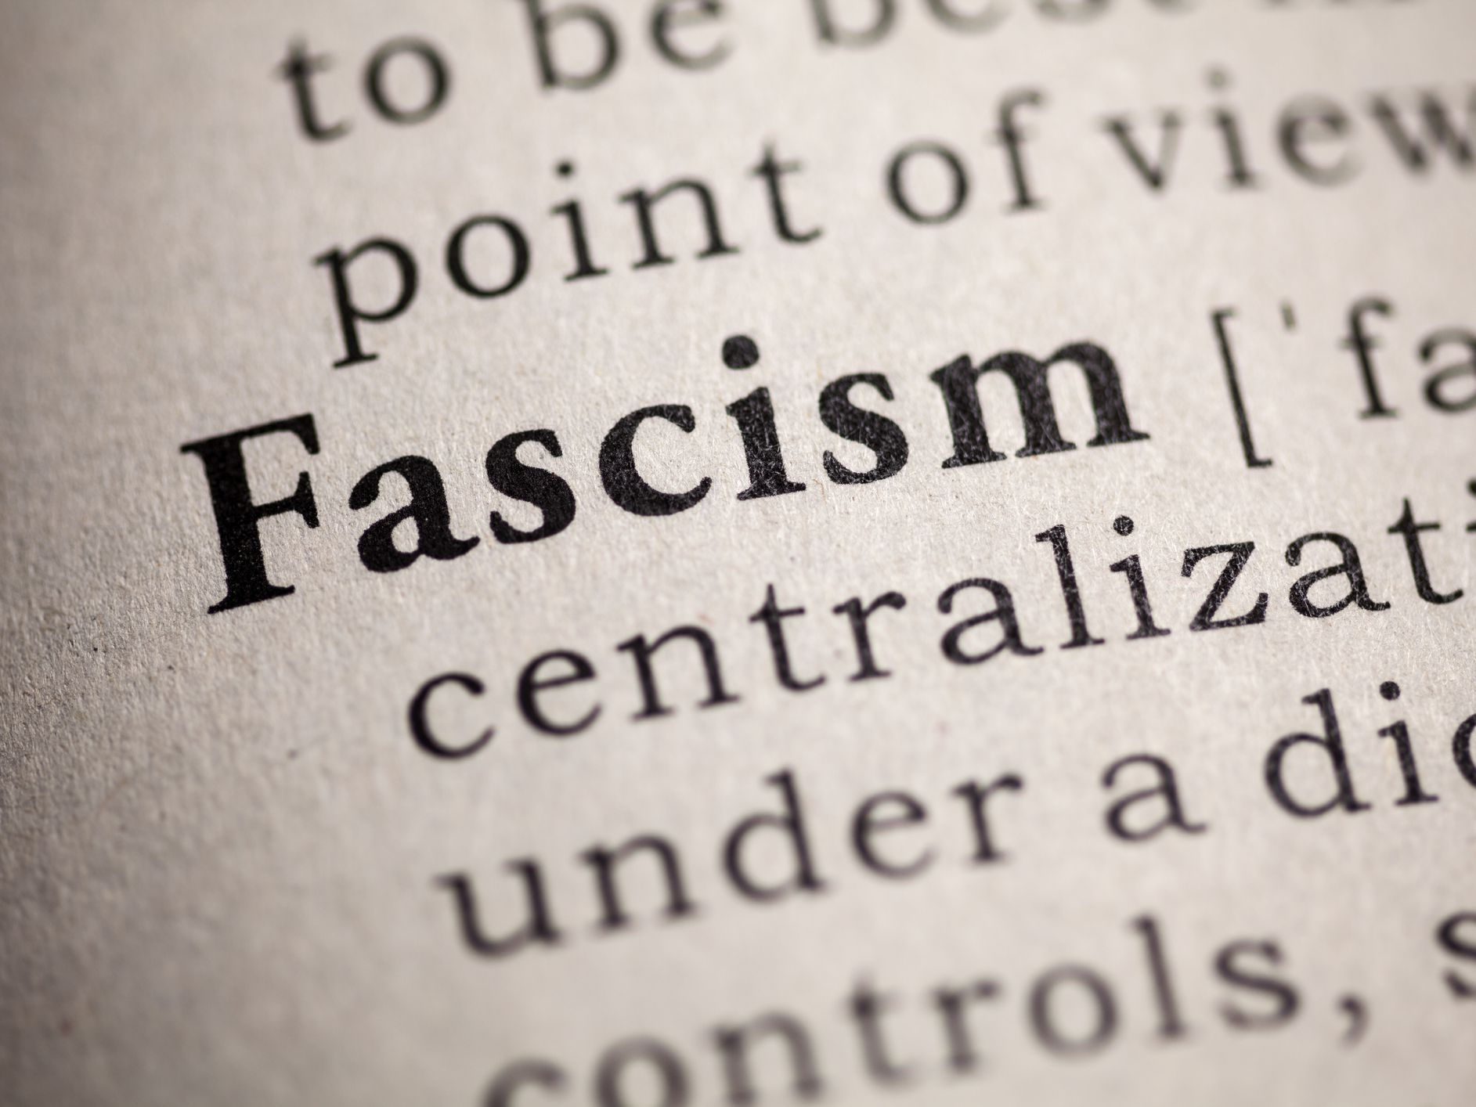
Fascism
Fascism is a far-right political philosophy that emerged between the First and Second World Wars. It combines elements of nationalism, militarism, economic self-sufficiency, and totalitarianism. Under Fascist rule, only one political party is represented in government, led by an authoritarian leader who wields total power and proclaims that a dominant ethnic group is racially and culturally superior over all other people.
Secret police, censorship, and propaganda are used to combat real or perceived threats that challenge the superiority of this group. Individuals who voice their dissent or hold opposing political beliefs (such as socialists and communists) are violently eliminated. Freedom of speech and human rights are suppressed. The population is manipulated to accept the leader’s values through the use of mass media.

Slide 3
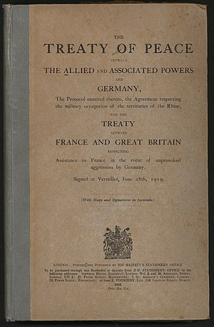
Problems in Italy After the First World War
In exchange for entering the First World War on the side of the Triple Entente (Great Britain, France, and Russia) against the Central Powers (Germany, Austria-Hungary and the Ottoman Empire) in 1915, Italy was secretly promised Austria-Hungarian territory by the British and French in the Treaty of London. However, in the peace agreement of 1919 – the Treaty of Versailles - Italy only received some of the land it was promised.
With little to show for their sacrifices in the Allied victory - including 460,000 soldiers killed and heavy war debt – many Italians felt betrayed by their government. Veterans returning home from the war faced widespread unemployment and poverty. Workers went on strike or seized factories. Trade declined and taxes rose. The government seemed powerless to end the crisis. Italians were fearful of a communist revolution.

Slide 4
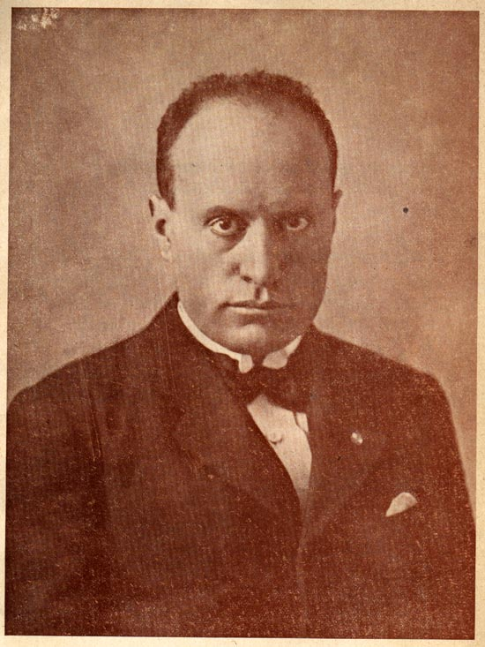
Benito Mussolini Forms the Fascist Party
In this time of chaos, Benito Mussolini returned home after serving in the Italian Army and delivered speeches declaring that only he could bring stability and order to the country. Projecting a sense of power and confidence, he spoke of reviving national pride by returning Italy to the greatness of its ancient Roman Empire past and ending Italy’s postwar mass unemployment, political party conflicts, and labor strikes.
Capitalizing on public discontent in Italy, on March 23, 1919, Benito Mussolini launched the fascist party. It gained the support of many groups: wealthy landowners and industrialists worried about their property, nationalists who felt Italy had been cheated out of World War One territorial gains, war veterans who returned from service to find only unemployment, and the army, which feared the socialists would dismantle the army.

Slide 5
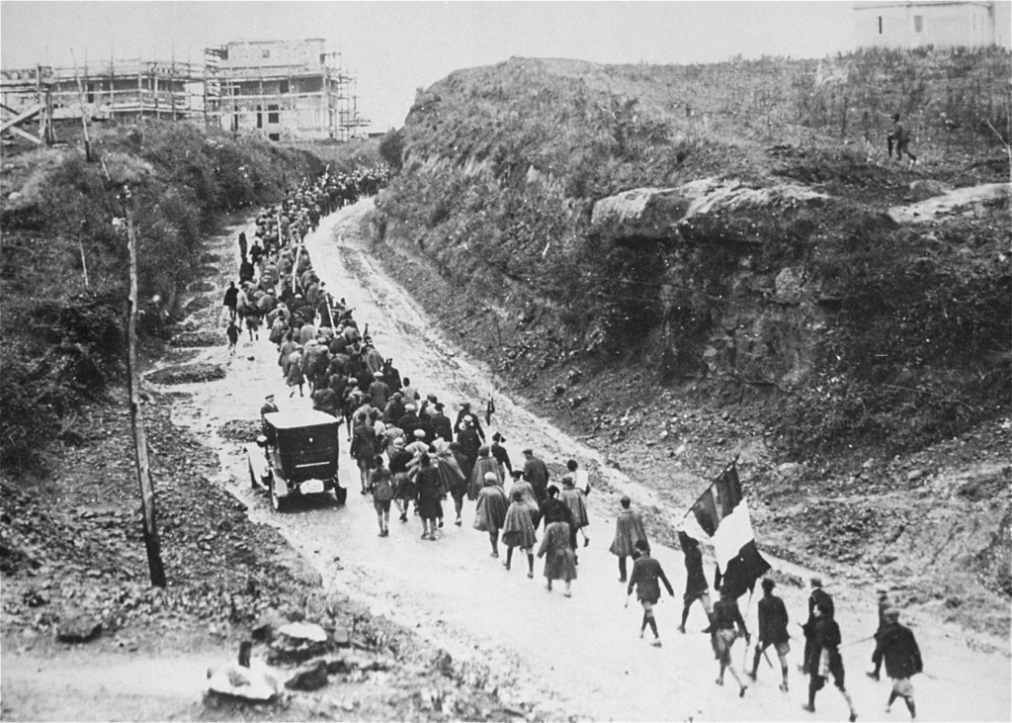
Mussolini’s Rise to Power
Mussolini organized his supporters into armed squads known as “blackshirts.” These fascist gangs rejected the democratic process, choosing instead to use violence and intimidation against (socialist and communist) political opponents. Blackshirts beat or killed their enemies or forced them to drink castor oil. They broke up opposition rallies, destroyed their offices and newspaper presses, and threw them out of local governments.
On October 24, 1922, Mussolini threatened to seize power declaring, “either the government will be given to us, or we will seize it by marching on Rome.” At night between October 27-28, 30,000 blackshirts converged on Rome to demand the resignation of liberal Prime Minister Luigi Facta and the appointment of a new fascist government. To avoid a civil war, King Victor Emmanuel III granted Mussolini control of government.

Slide 6
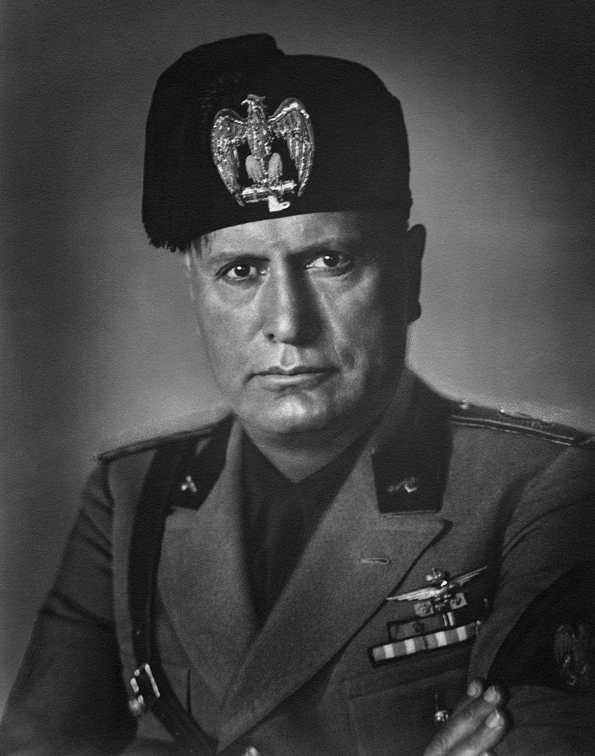
The Police State
After becoming prime minister, Mussolini gradually dismantled all constitutional restraints on his power, and by 1925, had declared himself dictator of Italy, taking the title “Il Duce” (The Leader). Under the slogan “everything in the state, nothing outside the state, nothing against the state,” he rigged elections, abolished freedom of the press, and outlawed all opposition political parties, labor strikes and trade unions.
Newspaper editors were all personally chosen by Mussolini and no one without a certificate of approval from the fascist party could practice journalism. Mussolini established a special court to try political crimes and created a secret police force to arrest political opponents. Thousands were convicted on vague charges and imprisoned or sent into exile on remote islands where they were interned and deprived of all liberties.

Slide 7
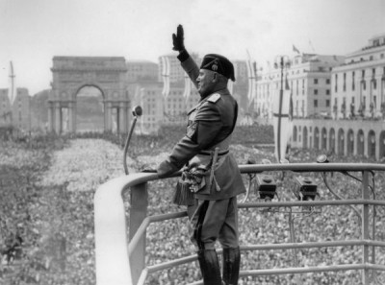
The Economy
To increase economic growth and end conflicts between owners and workers, Mussolini brought the economy under state control. Under Mussolini’s corporate state, representatives of business, labor, government, and the fascist party controlled industry, agriculture, and trade. Although production increased, success came at the expense of workers. They were forbidden to strike, and their wages were kept low.
Mussolini was a superb publicist and was repeatedly able to showcase projects to clear swamps, increase grain production, introduce educational reforms, and get the trains running on time. These extensive public works project caused an increase in employment which made Mussolini a popular figure in Italy. Order was restored to Italian economic life, and old days of strikes and factory occupations were ended.

Slide 8
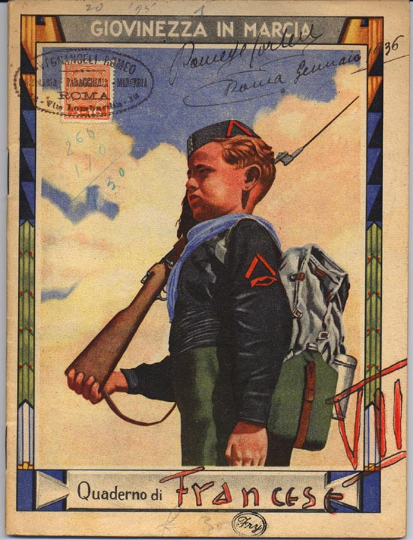
The Individual and the State
Men, women, and children were bombarded with slogans glorifying the state and Mussolini. “Believe! Obey! Fight!” loudspeakers blared and posters proclaimed. To create as many new soldiers and loyal citizens as possible, men were urged to be ruthless, selfless warriors fighting for the glory of Italy and women were encouraged to give birth to numerous children so they could raise a new generation of warriors.
All teachers had to swear an oath to defend the fascist regime. Boys and girls learned about the glories of ancient Rome. Youth organizations toughened children and taught them to obey strict military discipline. These groups promoted physical training, military drills (for boys), and the ideals of the fascist state. By the 1930s, a generation of young soldiers stood ready to back Mussolini’s drive to expand Italian power.

Slide 9
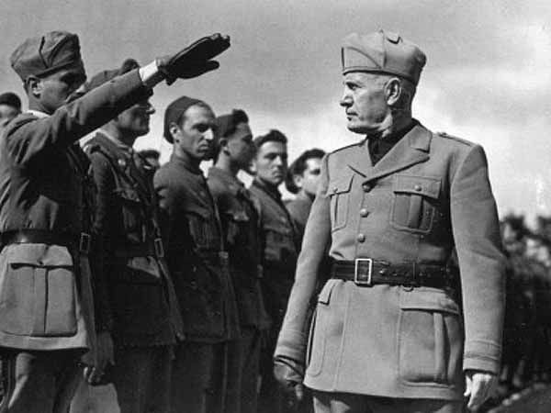
Expansionism
Determined to expand Italy’s empire, Mussolini ordered the Italian military to invade the African country of Ethiopia in October 1935. The Ethiopians, equipped with obsolete weapons, were no match for Italy’s poison gas, modern tanks and airplanes. Mussolini announced to cheering crowds that the Roman Empire was back. To justify this act of aggression, the fascist regime claimed that Italians were superior to the peoples of Africa.
The League of Nations condemned Italy’s action and imposed economic sanctions upon it. These were ineffective, however, because vital imports for Italy such as oil were not included. Continuing his expansionist foreign policy, Mussolini invaded and annexed Albania in 1939. From 1936-1939, he aided General Francisco Franco’s fascist movement in Spain by deploying Italian troops there to fight in the Spanish Civil War.

Slide 10
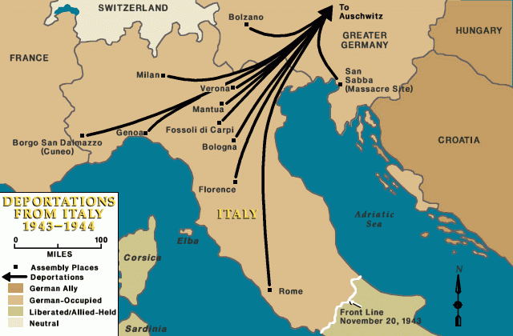
Racial Laws and the Holocaust
In 1938, Mussolini enacted a series of Nazi-style anti-semitic laws targeting Jews called the Manifesto of Race. Jews were stripped of their Italian citizenship, removed from their jobs in government, the armed forces, education, and banking, forbidden to have sexual relations and marriages with non-jews, banned from owning land over a certain value, and could have their property confiscated.
Despite Italy’s alliance with Nazi Germany, Mussolini refused to allow Jews from Italy or Italian occupied areas to be deported to concentration camps. However, following Italy’s surrender on September 3, 1943, Germany occupied northern Italy. Jewish Italians were then rounded up by German and Italian police and sent on trains to concentration and extermination camps (mainly Auschwitz). Approximately 7000 Jewish Italians were killed.

Slide 11
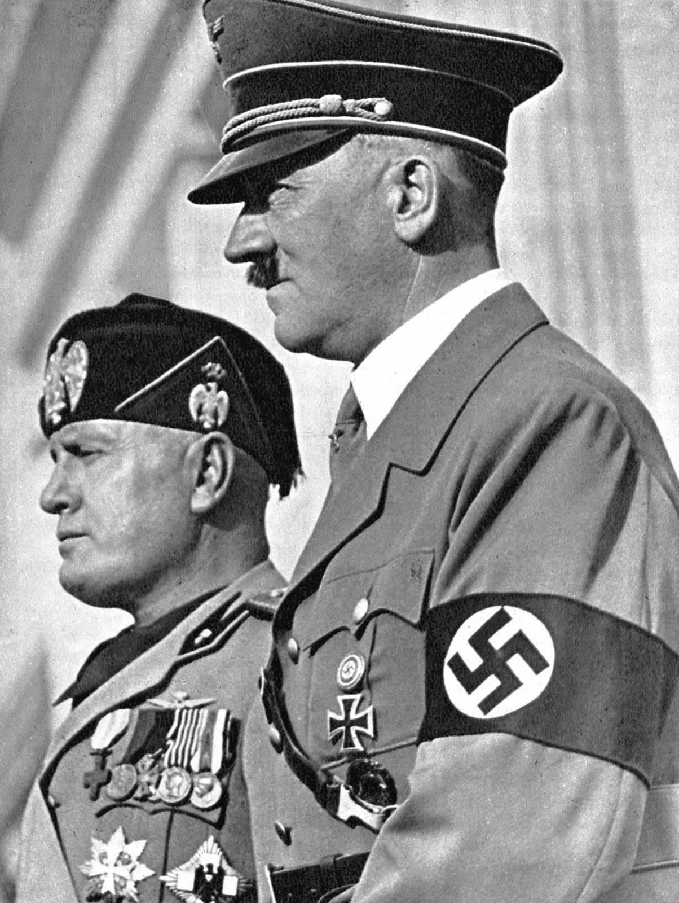
Defeat and Demise
On May 22, 1939, Mussolini and Hitler signed a military alliance known as the “Pact of Steel,” officially creating the Axis powers. Then on September 1, 1939, Hitler invaded Poland triggering the start of the Second World War. Mussolini delayed joining the war until June 10, 1940, when the Nazis were on the verge of defeating France. After a series of Italian losses in Greece, Russia, north and east Africa, Mussolini’s popularity in Italy fell
After the Allies invaded Sicily in July 1943, members of Mussolini’s own government voted for him to resign and King Victor Emmanuel III stripped him of his power and ordered his arrest. Italy signed an armistice with the Allies on September 3, 1943. German forces occupied northern Italy and installed Mussolini as head of a new pro-German government. On April 28, 1943, he was killed after trying to flee from the advancing Allies.

Slide 12
Problems in Germany After the First World War
Following Germany’s defeat in the First World War, the country was subject to the punishing terms of the Treaty of Versailles. It demanded that Germany’s new government, the Weimar Republic, accept the blame for starting the war and pay war reparations to the Allies totaling $33 billion dollars. It required Germany to forfeit territory and its overseas colonies. Plus, it imposed strict limitations on the size of Germany’s army and navy.
Many Germans felt betrayed by their government for accepting the treaty. The burden of paying reparations financially crippled the German economy. As a result, Germany suffered terrible inflation and unemployment. This instability led to uprisings as extreme political parties from both the right and left tried to overthrow the government. The worsening economy and lawlessness made Germans fearful of a communist revolution.

Slide 13
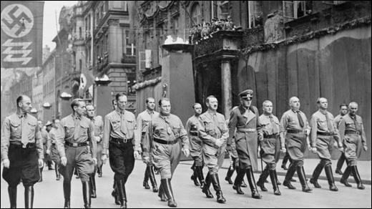
Beer Hall Putsch
After serving in the German Army, Adolf Hitler returned home and worked as an army intelligence officer. He was sent to spy on the German Workers’ Party - a far-right, anti-semitic, nationalist group (which later became the Nazis). Agreeing with their beliefs, he joined it. Hitler’s popularity grew at party meetings and rallies due to his speeches blaming the Jews for inflation, political instability, unemployment, and the Treaty of Versailles.
In April 1921, Hitler became the leader of the Nazi party. Then, on November 8, 1923, he and his followers interrupted a speech given by Bavarian Prime Minister Gustav Kahr at a beer hall in Munich. Hitler proclaimed a national revolution had begun and at gunpoint forced Kahr to pledge support to the Nazis. The next day, Hitler led a march from the beer hall to the Bavarian War Ministry to try to overthrow the Bavarian government

Slide 14
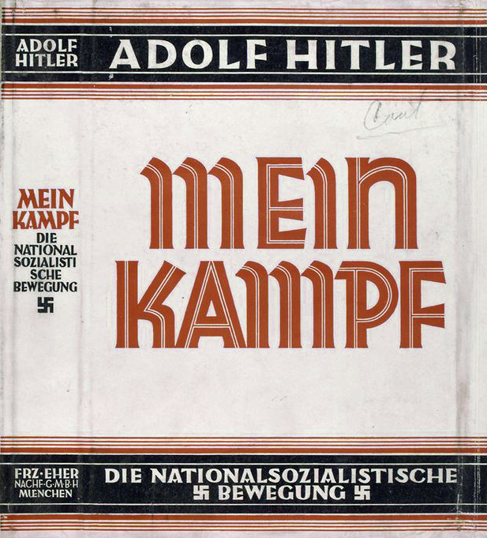
Mein Kampf
Hitler intended to emulate Benito Mussolini’s “March on Rome,” – which brought the fascists to power in Italy in October 1922 - by staging his own “March on Berlin” to overthrow the Weimar Republic. However, police crushed the rebellion. Hitler was arrested, convicted of high treason, and sentenced to five years in jail, though he was released after only nine months. While in jail, he began writing Mein Kampf (My Struggle).
In his book, Hitler outlined his beliefs on racial anti-semitism (that Jews were inferior by virtue of their race, or genetic makeup), Social Darwinism (that certain individuals or ethnic groups are dominant because of their inherent genetic superiority), and living space (that Germans needed to seize more territory, particularly in Eastern Europe for their own farms and communities). Hitler also expressed his desire to rid Europe of Jews.

Slide 15
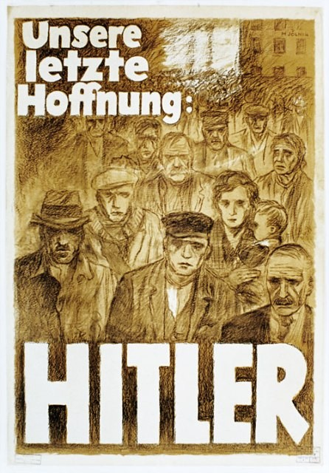
Hitler’s Rise to Power
The onset of the Depression in 1929 caused mass unemployment and poverty within Germany. It left people feeling dissatisfied with the Weimar Republic and seeking change. Political opponents (mainly communists) and individuals who chose not to support the Nazi party were threatened into subordination or eliminated by Hitler’s paramilitary organization, the Sturmabteilung (SA) and his personal bodyguards, the Schutzstaffel (SS).
Nazi party membership also grew through their propaganda campaigns. Posters, newspapers, films and radio vilified Jews and communists as enemies of the people and portrayed Hitler as a strong patriotic leader who would save Germany. Nazis gained broad support from wealthy businessmen worried about their property, nationalists furious about the Treaty of Versailles, and the middle class financially ruined by the Depression.

Slide 16
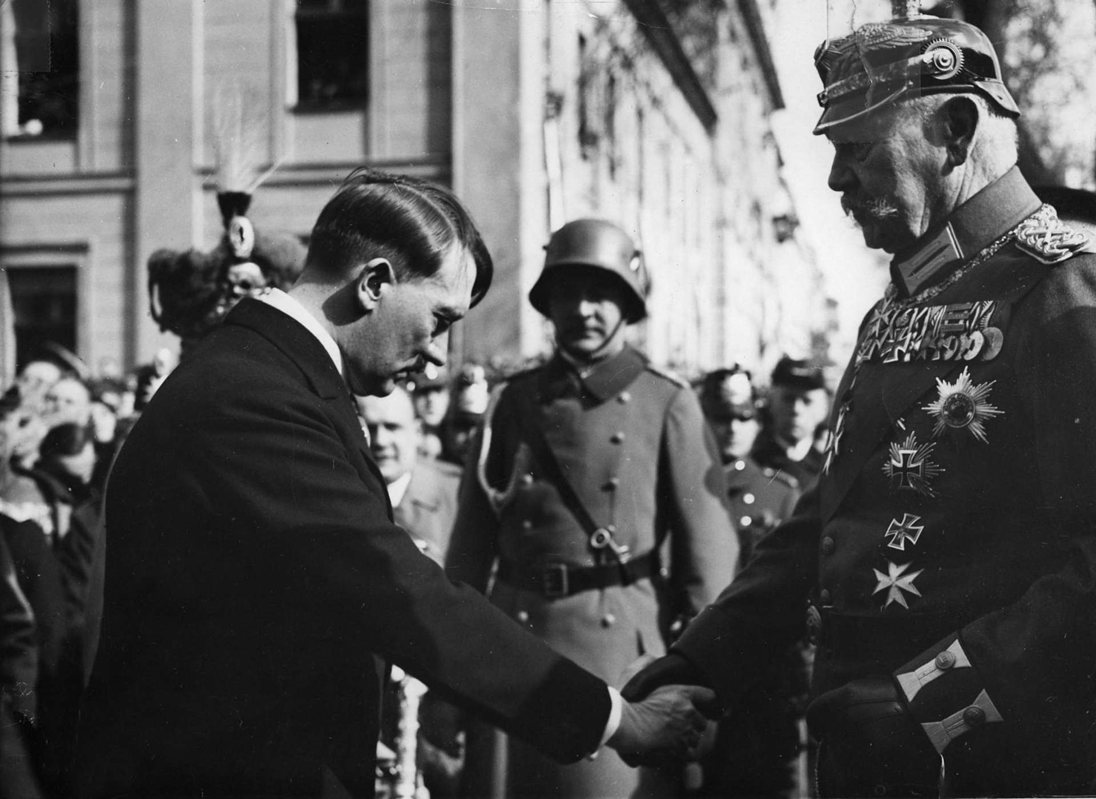
Reichstag Fire
In the German elections of July 1932, Hitler led the Nazis to become the largest party in parliament with 37.3% of the vote. He was appointed chancellor (leader of the German government) on January 30, 1933. The Nazi’s were finally in a position of power. However, this power was limited, as the Nazis were just one party in a three-party coalition government, under President Paul von Hindenburg.
The Reichstag, the German parliament building, was set on fire and burned down on February 27, 1933. Police arrested a Dutch communist who confessed to starting it. Hitler used this incident to convince President Hindenburg the next day to sign the Reichstag Fire Decree. This suspended basic rights such as people’s right to trial before imprisonment. Nazi political opponents were arrested and sent to concentration camps.

Slide 17
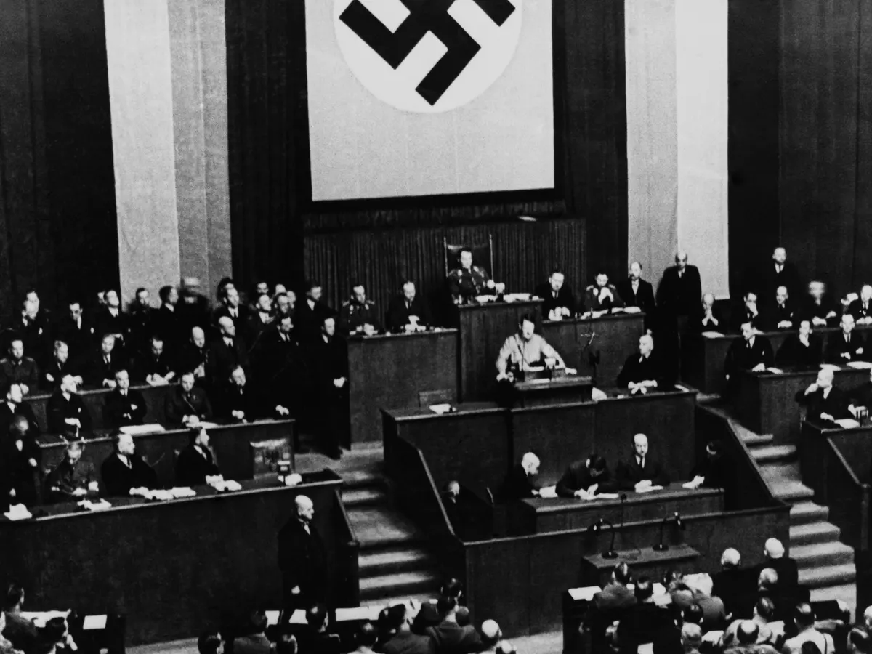
The Enabling Act
To achieve full political control despite not having an absolute majority in parliament, Hitler's government brought the Enabling Act to a vote in parliament on March 23, 1933. If passed, this act would end parliamentary democracy in Germany by granting Hitler the dictatorial power to pass laws without the approval of parliament or President Paul von Hindenburg for a period of four years.
A two-thirds majority vote in parliament was required to pass the act. To ensure success, the Nazis prevented all 81 communist opposition delegates and 26 of the 120 Social Democrat delegates from taking their seats by arresting and detaining them in accordance with the Reichstag Fire Decree. To intimidate the remaining non-Nazi delegates into compliance, SA members were stationed in the parliament building. The act passed.

Slide 18
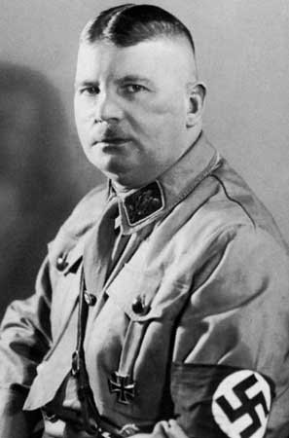
Night of Long Knives
Possessing full control over the government, Hitler began to tighten his grip on power. In 1933, trade unions were banned and their leaders were arrested, opposition political parties and newspapers were outlawed. But tension remained as the leadership of the Sturmabteilung (SA), led by Ernst Röhm, demanded more political and military power. This caused anxiety among political, military, and business leaders.
Hitler feared that the SA and Röhm were a potential threat to his leadership. In response, he ordered his personal bodyguards, the Schutzstaffel (SS), to round up, arrest, and murder without trial Röhm and other SA leaders. While this purge from June 30 to July 2, 1934, focused on the SA, political opponents were also eliminated. This event allowed Hitler and the Nazi Party to consolidate power by removing internal opposition

Slide 19
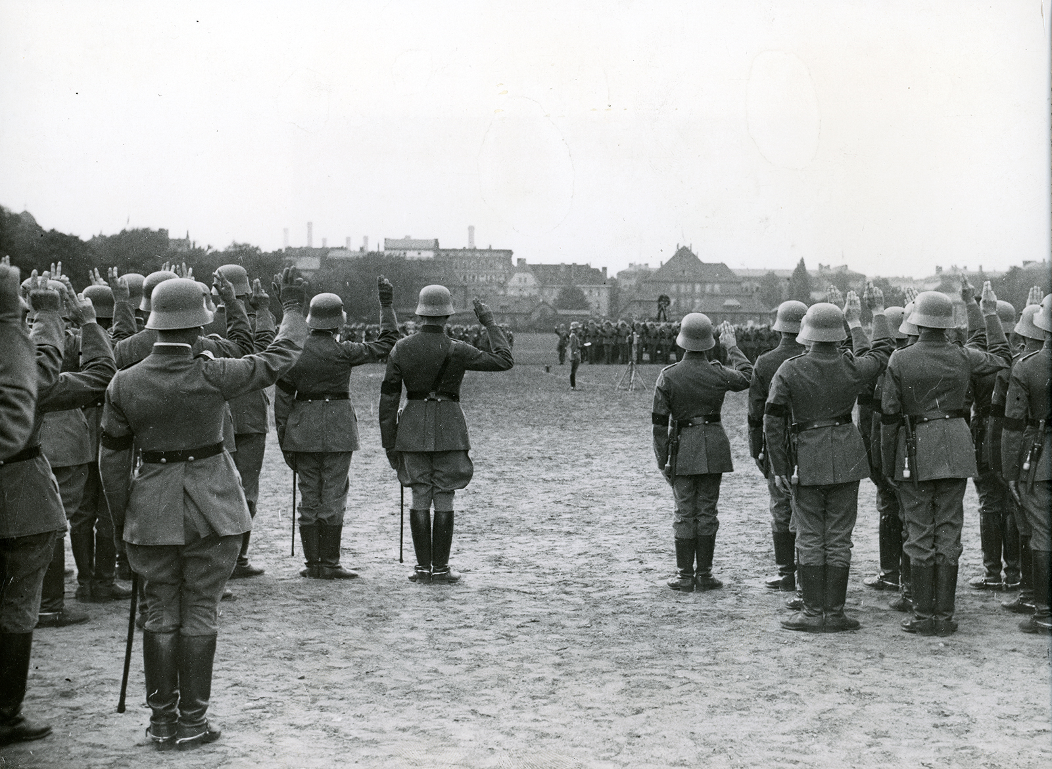
Hitler Becomes Führer
President Paul von Hindenburg passed away on August 2, 1934. This cleared the way for Hitler on August 19, 1934, to proclaim himself Führer and chancellor, leader of Germany and head of the Government. With Hindenburg gone, Hitler became commander-in-chief of the armed forces. There was no longer a limit to Hitler’s power.
Members of the armed forces swore an oath of allegiance to Adolf Hitler. All civil servants, including teachers and police, members of parliament and the judiciary, swore an oath of loyalty — not to any constitution — but to Hitler as Führer of the German nation.

Slide 20
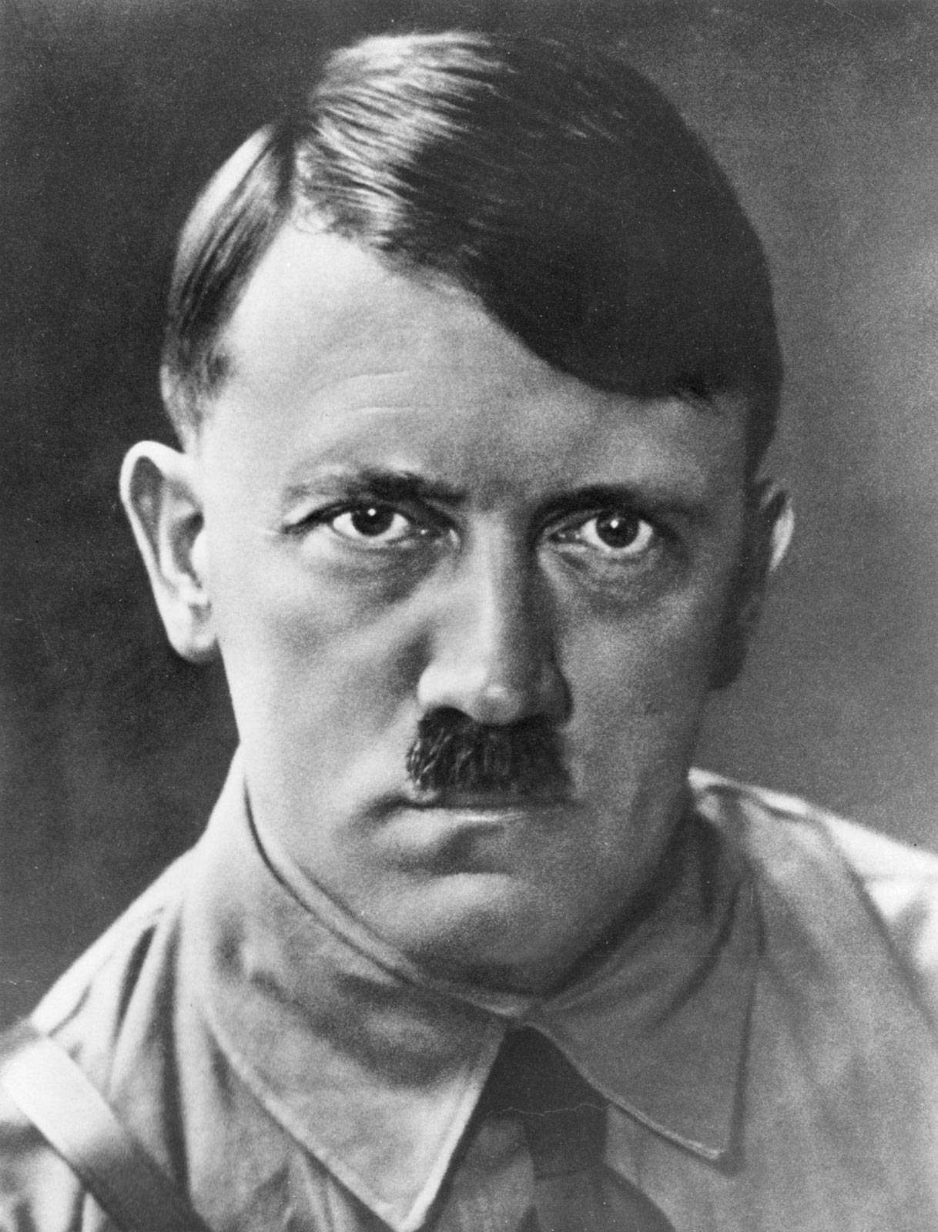
The Police State
Established on April 27, 1933, the Gestapo were the Nazi’s secret police. Following the enactment of the Enabling Law, the Gestapo could arrest anyone for any or no reason, and imprison them without trial. Its job was to monitor the German population for signs of opposition or resistance to Nazi rule. It was dangerous to express any form of discontent because German people often reported their fellow citizens to the Gestapo.
All newspapers were controlled and censored by the government and could only print stories favourable to the Nazi regime. Newspapers, mass rallies, radios, and loudspeakers in public places broadcast Nazi propaganda. Much of the information Germans received reinforced the message of Aryan racial superiority whilst demonizing the Jews and other ‘enemies’ of the regime.

Slide 21
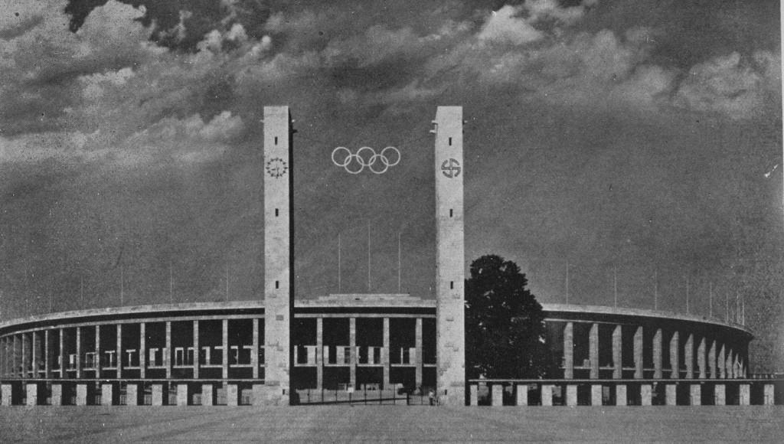
The Economy
Hitler increased employment by launching huge public works projects like constructing highways, railroads, and public buildings such as the 1936 Olympic Stadium. Germans were also put to work on a massive military rearmament program designed to prepare Germany for war. Hitler expanded the army tremendously, reintroduced conscription, and began developing a new air force — all violations of the Treaty of Versailles.
Hitler pursued an economic policy of self-sufficiency known as autarky. The government attempted to cease international trade and rely entirely on its own resources. In the First World War, Germany suffered from all kinds of shortages due to the Allies blocking the flow of goods into the country. Hitler sought to avoid a repeat of this situation. Yet, autarky was not fully achieved due to food, raw material and labour shortages.

Slide 22
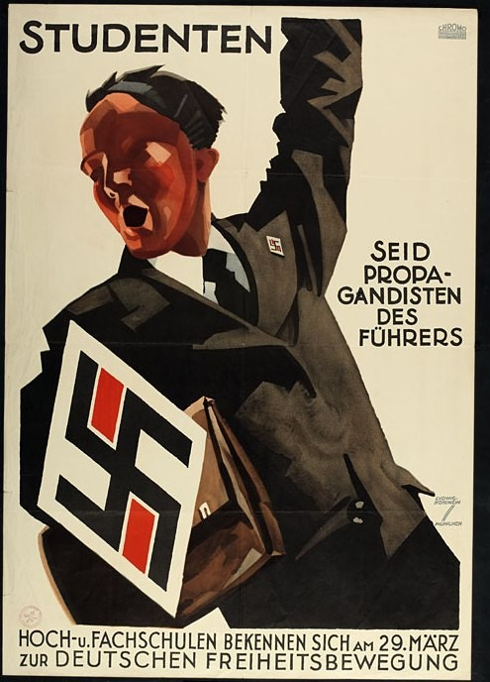
The Individual and the State
The Nazis expected women to stay at home, look after the family and produce children in order to raise the birth rate so the Aryan population would grow. To encourage these behaviours, financial incentives were given by the government to women who followed these ideals. Men were expected to work as labourers on public works projects, in factories for the war effort, or as soldiers.
Membership in the Nazi Party was mandatory for all teachers. Students learned racist Nazi ideology from new textbooks approved by the party including racial theories, anti-semitism and the need for living space. From ten years of age, boys and girls were encouraged to join Nazi youth organizations. Boys were taught physical exercise and rifle practice to be future soldiers and girls were taught domestic skills to be future mothers.

Slide 23
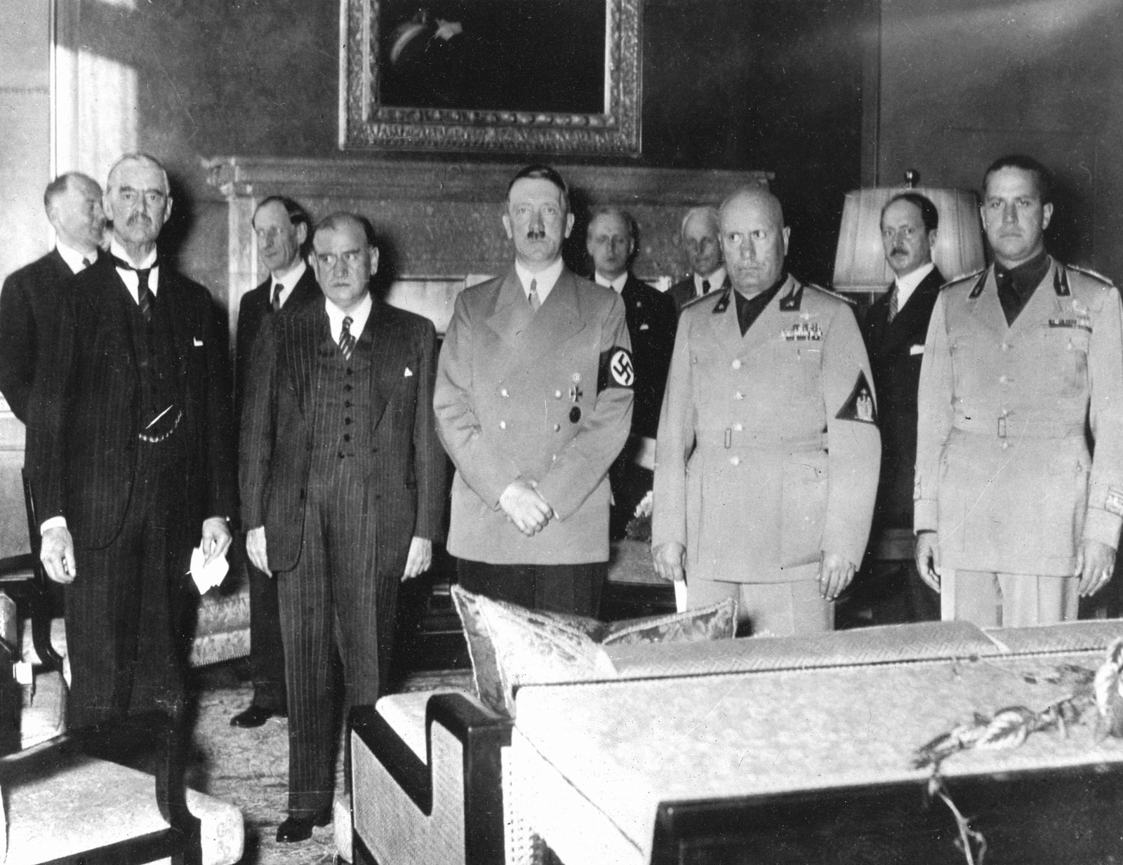
Expansionism and Appeasement
Beginning in 1938, Hitler began his quest to acquire more living space. On March 12, 1938, the German Army marched through Austria and annexed it to Germany in a move known as the Anschluss. Hitler’s next target was the Sudetenland in Czechoslovakia. He demanded the German annexation of this territory on September 29, 1938, when he met with the leaders of Britain, France, and Italy at a conference in Munich, Germany.
An agreement – known as the Munich Pact – was reached allowing Nazi Germany to annex the Sudetenland in exchange for Hitler’s promise that he would seek no further territorial gains in Europe. Desperate to avoid war, Britain and France decided to appease Hitler’s demands. But in March 1939, Hitler broke his promise and invaded and occupied the rest of Czechoslovakia. Still, Hitler did not face a military response from the Allies.

Slide 24
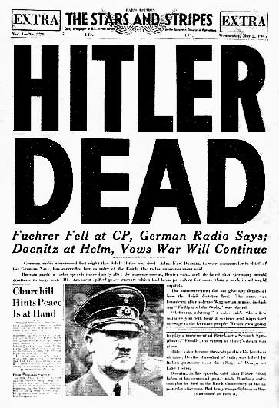
Defeat and Demise
The policy of appeasement that the British and French had been following ended on September 1, 1939, when the German Army invaded Poland. Britain and France issued an ultimatum to Germany: withdraw troops from Poland or face a declaration of war from Britain and France. On September 3, 1939, having received no reply and unwilling to accept further German expansion, Britain and France declared war on Germany.
The Allies’ D-Day invasion of Nazi-occupied Normandy on June 6, 1944 marked the beginning of the end for Nazi Germany. Germany was losing the war on two fronts – against British, Canadian, and American forces advancing from the west and Soviet forces advancing from the east. Fearful of being captured by enemy troops, Hitler committed suicide on April 30, 1945. Nazi Germany surrendered on May 7, 1945.

