Slide 1
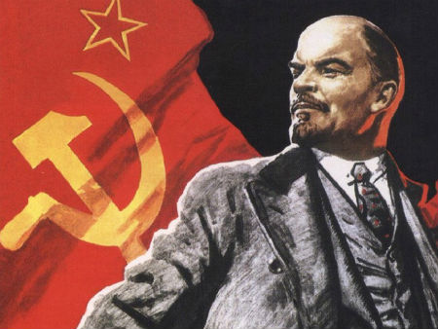
The Russian Revolution

Slide 2
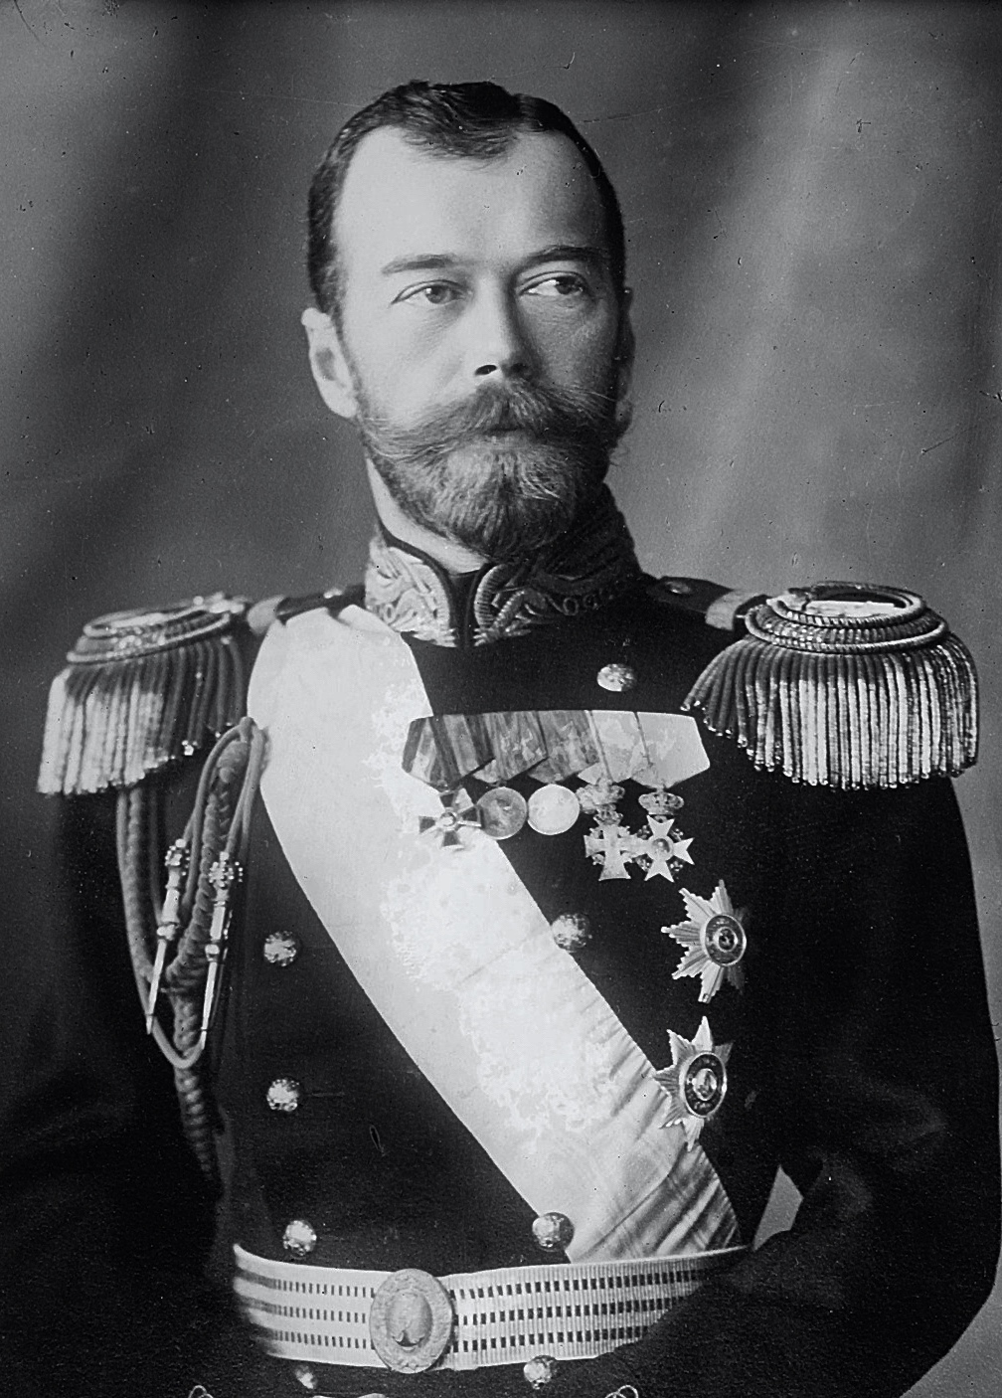
Background to the Russian Empire
From 1613-1917, Russia was ruled by a royal family - the Romanovs. In 1894, Nicholas Romanov became Tsar Nicholas II, ruler of Russia. Under a form of government known as autocracy – in which one person, in this case the Tsar, had absolute power – there was no elected parliament and there were no elections for positions in the government. There were no legal or constitutional methods by which Tsarist power could be challenged. Censorship of books and newspapers prevented radical ideas from being published and people suspected of working against the regime were imprisoned or exiled to Siberia (the remote east of Russia).
Peasants, who were the vast majority of the population in Russia, lived in poverty. Population growth meant peasants needed more land, but almost all were too poor to buy it. Famine was widespread as many struggled to obtain enough food. Workers, who were employed in the mines, factories and workshops of the major cities, suffered low wages, long working hours, and many accidents. While Russia’s elite – its royal family and aristocracy – lived lives of luxury. Most Russians felt that this system was unjust. To demonstrate their discontent with awful living conditions and demand reform, protests, riots and strikes became common.

Slide 3
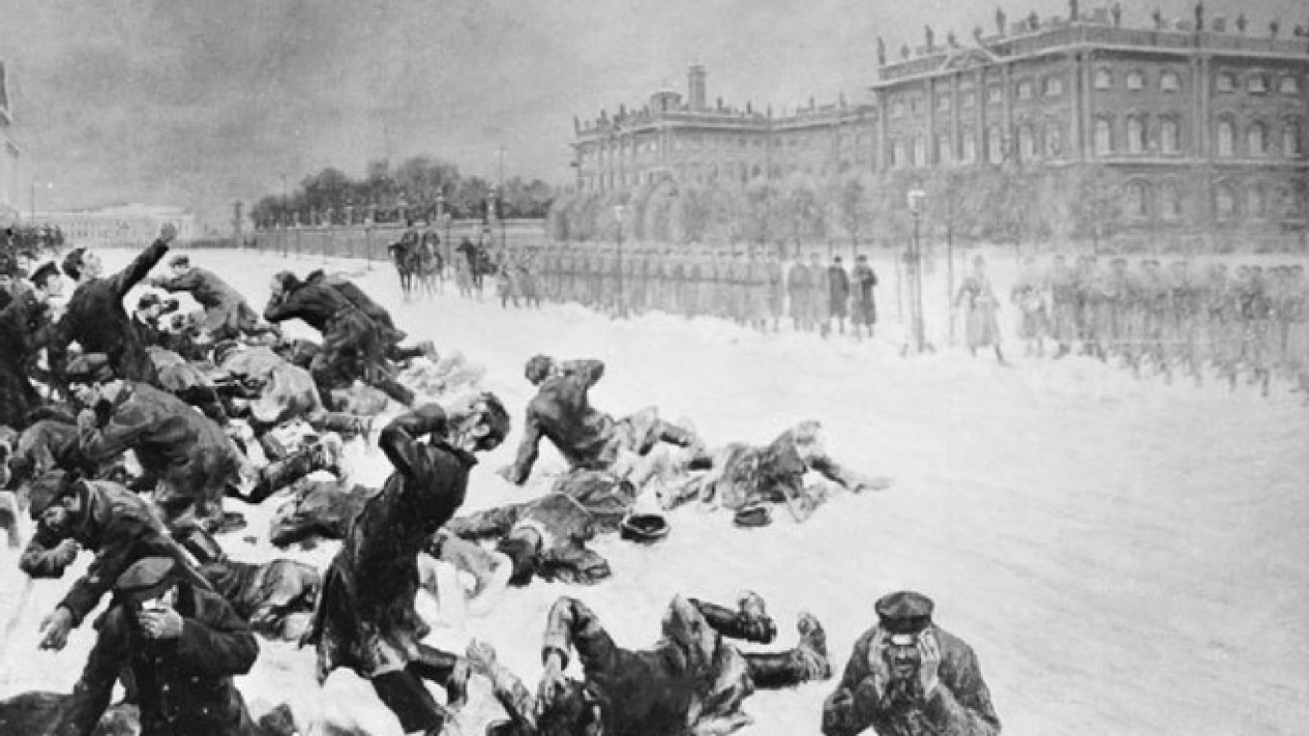
Bloody Sunday
Nicholas’ already unpopular leadership attracted more dissatisfaction in 1904-1905, as Russia experienced a series of military defeats in the Russo-Japanese War. Meanwhile, in the capital of St. Petersburg, there was rising unrest among factory workers. Like elsewhere in the country, these individuals worked in unsafe environments, received little pay, endured eleven-hour workdays, and were forced to live in overcrowded, dirty barracks where diseases spread rapidly. Amid these horrendous conditions, a trade union in the capital called the Assembly of Russian Factory and Mill Workers, was willing to demand change.
When in late December 1904, four union members were fired from the Putilov Ironworks, the leader of the Assembly, priest Georgy Gapon, called for a mass strike. On Sunday, January 22, hoping to deliver a petition to the Tsar requesting better working conditions, fairer wages, and a reduction in the working day to eight hours, Gapon led thousands of workers in a peaceful march to the Tsar’s official residence, the Winter Palace. Russian soldiers shot at the demonstrators killing over a hundred and wounding many more. This massacre, known as Bloody Sunday, outraged the Russian people and led to an increase in the number of strikes.

Slide 4
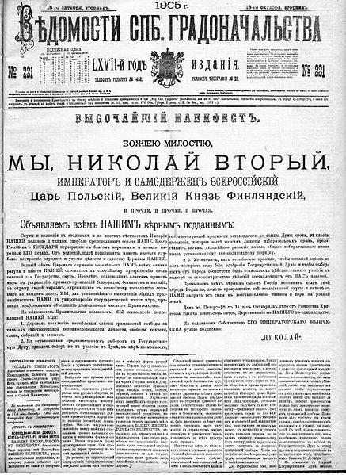
The October Manifesto
Workers from the most important industries, including the railway, joined the strike. Without railways to transport resources, information and people, Russia was in a state of chaos. The strikes put pressure on Tsar Nicholas II to appease the people and restore order. To achieve this, he reluctantly released the October Manifesto on October 30, 1905. In it, he granted basic civil rights (like freedom of speech, freedom of assembly, and the right to form political parties) and created an elected parliament, known as the Duma, with representatives whose approval would be necessary before the passing of any laws.
But when the Tsar issued the Russian Constitution of 1906, he betrayed his promises of democracy by asserting his power over the Duma. He gave himself the authority to pass any new laws he thought were necessary when the Duma was not in session, to dissolve (close) the Duma at any time, and veto (reject) any Duma laws. When the first and second Dumas proved unsatisfactory to him, he dissolved them. Although the third and fourth Dumas proved more lasting, the Russian peoples’ unfulfilled hopes of democracy fueled revolutionary ideas and violence targeted at the Tsar’s regime.

Slide 5
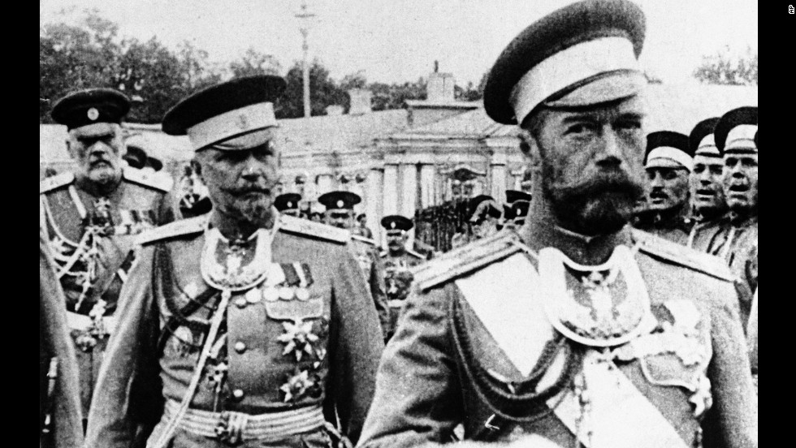
World War One
In August 1914, Russia was plunged into another crisis - World War One. Unprepared militarily or industrially, the country suffered a series of demoralizing defeats to the better led, better trained, and better supplied German Army. At home, there were severe food shortages and economic chaos. Despite his lack of knowledge of war tactics, Tsar Nicholas II proceeded to the Eastern Front in 1915, and took command of the Russian Army. He was blamed for Russia’s continuing losses – after all, he was the army’s commander-in-chief, and he was standing in the way of government reform. What little support he had left began to crumble.
The departure of the Tsar to the front left his wife, Alexandra, in charge of the government. Since she was German by birth and her first cousin was Kaiser Wilhelm II, some were suspicious as to where her loyalties lay in the war. Her controversial advisor, Grigori Rasputin - who appeared to be able to stop the bleeding of her only son and heir to the throne, Alexei, who suffered from the disease hemophilia – increased his influence over the government. His interference in government decisions, drunkenness and sexual escapades brought scandal to the royal family. It was even rumored that Rasputin was having an affair with Alexandra.

Slide 6
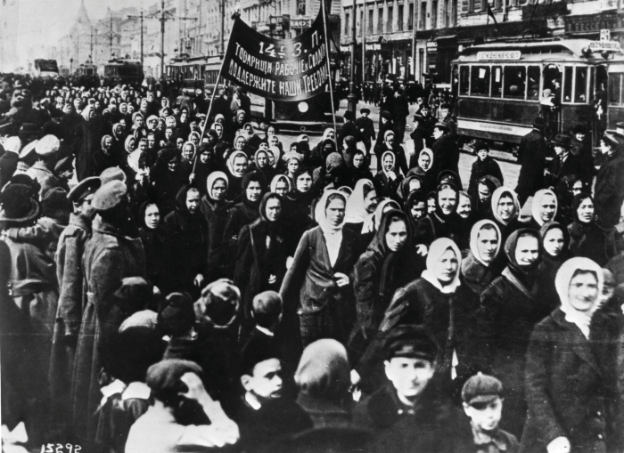
The February Revolution
By February of 1917, many Russians had had enough. Beginning on International Women’s Day, February 23, huge crowds of striking workers and demonstrators - many of whom were women - took to the streets of the Russian capital, St. Petersburg, to demand an end to food shortages, an end to the war, and an end to autocracy. The protests dragged on for days. Disobeying the orders of the Tsar to shoot the demonstrators, large sections of the army stationed in the capital rebelled and joined the protests instead. By February 27, the government had lost control of the capital and on March 2, Tsar Nicholas II was forced to abdicate.
In just 10 days, 304 years of Romanov rule had come to an end. Members of the Duma formed a Provisional (temporary) Government, which shared administrative control of Russia with councils elected by workers and soldiers, called the Petrograd Soviet. The leaders of the Provisional Government, including minister of war and later Prime Minister Alexander Kerensky, decided to continue the Russian war effort, even though Russian involvement in the war was enormously unpopular. This further worsened Russia’s food supply problems. Unrest continued to grow as peasants looted farms and food riots erupted in the cities.

Slide 7
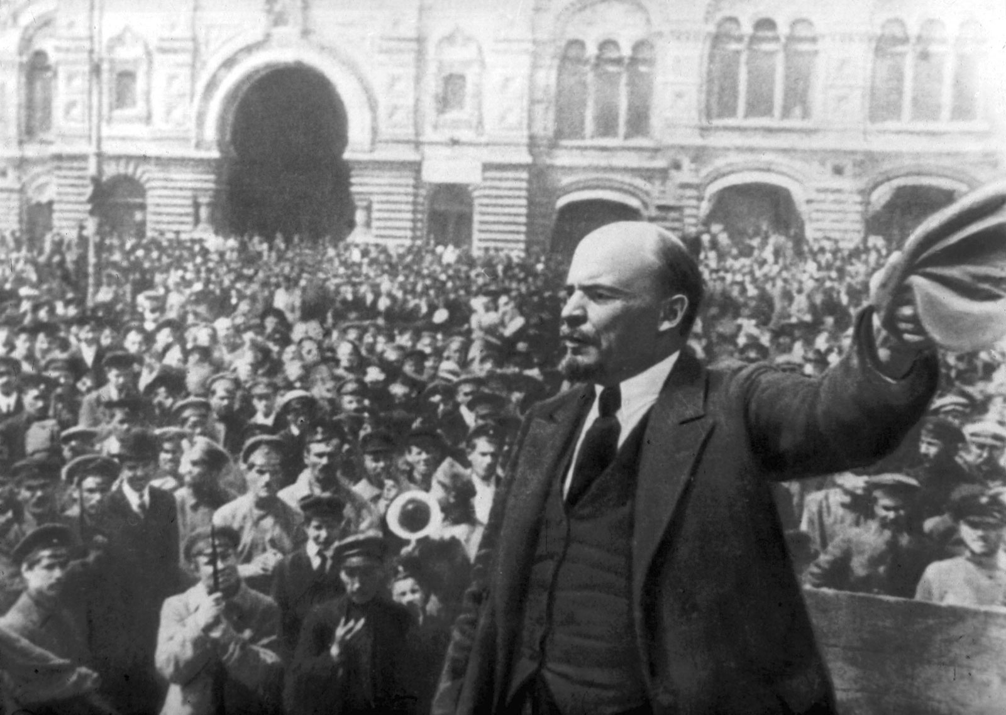
Vladimir Lenin and the Bolsheviks
The political group that proved most troublesome for Kerensky, and would eventually overthrow him, was the Bolshevik Party, led by Vladimir Lenin. The Bolsheviks were a revolutionary party, committed to the theories of German philosopher, Karl Marx. His political ideology, known as communism, is based on the idea that the poor working class (proletariat) would rise up in rebellion and liberate themselves from the economic and political control of the wealthy ruling class (bourgeoisie). Once power had been seized, a fairer society based on equality, in which all property would be collectively owned, could be established.
Exiled from Russia for spreading revolutionary ideas, Lenin returned in April 1917. In speeches he condemned the provisional government and called for an armed uprising to overthrow it. He also advocated immediate peace with Germany and Austria-Hungary, redistribution of land from rich landowners to peasants, and the transfer of power from the Provisional Government to the people’s Soviets, or councils that were springing up across Russia. The Bolshevik programme was summed up in a simple slogan, “Bread, Peace and Land.” And as Russia’s economic and military crisis deepened, its appeal to the masses grew and grew.

Slide 8
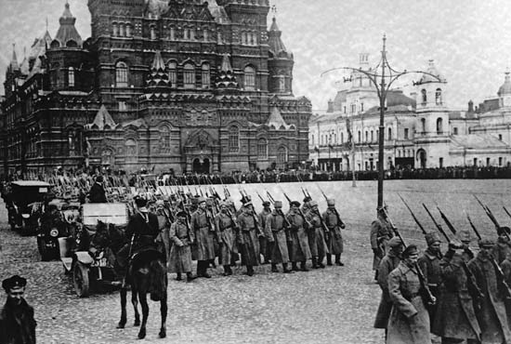
the October Revolution
On October 24, 1917, leftist revolutionaries led by Bolshevik Party leader Vladimir Lenin launched a nearly bloodless coup d’état against the provisional government. The Bolsheviks’ militia, formed from armed factory workers, soldiers and sailors, called the Red Guard, captured government buildings and other strategic locations around the capital. Most of the city's military units also joined the insurrection against the Provisional Government. The next day, the combined forces stormed the Winter Palace, headquarters of the provisional government, and arrested government ministers, bringing the provisional government to an end.
Following the revolution, Russia became the world’s first communist country. The Bolshevik government under the leadership of Lenin gained considerable support from the people by ordering Russian troops to cease all hostilities on the front in November 1917. A formal peace agreement with Germany was signed on March 3, 1918, called the Treaty of Brest-Litovsk. The government also introduced reforms that established a communist system: redistributing the land amongst the peasantry, creating a system for workers’ control of factories, and transferring control of banks and large-scale industry from private to state ownership.

Slide 9
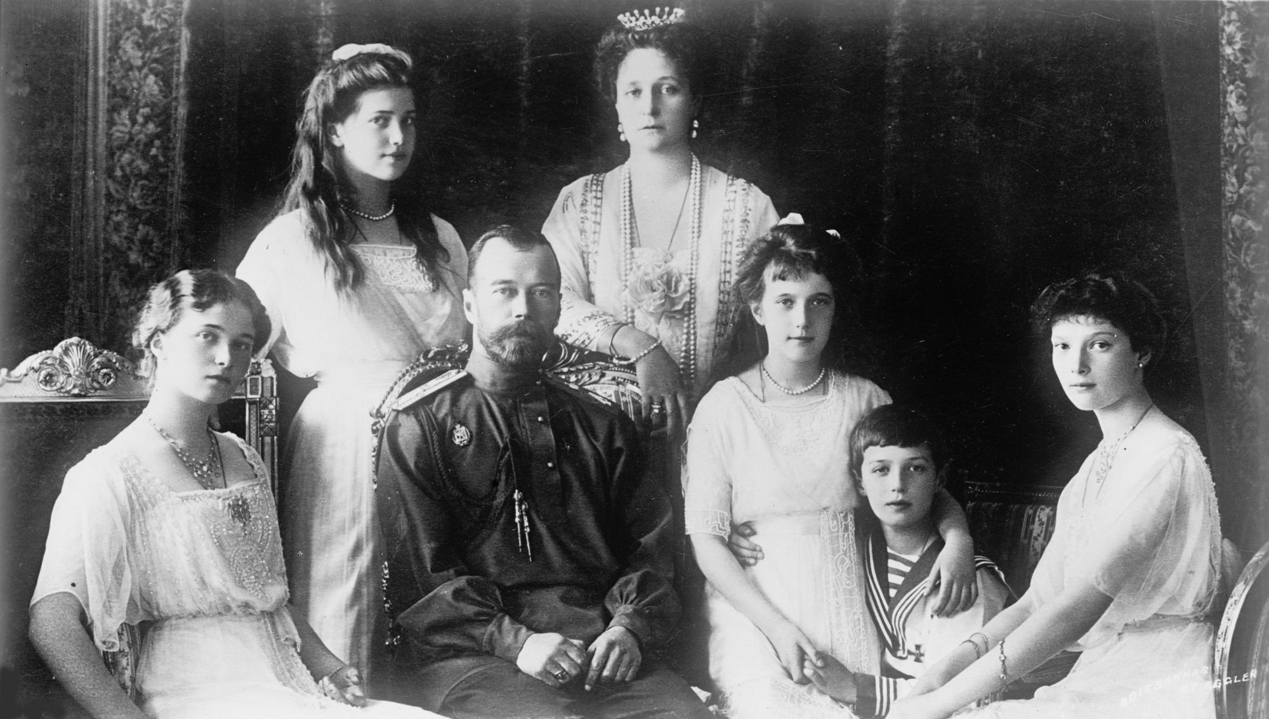
Russian Civil War
Civil war followed from 1918 to 1920 as the Bolshevik Red Army, formed to defend the October Revolution, and the White Army, a coalition of anti-Bolshevik groups, fought to gain control of the country. To feed the Red Army, an economic policy was introduced, War Communism, which forced peasants to give up all their surplus crops to the government. The Cheka, a secret police, fiercely suppressed dissent and rebellion by arresting, interrogating and executing anyone suspected of hostility towards the Bolsheviks. The Bolsheviks also closed down newspapers that opposed them, banned all political parties and arrested their leaders.
Some in the White Army wanted to restore the Russian monarchy by putting Nicholas Romanov back on the throne. In July 1918, the White Army approached Yekaterinburg, where Nicholas and his family had been placed under house arrest. Worried that the Whites could rescue the royal family and thus rally anti-Bolshevik support, Red Army soldiers on July 17, 1918, gathered the Tsar, his wife Alexandra, their son Alexei, their 4 daughters, Olga, Tatiana, Maria and Anastasia, as well as 4 servants – and executed them all. By the end of 1920, all counterrevolutionary opposition to Lenin’s rule had been arrested, murdered, or forced into exile.

Slide 10
Significance
By the end of the civil war, around 15 million people had died in the conflict and famine. The Bolsheviks succeeded in securing their grip on power in Russia. Victorious, they renamed themselves as the Communist Party. They also established power in the newly independent republics of Armenia, Azerbaijan, Belarus, Georgia and Ukraine. They brought these jurisdictions into unification under the Union of Soviet Socialist Republics (USSR), also known as the Soviet Union, in 1922. This set the stage for the rise of the Soviet Union as a world power that would go head-to-head with the United States during the Cold War (1947-1991).
The Russian Revolution marked the end of 304 years of Romanov Tsarist rule, the end of Russian participation in World War One, and the end of private ownership in Russia until the collapse of the Communist Party in 1991. It also led to the creation of the first communist country in the world and generated a new way of thinking about economy, society and the government. Communism became an alternative to capitalism. The communist movement began to grow worldwide, which frightened the capitalist world, and inspired other communist movements around the world in regions such as China, Cuba, and Vietnam.

