Slide 1
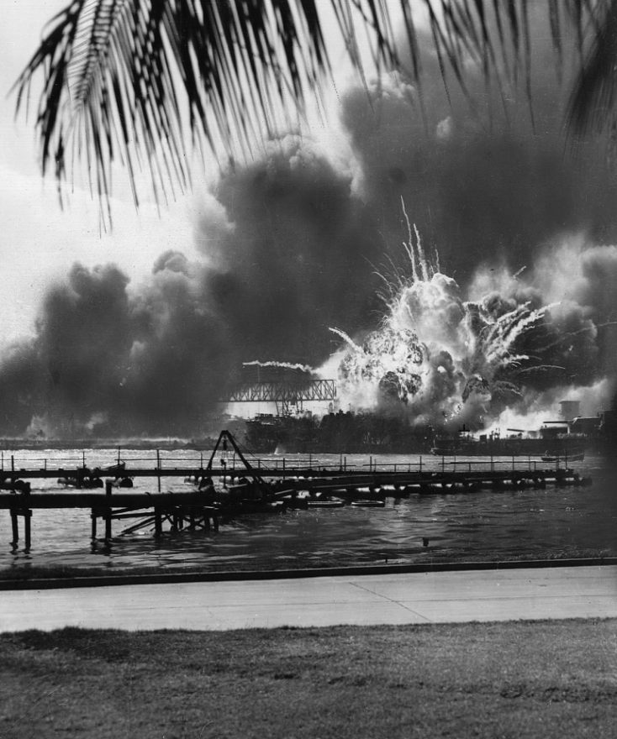
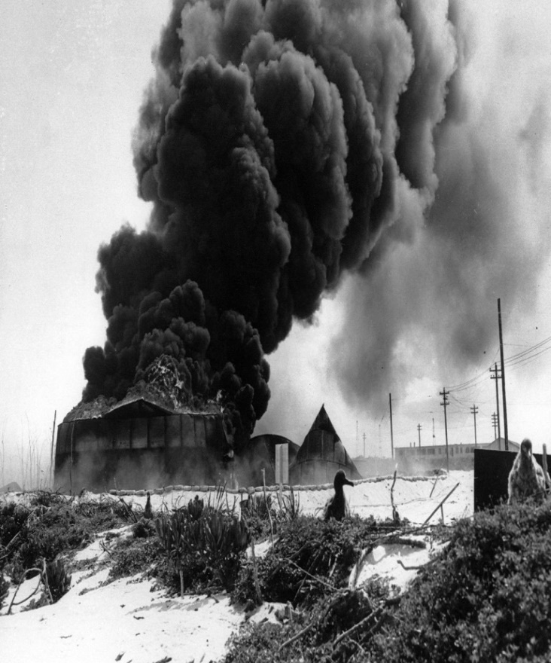
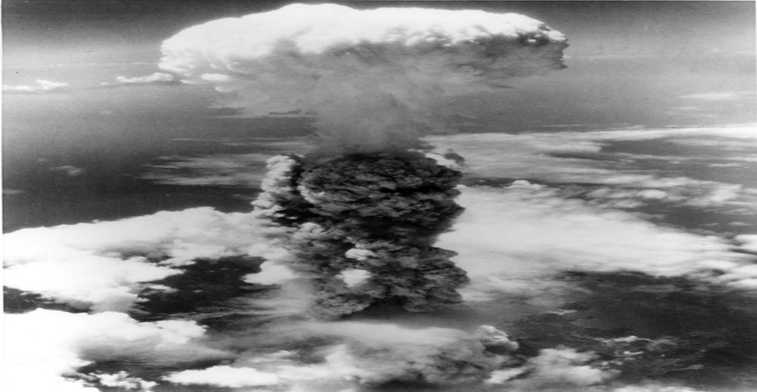
World War Two in the Pacific: The Attack on Pearl Harbor, Battle of Midway, and the Bombing of Japan

Slide 2
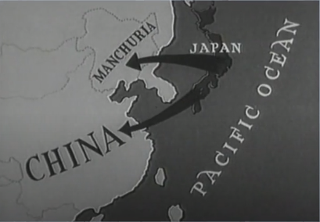
Japanese Expansion in the 1930s
To secure natural resources and markets for their goods, Japan sought to expand its empire by establishing colonies in Asia and the Pacific. Japanese aggression began on September 18, 1931 with the invasion of Manchuria, in northeastern China. This territory was conquered by Japanese forces and transformed into a Japanese puppet state, Manchukuo.
America opposed Japanese aggression towards China. The U.S. refused to recognize the new allegedly independent state. The U.S. assisted China by providing it with military aircraft and loans for the purchase of war supplies. In 1937, Japan began a full-scale invasion of the rest of China.

Slide 3
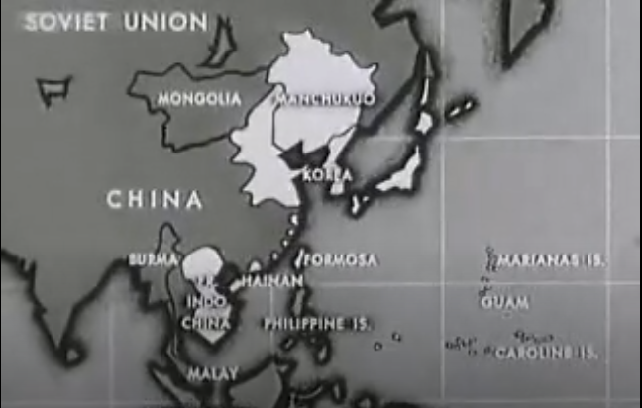
Deteriorating U.S. – Japan Relations
Tensions escalated in July 1940, as the U.S. imposed economic embargos on vital war material exports to Japan such as scrap iron, steel, and aviation fuel. Restricting trade gave U.S. leverage to weaken Japan’s war effort against China.
In September 1940, Japan invaded French Indo-China and signed an alliance with Germany and Italy called the Tripartite Pact. In July 1941, the U.S. halted all exports to Japan, including oil. A dwindling oil supply threatened to leave Japan’s military out of fuel. Neither side budged amid diplomatic negotiations. Japan demanded the U.S. lift the embargos and cease its support of China. U.S. insisted Japan withdraw troops from China and sever ties with the Axis powers.

Slide 4
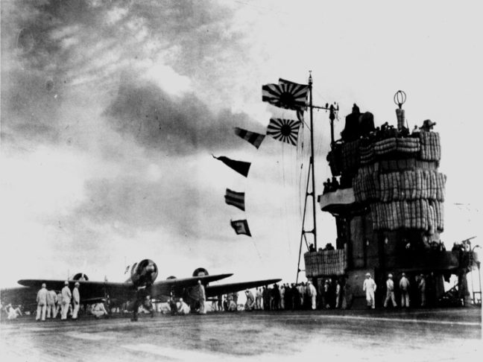
Preparing The Attack
Japan’s primary objective was to destroy the U.S. Pacific Fleet at Pearl Harbor, and thus prevent it from interfering with Japanese expansion in Southeast Asia. Japanese Vice Admiral Chuichi Nagumo commanded a strike force consisting of 414 planes aboard six aircraft carriers, two battleships, three cruisers, nine destroyers, eight tankers, 23 fleet submarines, and five midget submarines.
By avoiding shipping routes and maintaining strict radio silence, the strike force travelled undetected from Hitokappu Bay, Japan, to a position 230 miles (370 kilometers) north of the Hawaiian island of Oahu. The stealth maneuvers set up Japan to launch a surprise air raid on Pearl Harbor on December 7, 1941.

Slide 5
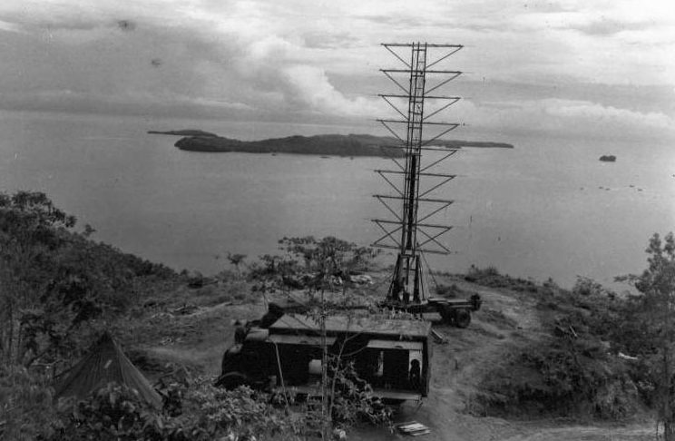
Warning Signs Missed
On the morning of the attack, a U.S. minesweeper, the USS Condor spotted an unidentified midget submarine’s periscope near the entrance to Pearl Harbor. It alerted a U.S. destroyer, the USS Ward, which sunk the submarine at 6:45 am. But, the report of the sinking was handled routinely without raising an alarm.
At 7:02 am, two U.S. Army radar operators at the Opana Radar Site on the northern coast of Oahu began tracking unidentified aircraft approaching the island from the north. A lieutenant was notified, but dismissed the warning mistakenly assuming that these planes were a squadron of U.S. B-17 bombers scheduled to come from California and arrive at Hickam Field on Oahu.

Slide 6
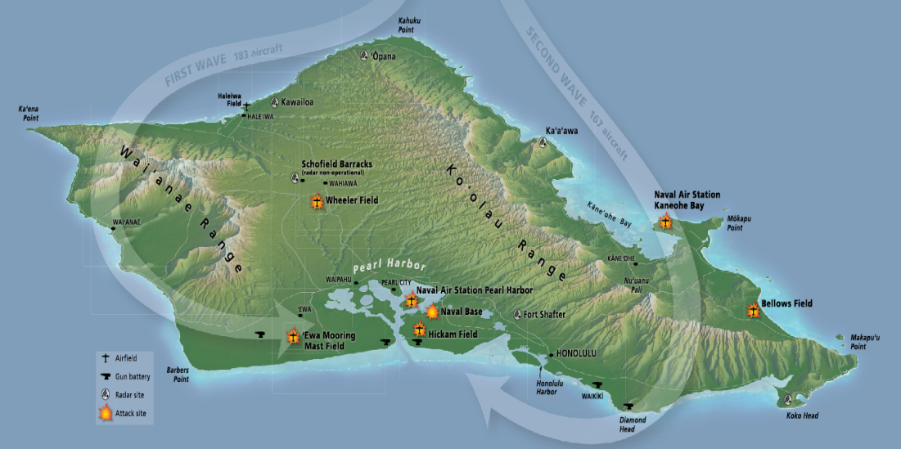
The Japanese Attack
Japanese aircraft including dive bombers, torpedo bombers, and fighters flew in two waves. 183 planes struck first destroying targets on the western side of Oahu beginning at 7:55am. About an hour later, 167 planes kept up the assault, pummelling targets on the eastern side of the island. Both waves met over Pearl Harbor where they concentrated their firepower. The battle raged till 10:00am.
The Japanese air raid inflicted heavy damage on the U.S. Pacific Fleet’s eight battleships anchored in Pearl Harbor, destroying two. Nearly all the 188 U.S. aircraft destroyed and 159 damaged were clustered together at airfields across Oahu. U.S. losses were high: 2335 service members and 68 civilians were killed.

Slide 7
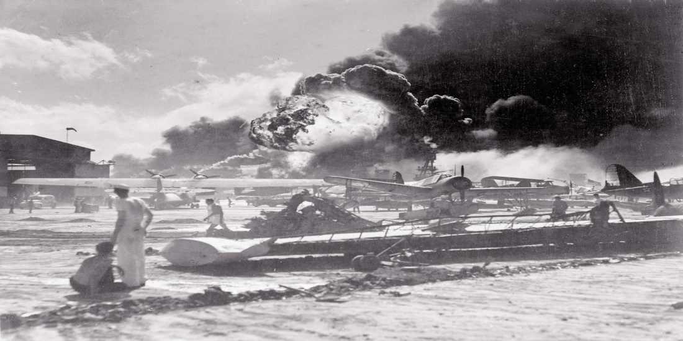
The American Defence
With no early warning of the incoming Japanese force and no declaration of war announced by Japan against the U.S., American service members were caught off guard. Many awoke to the sounds of alarms, explosions, and gunfire.
Despite the shock of the surprise attack, American service members responded with courage. Under heavy bombardment, soldiers on the ground fired nearly 300,000 rounds of ammunition and rushed to the aid of their wounded comrades. While their runways were under attack, eight U.S. pilots boarded aircraft, took to the skies and fought back. But Japanese losses were low: 64 service members killed, 29 aircraft and five midget submarines were destroyed.

Slide 8
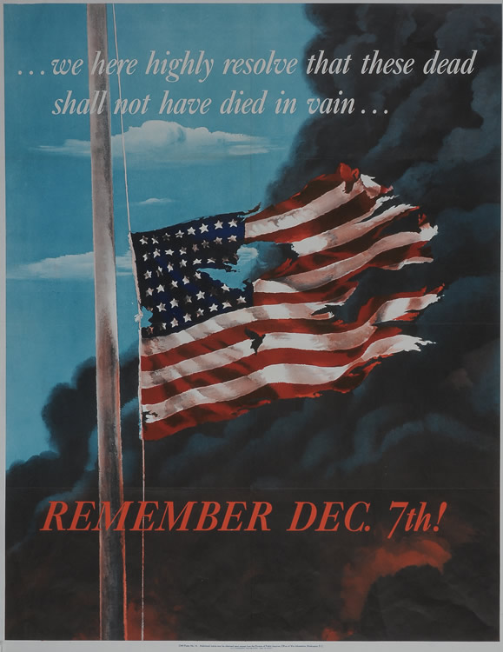
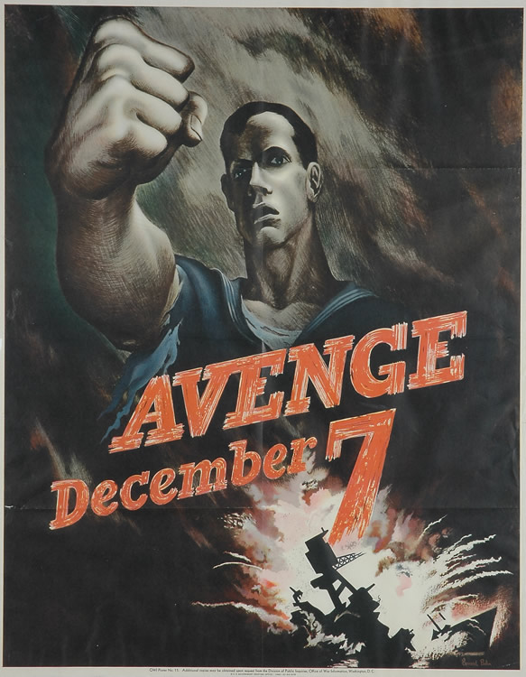
Propaganda
News of Japan’s unprovoked aerial assault on Pearl Harbor triggered feelings of vengeance across America, motivating volunteers to enlist in the armed forces.
Propaganda posters featured images of the bombing as a rallying cry to the American people to join the fight. One poster featured the symbol of America, the American flag, flying low, tattered and torn as dark smoke billows in the background. An appeal is made to the viewer to take action so that those who perished at Pearl Harbor “shall not have died in vain”. Another poster depicts a sailor in a tattered uniform raising his clenched fist high, as a naval ship explodes. Printed in bold red lettering is the message: “Avenge December 7”.

Slide 9
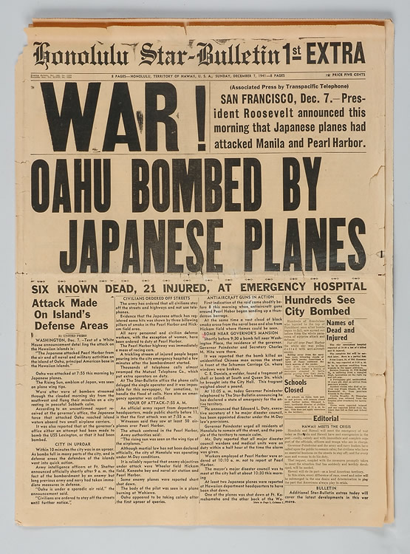
Significance
The U.S. Pacific Fleet’s three aircraft carriers were not at Pearl Harbor on the morning of December 7, 1941, and so avoided damage. These vessels would prove vital to the U.S. the following June at the Battle of Midway. Oahu’s oil storage facilities, naval repair facilities, and submarine base emerged unscathed as well. Six of the fleet’s eight battleships were repaired and returned to service.
Outraged by the surprise attack, previously divided U.S. public opinion about neutrality united in favor of entering the Second World War. The next day, December 8, 1941, the U.S. declared war on Japan. Three days later, Japan’s allies, Germany and Italy, declared war on the U.S. and the U.S. reciprocated.

Slide 10
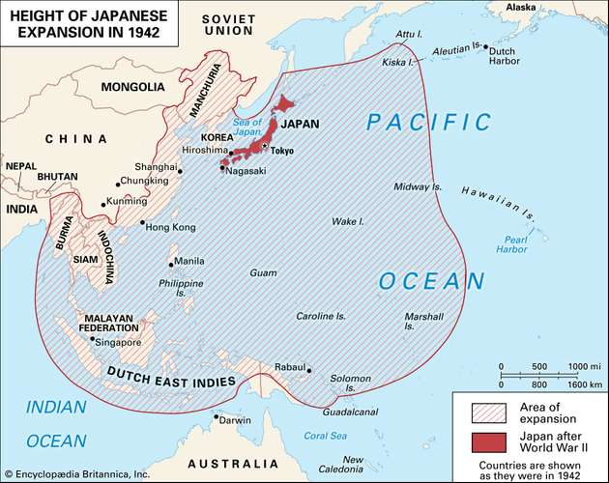
Background to the Battle of Midway
Following the Pearl Harbor attack, Japan extended its empire across southeast Asia and the Pacific. By April 1942, Japan controlled Korea, Manchuria, a large part of coastal China, French Indo-China (Vietnam, Cambodia, and Laos), Siam (Thailand), Burma (Myanmar), Malaysia, Singapore, the Philippines, the Dutch East Indies (Indonesia), and various islands in the central and western Pacific.
On April 18, 1942, a U.S. aircraft carrier, USS Hornet, launched bomber planes to strike Japan’s capital, Tokyo. Japan military leaders, ashamed of their failure to prevent the raid, sought to widen the defence perimeter of their homeland by seizing U.S.-held Midway Island and sinking U.S. Pacific Fleet aircraft carriers.

Slide 11
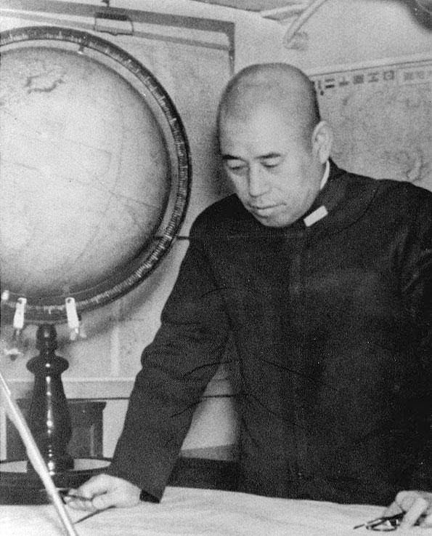
Planning the Attack
The Japanese Navy, led by Admiral Isoroku Yamamoto, executed Operation MI. According to the plan, the First Carrier Striking Force, (commanded by Vice Admiral Chuichi Nagumo,) would launch fighter and bomber planes from four aircraft carriers to knock out Midway’s defences. The Second Fleet Main Invasion Force, (led by Vice Admiral Nobutake Kondo,) would follow up with support ships and troop carriers to begin landing 5000 soldiers on the island.
Once anticipated U.S. Pacific Fleet reinforcements from Pearl Harbor neared Midway, Nagumo’s force would hit them in unison with Yamamoto’s First Fleet Main Force of battleships, carriers, and destroyers 600 miles west of Midway.

Slide 12
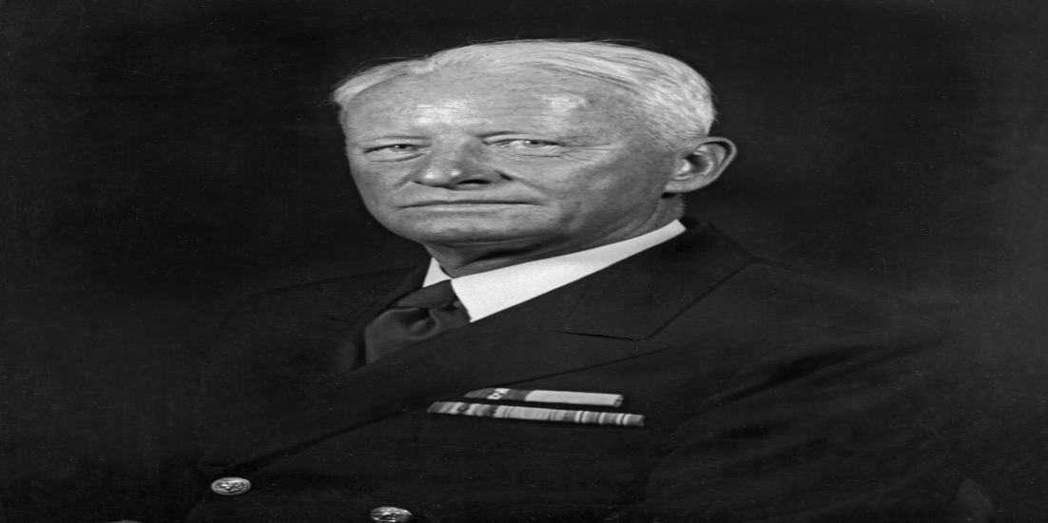
Cracking the Code
Yamamoto did not know that U.S. Pacific Fleet commander, Admiral Chester Nimitz, had one key advantage: U.S. Navy codebreakers had begun deciphering Japanese naval codes in early 1942. Staff based in Pearl Harbor at Station Hypo intercepted Japan radio communications regarding a pending operation at “AF”
Following a deception plan, codebreakers confirmed their suspicions that “AF” was Midway. An officer at the U.S. base at Midway was instructed to send out a false radio message claiming that the base’s water distillation plant had suffered serious damage and that fresh water was needed immediately. Shortly after the transmission, an intercepted Japan message relayed that “AF is short of water.”

Slide 13
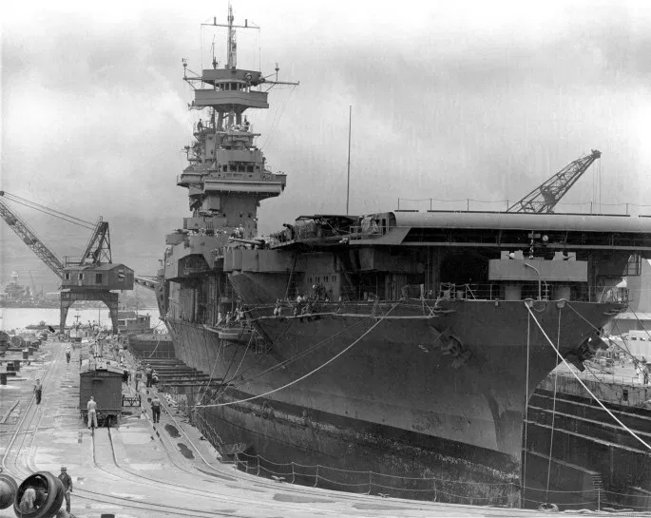
Preparing the Defence
Due to U.S. Navy codebreaking efforts, U.S. Admiral Chester Nimitz was given advance warning of where Japan planned to attack, when, what forces would be involved, and how it would proceed. Then Nimitz planned countermeasures.
First, he reinforced Midway by sending bomber and fighter planes, marines and supplies. Second, he ordered that a damaged aircraft carrier, USS Yorktown, receive speedy repairs at Pearl Harbor’s naval shipyard so it would be combat ready. Third, he deployed the U.S. Pacific Fleet’s aircraft carriers, cruisers and destroyers (under the command of Rear Admiral Raymond Spruance and Rear Admiral Frank Fletcher) in an ambush position, 350 miles northeast of Midway

Slide 14
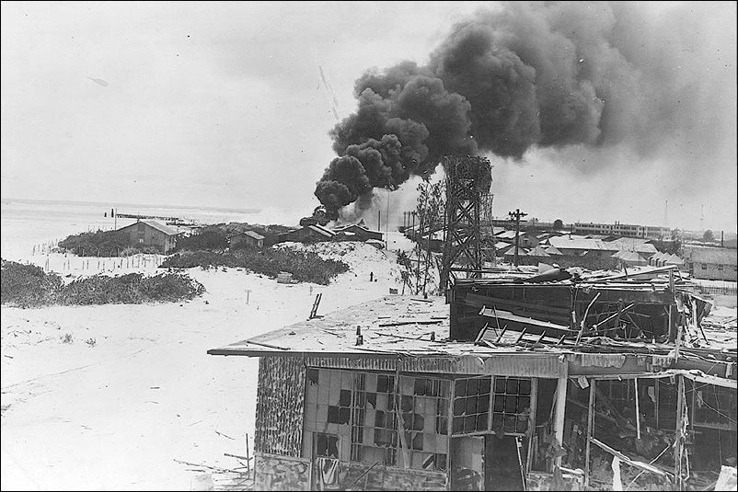
The Japanese Attack
On the morning of June 4, 1942, Japan’s First Carrier Striking Force launched phase one of the Midway battle plan: an air raid on the island by 108 fighter, torpedo bomber and dive bomber planes from four aircraft carriers: Akagi, Kaga, Soryu, and Hiryu. Japan fighter planes and fleet antiaircraft fire quashed Midway’s fighter plane defence and bomber plane offence against the carriers.
Midway’s land-based defences were mostly still intact and its runway remained operational when the first phase of the attack ended. A Japan pilot later radioed First Carrier Striking Force commander Nagumo advising him it was necessary to strike Midway again to weaken resistance so the invasion plan could proceed.

Slide 15
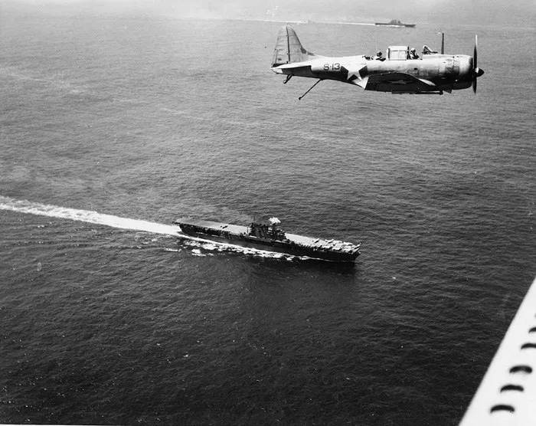
A Vulnerable Position
In preparation for another Midway attack, Nagumo ordered that reserve planes on his aircraft carriers were to have their torpedoes replaced with bombs. In the midst of this rearmament, a Japan scout plane reported spotting ten U.S. ships off Midway. News of enemy ships already within range of his fleet shocked Nagumo. He had assumed the U.S. Pacific Fleet was miles away at Pearl Harbor
Nagumo cancelled his order and directed crews to prepare planes still armed with torpedoes to attack the ships. The Japanese were unaware that torpedo bomber and dive bomber planes had already been launched against them from the three U.S. aircraft carriers: USS Yorktown, USS Enterprise, and USS Hornet

Slide 16
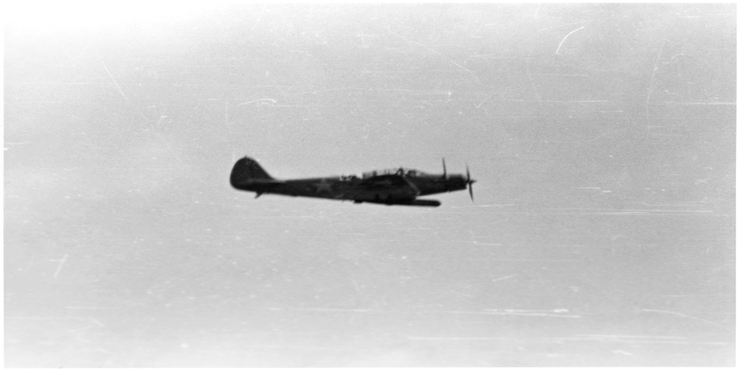
U.S. Devastators Prove Ineffective
Japan’s initial wave of Midway attack planes – now low on fuel and munitions – were returning to their aircraft carriers, halting the launch of planes poised to engage the U.S. ships. Then, the first squadron of planes from the U.S. aircraft carriers swooped in. But, with no fighter plane escort to protect them, the USS Hornet’s 15 slow, low-flying TBD Devastator torpedo bombers were shot down by the Japanese fleet’s antiaircraft fire and its fast, maneuverable fighter planes.
Two more TBD Devastator torpedo bomber squadrons followed: 14 planes from the USS Enterprise and another 12 from the USS Yorktown. None carried out a successful torpedo attack. Of the 41 Devastators sent in, only six returned.

Slide 17
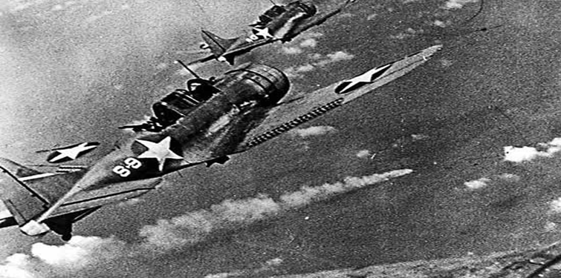
U.S. Dauntlesses Turn the Tide
Though the TBD Devastator torpedo bombers failed to inflict any damage, they did succeed in pulling Japan fighter planes out of position – down to sea level –clearing the way for an overhead attack which would turn the tide of the battle.
As the Devastators were finishing their attacks, three squadrons of U.S. SBD Dauntless dive bombers from the USS Enterprise and USS Yorktown appeared high above the Japanese aircraft carriers and bombed three in rapid succession: the Kaga, Akagi, and Soryu. Their flight decks were set ablaze, igniting fueled and armed planes and detonating unsecured munitions. The resulting fires spread out of control, forcing the Japanese to abandon all three aircraft carriers

Slide 18
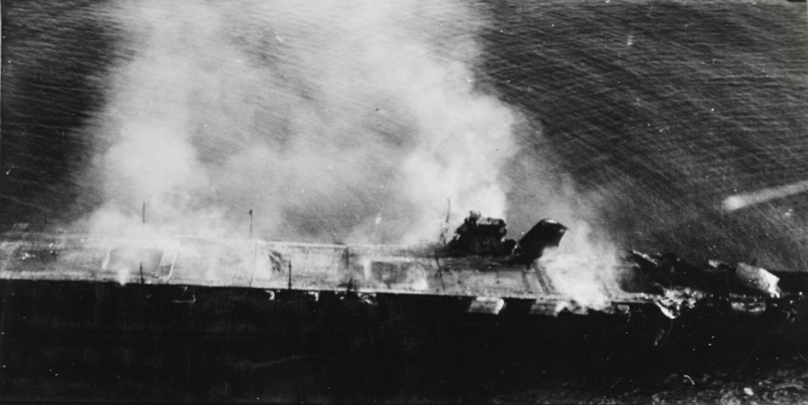
Counterattacks
As the three Japanese aircraft carriers burned, Hiryu, the last surviving aircraft carrier of Japan’s First Carrier Striking Force, retaliated with two waves of attacks – both times targeting the USS Yorktown. Japanese D3A dive bomber planes and B5N torpedo bomber planes, escorted by fighter planes landed heavy blows to the flight deck and engines of the U.S. aircraft carrier. A Japan submarine later sank the abandoned and immobilized vessel on June 7, 1942.
SBD Dauntless dive bombers from all three U.S. aircraft carriers struck back against the Hiryu. Their bombs tore through the Japanese aircraft carrier, reducing it to a flaming wreck. Now all four Japan aircraft carriers were in ruins

Slide 19
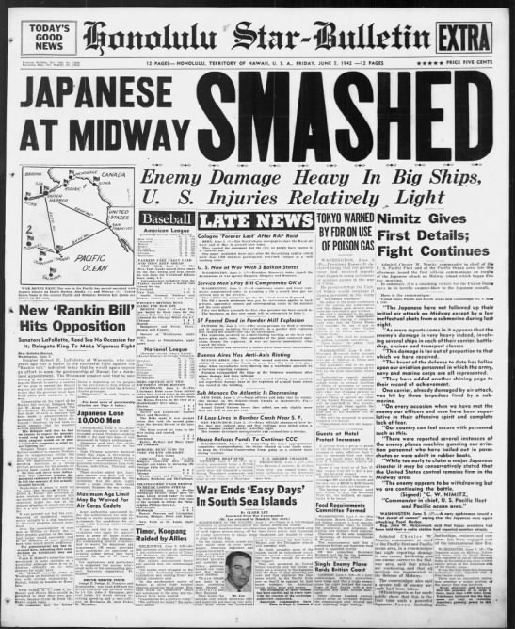
Significance
Although small clashes continued over the next two days, the major combat of the Battle of Midway ended on June 4, 1942, with a decisive U.S. victory. Japan’s losses were disastrous: four aircraft carriers, one heavy cruiser, 332 aircraft, and 3057 service members. In contrast, the U.S. losses were slight: one aircraft carrier, one destroyer, 145 aircraft, and 307 service members.
Yamamoto’s invasion plan was derailed. Deprived of useful air cover, he called off the Midway operation and his force retreated. Japanese territorial expansion in the Pacific was stopped. From this point on, U.S. naval superiority in the Pacific forced Japan to remain on the defensive for the rest of World War Two.

Slide 20
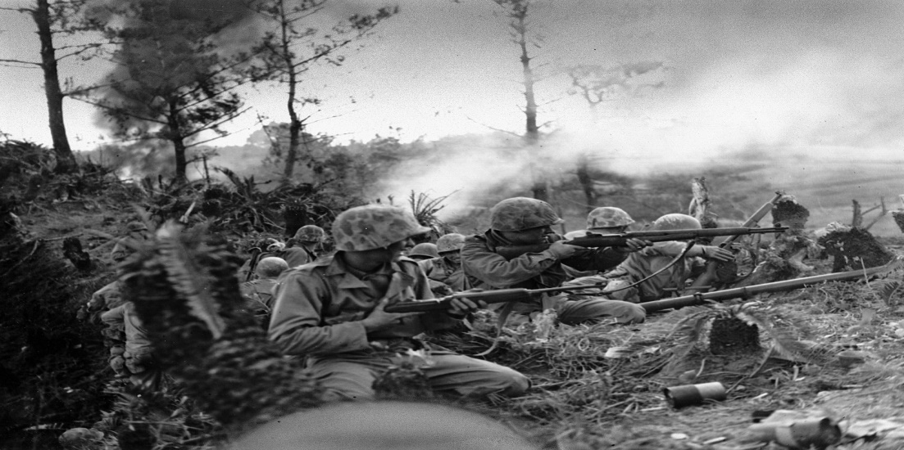
Background to the Bombing of Japan
For the next three years, the Japanese defended a continually shrinking empire. Strategic Japan islands in the south Pacific including Tarawa, Saipan, Iwo Jima, and Okinawa were captured as the Allies went on the offensive. But, undeterred by demoralizing defeats, horrific casualty numbers, and even the surrender of its strongest ally - Nazi Germany on May 7, 1945, Japan vowed to fight on.
Combat on the Japan islands proved costly in terms of lives lost. At Okinawa, for example, more than 12,000 U.S. and 110,000 Japanese service members died. Aware that a U.S. invasion of mainland Japan would result in millions of casualties, U.S. strategists sought an alternative to force Japan into submission.

Slide 21
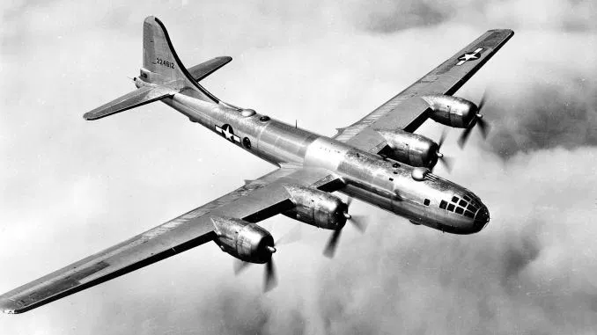
Fire From the Sky
Each Japanese defeat brought U.S. forces closer to within air striking distance of mainland Japan. U.S. B-29 Superfortress bombers stationed on airfields built on newly conquered islands of Saipan, Tinian, and Guam could strike it. And from November 24, 1944, until Japan’s surrender on August 15, 1945, they did.
On the night of March 9-10, 1945, Tokyo, Japan’s capital, was set ablaze by the deadliest air raid in history - codenamed Operation Meetinghouse. 279 U.S. B-29 bombers unleashed 1,665 tons of napalm-filled incendiary bombs on the wooden structures of Tokyo. The fires spread, incinerating 15 square miles of the city and killing about 100,000 Japanese. Still Japan refused to admit defeat.

Slide 22
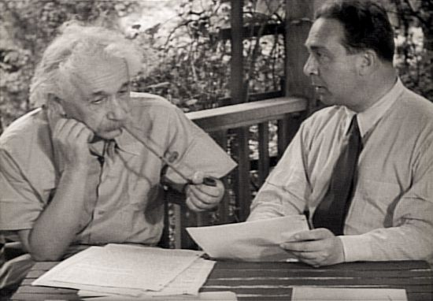
The Manhattan Project
Back in 1939, refugee scientists from Europe, Albert Einstein and Leo Szilard expressed their suspicions to the U.S. president that Nazi Germany was developing a nuclear weapon. This led to a race to build the world’s first nuclear weapons and the creation of a top-secret U.S. government research program, codenamed The Manhattan Project. By August 1942, the project was underway.
On July 16, 1945, Manhattan Project scientists and engineers successfully tested the first ever atomic bomb in a desert area of Alamogordo, New Mexico. By August, two different types of atomic bombs had been produced: a uranium-based design called “Little Boy” and a plutonium-based design called “Fat Man”

Slide 23
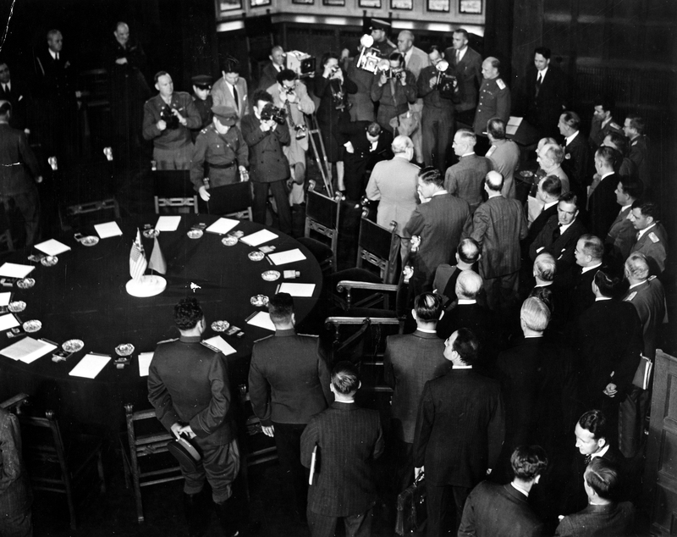
A Warning
In occupied Germany, Allied leaders met in the city of Potsdam from July 17 to August 2, 1945, to discuss the transition to peace. U.S. President Harry Truman, British Prime Minister Winston Churchill, and Chinese Nationalist leader Chiang Kai-shek issued a document on July 26, 1945, that outlined the terms for Japan’s unconditional surrender, known as the Potsdam Declaration.
Terms included Allied occupation of Japanese territory, disarmament, and the creation of a “responsible government.” Though a capitulated Japan would not be destroyed or subjected to enslavement, the declaration warned that failure to immediately surrender would result in Japan’s “prompt and utter destruction.”

Slide 24
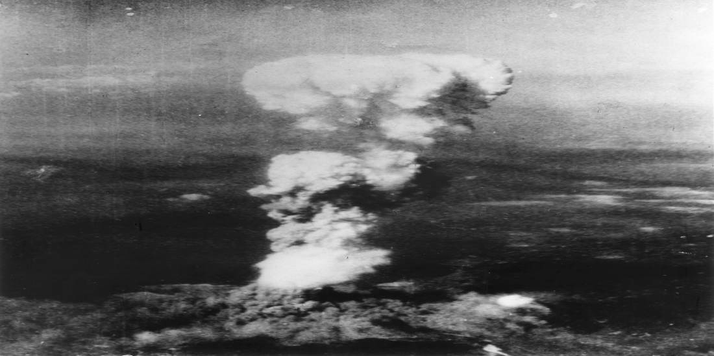
Bombing of Hiroshima
Japanese leaders ignored the demand for unconditional surrender. In response, the U.S. launched the first nuclear attack in history. At 8:15 A.M. on August 6, 1945, a U.S. B-29 Superfortress bomber dropped a uranium-based atomic bomb (“Little Boy”) over the city of Hiroshima, Japan. In a searing flash of heat, 4.7 square miles of the city was destroyed. An estimated 70,000 people died instantly and 70,000 more later succumbed to burns and radiation poisoning.
In a press release issued sixteen hours after the atomic bombing of Hiroshima, American President Harry Truman warned Japan to surrender or "expect a rain of ruin from the air, the like of which has never been seen on this earth."

Slide 25
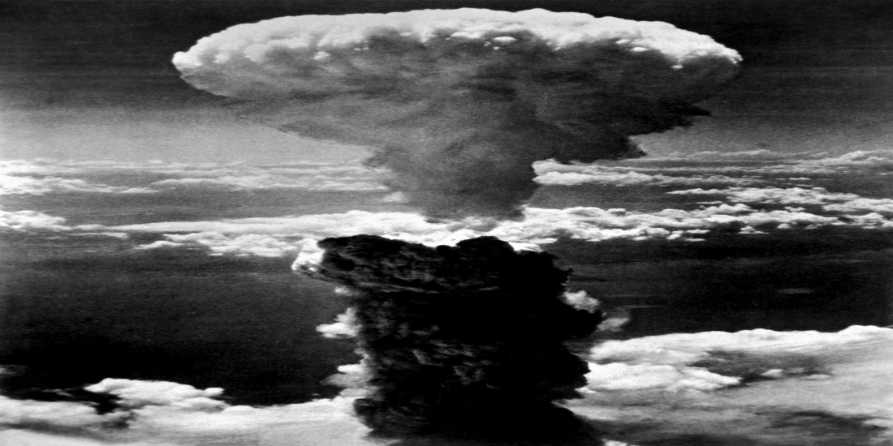
Bombing of Nagasaki
The U.S. president’s warning was also ignored by Japanese leaders. Japan’s desperate situation worsened when the Soviet Union declared war against it on August 8, 1945. The next day, Soviet forces attacked Japan-held Manchuria.
On August 9, 1945, three days after the bombing of Hiroshima, another U.S. B-29 Superfortress bomber dropped a plutonium-based atomic bomb (“Fat Man”) at 11:02 A.M. over the city of Nagasaki, Japan. 1.8 square miles of the city were destroyed. Approximately 40,000 people were killed instantly and 40,000 more later succumbed to burns and radiation poisoning. Japanese Emperor Hirohito announced his country’s surrender on August 15, 1945.

Slide 26
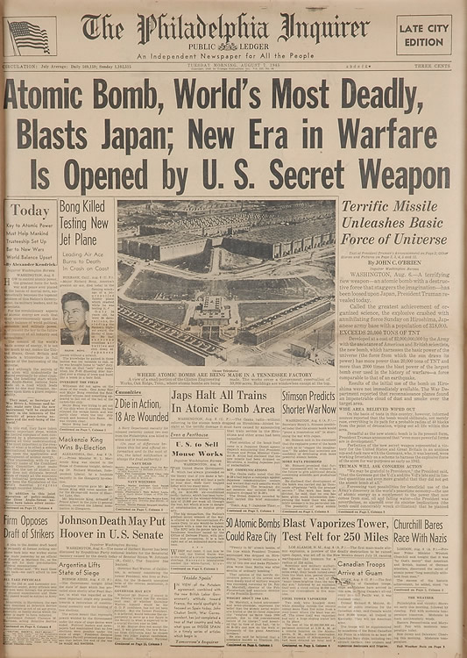
Significance
The ethical considerations and role in Japan’s surrender of the atomic bombing of Hiroshima and Nagasaki are still debated by historians today. But there is no question that the creation and use of the atomic bomb in 1945 changed the nature of warfare forever. Even in our world today, we worry that international conflicts between nations may erupt into unprecedented nuclear devastation.
Unbeknownst to the Americans, spies had infiltrated the Manhattan Project. Data gathered by these individuals enabled Soviet scientists to develop their own nuclear bomb in 1949. Thus began the Cold War in which superpowers, U.S. and the Soviet Union, opposed each other without actually going to war.

