Slide 1
Canadian Confederation

Slide 2
The Corn Laws
The Corn Laws allowed grain to be shipped from Canada to Britain with lower tariffs than grain from other countries.
Although this raised Canadian farmers’ profits, it limited the grain imported to Britain from other countries and drove up the price of bread in Britain.
In 1846, Britain cancelled the Corn Laws. Canadian grain was forced to compete in British markets without low tariffs against low-priced grain from other countries. This led to an economic depression in Canada and a need to unite the British North America colonies to open large markets, more industry, and better transportation systems.

Slide 3
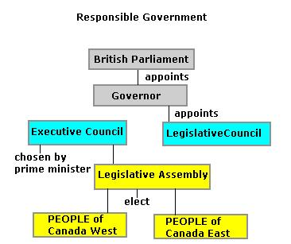
Lord Elgin and Responsible Government
In 1846, Lord Elgin was appointed the new governor general of Canada and was instructed to bring in responsible government, a government subject to the votes of the people.
Britain saw this as a necessary change since it would reduce its expenses of governing, financing, and defending its colonies, while still keeping them as parts of the British Empire.
By taking more responsibility for governing themselves, the colonies would incur the costs of government and defense.

Slide 4
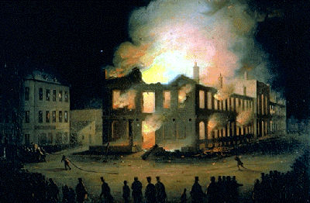
The Rebellion Losses Bill
In 1849, the newly elected government introduced the Rebellion Losses Bill.
This was a controversial piece of legislation which proposed to use tax money to compensate those whose property was destroyed during the 1837 rebellions. Many people were enraged because even some citizens who were on the rebel side would get money.
After Elgin signed the bill, angry citizens in Montreal reacted by throwing stones and rotten eggs at Elgin's carriage and burning the Parliament Buildings to the ground. Despite these protests, England still upheld Elgin's decision. This was the first big test of responsible government.

Slide 5
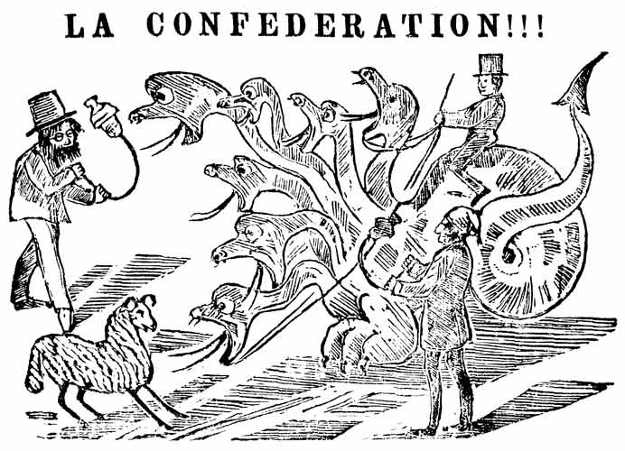
Resistance towards confederation
The colonies felt that if they united together through Confederation, they would lose their independence. A central government would fully control defence, foreign affairs, money, postage, and taxation.
French Canadians felt that they had little in common with English-speaking Canadians. The Maritime colonies’ economies had closer links to Britain and eastern United States than to Canada.
It would also cost a lot of money, which would have to be paid for with more taxes. The people of the colonies would have to be convinced that the advantages of joining Confederation outweighed the disadvantages.

Slide 6
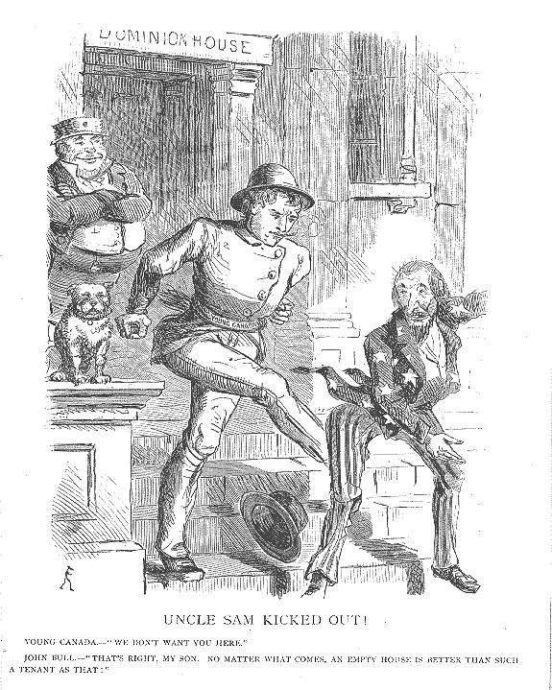
The West and the American Threat
If the colonies united, Canada could expand west and take over territory. By claiming the territory as Canadian, it would prevent it from becoming American.
Fears of American invasion were strong. Many American politicians declared that the United States was destined to control all of North America, a belief known as Manifest Destiny.
Americans had already invaded Canada twice – during the American Revolution and during the War of 1812.
However, the United States would be less likely to attack a united, sovereign country.

Slide 7
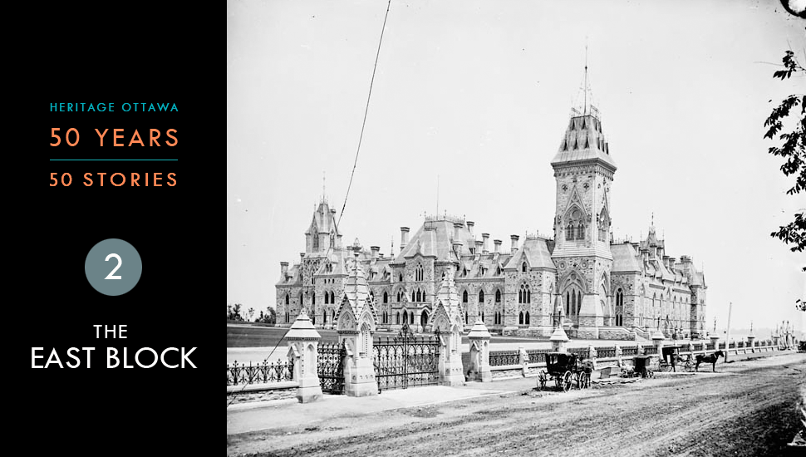
The Promise of Better Government
In the province of Canada, the government was filled with independent party members. Because each member could vote however they wanted, it was very difficult to get enough support for new bills and laws.
The government was always made up of several parties together - a coalition. If a party left the coalition, the government would not have a majority of support, and would fall. The government would do nothing, so that there was nothing for parties to disagree with.
Confederationists promised to bring change to government.

Slide 8
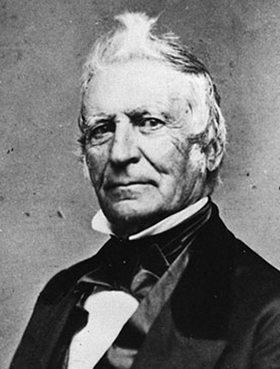
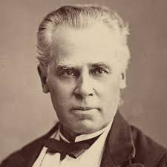
Party Politics – Canada East
Louis-Joseph Papineau led the Parti Rouge. It was supported by French-speaking farmers and business people. They wanted American-style government, and hated the Act of Union.
George- Etienne Cartier led the Parti Bleu. It had similar supporters, but it also had the support of the Catholic Church. They focused more on economic development and the protection of French-Canadian culture and rights.
The Parti Bleu was willing to work with politicians in Canada West, as long as French interests were protected.

Slide 9
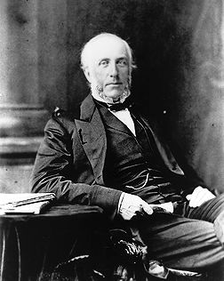
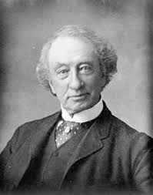
Party Politics – Canada West
George Brown led the Clear Grits. He disliked both Catholics and the French. The Clear Grits attacked corruption in government, wanted more democracy, and defended English-Canadian interests.
The Grits also wanted a form of proportional representation in government which gave areas with higher populations more elected officials, this was called representation by population.
John A. Macdonald led the Tories. He made a deal with George- Etienne Cartier’s Parti Bleu that enabled the combined party – the Liberal-Conservatives – to form a government.

Slide 10
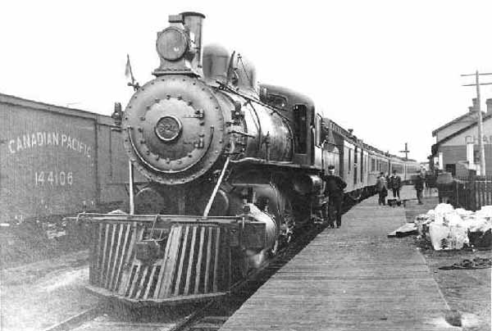
Bringing the Colonies Together
The colonies could prosper in Confederation because trade barriers and tariffs between the colonies would end.
Trade for the colonies could also be improved by a new national railway. It could reach all the way to the Pacific – to the new colonies of British Columbia and Vancouver Island. Though no individual colony could afford to build a transcontinental railway, they could do it together.
Linking the central colonies with the Maritimes would mean that goods travelling to Europe in winter could use the ice-free port at Halifax.

Slide 11
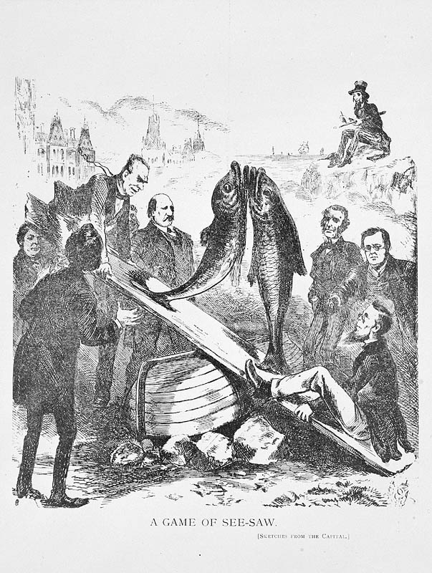
New Brunswick and Nova Scotia
In the 1860s, New Brunswick and Nova Scotia were small, prosperous colonies that had already achieved responsible government. This fostered a feeling of independence and self-sufficiency – a feeling that was not favourable to Confederation.
Confederation supporters believed that it would offer security and that the railway would provide larger markets for their products. Protection was a primary concern for New Brunswickers, who shared a border with the United States.
Macdonald tried unsuccessfully to convince Maritimers that Confederation would help their economies. They refused to join.

Slide 12
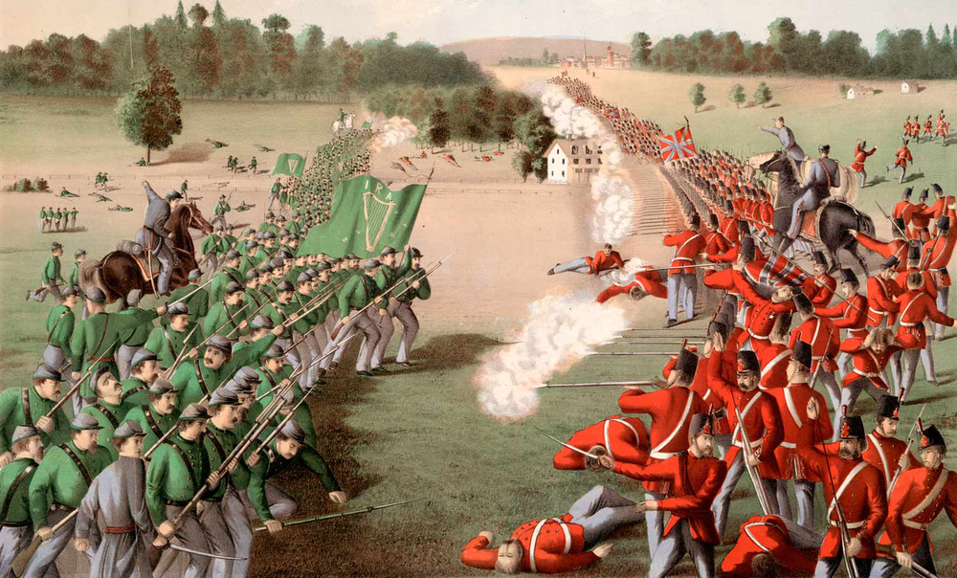
The Fenian Raids
​The Fenians were a secret society of Irish men who had emigrated to America, but were still committed to Irish independence from Britain.
They were determined to attack the British Empire in revenge for injustices inflicted on Ireland by the English.
In 1866 the Fenians launched a series of attacks on Britain’s colonies, including the Canadas and the Maritimes.
Neither the Americans nor the Canadians supported them. But, their attacks made many colonists realize how vulnerable they were to invasion and strengthened support for Confederation.

Slide 13
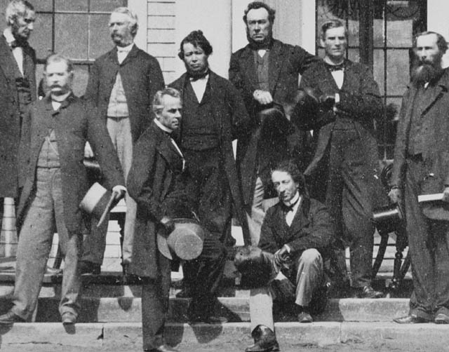
The Charlottetown Conference
​The Charlottetown Conference was originally planned as a meeting of Maritime leaders to discuss the possibility of a union between the three Maritime provinces, New Brunswick, Nova Scotia and Prince Edward Island.
Leaders of the Canadian political parties, Macdonald, Brown, and Cartier asked to attend the conference because they wanted to convince the Maritimers to join a larger union of all the British North American colonies.
The Maritime delegates were convinced that the idea of a larger federal union could work.

Slide 14
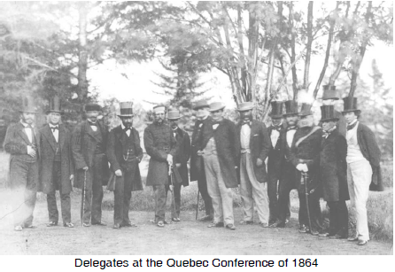
The Quebec Conference
​Canadian and Maritime delegates met again in Quebec to work out the details of Confederation.
While trying to work out an agreement, the delegates discussed issues such as the operations and powers of the new federal government, the powers of the new provinces, and protecting French language and culture.
The Quebec Conference produced 72 resolutions as well as an agreement and plan for Confederation.

Slide 15
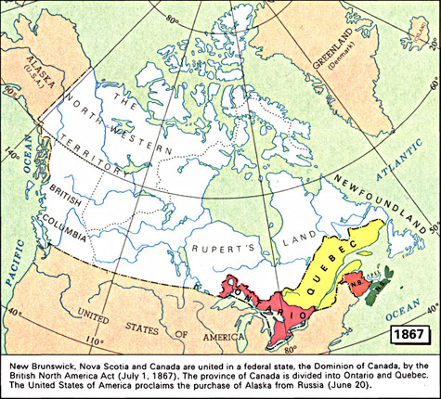
The British North America Act
​On July 1, 1867, the country of Canada was created when the British Parliament passed The British North America Act.
Initially there were four provinces. Canada West became Ontario. Canada East became Quebec. The other two provinces were the former British colonies of Nova Scotia and New Brunswick.
The British North America Act laid out the structure of the government of Canada and listed the division of powers between the federal government and the provincial governments.

