Slide 1
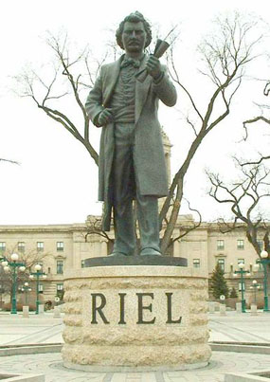
Changes Come to the Prairies

Slide 2
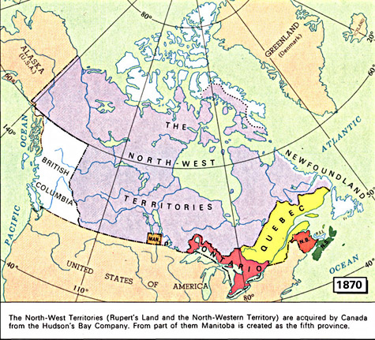
The Manitoba Act
The Manitoba Act was passed in 1870, making the lands surrounding the Red River the new province of Manitoba.
The act made French and English the official languages of the province, and made two education systems – one Protestant and one Roman Catholic. In addition, 566,580 hectares were put aside for the “children of the Metis” as farmland, and the rights of the Metis to their existing lands were protected.
The Metis provisional government ended and Manitoba became firmly under the control of Ottawa.

Slide 3
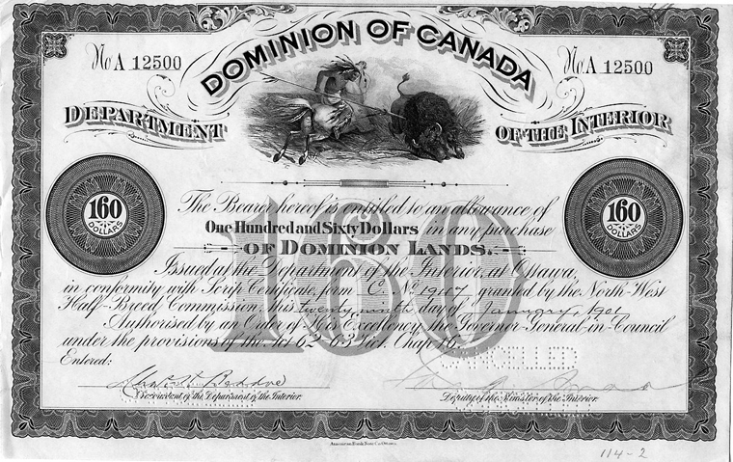
The Issue of Land
The Metis wanted legal title to the land they were using. However, in order to gain title to the land that was reserved for them, all Metis in Manitoba were required to have scrip, a piece of paper similar to money.
Money scrip was worth $160 or $240, based on the value of the farmland. Land scrip could be exchanged for a homesteader’s land grant – 160 acres. Both kinds of scrip could be sold for cash.
The children’s land grant was not what the Metis had expected. The land was open prairie up to 6 km away from the river. The recipients also had no control over where their land grant was located.

Slide 4
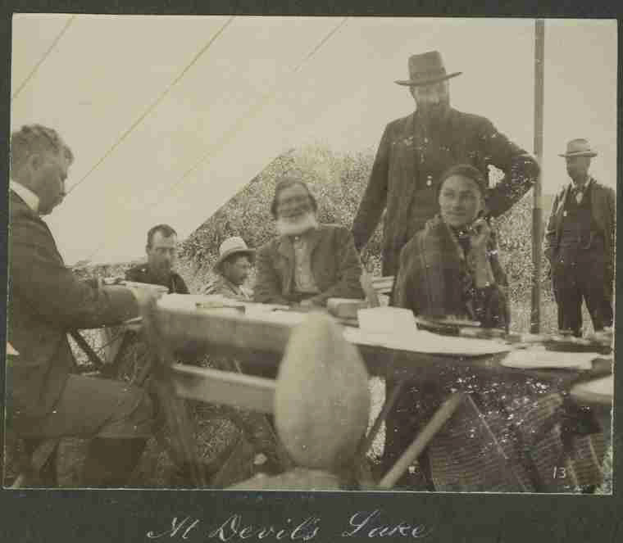
Land Speculation in Manitoba
By the early 1870s, the number of bison decreased significantly in the eastern Prairies. The declining number of bison negatively impacted the Metis economy.
The shrinking number of bison and slow process of land distribution led many frustrated Metis to sell their land entitlements and leave.
Land speculators who bought and sold land for a profit often pressured the Metis to sell their scrip cheaply on the spot. These entitlements were sold for far less than what the scrip was worth.

Slide 5
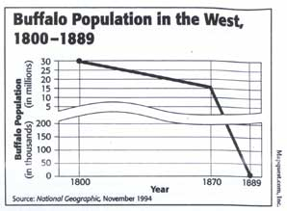
What Happened to the Bison
The shrinking number of bison threatened the livelihood and the existence of the Blackfoot, Nakoda, Sioux, and the Metis. These groups depended on the bison for food and shelter. To prevent starvation, many First Nations were forced to ask the government for assistance.
The American government encouraged Europeans to slaughter bison in order to force First Nations onto reservations so that the American West could be made available to European settlers.
The pemmican and hide trade also reduced the bison population, as well as the building of the railways which brought in more hunters.

Slide 6
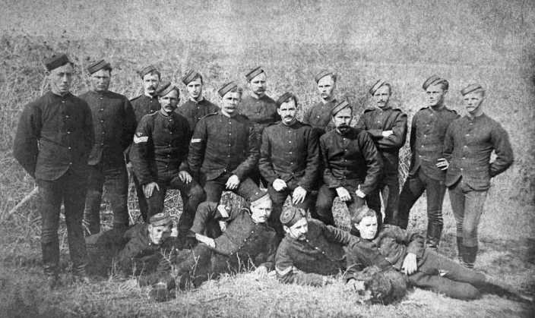
The North West Mounted Police
American fur traders traded strong, cheap liquor called “firewater” to First Nations trappers in exchange for furs.
This trade was outlawed. The whiskey trade devastated local Blackfoot communities, leading to widespread alcoholism, malnutrition, disease and death.
The Canadian government worried that the presence of the American traders might lead to the loss of the territory to the Americans. In 1873, the government created the North West Mounted Police. This group enforced the law and had a Canadian presence in the region.

Slide 7
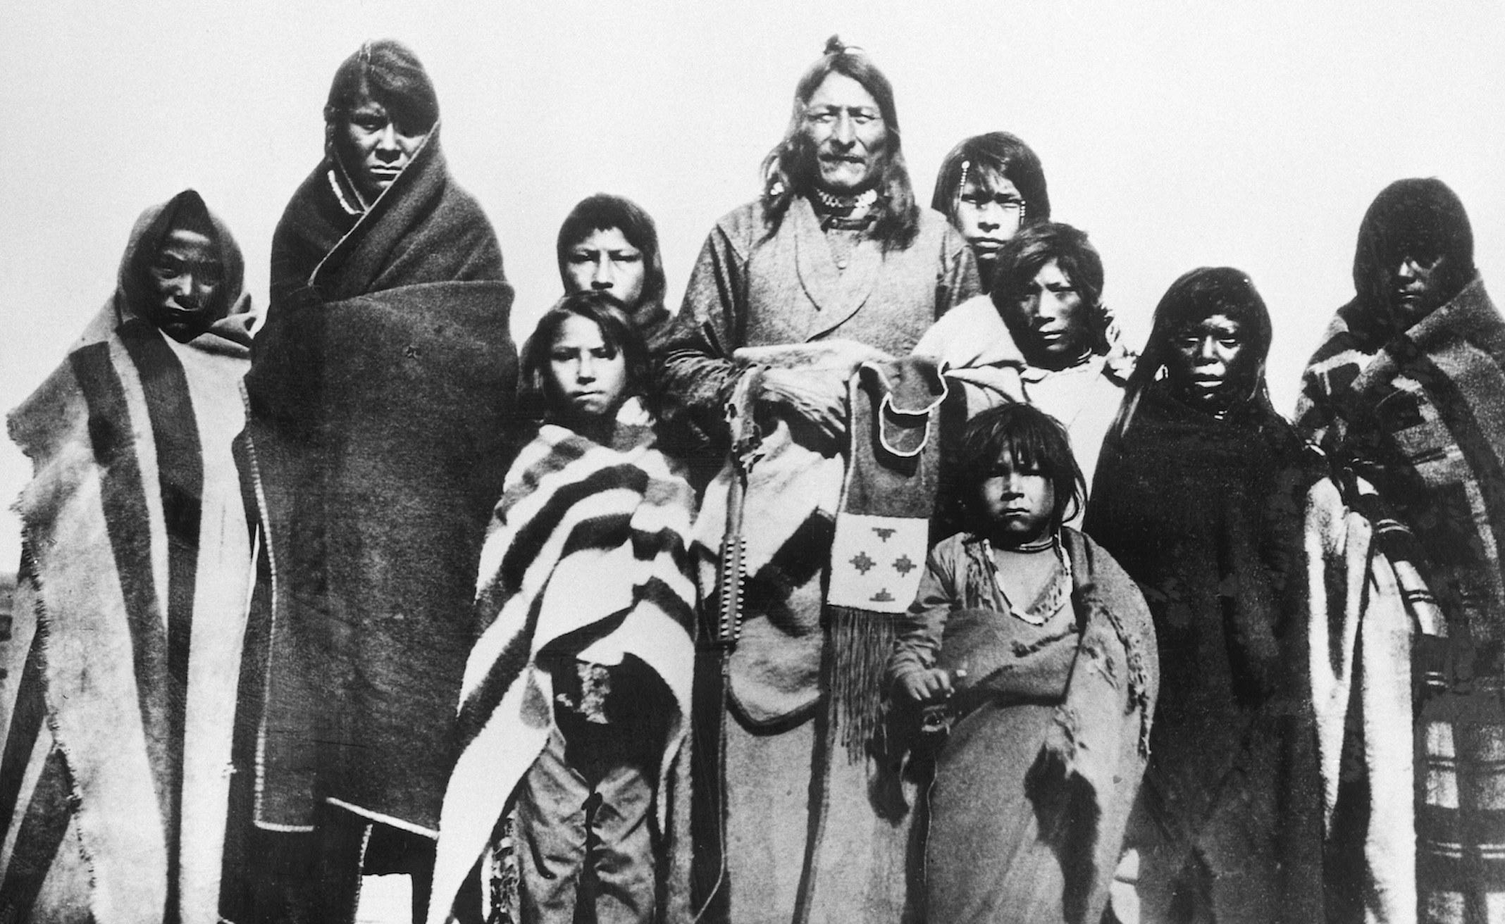
The Numbered Treaties 1871-1877
The Canadian government was determined to open up the Prairies to European and Canadian settlers.
The government gained title to lands in the Northwest by promising First Nations rights to health care and education, as well as access to farming seeds, farming equipment, and training in farming techniques.
First Nations had a long-standing tradition of negotiating agreements. First Nations tended to stand by their word and mean what they said. They believed they were making an exchange – sharing their land for the protection and support of their people.

Slide 8
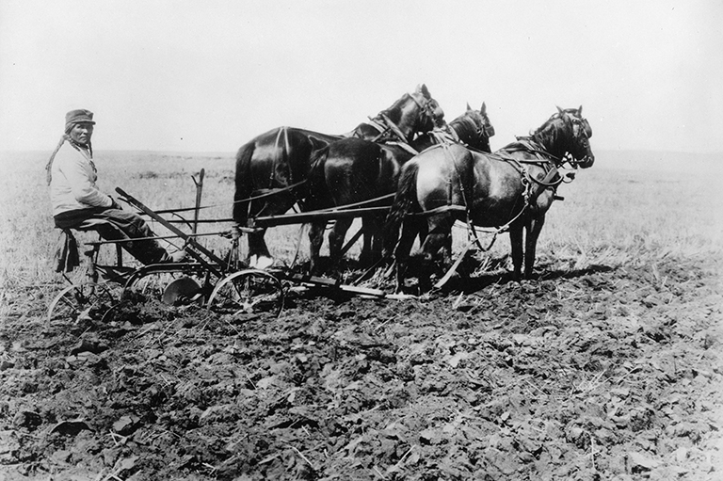
First Nations Farming
Farming on the Prairies was a challenge. Many farmers, both European and First Nations, struggled with poor crops, insects, and drought. With the poor harvests, many people were on the brink of starvation.
The tools, supplies, animals, and instruction proved inadequate.
The plows were poorly made and were useless for prairie soils. The oxen that were provided could not pull plows. The seed was sent too late in the year, and First Nations farmers were forbidden to use steam-powered threshing machines after the harvest.

Slide 9
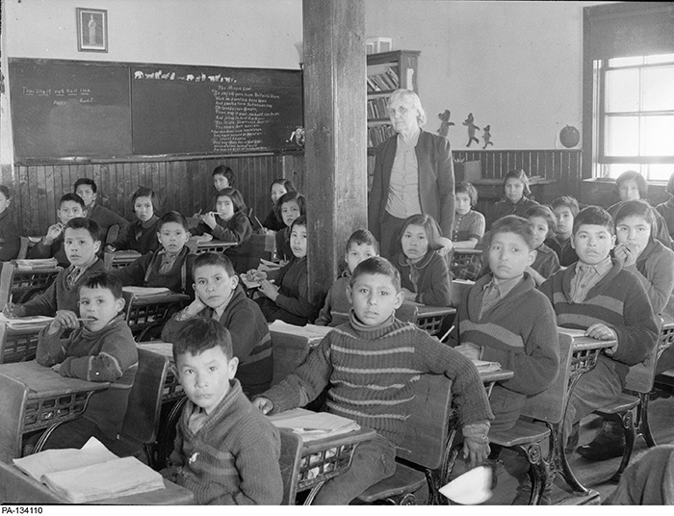
The Indian Act
First Nations became wards of the government, only allowed to live on reserves.
First Nations were required to register with the government to receive status. If they did not, they would lose their rights.
First Nations were not allowed to leave reserves without a special pass given by an Indian Agent.
First Nations children were forced to go to residential school, designed to assimilate them.
Traditional ceremonies and forms of governance were abolished.

Slide 10
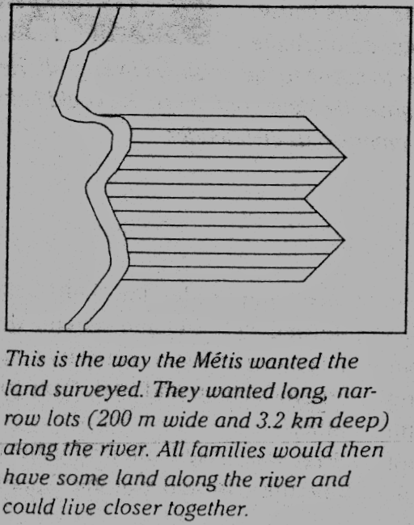
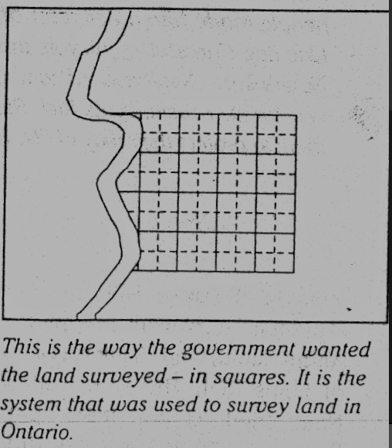
The Metis Petitions
The Metis wanted legal title to the land they were using. They wanted that land to be surveyed according to the seignieurial system. The Canadian government was not consistent. Some surveyors came and surveyed according to seigneurial system. Other surveyors surveyed according to township system (in squares).
In their petitions to the government, Metis expressed their concerns about the land. They also asked for help to become successful farmers. They needed to become better farmers because they were adapting to the decrease in bison. European settlers also were concerned about the same problems.

Slide 11
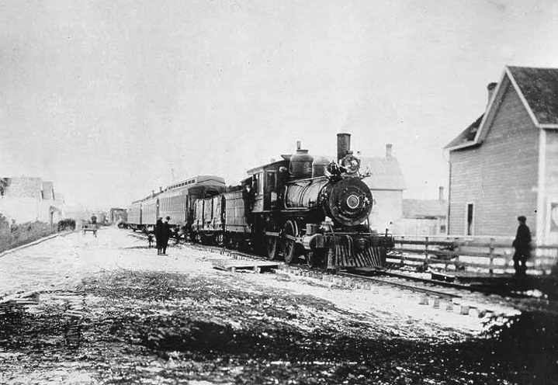
The Government’s Agenda
The Canadian government were not worried about Metis concerns. The Canadian government needed money. It saw the land on the prairies as an opportunity to make some profit. It could sell the land to settlers. The Canadian government ignored the Metis petitions.
The building of the railway also influenced the way the government treated First Nations. Since the railway was so expensive, the Canadian government had little money to spend on other things. When the Metis asked for financial help, the government had no money to give.

Slide 12
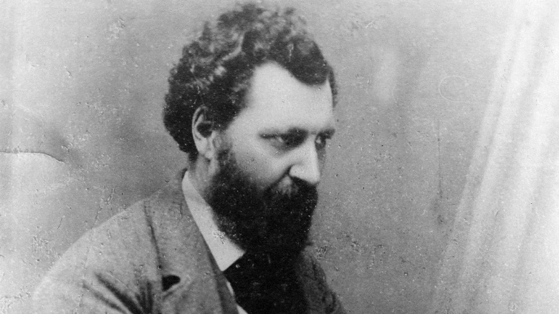
Louis Riel Returns
In the spring of 1884, the Metis decided that they needed a leader who could get the government to pay attention to their petitions. They chose Louis Riel. Gabriel Dumont led a small group of Metis representatives to find Riel. Riel agreed to return to Canada to help the Metis fight the government.
That fall, Riel wrote the Metis Bill of Rights. This document presented the Metis problems and concerns. William Henry Jackson helped Riel write the Metis Bill of Rights. Jackson was a representative of the local European farmers.
The Metis Bill of Rights was sent to Ottawa in December 1884.

Slide 13
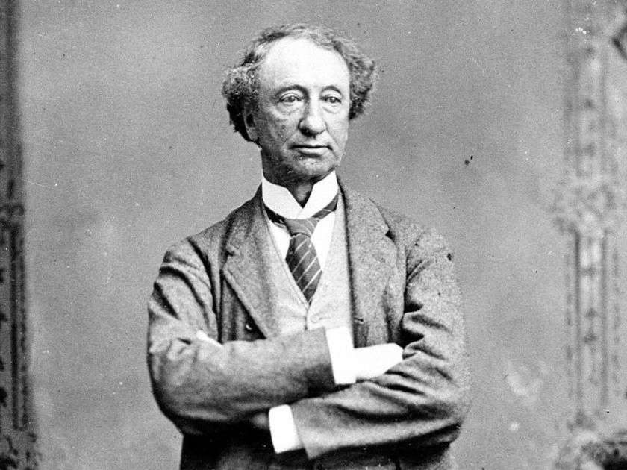
Trouble Builds in the Northwest
John A. Macdonald’s government had many crises, most of them about the railway. Some people think that Macdonald saw Riel’s pressure as a good thing. He could allow Riel to make trouble. Military could be sent by train to defend Canada. Then, everybody would see the value of having a railway. Then they would give him the money to continue building the railway.
Lawrence Clarke become a land speculator. He thought that if the Metis got their land, he would lose a lot of money. He wanted Riel to make trouble so that the Canadian government could send in the military. Clarke started false rumors to build tension in the Metis community.

Slide 14
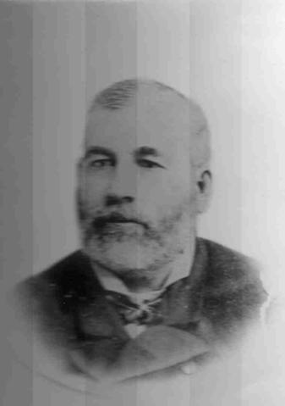
“Justice Commands Us”
The Metis knew that the Canadian government had acknowledged the Metis Bill of Rights. Riel decided to send another petition.
This petition demanded responsible government for the North-West Territories. They asked Lawrence Clarke to be their representative and present their petition to Ottawa.
Clarke came back and said that Ottawa opposed the petition. Riel spoke to the Metis at Batoche on March 19. He said that a peaceful solution was impossible. The Canadian government was determined to make war. He said, “Justice commands us to take up arms”.

Slide 15
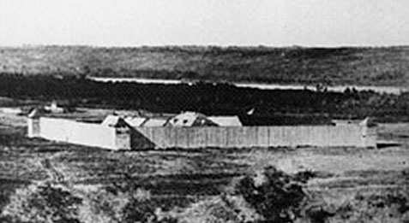
Conflict Begins
The only North West Mounted Police (NWMP) in the area was the group at Fort Carlton.
Reinforcements were coming, but would take a week to arrive. Metis went to Fort Carlton to seize supplies.
Lawrence Clarke sent a message to the reinforcements to come one day later. He also sent a message to NWMP leader Crozier. He called Crozier a coward. Crozier was angry and came out with his men to fight. The NWMP met the Metis at Duck Lake on March 26. The Metis won the Battle of Duck Lake with 12 NWMP dead and 25 wounded. Crozier escaped Fort Carlton the next day.

Slide 16
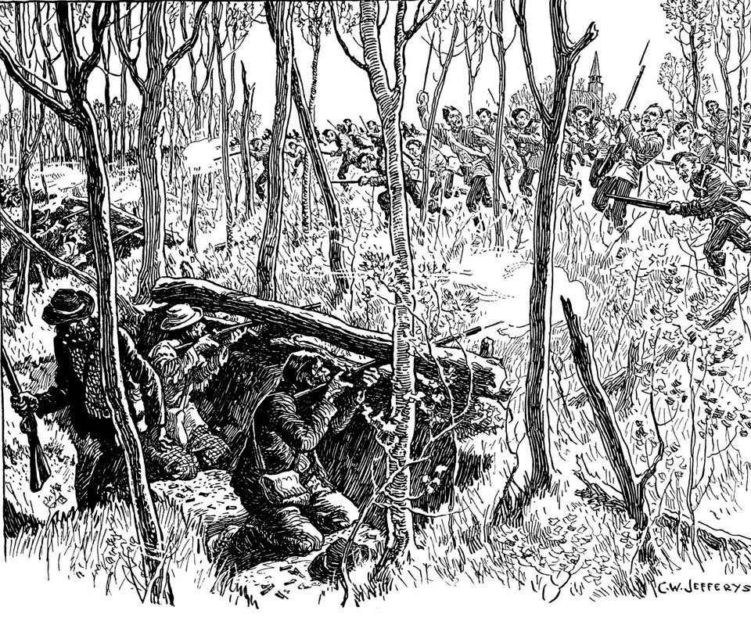
Battles at Fish Creek and Batoche
The Canadian government sent more than 5000 Canadian soldiers to the Northwest Territories. They came on the new railway.
Gabriel Dumont’s Metis warriors ambushed the Canadian troops at Fish Creek. Less than 300 Metis stopped 1600 Canadian militia.
Canadian troops attacked Batoche. They had better guns than the Metis. The Metis ran out of ammunition after fighting for three days. They were exhausted, and half of them were wounded. Dumont fled to the United States. Riel surrendered on May 15, 1885.

Slide 17
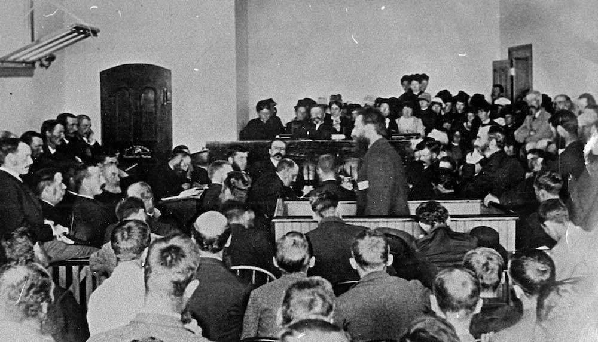
The Trial of Louis Riel
After his surrender, Louis Riel was taken to Regina to stand trial. He was on trial for treason.
Riel was defended by two lawyers. They wanted to show that he was not guilty because he was insane. Riel did not want to use this strategy. He wanted to make it clear that the Canadian government was trying to destroy the Metis.
The trial started on July 28, 1885. The jury found Riel to be guilty on August 1. He was sentenced to death and executed on November 16.

Slide 18
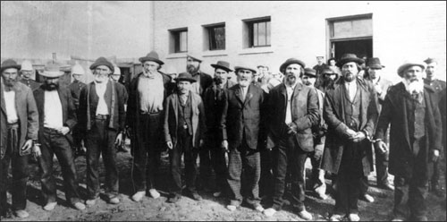
Aftermath of the Uprising
The consequences of the Northwest Uprising were very bad for Metis. They lost the title to their land, and had to move farther north and west. They could not own land, so they had to live on public land, such as on roads. They faced decades of discrimination and prejudice. Many Metis moved to cities so they could hide their Metis identity.
Many First Nations people also suffered in the uprising. Many were charged with treason, and also executed. Even the ones who were not executed usually died in prison.

Slide 19
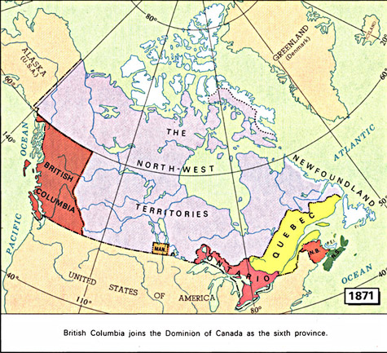
Who Will Build the Railway?
In 1871, British Columbia entered Confederation based on a promise of a transcontinental railway connecting it to the rest of Canada within 10 years.
To build the railroad, Macdonald needed outside backers to help build and finance the project.
Hugh Allan, a Canadian shipping and manufacturing tycoon created the Canadian Pacific Railroad company. However, this was not a Canadian company, the CPR was actually controlled by the Northern Pacific Railway, owned by American, Jay Cooke.

Slide 20
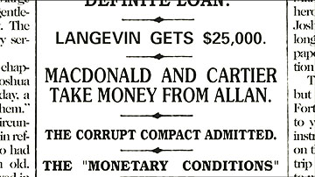
The Pacific Scandal
In 1872, Macdonald called the first election in Canada since Confederation. Macdonald realized that he needed more money in order to successfully campaign during the election.
Macdonald asked George-Etienne Cartier to ask Hugh Allan if he would agree to finance Macdonald’s next election campaign in exchange for a contract to build the CPR.
One of Cartier’s letters to Allan was publicized. It seemed to Canadians that Macdonald accepted a bribe in order to secure campaign funding.

Slide 21
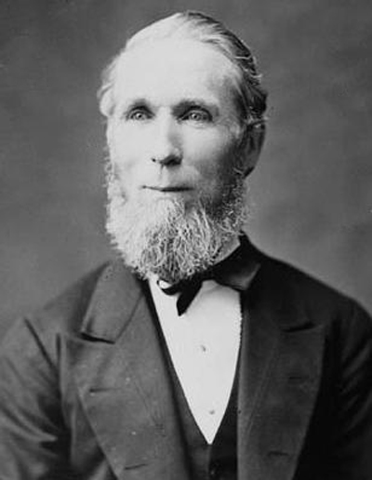
Alexander Mackenzie and the Railway
Macdonald stepped down as Prime Minster in 1873. The leader of the Liberal Party, Alexander Mackenzie, became the new Prime Minister.
Mackenzie did not think building a railway was necessary. He thought it was a waste of time and money. An economic depression hit all of North America in 1873, reducing the money the government had.
British Columbian politicians were mad. They threatened to withdraw from Confederation if the railway was not built as promised. Mackenzie decided to allow the railway land survey to continue.

Slide 22
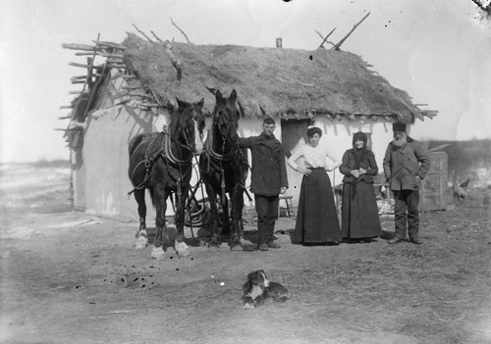
The National Policy
John A. Macdonald developed the National Policy, which became the basis of the Conservative election platform in 1878. The voters agreed with Macdonald’s vision, and he and his party returned to office with a large majority.
The National Policy had three major parts. Tariffs were applied to American goods to protect Canadian manufacturing, mining, and agriculture by making American goods more expensive. Immigrant farmers were encouraged to settle the west and produce and export grain. The railway would be used to transport goods and people across Canada.

Slide 23
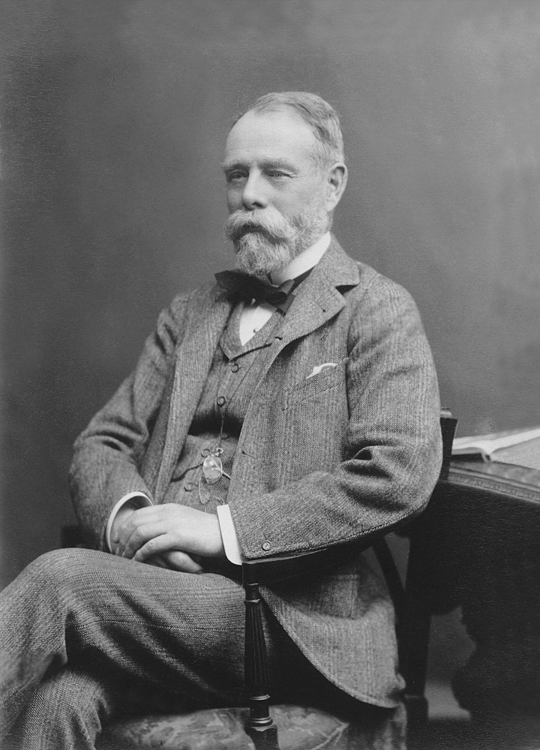
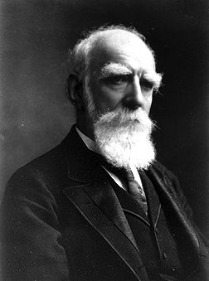
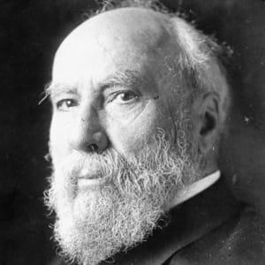
The CPR Syndicate
After two years of searching, the government found three private investors to finance the building of the railway: George Stephen, president of the Bank of Montreal, Donald Smith of the Hudson’s Bay Company, and James J. Hill, an expatriate Canadian who invested in US railways.
The three investors, known as the CPR syndicate, received over 25 million dollars, a land grant of 25 million acres, and a monopoly west of Lake Superior for 20 years. In return, the CPR syndicate promised to complete the construction of the railway within ten years.

Slide 24
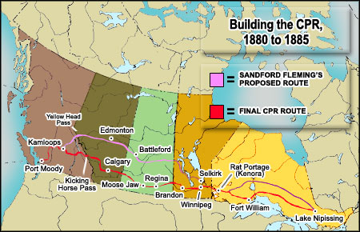
Planning the Railway
The planned route of the railway, through land between Saskatoon and Edmonton, was moved 300km south by the CPR Syndicate. This gave the Syndicate control over the land the CPR would cross. Since there were no speculators or homesteaders in the area, the CPR would control the location of the railway stations and towns.
Railway construction began in the Spring of 1881. But, by the end of the year, only 230km had been built. At this rate, the railway would not be finished in 10 years.
William Van Horne was chosen as the CPR’s new general manager.

Slide 25
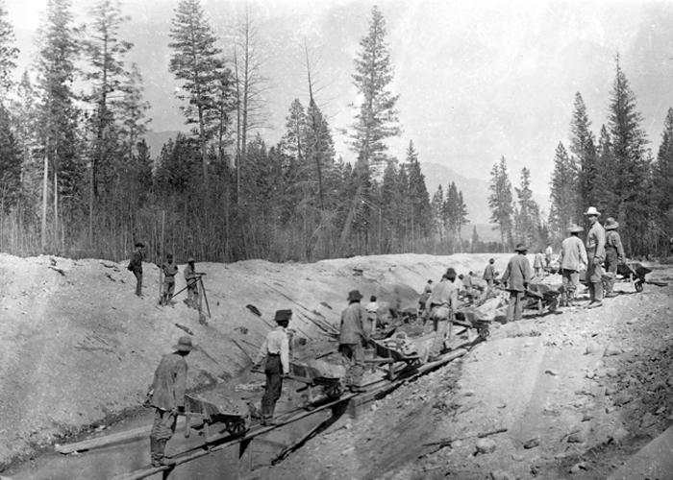
Building “The Impossible Railway”
Van Horne’s drive and efficiency sped up the CPR building process. He was able to have 1600km of track laid between 1882 and 1883.
By the end of 1883, the company was running out of money and the most costly and difficult sections in B.C. had yet to be built. In 1884, the government passed a bill that provided another $22.5 million.
Between 1882 and 1885, more than 35,000 workers were employed to build the railway. Many of these workers came from China. Living and working conditions were terrible.

Slide 26
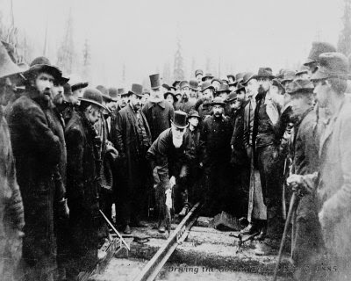
The CPR and the Northwest Uprising
When the Northwest Uprising broke out in 1885, the Canadian government needed to move troops to the Northwest quickly.
Thanks to the CPR, troops made it to the Prairies fast in 10 days.
This proved to Canadians that the railway was necessary for the protection of the country. It also made it possible for Macdonald to secure more money for building the CPR from the public.
The CPR was completed in November 1885 - five years ahead of schedule!

