Slide 1
New France and the Fur Trade

Slide 2
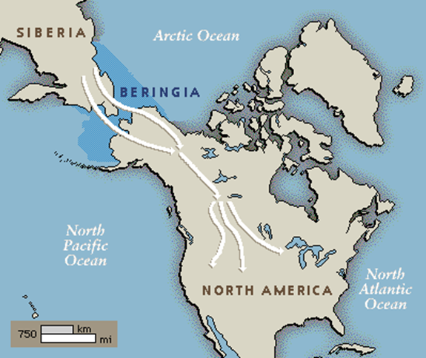
First People in Canada
The first inhabitants of Canada came from Asia across the Bering Strait Land Bridge about 15,000 years ago

Slide 3
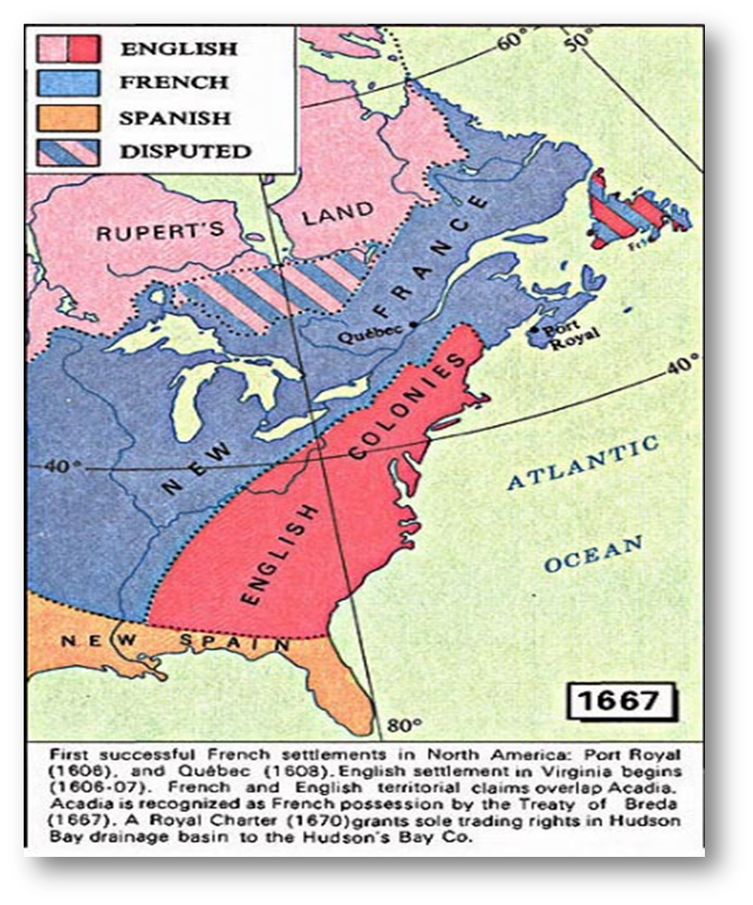
New France
In 1608, Samuel de Champlain built the first permanent French settlement in New France—called Quebec.
Quebec was well located on the banks of the St. Lawrence River to allow the French to trade with the local Indians, who were skilled fur trappers.

Slide 4
Mercantilism and Colonialism
Mercantilism: An economic theory that there is a certain amount of wealth in the world and it’s in the country’s best interest to accumulate it. Through wealth, a nation can achieve power.
Colonialism: The act of settling and controlling the lands of others for commercial advantage.

Slide 5
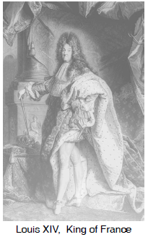
Government in New France
The government of New France was headed by a governor who was responsible to the King.
The governor took advice from a Sovereign Council which consisted of the intendant, the bishop and a number of high ranking seigneurs and clergy appointed by the governor.
The Sovereign Council was both a lawmaking body and a court for criminal and civil cases which had been referred from lower courts.

Slide 6
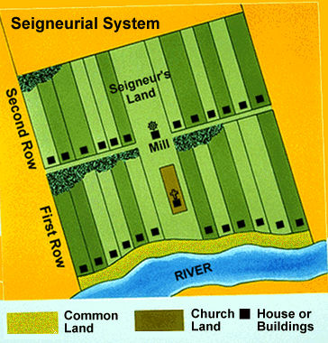
Seigneurial System
Seigneuries were plots of land given to noblemen - who were called seigneurs - in return for loyalty to the King and a promise to perform military service when necessary.
Each seigneur sublet his land in smaller parcels to peasant farmers.
The peasant farmers paid rent for the land and gave one-fourteenth of his grain harvest to the seigneur. The seigneur built and maintained a mill for grinding the grain.

Slide 7
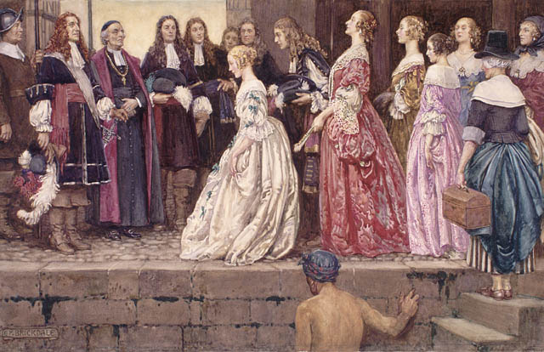
Life in New France
Most people were farmers growing wheat, peas, oats, rye, barley and maize on long, narrow farms huddled along the St. Lawrence River.
The Church provided social services and education to the community.
Many people also participated in fur trading.

Slide 8
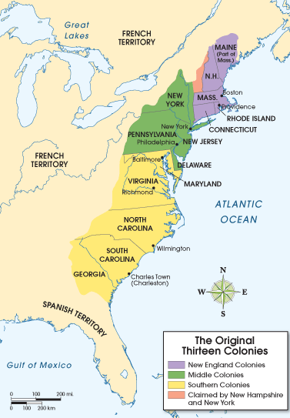
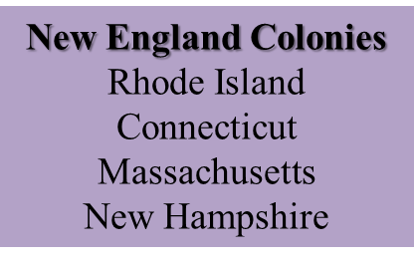
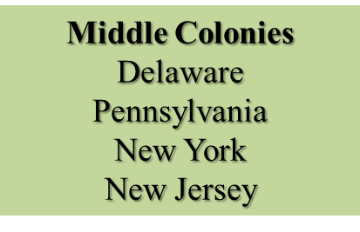
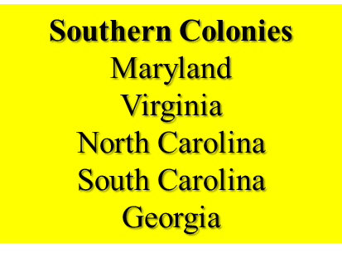
British in North America
The British colonized the region south of New France.
They saw New France’s success in fur trapping and wanted to take control of the fur trade.

Slide 9
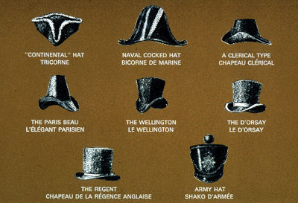
Fur Trade
One valuable resource of New France was beavers.
Men`s Beaver hats were very fashionable in Europe.
From roughly 1600 to 1650, the French forged alliances of kinship and trade with indigenous peoples: the Huron-Wendat, Algonquin and Innu. These peoples helped the French to collect and process beaver furs.

Slide 10
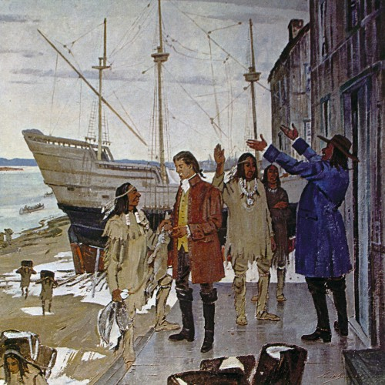
First Nations in New France
The fur trade provided Indigenous peoples with European goods that they wanted such as kettles, knives, blankets, guns, and glass beads. The French forged military alliances with their Indigenous allies in order to maintain good trade and social relations.
The fur trade also had huge drawbacks for Indians. Many became addicted to alcohol (traded to them) and they were decimated by white diseases like smallpox and measles.

Slide 11
Hudson`s Bay Company
Founded in 1670.
The Hudson`s Bay Company built trading posts at the mouths of rivers, on the shore of Hudson Bay.
First Nations trappers and traders travelled long distances to bring their furs to the trading posts and exchanged them for trade goods.

Slide 12
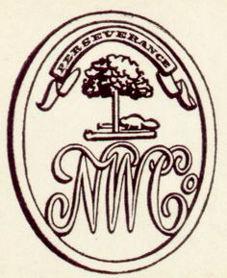
North West Company
Founded in 1783.
The North West Company built trading posts along the rivers in the North West.
First Nations people traded more with the North West Company than the HBC because they did not have to travel as far as the shore of Hudson Bay.

Slide 13
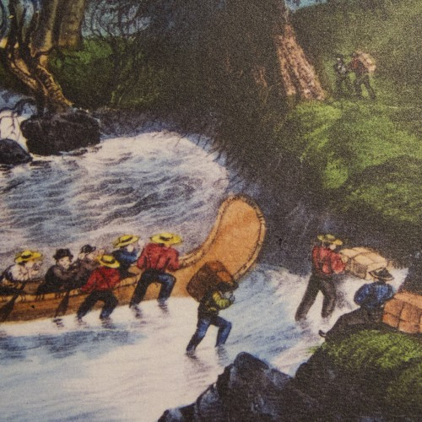
Voyageurs
French-Canadian voyageurs were a main labour force for the fur trade in New France. These men paddled the canoes, and carried supplies and fur bales over the portages for the fur trading companies.
The route from Montreal to Lake Superior and back would take 12 – 16 weeks. The men paddled from sunrise to sunset, and carried back-breaking loads of trade goods and furs.

Slide 14
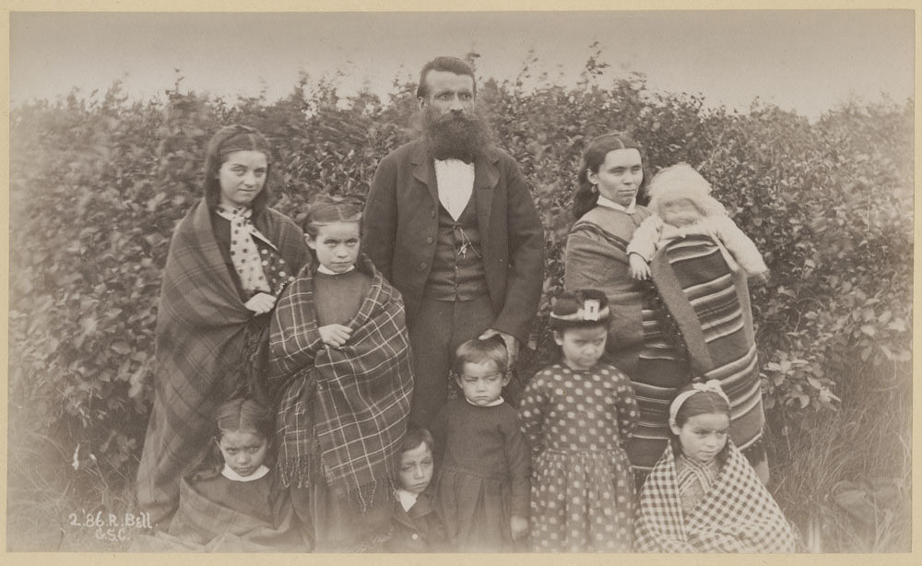
Metis
First Nations women assisted European fur traders in collecting, processing and transporting furs. They also provided food, medicine, clothing and shelter. First Nations women worked as guides, interpreters, and negotiators, oftentimes travelling with traders.
Sometimes the European traders married Aboriginal women and had families. The unions between European men and First Nations women solidified trade relations. Their children of European and Native blood become part of a new Canadian people, the Metis.

