Slide 1
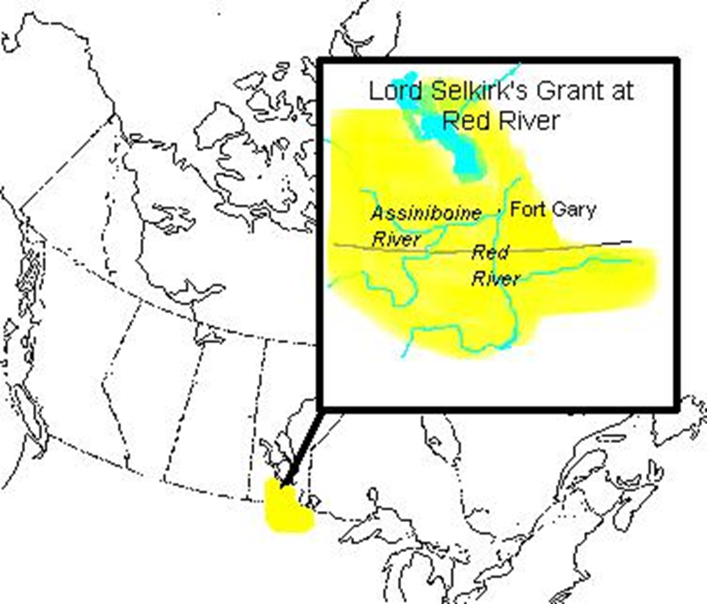
The Northwest From 1800 to 1870

Slide 2
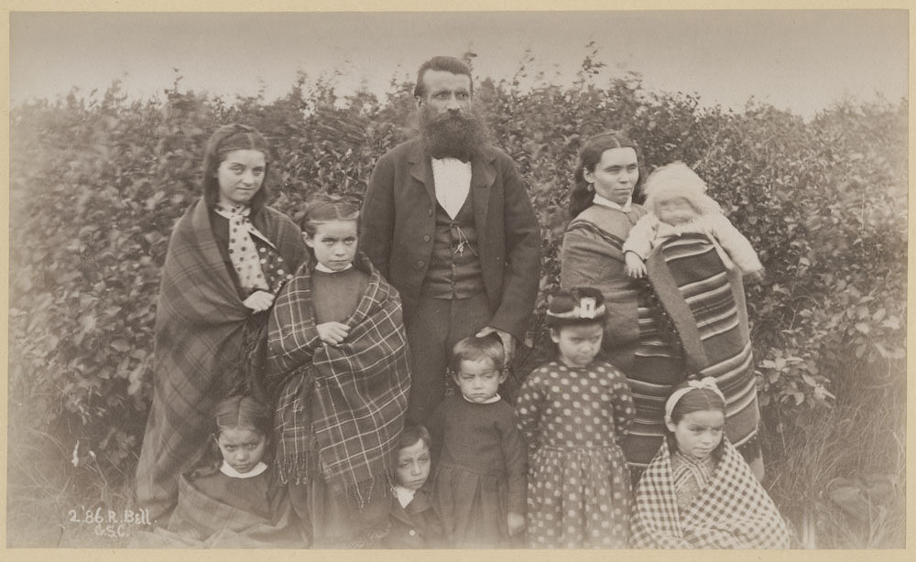
The Metis
When English, Scottish, or French fur traders married First Nations women, their children of European and Native blood become part of a new Canadian people, the Metis.
Parents of both First Nations and European descent raised the Métis. These children learned several languages including French, English and one or more First Nations languages.

Slide 3
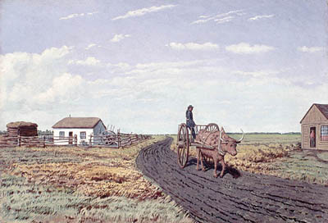
Settling at Red River
By 1810, a large number of Metis had settled in the Red River Valley, near the junction of the Red and Assiniboine Rivers, in what is now southern Manitoba.
This territory had some of the best farming land on the Prairies, and the Metis established farms along the Red and Assiniboine Rivers.

Slide 4
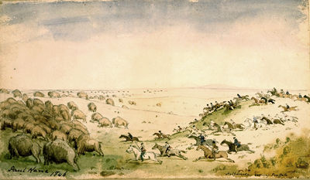
The Bison Hunt
The buffalo hunt supplied the Metis with meat and hides. Most of the meat was dried to make pemmican. Hides were tanned and made into buffalo robes. These goods were sold to the North West Company.
The pemmican trade was very important to the Metis and the North West Company, since it provided income for the Metis and a source of food for the North West Company’s traders.

Slide 5
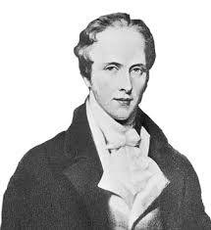
The Earl of Selkirk
Lord Selkirk was a Scottish man who fought for the rights of the poor and the dispossessed.
Near the end of the 1700s, many landowners in Scotland began evicting their tenant farmers. Selkirk wanted to help these people by providing them with fertile farmland where they could settle along the Red River.
Since he was one of the directors of the Hudson’s Bay Company, he was able to convince the company to grant him 300,000 square kilometers of Rupert’s Land for settlement.

Slide 6
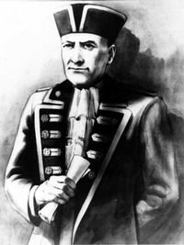
The Pemmican Proclamation
Governor Miles Macdonell issued the Pemmican Proclamation in January 1814. This banned the sale and export of pemmican from the Red River Valley for one year.
The purpose of this ban was to ensure that the new Scottish settlers would have enough food to eat.
The proclamation was hated by the Metis because they were denied the opportunity to sell the pemmican they produced.

Slide 7
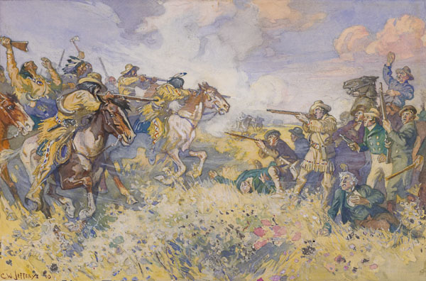
The Battle of Seven Oaks
New Governor Robert Semple arrived in the Red River Valley with 84 new colonists. They burned North West Company owned Fort Gibraltar. The Metis saw this as an act of war.
A group of Metis led by Cuthbert Grant raided many Hudson’s Bay Company York boats and seized a large supply of pemmican.
Semple rode out with 28 men to confront the Metis. Angry words were said and a gunfight began. Semple and 20 of his men were killed; one Metis died.

Slide 8
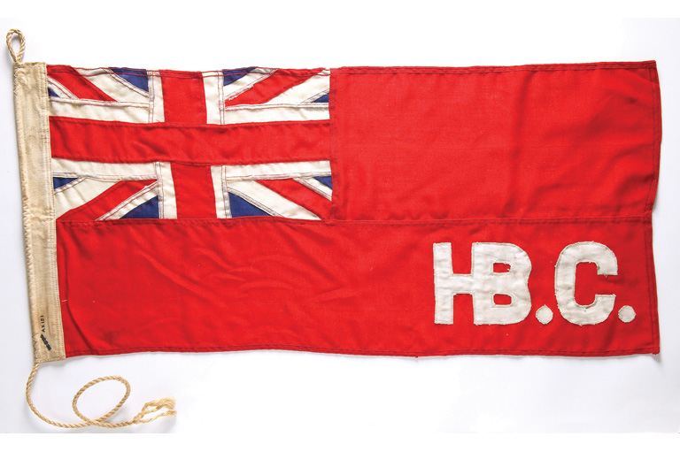
Hudson’s Bay Company and North West Company Merge
By 1820, both the Hudson’s Bay Company and the North West Company were suffering financially. There were not enough furs in the Northwest to justify two full scale trading companies.
In 1821, the British government forced the Hudson’s Bay Company and the North West Company to agree to a merger of their two companies. A new company was formed called, the Hudson’s Bay Company. Its trading monopoly extended over all Rupert’s Land, land west of the Rocky Mountains (B.C.), and north to the Arctic Ocean.

Slide 9
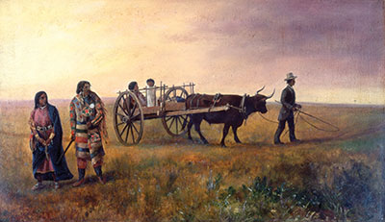
Rising Tensions In the Red River Settlement
Many of the new colonists were Protestants and members of the Orange Order, a violently anti-French, and anti-Catholic movement.
The French Metis were discriminated against because of their language and Catholic religion, and the English-speaking Metis were discriminated against because of their First Nations heritage.

Slide 10
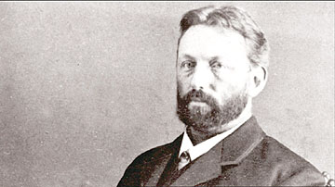
Rising Tensions In the Red River Settlement
John Christian Schultz took over the only newspaper in the settlement, the Nor’Wester.
Schultz used the Nor’Wester as a platform for his anti-Metis views. Discriminatory statements made by him and published in the newspaper only increased tension within the community.
By the end of the 1860’s he had organized a small group called the Canadian Party which he hoped would gain political control of the settlement.

Slide 11
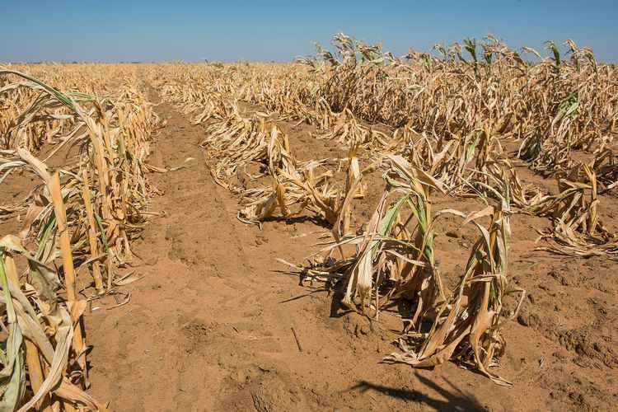
Rising Tensions In the Red River Settlement
Economic problems during the 1860s at Red River also contributed to rising tensions.
There were several crop failures.
The bison hunts were less successful than in earlier years.
The Hudson’s Bay Company was also losing interest in the area.

Slide 12
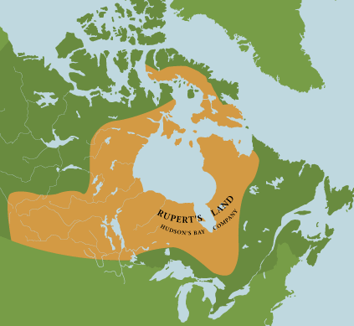
Rising Tensions In the Red River Settlement
Rupert’s Land owned by the Hudson’s Bay Company was sold to the Canadian government.
The inhabitants of the Red River Settlement were not consulted during the negotiations between the Canadian government and the Hudson’s Bay Company to transfer control of Rupert’s Land.
In 1868, government surveyors arrived in the Red River Valley to survey the area. The surveyors assumed that the riverside farms of the Metis were not legally owned.

Slide 13
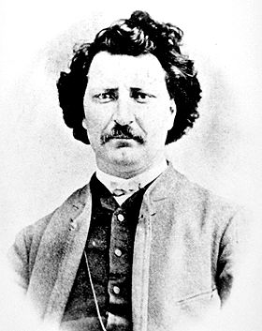
Louis Riel
He was a literate, well- educated lawyer who was fluent in both English and French. He was also an excellent speaker.
He, along with a party of horsemen, confronted the surveyors and told them that they were trespassing. One Metis even stood on the surveyors’ chain stopping their work.
Although just 24 years old, he became the leader in what would become known as the Red River Resistance.

Slide 14
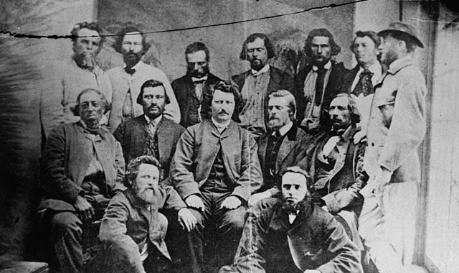
The Provisional Government
A provisional government is a temporary government.
When Riel set up a provisional government it helped maintain order and gave the people of Red River the power to negotiate an agreement to enter Confederation.
They wanted the Red River Settlement to join Canada as its own province – Manitoba.

Slide 15
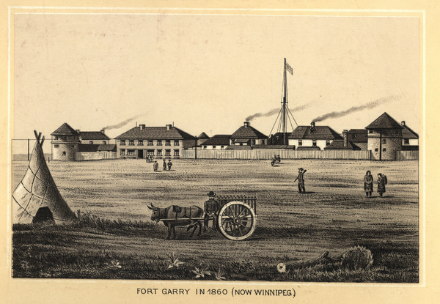
Riel Takes Action
Fearing that John Christian Schultz’s Canadian Party was armed and prepared to take control of the Red River Settlement, Riel ordered a party of armed Metis to arrest Schultz and 48 of his supporters.
They were imprisoned in Upper Fort Garry. Schultz and some of his men escaped and plotted to free the other prisoners. However, the Metis arrested them again shortly afterwards. One of the prisoners was a member of the Canadian Party named Thomas Scott.

Slide 16
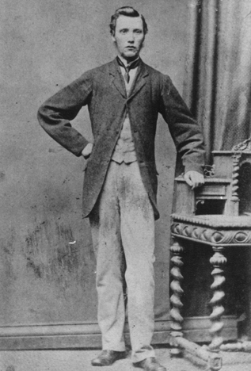
Thomas Scott
Thomas Scott was born in northern Ireland and settled in Red River in late 1869. Scott was a labourer and a bartender.
He was a Canadian Party member known for fighting, drinking and shouting his anti-Catholic and anti-Métis views.
While in jail, he was verbally and physically abusive to the guards. He also threatened to kill Louis Riel once he was released.

Slide 17
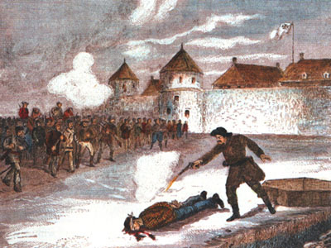
The Execution of Thomas Scott
While imprisoned, Scott constantly shouted violent threats and racist insults at his Métis guards. Finally, after hitting a guard the guards convinced Riel to take action.
In response to Scott’s behaviour, Riel’s provisional government decided to put Scott on trial for treason. He was found guilty.
On March 4th 1870, Scott was executed. Schultz and the Orange Order made Thomas Scott into a Protestant martyr who had been cruelly murdered by the Metis.

Slide 18
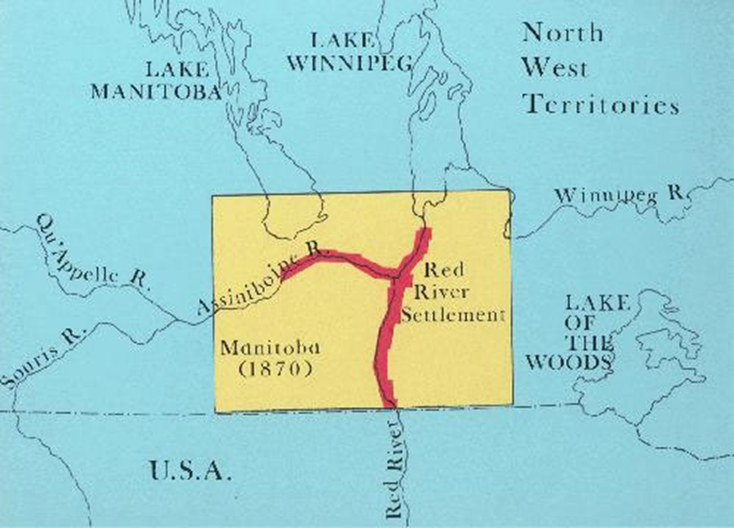
Manitoba is Created
Prime Minister John A. Macdonald welcomed representatives from Red River to negotiate. Although he did not allow provincial control of public lands, he did give the Metis 200,000 hectares of land.
He agreed with most of Riel’s terms, including: the creation of the province of Manitoba, protection for Métis land, the Catholic religion, and French language. On July 15th 1870 Manitoba enters Confederation.

